Slide 1
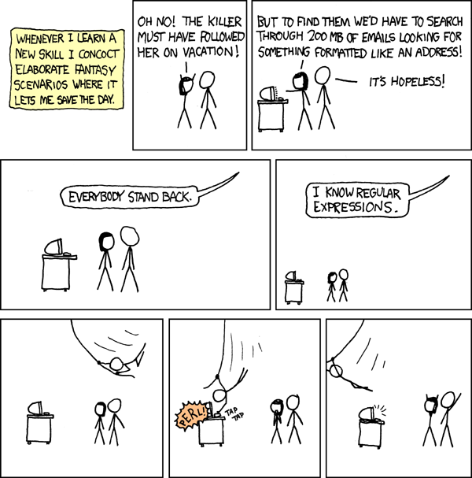
CSE 311: Foundations of Computing
Fall 2013
Lecture 18: Structural induction, regular expressions

Slide 2
Announcements
Midterm back today
Graded Homework 5 back Friday
Homework 6 out later today

Slide 3
Review: Structural Induction
How to prove ∀ 𝑥 ∈ 𝑆, 𝑃(𝑥) is true:
Base Case: Show that 𝑃(𝑢) is true for all specific elements 𝑢 of 𝑆 mentioned in the Basis step
Inductive Hypothesis: Assume that 𝑃 is true for some arbitrary values of each of the existing named elements mentioned in the Recursive step
Inductive Step: Prove that 𝑃(𝑤) holds for each of the new elements 𝑤 constructed in the Recursive step using the named elements mentioned in the Inductive Hypothesis
Conclude that ∀ 𝑥 ∈ 𝑆, 𝑃(𝑥)

Slide 4
Function Definitions on Recursively Defined Sets
Length:
len(ℇ) = 0
len(wa) = len(w) + 1 for w ∈ Σ*, a ∈ Σ
Reversal:
ℇ^{R} = ℇ
(wa)^{R} = aw^{R} for w ∈ Σ*, a ∈ Σ
Concatenation:
x • ℇ = x for x ∈ Σ*
x • wa = (x • w)a for x ∈ Σ*, a ∈ Σ

Slide 5
len(x•y) = len(x) + len(y) for all x,y ∈ Σ*
Let P(y) be “len(x•y) = len(x) + len(y) for all x ∈ Σ* ” .
We prove P(y) for all y ∈ Σ* by structural induction.
Base Case: y= ℇ. For any x ∈ Σ*, len(x• ℇ) = len(x) = len(x) + len(ℇ) since len(ℇ)=0. Therefore P(ℇ) is true
Inductive Hypothesis: Assume that P(w) is true for some arbitrary w ∈ Σ*
Inductive Step: Goal: Show that P(wa) is true for every a ∈ Σ
Let a ∈ Σ. Let x ∈ Σ*. Then len(x•wa) = len((x•w)a) by defn of •
= len(x•w)+1 by defn of len
= len(x)+len(w)+1 by I.H.
= len(x)+len(wa) by defn of len
Therefore len(x•wa)= len(x)+len(wa) for all x ∈ Σ*, so P(wa) is true.
So, by induction len(x•y) = len(x) + len(y) for all x,y ∈ Σ*

Slide 6
Rooted Binary Trees
Basis: • is a rooted binary tree
Recursive step: If and are
rooted binary trees
then so is:
T₁
T₂
T₂
T₁

Slide 7
Functions Defined on Rooted Binary Trees
size(•)=1
size( ) = 1+size(T₁)+size(T₂)
height(•)=0
height( )=1+max{height(T₁),height(T₂)}
T₁
T₂
T₁
T₂

Slide 8
Claim: For every rooted binary tree T, size(T) ≤ 2^{height(T) + 1} - 1

Slide 9
Languages: sets of strings
Sets of strings that satisfy special properties are called languages. Examples:
English sentences
Syntactically correct Java/C/C++ programs
Σ∗ = All strings over alphabet Σ
Palindromes over Σ
Binary strings that don’t have a 0 after a 1
Legal variable names. keywords in Java/C/C++
Binary strings with an equal # of 0’s and 1’s

Slide 10
Regular Expressions
Regular expressions over Σ
Basis:
∅, ε are regular expressions
a is a regular expression for any a ∈ Σ
Recursive step:
If A and B are regular expressions then so are:
(A ∪ B)
(AB)
A*

Slide 11
Each Regular Expression is a “pattern”
ε matches the empty string
a matches the one character string a
(A ∪ B) matches all strings that either A matches or B matches (or both)
(AB) matches all strings that have a first part that A matches followed by a second part that B matches
A* matches all strings that have any number of strings (even 0) that A matches, one after another

Slide 12
Examples
001*
0*1*
(0 ∪ 1)0(0 ∪ 1)0
(0*1*)*
(0 ∪ 1)* 0110 (0 ∪ 1)*
(00 ∪ 11)* (01010 ∪ 10001)(0 ∪ 1)*

Slide 13
Regular Expressions in Practice
Used to define the “tokens”: e.g., legal variable names, keywords in programming languages and compilers
Used in grep, a program that does pattern matching searches in UNIX/LINUX
Pattern matching using regular expressions is an essential feature of PHP
We can use regular expressions in programs to process strings!

Slide 14
Regular Expressions in Java
Pattern p = Pattern.compile("a*b");
Matcher m = p.matcher("aaaaab");
boolean b = m.matches();
[01] a 0 or a 1 ^ start of string $ end of string
[0-9] any single digit \. period \, comma \- minus
. any single character
ab a followed by b (AB)
(a|b) a or b (A ∪ B) a? zero or one of a (A ∪ ℇ) a* zero or more of a A*
a+ one or more of a AA*
e.g. ^[\-+]?[0-9]*(\.|\,)?[0-9]+$
General form of decimal number e.g. 9.12 or -9,8 (Europe)

Slide 15
More Examples
All binary strings that have an even # of 1’s
All binary strings that don’t contain 101

