Slide 1
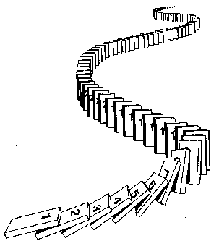
CSE 311: Foundations of Computing
Fall 2014
Lecture 16: Recursively Defined Sets

Slide 2
Strong Induction
$P\left(0\right)$
$$∀k \left(\left(P\left(0\right)∧P\left(1\right)∧P\left(2\right)∧⋯∧P\left(k\right)\right)→P\left(k+1\right)\right)$$
$∴∀n P(n)$
By induction we will show that $P(n)$is true for every $n≥0$
Base Case: Prove $P(0)$
Inductive Hypothesis: Assume that for some arbitrary integer $k ≥ 0$, $P(j)$ is true for every $j$ from $0$ to $k$
Inductive Step: Prove that $P(k+1)$is true using the Inductive Hypothesis (that $P(j)$ is true for all values $ k$)
Conclusion: Result follows by induction

Slide 3
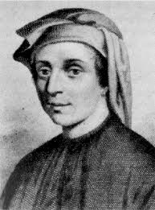
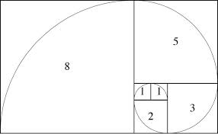
Fibonacci Numbers
$f_{0}=0$
$f_{1}=1$
$f_{n}=f_{n−1}+f_{n−2}$ for all $n≥2$

Slide 4
Bounding the Fibonacci Numbers
f₀ = 0; f₁ = 1; f_{n} = f_{n-1} + f_{n-2} for all $n≥2$
Theorem: 2^{n/2-1} ≤ f_{n} < 2^{n} for all $n≥2$
Proof:
1. Let P(n) be “2^{n/2-1} ≤ f_{n} < 2^{n}. By (strong) induction we prove P(n) for all n ≥ 2.
Base Case: P(2) is true: f₂=1, 2^{2/2-1}=2⁰=1 ≤ f₂, 2²=4>f₂
Ind.Hyp: Assume 2^{j/2-1} ≤ f_{j} < 2^{j} for all integers j with 2 ≤ j ≤ k for some arbitrary integer k ≥ 2.
Ind. Step: Goal: Show 2^{(k+1)/2-1} ≤ f_{k+1} < 2^{k+1}

Slide 5
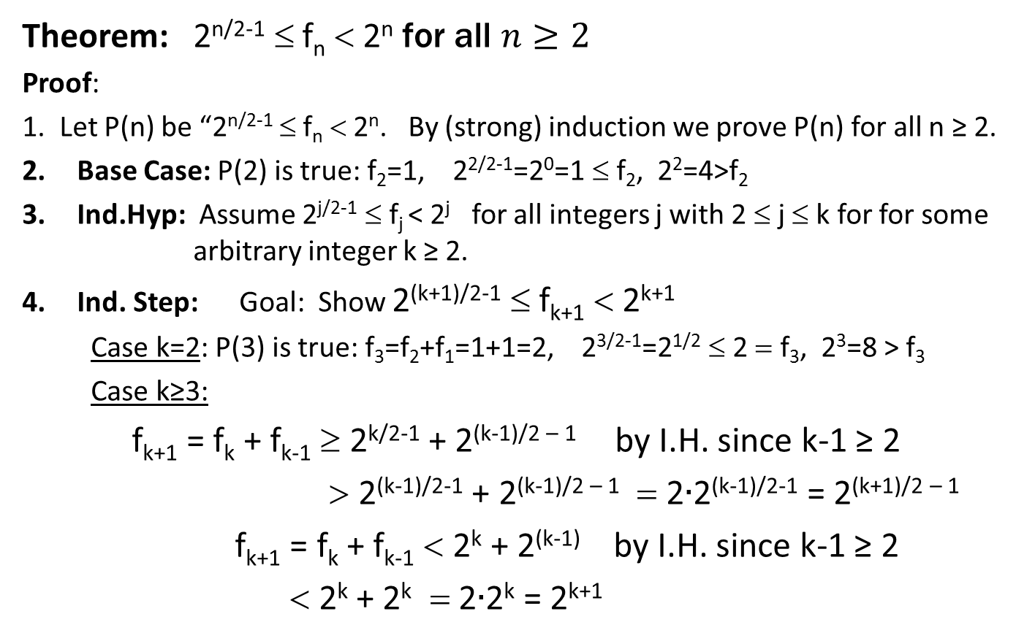
f₀ = 0; f₁ = 1; f_{n} = f_{n-1} + f_{n-2} for all $n≥2$
Theorem: 2^{n/2-1} ≤ f_{n} < 2^{n} for all $n≥2$
Proof:
1. Let P(n) be “2^{n/2-1} ≤ f_{n} < 2^{n}. By (strong) induction we prove P(n) for all n ≥ 2.
Base Case: P(2) is true: f₂=1, 2^{2/2-1}=2⁰=1 ≤ f₂, 2²=4>f₂
Ind.Hyp: Assume 2^{j/2-1} ≤ f_{j} < 2^{j} for all integers j with 2 ≤ j ≤ k for for some arbitrary integer k ≥ 2.
Ind. Step: Goal: Show 2^{(k+1)/2-1} ≤ f_{k+1} < 2^{k+1}
Case k=2: P(3) is true: f₃=f₂+f₁=1+1=2, 2^{3/2-1}=2^{1/2} ≤ 2 = f₃, 2³=8 > f₃
Case k≥3:
f_{k+1} = f_{k} + f_{k-1} ≥ 2^{k/2-1} + 2^{(k-1)/2 – 1} by I.H. since k-1 ≥ 2
> 2^{(k-1)/2-1} + 2^{(k-1)/2 – 1} = 2$∙$2^{(k-1)/2-1} = 2^{(k+1)/2 – 1}
f_{k+1} = f_{k} + f_{k-1} < 2^{k} + 2^{(k-1)} by I.H. since k-1 ≥ 2
< 2^{k} + 2^{k} = 2$∙$2^{k} = 2^{k+1}

Slide 6
Running time of Euclid’s algorithm
Theorem: Suppose that Euclid’s algorithm takes$n$steps for $gcd⁡(a,b)$ with $a>b$, then$a ≥f_{n+1}$
Set $r_{n+1}=a, r_{n}=b$ then Euclid’s algorithm computes
$r_{n+1}=q_{n}r_{n}+r_{n−1}$
$r_{n} =q_{n−1}r_{n−1}+r_{n−2}$
$⋮$
$r_{3} =q_{2}r_{2}+r_{1}$
$r_{2} =q_{1}r_{1}$
each quotient $q_{i}≥1$
$r_{1}≥1$

Slide 7
Recursive Definition of Sets
Recursive definition
Basis step: $0  S$
Recursive step: if $x  S$, then $x+2  S$
Exclusion rule: Every element in $S$ follows from basis steps and a finite number of recursive steps

Slide 8
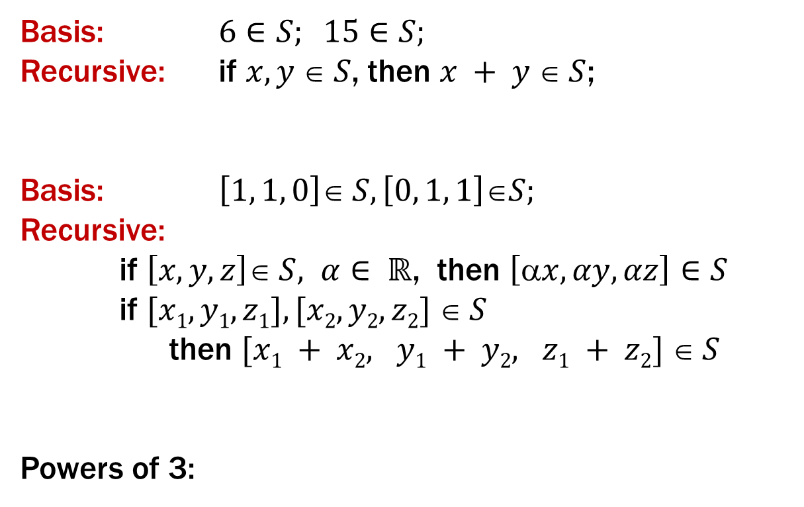
Recursive Definitions of Sets
Basis: $6∈S; 15∈S;$
Recursive: if $x, y  S$, then $x + y  S$;
Basis: $\left[1, 1, 0\right]∈ S, \left[0, 1, 1\right]∈S;$
Recursive:
if $\left[x, y, z\right]∈ S, α∈ ℝ$, then $\left[x, αy, αz\right]∈S$
if $[x1, y1, z1], [x2, y2, z2]  S$
then $[x1 + x2, y1 + y2, z1 + z2]  S$
Powers of 3:

Slide 9
Recursive Definitions of Sets: General Form
Recursive definition
Basis step: Some specific elements are in $S$
Recursive step: Given some existing named elements in $S$ some new objects constructed from these named elements are also in $S$.
Exclusion rule: Every element in $S$follows from basis steps and a finite number of recursive steps

Slide 10
Strings
An alphabet Σ is any finite set of characters
The set Σ* of strings over the alphabet Σ is defined by
Basis: ℇ ∈ Σ* (ℇ is the empty string)
Recursive: if $w$ ∈ Σ*, $a$ ∈ Σ, then $wa$ ∈ Σ*

Slide 11
Palindromes
Palindromes are strings that are the same backwards and forwards
Basis:
ℇ is a palindrome and any $a$∈ Σ is a palindrome
Recursive step:
If $p$ is a palindrome then $apa$ is a palindrome for
every $a∈$ Σ

Slide 12
All Binary Strings with no 1’s before 0’s

Slide 13
Function Definitions on Recursively Defined Sets
Length:
len (ℇ) = 0;
len ($wa$) = 1 + len($w$); for $w∈Σ^{∗}, a∈Σ$
Reversal:
${\text{ℇ}}^{R}=$ ℇ
${\left(wa\right)}^{R}={aw}^{R}$ for $w$ ∈ Σ*, $a$ ∈ Σ
Concatenation:
$x •\text{ℇ}= x$for $x $ Σ*
$x • wa$= $(x • w)a$ for $x, w $Σ*, $a  $

