Slide 1
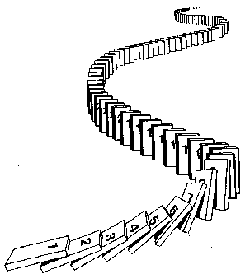
CSE 311: Foundations of Computing
Fall 2014
Lecture 15: Strong Induction

Slide 2
Administrivia
Midterm is in a week in lecture!
We will put out a practice exam + practice questions later today!
There will be three review sessions (one on Thursday, one on Saturday, and one on Sunday)
Examples to show its true
P(0)
P(k) → P(k+1)

Slide 3
Prove 3^{n} ≥ n² for all n ≥ 3.
Let P(n) be “3^{n} ≥ n²” for all n ≥ 3.
We go by induction on n.
Base Case:
3³ = 27 ≥ 9 = 3². So, P(3) is true.
Induction Hypothesis:
Suppose P(k) is true for some arbitrary k ≥ 3.
Induction Step:
Note that 3^{k+1} = 3(3^{k}) ≥ 3(k²), by the IH.
Furthermore, note that (k+1)² = k² + 2k + 1.
Note that since k ≥ 3, k² ≥ 3k ≥ 2k. And similarly, k² ≥ 1.
So, continuing from above:
3^{k+1} = 3(3^{k}) ≥ 3(k²) = k² + k² + k² ≥ k² + 2k + 1 = (k+1)²
Since this is exactly P(k+1), we’ve shown P(k) → P(k+1)
Thus, P(n) is true for all n ≥ 3, by induction.
Examples to show its true
P(0)
P(k) → P(k+1)

Slide 4
Prove 2n³ + 2n – 5 ≥ n² for all n ≥ 2.
Note that 2(n+1)³ = 2n³ + 6n² + 6n + 2.
Let P(n) be “2n³ + 2n – 5 ≥ n²” for all n ≥ 2.
We go by induction on n.
Base Case:
2*2³ + 2*2 – 5 = 45 ≥ 4 = 2². So, P(0) is true.
Induction Hypothesis:
Suppose P(n) is true for some arbitrary n ≥ 2.
Induction Step: Then, note that…
(n+1)² ≤ n² + 2n + 1
≤ (2n³ + 2n – 5) + 2n + 1 (by IH)
≤ (2n³ + 4n + 1) – 5 (Re-arranging)
≤ (2n³ + 6n² + 6n + 2) – 5 (4n + 1 ≤ 6n + 6n² + 2)
≤ 2(n+1)³ – 5 (Factoring)
≤ 2(n+1)³ + 2n – 5 (0 ≤ 2n)
Since this is exactly P(k+1), we’ve shown P(k) → P(k+1)
Thus, P(n) is true for all n ≥ 3, by induction.
Examples to show its true
P(0)
P(k) → P(k+1)

Slide 5
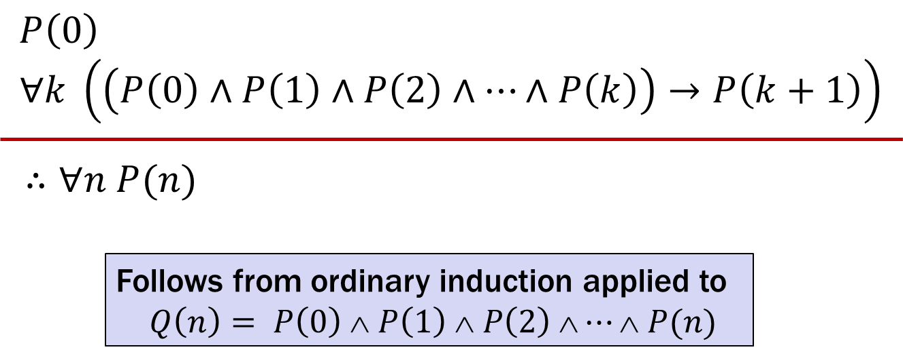
Strong Induction
$P\left(0\right)$
$$∀k \left(\left(P\left(0\right)∧P\left(1\right)∧P\left(2\right)∧⋯∧P\left(k\right)\right)→P\left(k+1\right)\right)$$
$∴∀n P(n)$
Follows from ordinary induction applied to
$$Q\left(n\right)= P\left(0\right) ∧ P\left(1\right) ∧ P\left(2\right) ∧⋯∧ P(n)$$

Slide 6
Strong Induction English Proof
By induction we will show that $P(n)$is true for every $n≥0$
Base Case: Prove $P(0)$
Inductive Hypothesis: Assume that for some arbitrary integer $k ≥ 0$, $P(j)$ is true for every $j$ from $0$ to $k$
Inductive Step: Prove that $P(k+1)$is true using the Inductive Hypothesis (that $P(j)$ is true for all values $ k$)
Conclusion: Result follows by induction

Slide 7
Every integer at least $2$ is the product of primes
We go by strong induction. Let P(n) be “n can be expressed as a product of primes” for n ≥ 2.
Base Case:
Note that 2 is prime; so, we can express it as “2” which is a
product of primes.
Induction Hypothesis:
Suppose P(2) ∧ P(3) ∧ ・・・ ∧ P(k) is true for some k ≥ 2.
Induction Step:
We go by cases.
Suppose k+1 is prime. Then, “k+1” is a product of primes.
Suppose k+1 is composite. Then, k+1 = ab for some a and b such that
1 < a, b < k+1.
By our IH, we know a = p₁p₂・・・p_{m} and b = q₁q₂・・・q_{n}.
So, k+1 = ab = “p₁p₂・・・p_{m}q₁q₂・・・q_{n}”, which is a product of primes.
Thus, our claim is true for n ≥ 2 by strong induction.

Slide 8
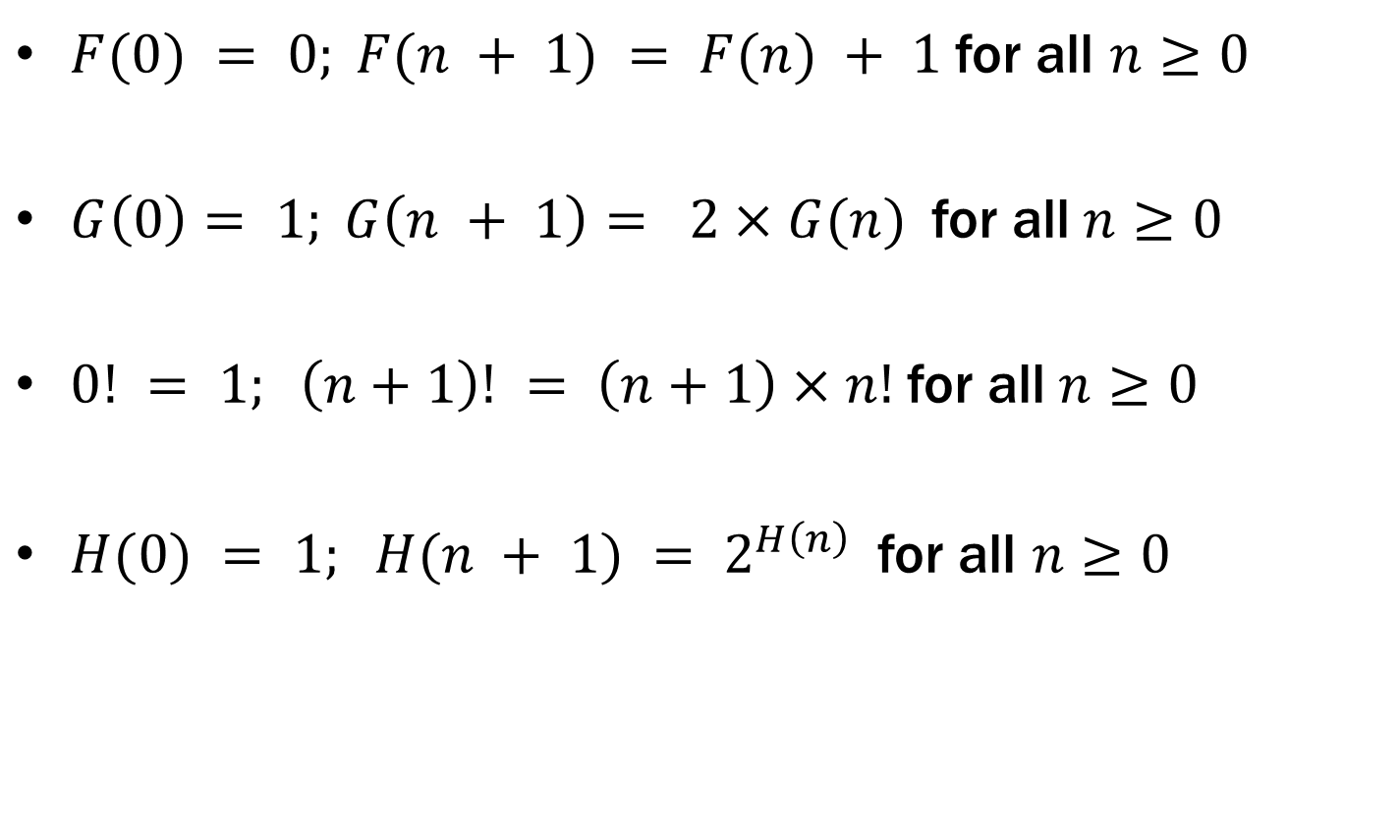

Recursive Definitions of Functions
$F(0) = 0; F(n + 1) = F(n) + 1$for all $n≥0$
$G\left(0\right)= 1; G\left(n + 1\right)= 2×G(n)$for all$n≥0$
$0! = 1; \left(n+1\right)! = \left(n+1\right)×n!$for all$n≥0$
$H(0) = 1; H(n + 1) = 2^{H\left(n\right)}$for all $n≥0$

Slide 9
Fibonacci Numbers
$f_{0}=0$
$f_{1}=1$
$f_{n}=f_{n−1}+f_{n−2}$ for all $n≥2$

Slide 10
Bounding the Fibonacci Numbers
Theorem: $f_{n}<2^{n}$ for all $n≥2.$

