Slide 1
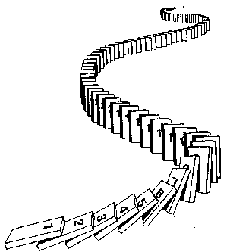
CSE 311: Foundations of Computing
Fall 2014
Lecture 14: Induction

Slide 2
Mathematical Induction
Method for proving statements about all natural numbers
A new logical inference rule!
It only applies over the natural numbers
The idea is to use the special structure of the naturals to prove things more easily
Particularly useful for reasoning about programs!
for(int i=0; i < n; n++) { … }
Show P(i) holds after i times through the loop
public int f(int x) {
if (x == 0) { return 0; }
else { return f(x – 1)+1; }
}
f(x) = x for all values of x ≥ 0 naturally shown by induction.

Slide 3
Prove for all n > 0, a is odd → a^{n} is odd
Let n > 0 be arbitrary.
Suppose that a is odd. We know that if a, b are odd, then ab is also odd.
So,
(…• ((a•a) •a) •…•a) = a^{n}
(n times)
Those “…”s are a problem! We’re trying to say “we can use the same argument over and over”… We’ll come back to this.

Slide 4
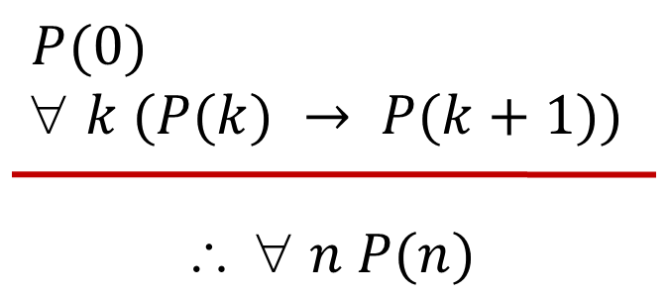
Induction Is A Rule of Inference
Domain: Natural Numbers
How does this technique prove P(5)?
First, we prove P(0).
Since P(n) → P(n+1) for all n, we have P(0) → P(1).
Since P(0) is true and P(0) → P(1), by Modus Ponens, P(1) is true.
Since P(n) → P(n+1) for all n, we have P(1) → P(2).
Since P(1) is true and P(1) → P(2), by Modus Ponens, P(2) is true.
Formal steps
Show P(0)
Assume P(k), Prove P(k+1), Conclude P(k)→ P(k+1)
Conclude ∀ k (P(k)→ P(k+1))
Conclude ∀ n P(n)

Slide 5
Using The Induction Rule In A Formal Proof
1. Prove P(0)
Let k be an arbitrary integer ≥ 0
3. Assume that P(k) is true
4. ...
5. Prove P(k+1) is true
P(k) → P(k+1) Direct Proof Rule
7. ∀ k (P(k) → P(k+1)) Intro ∀ from 2-6
8. ∀ n P(n) Induction Rule 1&7

Slide 6
Instead, Let’s Use Induction
Base Case
1. Prove P(0)
Let k be an arbitrary integer ≥ 0
3. Assume that P(k) is true
4. ...
5. Prove P(k+1) is true
P(k) → P(k+1) Direct Proof Rule
7. ∀ k (P(k) → P(k+1)) Intro ∀ from 2-6
8. ∀ n P(n) Induction Rule 1&7
Inductive
Hypothesis
Inductive
Step
Conclusion

Slide 7
5 Steps To Inductive Proofs In English
Proof:
1. “We will show that P(n) is true for every n ≥ 0 by Induction.”
2. “Base Case:” Prove P(0)
3. “Inductive Hypothesis:”
Assume P(k) is true for some arbitrary integer k ≥ 0”
4. “Inductive Step:” Want to prove that P(k+1) is true:
Use the goal to figure out what you need.
Make sure you are using I.H. and point out where you are using it. (Don’t assume P(k+1) !!)
5. “Conclusion: Result follows by induction”

Slide 8
What can we say about 1 + 2 + 4 + 8 + … + 2^{n}
1 = 1
1 + 2 = 3
1 + 2 + 4 = 7
1 + 2 + 4 + 8 = 15
1 + 2 + 4 + 8 + 16 = 31
Can we describe the pattern?
1 + 2 + 4 + … + 2^{n} = 2^{n+1} – 1

Slide 9
Proving 1 + 2 + 4 + … + 2^{n} = 2^{n+1} – 1
We could try proving it normally…
We want to show that 1 + 2 + 4 + … + 2^{n} = 2^{n+1}.
So, what do we do now? We can sort of explain the pattern, but that’s not a proof…
We could prove it for n=1, n=2, n=3, …(individually), but that would literally take forever…

Slide 10
5 Steps To Inductive Proofs In English
Proof:
1. “We will show that P(n) is true for every n ≥ 0 by Induction.”
2. “Base Case:” Prove P(0)
3. “Inductive Hypothesis:”
Assume P(k) is true for some arbitrary integer k ≥ 0”
4. “Inductive Step:” Want to prove that P(k+1) is true:
Use the goal to figure out what you need.
Make sure you are using I.H. and point out where you are using it. (Don’t assume P(k+1) !!)
5. “Conclusion: Result follows by induction”

Slide 11
Proving 1 + 2 + … + 2^{n} = 2^{n+1} – 1
Examples to show its true
P(0)
P(k) → P(k+1)

Slide 12
Proving 1 + 2 + … + 2^{n} = 2^{n+1} – 1
Let P(n) be “1 + 2 + … + 2^{n} = 2^{n+1} – 1”. We will show P(n) is true for all natural numbers by induction.
Base Case (n=0): 2⁰ = 1 = 2 – 1 = 2⁰⁺¹ – 1
Induction Hypothesis: Suppose that P(k) is true for some arbitrary k ≥ 0.
Induction Step:
Goal: Show P(k+1), i.e. show 1 + 2 + … + 2^{k} + 2^{k+1} = 2^{k+2} – 1
1 + 2 + … + 2^{k} = 2^{k+1} – 1 by IH
Adding 2^{k+1} to both sides, we get:
1 + 2 + … + 2^{k} + 2^{k+1} = 2^{k+1} + 2^{k+1} – 1
Note that 2^{k+1} + 2^{k+1} = 2(2^{k+1}) = 2^{k+2}.
So, we have 1 + 2 + … + 2^{k} + 2^{k+1} = 2^{k+2} – 1, which is
exactly P(k+1).
5. Thus P(k) is true for all k ∈ℕ, by induction.
Examples to show its true
P(0)
P(k) → P(k+1)

Slide 13
Another Example
We want to prove 3 | 2^{2n} – 1 for all n ≥ 0.
Examples to show its true
P(0)
P(k) → P(k+1)

Slide 14
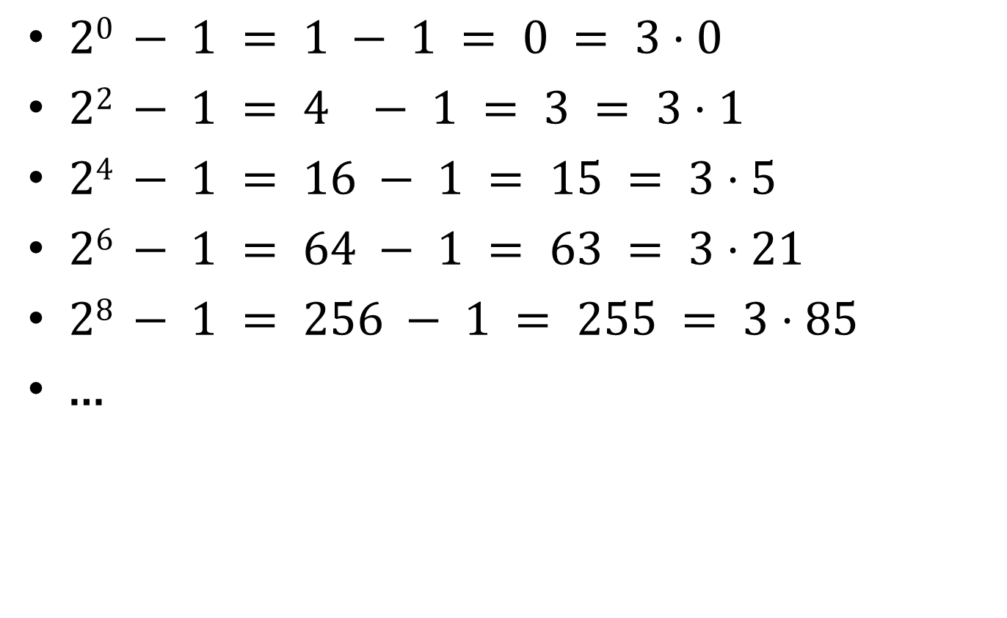
Finding A Pattern
$20 − 1 = 1 − 1 = 0 = 3⋅0$
$22 − 1 = 4 − 1 = 3 = 3⋅1$
$24 − 1 = 16 − 1 = 15 = 3⋅5$
$26 − 1 = 64 − 1 = 63 = 3⋅21$
$28 − 1 = 256 − 1 = 255 = 3⋅85$
…

Slide 15
Prove: 3 | 2^{2n} – 1 for all n ≥ 0
Examples to show its true
P(0)
P(k) → P(k+1)

Slide 16
Prove: For all $n≥1: 1+2+⋯+n=\sum_{i=1}^{n}{i}=\frac{n\left(n+1\right)}{2}$

Slide 17
Prove: n^{n} ≥ n! for all n ≥ 1.
Recall: n! is the product of all the integers between 1 and n.
Examples to show its true
P(0)
P(k) → P(k+1)

Slide 18
Checkerboard Tiling
Prove that a 2^{n} × 2^{n} checkerboard with one
square removed can be tiled with:

