Slide 2
Useful GCD Fact
If a and b are positive integers, then gcd(a,b) = gcd(b, a mod b)
Proof:
By definition of mod, a = qb+ (a mod b) for some integer q=a div b.
Let d=gcd(a,b). Then d|a and d|b so a=kd and b=jd for some integers k and j.
Therefore (a mod b) = a – qb = kd – qjd = d(k – qj).
So, d | (a mod b) and since d | b we must have d ≤ gcd(b, a mod b).
Now, let e=gcd(b, a mod b). Then e | b and e | (a mod b). It follows
that b=me and (a mod b) = ne for some integers m and n. Therefore
a = qb+ (a mod b) = qme + ne = e(qm+n)
So, e | a and since e | b we must have e ≤ gcd(a, b).
Therefore gcd(a, b)=gcd(b, a mod b).

Slide 3
Euclid’s Algorithm
Repeatedly use the fact to reduce numbers
until you get
gcd(660,126) = gcd(126, 660 mod 126) = gcd(126, 30)
= gcd(30, 126 mod 30) = gcd(30, 6)
= gcd(6, 30 mod 6) = gcd(6, 0)
= 6
gcd(660,126)
660 = 5 • 126 + 30
126 = 4 • 30 + 6
30 = 5 • 6

Slide 4
Euclid’s Algorithm
GCD(x, y) = GCD(y, x mod y)
int GCD(int a, int b){ /* a >= b, b > 0 */
int tmp;
while (y > 0) {
tmp = a % b;
a = b;
b = tmp;
}
return a;
}
Example: GCD(660, 126)

Slide 5
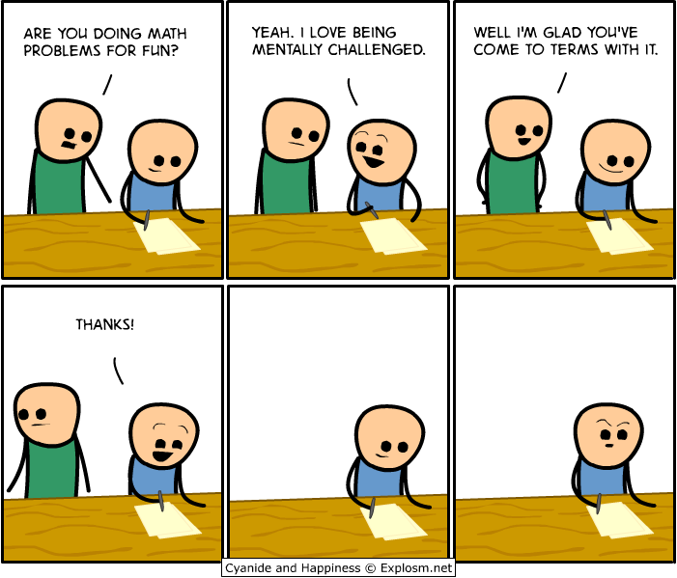
CSE 311: Foundations of Computing
Fall 2014
Lecture 13: Modular Inverses, Induction

Slide 6
Bézout’s theorem
If a and b are positive integers, then there exist integers s and t such that
gcd(a,b) = sa + tb.

Slide 7
Extended Euclidean algorithm
Can use Euclid’s Algorithm to find $s, t$ such that
$\gcd\left(a,b\right)=sa+tb$
e.g. gcd(35,27): 35 = 1 • 27 + 8 35 - 1 • 27 = 8
27= 3 • 8 + 3 27- 3 • 8 = 3
8 = 2 • 3 + 2 8 - 2 • 3 = 2
3 = 1 • 2 + 1 3 - 1 • 2 = 1
2 = 2 • 1 + 0
Substitute back from the bottom
1= 3 - 1 • 2 = 3 – 1 (8 - 2 • 3) = (-1) • 8 + 3 • 3
= (-1) • 8 + 3 (27- 3 • 8 ) = 3 • 27 + (-10) • 8
=

Slide 8
multiplicative inverse $mod m$
Suppose $GCD\left(a,m\right)=1$
By Bézout’s Theorem, there exist integers $s$ and $t$
such that $sa+tm=1.$
$s mod m$ is the multiplicative inverse of $a$:
$1=\left(sa+tm\right) mod m=sa mod m$

Slide 9
Solving Modular Equations
Solving $ax≡b (mod m)$ for unknown $x$ when $\gcd\left(a,m\right)=1$.
Find $s$ such that $sa+tm=1$
Compute $a^{−1}=s mod m$, the multiplicative inverse of $a$ modulo $m$
Set $x=\left(a^{−1}⋅b\right) mod m$

Slide 10
multiplicative cipher: $f(x) = ax mod m$
For a multiplicative cipher to be invertible:
$f\left(x\right)=ax mod m :\left\{0,…,m−1\right\}→\{0,…,m−1\}$
must be one-to-one and onto
Lemma: If there is an integer $b$ such that
$ab mod m = 1$, then the function $f(x) = ax mod m$is one-to-one and onto.

Slide 11
Example
Solve: $7x≡1 (mod 26)$

Slide 12
Mathematical Induction
Method for proving statements about all integers ≥ 0
A new logical inference rule!
It only applies over the natural numbers
The idea is to use the special structure of the naturals to prove things more easily
Particularly useful for reasoning about programs!
for(int i=0; i < n; n++) { … }
Show P(i) holds after i times through the loop
public int f(int x) {
if (x == 0) { return 0; }
else { return f(x – 1)+1; }}
f(x) = x for all values of x ≥ 0 naturally shown by induction.

Slide 13
Prove for all n > 0, a is odd → a^{n} is odd
Let n > 0 be arbitrary.
Suppose that a is odd. We know that if a, b are odd, then ab is also odd.
So,
(…• ((a•a) •a) •…•a) = a^{n}
(n times)
Those “…”s are a problem! We’re trying to say “we can use the same argument over and over”… We’ll come back to this.

Slide 14
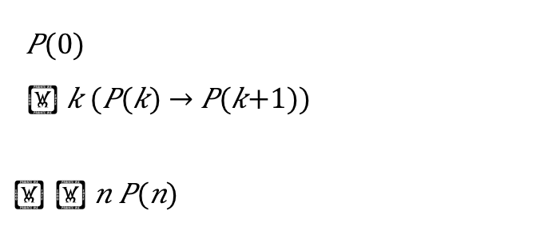
Induction Is A Rule of Inference
Domain: Natural Numbers
$P(0)$
$ k (P(k) → P(k+1))$
$$  n P(n)$$
Formal steps
Show P(0)
Assume P(k), Prove P(k+1), Conclude P(k)→ P(k+1)
Conclude ∀ k (P(k)→ P(k+1))
Conclude ∀ n P(n)

Slide 15
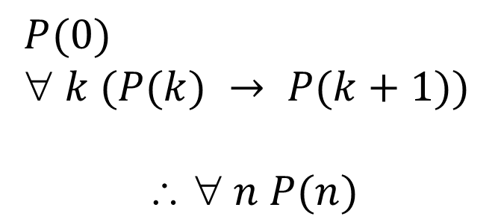
Using The Induction Rule In A Formal Proof
$P(0)$
$ k (P(k) → P(k+1))$
$$  n P(n)$$
1. Prove P(0)
Let k be an arbitrary integer ≥ 0
3. Assume that P(k) is true
4. ...
5. Prove P(k+1) is true
P(k) → P(k+1) Direct Proof Rule
7. ∀ k (P(k) → P(k+1)) Intro ∀ from 2-6
8. ∀ n P(n) Induction Rule 1&7

Slide 16
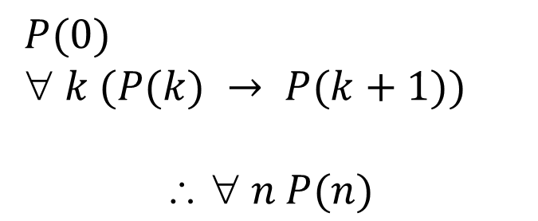
Instead, Let’s Use Induction
$P(0)$
$ k (P(k) → P(k+1))$
$$  n P(n)$$
Base Case
1. Prove P(0)
Let k be an arbitrary integer ≥ 0
3. Assume that P(k) is true
4. ...
5. Prove P(k+1) is true
P(k) → P(k+1) Direct Proof Rule
7. ∀ k (P(k) → P(k+1)) Intro ∀ from 2-6
8. ∀ n P(n) Induction Rule 1&7
Inductive
Hypothesis
Inductive
Step
Conclusion

Slide 17
5 Steps To Inductive Proofs In English
Proof:
1. “We will show that P(n) is true for every n ≥ 0 by Induction.”
2. “Base Case:” Prove P(0)
3. “Inductive Hypothesis:”
Assume P(k) is true for some arbitrary integer k ≥ 0”
4. “Inductive Step:” Want to prove that P(k+1) is true:
Use the goal to figure out what you need.
Make sure you are using I.H. and point out where you are using it. (Don’t assume P(k+1) !!)
5. “Conclusion: Result follows by induction”

Slide 18
What can we say about 1 + 2 + 4 + 8 + … + 2^{n}
1 = 1
1 + 2 = 3
1 + 2 + 4 = 7
1 + 2 + 4 + 8 = 15
1 + 2 + 4 + 8 + 16 = 31
Can we describe the pattern?
1 + 2 + 4 + … + 2^{n} = 2^{n+1} – 1

Slide 19
Proving 1 + 2 + 4 + … + 2^{n} = 2^{n+1} – 1
We could try proving it normally…
We want to show that 1 + 2 + 4 + … + 2^{n} = 2^{n+1}.
So, what do we do now? We can sort of explain the pattern, but that’s not a proof…
We could prove it for n=1, n=2, n=3, …(individually), but that would literally take forever…

Slide 20
5 Steps To Inductive Proofs In English
Proof:
1. “We will show that P(n) is true for every n ≥ 0 by Induction.”
2. “Base Case:” Prove P(0)
3. “Inductive Hypothesis:”
Assume P(k) is true for some arbitrary integer k ≥ 0”
4. “Inductive Step:” Want to prove that P(k+1) is true:
Use the goal to figure out what you need.
Make sure you are using I.H. and point out where you are using it. (Don’t assume P(k+1) !!)
5. “Conclusion: Result follows by induction”

Slide 21
Proving 1 + 2 + … + 2^{n} = 2^{n+1} – 1
Examples to show its true
P(0)
P(k) → P(k+1)

Slide 22
Proving 1 + 2 + … + 2^{n} = 2^{n+1} – 1
Let P(n) be “1 + 2 + … + 2^{n} = 2^{n+1} – 1”. We will show P(n) is true for all natural numbers by induction.
Base Case (n=0): 2⁰ = 1 = 2 – 1 = 2⁰⁺¹ – 1
Induction Hypothesis: Suppose that P(k) is true for some arbitrary k ≥ 0.
Induction Step:
Goal: Show P(k+1), i.e. show 1 + 2 + … + 2^{k} + 2^{k+1} = 2^{k+2} – 1
1 + 2 + … + 2^{k} = 2^{k+1} – 1 by IH
Adding 2^{k+1} to both sides, we get:
1 + 2 + … + 2^{k} + 2^{k+1} = 2^{k+1} + 2^{k+1} – 1
Note that 2^{k+1} + 2^{k+1} = 2(2^{k+1}) = 2^{k+2}.
So, we have 1 + 2 + … + 2^{k} + 2^{k+1} = 2^{k+2} – 1, which is
exactly P(k+1).
5. Thus P(k) is true for all k ∈ℕ, by induction.
Examples to show its true
P(0)
P(k) → P(k+1)

Slide 23
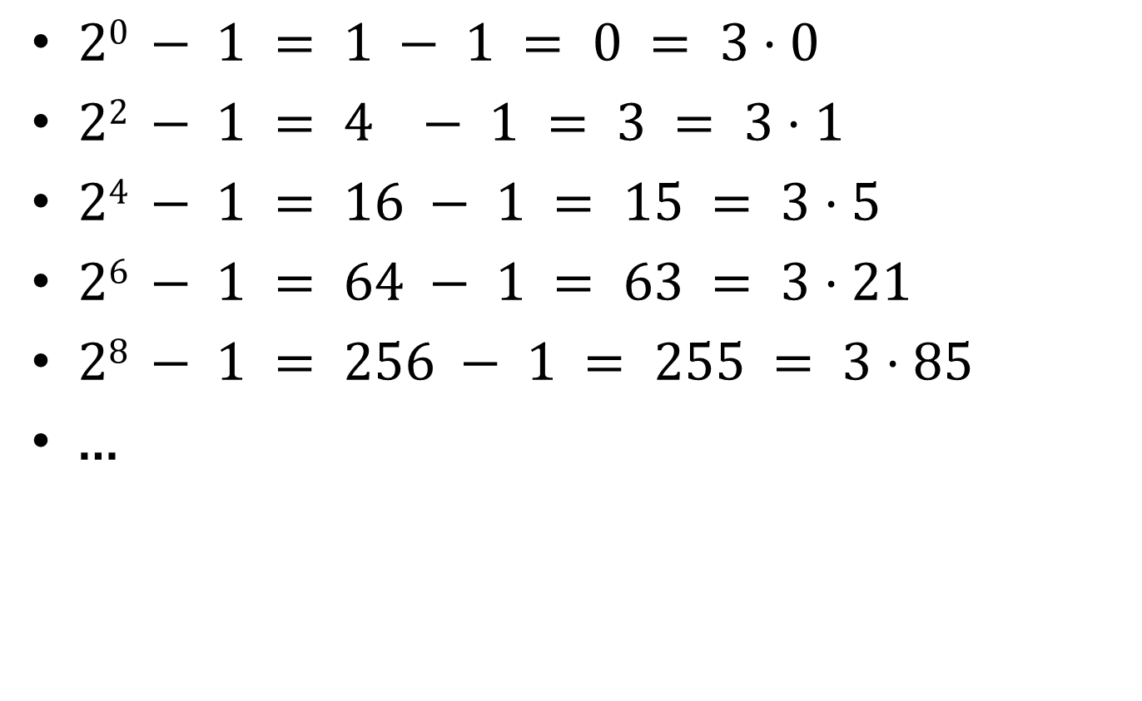
Another example of a pattern
$20 − 1 = 1 − 1 = 0 = 3⋅0$
$22 − 1 = 4 − 1 = 3 = 3⋅1$
$24 − 1 = 16 − 1 = 15 = 3⋅5$
$26 − 1 = 64 − 1 = 63 = 3⋅21$
$28 − 1 = 256 − 1 = 255 = 3⋅85$
…

Slide 24
Prove: 3 | 2^{2n} – 1 for all n ≥ 0
Examples to show its true
P(0)
P(k) → P(k+1)

Slide 25
For all $n≥1: 1+2+⋯+n=\sum_{i=1}^{n}{i}=\frac{n\left(n+1\right)}{2}$

