Slide 1
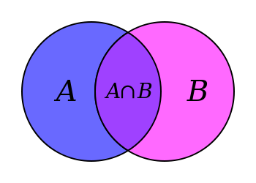

Slide 2
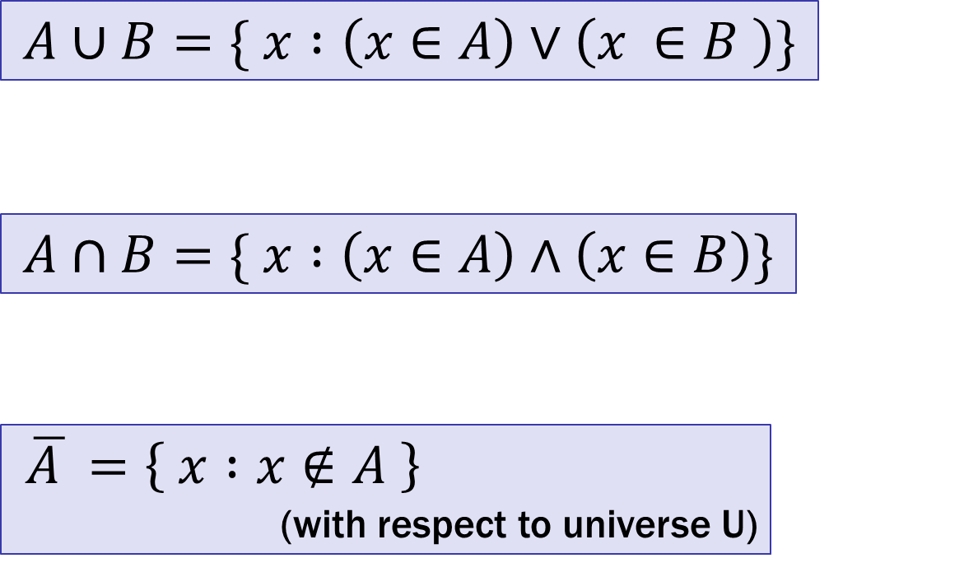
It’s Boolean algebra again
Definition for ∪ based on ∨
Definition for ∩ based on ∧
Complement works like ¬
$$A∪B=\{ x :\left(x∈A\right)∨\left(x ∈B \right)\}$$
$$A∩B=\{ x :\left(x∈A\right)∧\left(x∈B\right)\}$$
$\overline{A }=\left\{ x :x∉A \right\}$
(with respect to universe U)

Slide 3
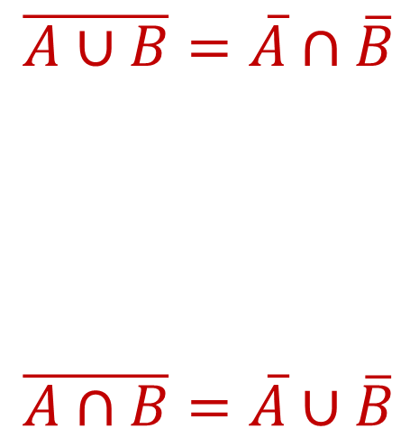
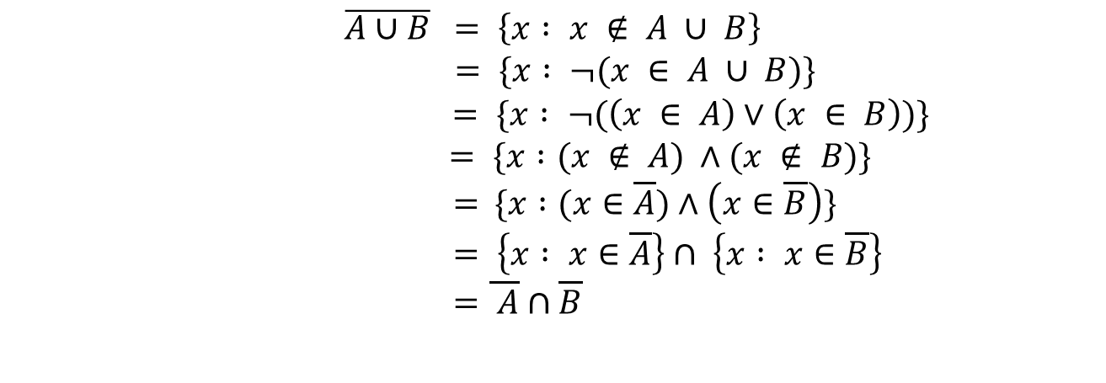
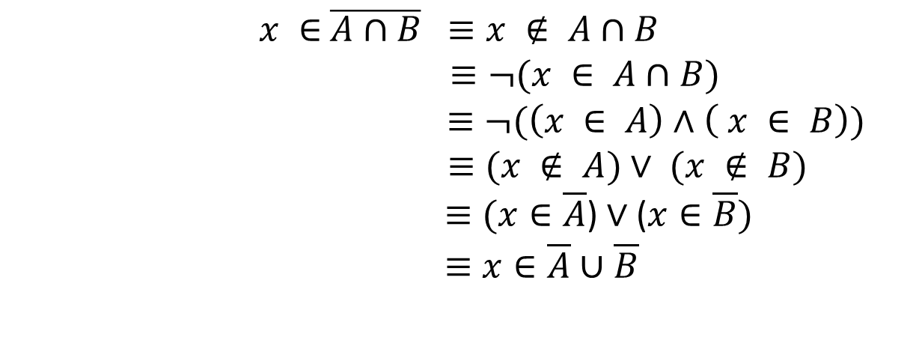
De Morgan’s Laws
Let $U$ be the universe.
Prove A ∪ B = A ∩ B
Begin with x ∈ A ∪ B ↔ x ∈ A ∨ x ∈ B

Slide 4
Distributive Laws
$$A∩\left(B∪C\right)=\left(A∩B\right)∪\left(A∩C\right)$$
$$A∪\left(B∩C\right)=\left(A∪B\right)∩\left(A ∪C\right)$$
A
B
A
B
C
C

Slide 5
Representing Sets Using Bits
Suppose universe $U$ is $\{1,2,…,n\}$
Can represent set $B⊆U$ as a vector of bits:
$b_{1}b_{2}…b_{n}$ where $b_{i}=1$ when $i∈B$
$b_{i}=0$when $i∉B$
Called the characteristic vector of set B
Given characteristic vectors for $A$ and $B$
What is characteristic vector for $A∪B$? $A∩B$?

Slide 6
UNIX/Linux File Permissions
ls –l
drwxr-xr-x ... Documents/
-rw-r--r-- ... file1
Permissions maintained as bit vectors
Letter means bit is 1
“--” means bit is 0.

Slide 7
Bitwise Operations
01101101 Java: z=x|y ∨ 00110111
01111111
00101010 Java: z=x&y ∧ 00001111
00001010
01101101 Java: z=x^y
⊕ 00110111
01011010

Slide 8
A Useful Identity
If x and y are bits: (x ⊕ y) ⊕ y = ?
(x ⊕ y) ⊕ y = x ⊕ (y ⊕ y) = x ⊕ 0 = x

Slide 9
Private Key Cryptography
Alice wants to communicate message secretly to Bob so that eavesdropper Eve who hears their conversation cannot tell what Alice’s message is.
Alice and Bob can get together and privately share a secret key K ahead of time.

Slide 10
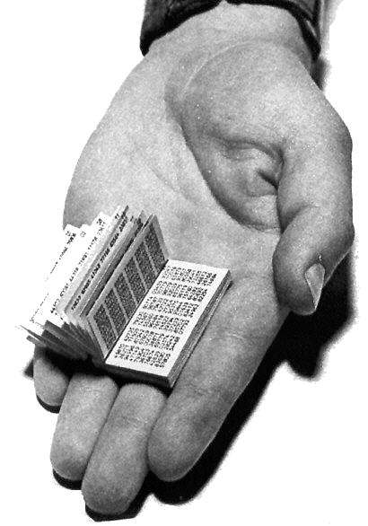
One-Time Pad
Alice and Bob privately share random n-bit vector K
Eve does not know K
Later, Alice has n-bit message m to send to Bob
Alice computes C = m ⊕ K
Alice sends C to Bob
Bob computes m = C ⊕ K which is (m ⊕ K) ⊕ K
Eve cannot figure out m from C unless she can guess K

Slide 11
CSE 311: Foundations of Computing
Fall 2014
Lecture 10: Functions, Modular arithmetic

Slide 12
Announcements
Homework 3 due now
Homework 2 Solutions available
Homework 4 out later today

Slide 13
Functions
A function from A to B.
Every element of A is assigned to exactly one element of B.
We write f : A → B.
“Image of X” = {x : ∃y (y ∈ X ∧ x = f(y))}
Domain of f is A
Codomain of f is B
Image of f = Image of domain = all the elements pointed to by something in the domain.

Slide 14
Image
$A B$
Image({a}) = {2}
Image({a, e}) = {2}
Image({a, b}) = {1, 2}
Image(A) = {1, 2, 4}
a
1
b
2
c
3
d
4
e

Slide 15
Is this a function? One-to-One? Onto?
$A B$
It is one-to-one, because nothing in B is pointed to by multiple elements of A.
It is not onto, because 5 is not pointed to by anything.
a
1
b
2
c
3
d
4
e
5
6

Slide 16
Functional Examples
Domain: Reals
One-to-one Onto
x ↦ x²
x ↦ x³ - x
x ↦ e^{x}
x ↦ x³
No (-1, 1) No (no negatives)
No (-1, 1) Yes
Yes No (no negatives)
Yes Yes

Slide 17
Number Theory (and applications to computing)
Branch of Mathematics with direct relevance to computing
Many significant applications
Cryptography
Hashing
Security
Important tool set

Slide 18
Modular Arithmetic
Arithmetic over a finite domain
In computing, almost all computations are over a finite domain

Slide 19
I’m ALIVE!
public class Test {
final static int SEC_IN_YEAR = 364*24*60*60*100;
public static void main(String args[]) {
System.out.println(
“I will be alive for at least ” +
SEC_IN_YEAR * 101 + “ seconds.”
);
}
}
[-128, 127]
Prints : “I will be alive for at least -186619904 seconds.”
14
-116

Slide 20
Divisibility
Integers a, b, with a ≠ 0, we say that a divides b iff there is an integer k such that b = ka. The notation a | b denotes “a divides b.”

Slide 21
Division Theorem
Let a be an integer and d a positive integer. Then there are unique integers q and r, with 0 ≤ r < d, such that a = dq + r.
q = a div d r = a mod d
Note: r ≥ 0 even if a < 0.
Not quite the same as a % d.

Slide 22
Division Theorem
Let a be an integer and d a positive integer. Then there are unique integers q and r, with 0 ≤ r < d, such that a = dq + r.
q = a div d r = a mod d
public class Test2 {
public static void main(String args[]) {
int a = -5;
int d = 2;
System.out.println(a % d);
}
}
Note: r ≥ 0 even if a < 0.
Not quite the same as a % d.

Slide 23
Arithmetic, mod 7
a +₇ b = (a + b) mod 7
a ×₇ b = (a × b) mod 7
+ | 0 | 1 | 2 | 3 | 4 | 5 | 6
0 | 0 | 1 | 2 | 3 | 4 | 5 | 6
1 | 1 | 2 | 3 | 4 | 5 | 6 | 0
2 | 2 | 3 | 4 | 5 | 6 | 0 | 1
3 | 3 | 4 | 5 | 6 | 0 | 1 | 2
4 | 4 | 5 | 6 | 0 | 1 | 2 | 3
5 | 5 | 6 | 0 | 1 | 2 | 3 | 4
6 | 6 | 0 | 1 | 2 | 3 | 4 | 5
X | 0 | 1 | 2 | 3 | 4 | 5 | 6
0 | 0 | 0 | 0 | 0 | 0 | 0 | 0
1 | 0 | 1 | 2 | 3 | 4 | 5 | 6
2 | 0 | 2 | 4 | 6 | 1 | 3 | 5
3 | 0 | 3 | 6 | 2 | 5 | 1 | 4
4 | 0 | 4 | 1 | 5 | 2 | 6 | 3
5 | 0 | 5 | 3 | 1 | 6 | 4 | 2
6 | 0 | 6 | 5 | 4 | 3 | 2 | 1

Slide 24
Modular Arithmetic
Let a and b be integers, and m be a positive integer. We say a is congruent to b modulo m if m divides a – b. We use the notation a ≡ b (mod m) to indicate that a is congruent to b modulo m.

Slide 25
Modular Arithmetic: Examples
A ≡ 0 (mod 2)
This statement is the same as saying “A is even”; so, any
A that is even (including negative even numbers) will work.
1 ≡ 0 (mod 4)
This statement is false. If we take it mod 1 instead, then the
statement is true.
A ≡ -1 (mod 17)
If A = 17x – 1 = 17x + 16, then it works.
Note that (m – 1) mod m
= ((m mod m) + (-1 mod m)) mod m
= (0 + -1) mod m
= -1 mod m

Slide 26
Modular Arithmetic: A Property
Let a and b be integers, and let m be a positive integer. Then a ≡ b (mod m) if and only if
a mod m = b mod m.
Proof: Suppose that a ≡ b (mod m).
By definition: a ≡ b (mod m) implies m | (a – b) which by definition implies that a – b = km for some integer k.
Therefore a=b+km. Taking both sides modulo m we get a mod m=(b+km) mod m = b mod m.
Suppose that a mod m = b mod m.
By the division theorem, a = mq + (a mod m) and
b = ms + (b mod m) for some integers q,s.
a – b = (mq + (a mod m)) – (mr + (b mod m))
= m(q – r) + (a mod m – b mod m)
= m(q – r) since a mod m = b mod m
Therefore m |(a-b) and so a ≡ b (mod m).

Slide 27
Modular Arithmetic: Another Property
Let m be a positive integer. If a ≡ b (mod m) and c ≡ d (mod m), then a + c ≡ b + d (mod m)
Suppose a ≡ b (mod m) and c ≡ d (mod m). Unrolling definitions gives us some k such that
a – b = km, and some j such that c – d = jm.
Adding the equations together gives us
(a + c) – (b + d) = m(k + j). Now, re-applying the definition of mod gives us a + c ≡ b + d (mod m).

Slide 28
Modular Arithmetic: Another-nother Property
Let m be a positive integer. If a ≡ b (mod m) and c ≡ d (mod m), then ac ≡ bd (mod m)
Suppose a ≡ b (mod m) and c ≡ d (mod m). Unrolling definitions gives us some k such that
a – b = km, and some j such that c – d = jm.
Then, a = km + b and c = jm + d. Multiplying both together gives us ac = (km + b)(jm + d) = kjm² + kmd + jmb + bd.
Re-arranging gives us ac – bd = m(kjm + kd + jb). Using the definition of mod gives us ac ≡ bd (mod m).

Slide 29
Example
Let n be an integer.
Prove that n² ≡ 0 (mod 4) or n² ≡ 1 (mod 4)
Case 1 (n is even):
Suppose n ≡ 0 (mod 2).
Then, n = 2k for some k.
So, n² = (2k)² = 4k². So, by
definition of congruence,
n² ≡ 0 (mod 4).
Let’s start by looking a a small example:
0² = 0 ≡ 0 (mod 4)
1² = 1 ≡ 1 (mod 4)
2² = 4 ≡ 0 (mod 4)
3² = 9 ≡ 1 (mod 4)
4² = 16 ≡ 0 (mod 4)
It looks like
n ≡ 0 (mod 2) → n² ≡ 0 (mod 4), and n ≡ 1 (mod 2) → n² ≡ 1 (mod 4).
Case 2 (n is odd):
Suppose n ≡ 1 (mod 2).
Then, n = 2k + 1 for some k.
So, n² = (2k + 1)² = 4k² + 4k + 1 = 4(k² + k) + 1. So, by definition of congruence, n² ≡ 1 (mod 4).

