Slide 1
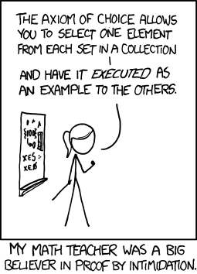

Slide 2
Inference rules for quantifiers
P(c) for some c
∀x P(x)
∴ ∃x P(x)
∴ P(a) for any a
“Let a be anything*”...P(a)
∃x P(x)
∴ ∀x P(x)
∴ P(c) for some special** c
** By special, we mean that c is a name for a value where P(c) is true. We can’t use anything else about that value, so c has to be a NEW variable!
* in the domain of P

Slide 3
Proof by Contrapositive: Strategy for implications
If we assume ¬q and derive ¬p, then we have proven ¬q → ¬p, which is the same as p → q.
1. ¬q Assumption
...
3. ¬p
4. ¬q → ¬p Direct Proof Rule
5. p → q Contrapositive

Slide 4
Proof by Contradiction: One way to prove ¬p
If we assume p and derive F (a contradiction), then we have proven ¬p.
1. p assumption
...
3. F
4. p → F direct Proof rule
5. ¬p ∨ F Law of Implication: 4
6. ¬p Identity: 5

Slide 5
Even and Odd
Even(x) ≡ ∃y (x=2y)
Odd(x) ≡ ∃y (x=2y+1)
Domain: Integers
Prove: “No integer is both even and odd.”
English proof: ¬ ∃x (Even(x)∧Odd(x))
≡∀x ¬(Even(x)∧Odd(x))
We go by contradiction. Let x be any integer and suppose that it is both even and odd. Then x=2k for some integer k and x=2m+1 for some integer m. Therefore 2k=2m+1 and hence k=m+½.
But two integers cannot differ by ½ so this is a contradiction. So, no integer is both even and odd.

Slide 6
Rational Numbers
A real number x is rational iff there exist integers p and q with q≠0 such that x=p/q.
Prove: If x and y are rational then xy is rational
Rational(x) ≡ ∃p ∃q ((x=p/q) ∧ Integer(p) ∧ Integer(q) ∧ q≠0)
∀x ∀y ((Rational(x) ∧ Rational(y)) → Rational(xy))
Domain: Real numbers

Slide 7
Rationality
Rational(x) ≡ ∃p ∃q ((x=p/q) ∧ Integer(p) ∧ Integer(q) ∧ q≠0)
Domain: Reals
“If x and y are rational then xy is rational.”
Proof: Let x and y be rational numbers. Then, x = a/b for some integers a, b, where b≠0, and y = c/d for some integers c,d, where d≠0.
Then xy = (ac)/(bd).
Since b and d are both non-zero, so is bd; furthermore, ac and bd are integers. It follows that xy is rational, by definition of rational.

Slide 8
Rationality
Rational(x) ≡ ∃p ∃q ((x=p/q) ∧ Integer(p) ∧ Integer(q) ∧ q≠0)
Domain: Reals
“If x and y are rational then x+y is rational.”

Slide 9
Proofs
Formal proofs follow simple well-defined rules and should be easy to check
In the same way that code should be easy to execute
English proofs correspond to those rules but are designed to be easier for humans to read
Easily checkable in principle
Simple proof strategies already do a lot
Later we will cover a specific strategy that applies to loops and recursion (mathematical induction)

Slide 10
CSE 311: Foundations of Computing
Fall 2014
Lecture 9: Set Theory

Slide 11
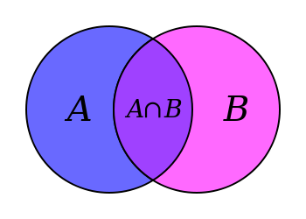
Set Theory
Formal treatment dates from late 19th century
Direct ties between set theory and logic
Important foundational language

Slide 12
Some Common Sets
ℕ is the set of Natural Numbers; ℕ = {0, 1, 2, …}
ℤ is the set of Integers; ℤ = {…, -2, -1, 0, 1, 2, …}
ℚ is the set of Rational Numbers; e.g. ½, -17, 32/48
ℝ is the set of Real Numbers; e.g. 1, -17, 32/48, π
[n] is the set {1, 2, …, n} when n is a natural number
{} = ∅ is the empty set; the only set with no elements
EXAMPLES
Are these sets?
A = {1, 1}
B = {1, 3, 2}
C = {☐, 1}
D = {{}, 17}
E = {1, 2, 7, cat, dog, ∅, α}
Give some examples:
Finite sets,
Multiple domains
N, Z, Q, R
Emptyset
Sets containing sets
We say 2 ∈E; 3 ∉E.

Slide 13
Definitions
A and B are equal if they have the same elements
A is a subset of B if every element of A is also in B
A = B ≡ ∀ x (x ∈ A ↔ x ∈ B)
A ⊆ B ≡ ∀ x (x ∈ A → x ∈ B)
A = {1, 2, 3}
B = {3, 4, 5}
C = {3, 4}
QUESTIONS
∅ ⊆ A?
A ⊆ B?
C ⊆ B
A ⊂ B

Slide 14
Definitions
A and B are equal if they have the same elements
A is a subset of B if every element of A is also in B
Note:
A = B ≡ ∀ x (x ∈ A ↔ x ∈ B)
A ⊆ B ≡ ∀ x (x ∈ A → x ∈ B)
$(A=B$) ≡ ($A⊆B) ∧(B⊆A)$
A ⊂ B

Slide 15
Building sets from predicates
The following says “S is the set of all x’s where P(x) is true.
The following says “S is the set of those elements of A for which P(x) is true.”
“The set of all the real numbers less than one”
$$\{x ℝ : x < 1\}$$
“The set of all powers of two”
$$\{x ℕ : j (x =2j)\}$$
S = {x : P(x)}
S = {x ∈A : P(x)}
A ⊂ B

Slide 16
Set Operations
$$A∪B=\{ x :\left(x∈A\right)∨\left(x ∈B \right)\}$$
Union
$$A∩B=\{ x :\left(x∈A\right)∧\left(x∈B\right)\}$$
Intersection
$$A \backslash B=\{ x :\left(x∈A\right)∧\left(x∉B\right)\}$$
Set Difference
A = {1, 2, 3}
B = {4, 5, 6} C = {3, 4}
QUESTIONS
Using A, B, C and set operations, make…
[6] = ?
{3} = ?
{1,2} = ?
{1,3} = ?

Slide 17
More Set Operations
$$A⊕B=\{ x :\left(x∈A\right)⊕\left(x∈B\right)\}$$
Symmetric
Difference
$\overline{A }=\left\{ x :x∉A \right\}$
(with respect to universe U)
Complement
A = {1, 2, 3}
B = {1, 4, 2, 6}
C = {1, 2, 3, 4}
QUESTIONS
Let $S$ = {1, 2}.
If the universe is A, then $\overline{S }$ is…
If the universe is B, then $\overline{S }$ is…
If the universe is C, then $\overline{S }$ is…

Slide 18
It’s Boolean algebra again
Definition for ∪ based on ∨
Definition for ∩ based on ∧
Complement works like ¬

Slide 19
Empty Set and power set
Power set of a set A = set of all subsets of A
$$𝒫\left(A\right)=\{ B :B⊆A \}$$
e.g. Days = $\{M,W,F\}$
$$𝒫\left(Days\right)=\{ ∅,$$
$\left\{M\right\}, \left\{W\right\}, \left\{F\right\},$
$\left\{M,W\right\},\left\{W,F\right\}, \left\{M,F\right\},$
$\left\{M,W,F\right\} \}$
e.g. $𝒫\left(∅\right)$ = $?$

Slide 20
Cartesian Product
$$A×B=\{ \left(a,b\right):a∈A, b∈B \}$$

Slide 21
De Morgan’s Laws
$$\overline{A∪B}=\overline{A}∩\overline{B}$$
$$\overline{A∩B}=\overline{A}∪\overline{B}$$
Proof technique:
To show C = D show
x ∈ C → x ∈ D and
x ∈ D → x ∈ C
Prove A ∪ B = A ∩ B
Begin with x ∈ A ∪ B ↔ x ∈ A ∨ x ∈ B

Slide 22
Distributive Laws
$$A∩\left(B∪C\right)=\left(A∩B\right)∪\left(A∩C\right)$$
$$A∪\left(B∩C\right)=\left(A∪B\right)∩\left(A ∪C\right)$$
A
B
A
B
C
C

Slide 23
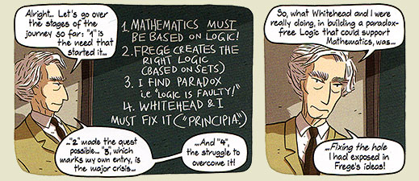
Russell’s Paradox
$$S=\{ x :x∉x \}$$

Slide 24
Representing Sets Using Bits
Suppose universe $U$ is $\{1,2,…,n\}$
Can represent set $B⊆U$ as a vector of bits:
$b_{1}b_{2}…b_{n}$ where $b_{i}=1$ when $i∈B$
$b_{i}=0$when $i∉B$
Called the characteristic vector of set B
Given characteristic vectors for $A$ and $B$
What is characteristic vector for $A∪B$? $A∩B$?

Slide 25
UNIX/Linux File Permissions
ls –l
drwxr-xr-x ... Documents/
-rw-r--r-- ... file1
Permissions maintained as bit vectors
Letter means bit is 1
“--” means bit is 0.

Slide 26
Bitwise Operations
01101101 Java: z=x|y ∨ 00110111
01111111
00101010 Java: z=x&y ∧ 00001111
00001010
01101101 Java: z=x^y
⊕ 00110111
01011010

Slide 27
A Useful Identity
If x and y are bits: (x ⊕ y) ⊕ y = ?
What if x and y are bit-vectors?

Slide 28
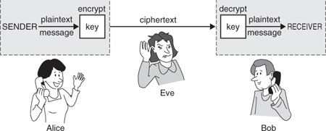
Private Key Cryptography
Alice wants to communicate message secretly to Bob so that eavesdropper Eve who hears their conversation cannot tell what Alice’s message is.
Alice and Bob can get together and privately share a secret key K ahead of time.

Slide 29
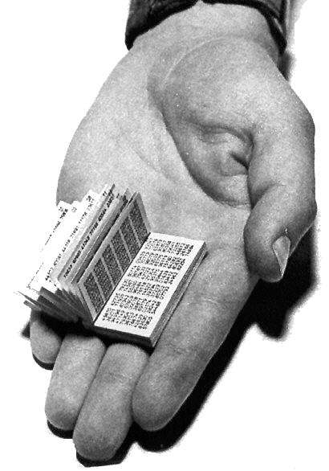
One-Time Pad
Alice and Bob privately share random n-bit vector K
Eve does not know K
Later, Alice has n-bit message m to send to Bob
Alice computes C = m ⊕ K
Alice sends C to Bob
Bob computes m = C ⊕ K which is (m ⊕ K) ⊕ K
Eve cannot figure out m from C unless she can guess K

