Slide 1
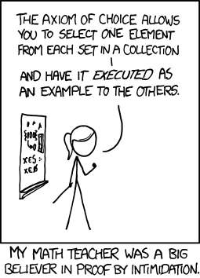
CSE 311: Foundations of Computing
Fall 2013
Lecture 8: More Proofs

Slide 2
Review: proofs
Start with hypotheses and facts
Use rules of inference to extend set of facts
Result is proved when it is included in the set
Fact 2
Statement
Hypothesis 1
Fact 1
Hypothesis 2
Statement
Result
Hypothesis 3

Slide 3
Review: Modus Ponens
If p and p → q are both true then q must be true
Write this rule as
Given:
If it is Wednesday then you have a 311 class today.
It is Wednesday.
Therefore, by modus ponens:
You have a 311 class today.
p, p → q
∴ q

Slide 4
Review: Inference Rules
Each inference rule is written as:
...which means that if both A and B
are true then you can infer C and
you can infer D.
For rule to be correct (A ∧ B) → C and
(A ∧ B) → D must be a tautologies
Sometimes rules don’t need anything to start with. These rules are called axioms:
e.g. Excluded Middle Axiom
A, B
∴ C,D
∴ p ∨¬p

Slide 5
Review: Propositional Inference Rules
Excluded middle plus two inference rules per binary connective, one to eliminate it and one to introduce it
p ∧ q
∴ p, q
p, q
∴ p ∧ q
p ∨ q , ¬p
∴ q
p
∴ p ∨ q, q ∨ p
p, p → q
∴ q
p ⇒ q
∴ p → q
Direct Proof Rule
Not like other rules

Slide 6
Review: Direct Proof of an Implication
p ⇒ q denotes a proof of q given p as an assumption
The direct proof rule:
If you have such a proof then you can conclude
that p → q is true
proof subroutine
Example: 1. p assumption 2. p ∨ q intro for ∨ from 1 3. p → (p ∨ q) direct proof rule

Slide 7
Review: Proofs using the Direct Proof Rule
Show that p → r follows from q and (p ∧ q) → r
1. q given
(p ∧ q) → r given
3. p assumption
4. p ∧ q from 1 and 3 via Intro ∧ rule 5. r modus ponens from 2 and 4
6. p → r direct proof rule
Notes:
p = Song paused
q = Premium user
r = maintain buffer

Slide 8
Inference rules for quantifiers
P(c) for some c
∀x P(x)
∴ ∃x P(x)
∴ P(a) for any a
“Let a be anything*”...P(a)
∃x P(x)
∴ ∀x P(x)
∴ P(c) for some special** c
** By special, we mean that c is a name for a value where P(c) is true. We can’t use anything else about that value, so c has to be a NEW variable!
* in the domain of P

Slide 9
Proofs using Quantifiers
“There exists an even prime number”
First, we translate into predicate logic:
∃x (Even(x) ∧ Prime(x))
1. Even(2) Fact (math)
Prime(2) Fact (math)
Even(2) ∧ Prime(2) Intro ∧: 1, 2
∃x (Even(x) ∧ Prime(x)) Intro ∃: 3

Slide 10
Proofs using Quantifiers
1. Even(2) Fact* (math)
Prime(2) Fact* (math)
Even(2) ∧ Prime(2) Intro ∧: 1, 2
∃x (Even(x) ∧ Prime(x)) Intro ∃: 3
Those first two lines are sort of cheating; we should prove those “facts”.
2 = 2*1 Definition of Multiplication
Even(2) Intro ∃: 1
There are no integers between 1 and 2 Definition of Integers
2 is an integer Definition of 2
Prime(2) Intro ∧: 3, 4
Prime(x): x is an integer > 1 and x is not a multiple of any integer strictly
between 1 and x
Even(x) ≡ ∃y (x=2y)

Slide 11
Proofs using Quantifiers
2 = 2*1 Definition of Multiplication
Even(2) Intro ∃: 1
There are no integers between 1 and 2 Definition of Integers
2 is an integer Definition of 2
Prime(2) Intro ∧: 3, 4
6. Even(2) ∧ Prime(2) Intro ∧: 2, 5
7. ∃x (Even(x) ∧ Prime(x)) Intro ∃: 7
Note that 2 = 2*1 by definition of multiplication. It follows that there is a y such that 2 = 2y; so, 2 is even. Furthermore, 2 is an integer, and there are no integers between 1 and 2; so, by definition of a prime number, 2 is prime. Since 2 is both even and prime, ∃x (Even(x) ∧ Prime(x)).
Prime(x): x is an integer > 1 and x is not a multiple of any integer strictly
between 1 and x
Even(x) ≡ ∃y (x=2y)

Slide 12
Even and Odd
Even(x) ≡ ∃y (x=2y)
Odd(x) ≡ ∃y (x=2y+1)
Domain: Integers
Prove: “The square of every even number is even.”
Formal proof of: ∀x (Even(x) → Even(x²))

Slide 13
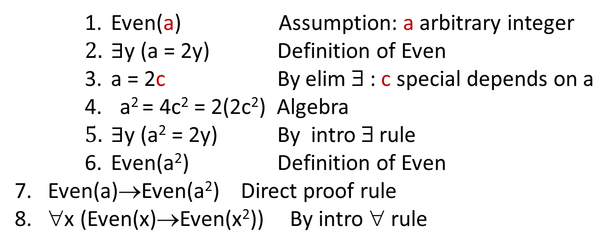
Even and Odd
Even(x) ≡ ∃y (x=2y)
Odd(x) ≡ ∃y (x=2y+1)
Domain: Integers
Prove: “The square of every even number is even.”
Formal proof of: ∀x (Even(x) → Even(x²))
Even(a) Assumption: a arbitrary integer
$∃$y (a = 2y) Definition of Even
a = 2c By elim ∃ : c special depends on a
a² = 4c² = 2(2c²) Algebra
$∃$y (a² = 2y) By intro ∃ rule
Even(a²) Definition of Even
7. Even(a)→Even(a²) Direct proof rule
8. ∀x (Even(x)→Even(x²)) By intro ∀ rule

Slide 14
Even and Odd
Even(x) ≡ ∃y (x=2y)
Odd(x) ≡ ∃y (x=2y+1)
Domain: Integers
Prove: “The square of every odd number is odd.”
English proof of: ∀x (Odd(x)→Odd(x²))
Let x be an odd number.
Then x=2k+1 for some integer k (depending on x)
Therefore x²=(2k+1)²= 4k²+4k+1=2(2k²+2k)+1.
Since 2k²+2k is an integer, x² is odd.

Slide 15
Counterexamples
To disprove ∀x P(x) find a counterexample:
some c such that ¬P(c)
works because this implies ∃x ¬P(x) which is equivalent to ¬∀x P(x)

Slide 16
Proof by Contrapositive: another strategy for implications
If we assume ¬q and derive ¬p, then we have proven ¬q → ¬p, which is the same as p → q.
1. ¬q Assumption
...
3. ¬p
4. ¬q → ¬p Direct Proof Rule
5. p → q Contrapositive

Slide 17
Proof by Contradiction: one way to prove ¬p
If we assume p and derive F (a contradiction), then we have proven ¬p.
1. p assumption
...
3. F
4. p → F direct Proof rule
5. ¬p ∨ F equivalence from 4
6. ¬p equivalence from 5

Slide 18
Even and Odd
Even(x) ≡ ∃y (x=2y)
Odd(x) ≡ ∃y (x=2y+1)
Domain: Integers
Prove: “No integer is both even and odd.”
English proof: ¬ ∃x (Even(x)∧Odd(x))
≡∀x ¬(Even(x)∧Odd(x))
We go by contradiction. Let x be any integer and suppose that it is both even and odd. Then x=2k for some integer k and x=2m+1 for some integer m. Therefore 2k=2m+1 and hence k=m+½.
But two integers cannot differ by ½ so this is a contradiction. So, no integer is both even an odd.

Slide 19
Rational Numbers
A real number x is rational iff there exist integers p and q with q≠0 such that x=p/q.
Prove:
If x and y are rational then xy is rational
If x and y are rational then x+y is rational
Rational(x) ≡ ∃p ∃q ((x=p/q) ∧ Integer(p) ∧ Integer(q) ∧ q≠0)

Slide 20
Rational Numbers
A real number x is rational iff there exist integers p and q with q≠0 such that x=p/q.
Prove: If x and y are rational then xy is rational
Rational(x) ≡ ∃p ∃q ((x=p/q) ∧ Integer(p) ∧ Integer(q) ∧ q≠0)
∀x ∀y ((Rational(x) ∧ Rational(y)) → Rational(xy))
Domain: Real numbers

Slide 21
Rational Numbers
A real number x is rational iff there exist integers p and q with q≠0 such that x=p/q.
Prove:
If x and y are rational then xy is rational
If x and y are rational then x+y is rational
If x and y are rational then x/y is rational
Rational(x) ≡ ∃p ∃q ((x=p/q) ∧ Integer(p) ∧ Integer(q) ∧ q≠0)

Slide 22
Proofs
Formal proofs follow simple well-defined rules and should be easy to check
In the same way that code should be easy to execute
English proofs correspond to those rules but are designed to be easier for humans to read
Easily checkable in principle
Simple proof strategies already do a lot
Later we will cover a specific strategy that applies to loops and recursion (mathematical induction)

