Slide 2
Negations of quantifiers
not every positive integer is prime
some positive integer is not prime
prime numbers do not exist
every positive integer is not prime

Slide 3
Negations of Quantifiers
Domain:
Fruit
∀x PurpleFruit(x)
“All fruits are purple”
What is ¬∀x PurpleFruit(x)?
“Not all fruits are purple”
How about ∃x PurpleFruit(x)?
“There is a purple fruit”
If it’s the negation, all situations should be covered by a statement and its negation
Consider the domain {Orange}: Neither statement is true!
No!
How about ∃x ¬PurpleFruit(x)?
“There is a fruit that isn’t purple”
Yes!
PurpleFruit(x)

Slide 4
De Morgan’s Laws for Quantifiers
¬∀x P(x) ≡ ∃x ¬P(x)
¬∃x P(x) ≡ ∀x ¬P(x)

Slide 5
De Morgan’s laws for Quantifiers
¬∀x P(x) ≡ ∃x ¬P(x)
¬ ∃x P(x) ≡ ∀x ¬P(x)
“There is no largest integer”
¬ ∃ x ∀ y ( x ≥ y)
∀ x ¬ ∀y ( x ≥ y)
∀ x ∃ y ¬ ( x ≥ y)
∀ x ∃ y (y > x)
“For every integer there is a larger integer”

Slide 6
Scope of Quantifiers
Example: NotLargest(x) ≡ ∃ y Greater (y, x) ≡ ∃ z Greater (z, x)
truth value:
doesn’t depend on y or z “bound variables”
does depend on x “free variable”
quantifiers only act on free variables of the formula they quantify
∀ x (∃ y (P(x,y) → ∀ x Q(y, x)))

Slide 7
scope of quantifiers
∃x (P(x) ∧ Q(x)) vs. ∃x P(x) ∧ ∃x Q(x)
This one asserts P and Q of the same x.
This one asserts P and Q of potentially different x’s.

Slide 8
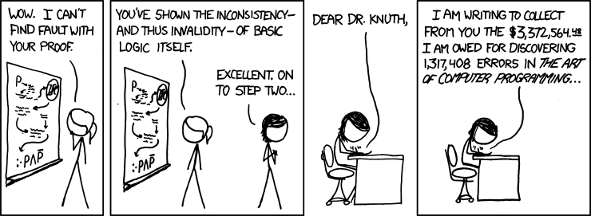
CSE 311: Foundations of Computing
Fall 2014
Lecture 6: Predicate Logic, Logical Inference

Slide 9
Turtles All The Way Down
If the tortoise walks at a rate of one node per step, and the hare walks at a rate of two nodes per step, then the distance between them increases by one node per step.
If the tortoise is on node x, and the hare is on node 2x, then the distance between them increases by one node per step
OnNode(x)
Domain:
Non-negative Integers
x∃y∃z ((Greater(x, 2) ∧ Even(x)) → (Equal(x, y+z) ∧ Prime(y) ∧ Prime(z))

Slide 10
Nested Quantifiers
Bound variable names don’t matter
∀ x ∃ y P(x, y) ≡ ∀ a ∃ b P(a, b)
Positions of quantifiers can sometimes change
∀ x (Q(x) ∧ ∃ y P(x, y)) ≡ ∀ x ∃ y (Q(x) ∧ P(x, y))
But: order is important...

Slide 11
Predicate with Two Variables
y
x
P(x,y)

Slide 12
Quantification with Two Variables
expression | when true | when false
∀x ∀ y P(x, y)
∃ x ∃ y P(x, y)
∀ x ∃ y P(x, y)
∃ y ∀ x P(x, y)

Slide 13
Logical Inference
So far we’ve considered:
How to understand and express things using propositional and predicate logic
How to compute using Boolean (propositional) logic
How to show that different ways of expressing or computing them are equivalent to each other
Logic also has methods that let us infer implied properties from ones that we know
Equivalence is a small part of this

Slide 14
Applications of Logical Inference
Software Engineering
Express desired properties of program as set of logical constraints
Use inference rules to show that program implies that those constraints are satisfied
Artificial Intelligence
Automated reasoning
Algorithm design and analysis
e.g., Correctness, Loop invariants.
Logic Programming, e.g. Prolog
Express desired outcome as set of constraints
Automatically apply logic inference to derive solution

Slide 15
Proofs
Start with hypotheses and facts
Use rules of inference to extend set of facts
Result is proved when it is included in the set

Slide 16
An inference rule: Modus Ponens
If p and p → q are both true then q must be true
Write this rule as
Given:
If it is Monday then you have a 311 class today.
It is Monday.
Therefore, by modus ponens:
You have a 311 class today.
p, p → q
∴ q

Slide 17
Proofs
Show that r follows from p, p → q, and q → r
1. p given
p → q given
q → r given
q modus ponens from 1 and 2
r modus ponens from 3 and 4

Slide 18
Proofs can use equivalences too
Show that ¬p follows from p → q and ¬q
1. p → q given
¬ q given
¬ q → ¬ p contrapositive of 1
¬ p modus ponens from 2 and 3

Slide 19
Inference Rules
Each inference rule is written as:
...which means that if both A and B
are true then you can infer C and
you can infer D.
For rule to be correct (A ∧ B) → C and
(A ∧ B) → D must be a tautologies
Sometimes rules don’t need anything to start with. These rules are called axioms:
e.g. Excluded Middle Axiom
A, B
∴ C,D
∴ p ∨¬p

Slide 20
Simple Propositional Inference Rules
Excluded middle plus two inference rules per binary connective, one to eliminate it and one to introduce it
p ∧ q
∴ p, q
p, q
∴ p ∧ q
p ∨ q , ¬p
∴ q
p x
∴ p ∨ q, q ∨ p
p, p → q
∴ q
p ⇒ q
∴ p → q
Direct Proof Rule
Not like other rules

Slide 21
Important: Applications of inference rules
You can use equivalences to make substitutions
of any sub-formula.
Inference rules only can be applied to whole formulas (not correct otherwise).
e.g. 1. p → q given
2. (p ∨ r) → q intro ∨ from 1.
Does not follow! e.g . p=F, q=F, r=T

Slide 22
Direct Proof of an Implication
p ⇒ q denotes a proof of q given p as an assumption
The direct proof rule:
If you have such a proof then you can conclude
that p → q is true
Example:
1. p assumption 2. p ∨ q intro for ∨ from 1 3. p → (p ∨ q) direct proof rule
proof subroutine

