Slide 2
1-bit Binary Adder
Cout
Cin
Inputs: A, B, Carry-in
Outputs: Sum, Carry-out
A A A A A
B B B B B
S S S S S
A B Cin Cout S
0 0 0 0 0 1
0 1 0
0 1 1
1 0 0 1 0 1
1 1 0
1 1 1
0
0
0
1
0
1
1
1
0
1
1
0
1
0
0
1
A
S
B
Cout
Cin
S = A’ B’ Cin + A’ B Cin’ + A B’ Cin’ + A B Cin
Cout = A’ B Cin + A B’ Cin + A B Cin’ + A B Cin

Slide 3
Apply Theorems to Simplify Expressions
The theorems of Boolean algebra can simplify expressions
e.g., full adder’s carry-out function
Cout = A’ B Cin + A B’ Cin + A B Cin’ + A B Cin
= A’ B Cin + A B’ Cin + A B Cin’ + A B Cin + A B Cin
= A’ B Cin + A B Cin + A B’ Cin + A B Cin’ + A B Cin
= (A’ + A) B Cin + A B’ Cin + A B Cin’ + A B Cin
= (1) B Cin + A B’ Cin + A B Cin’ + A B Cin
= B Cin + A B’ Cin + A B Cin’ + A B Cin + A B Cin
= B Cin + A B’ Cin + A B Cin + A B Cin’ + A B Cin
= B Cin + A (B’ + B) Cin + A B Cin’ + A B Cin
= B Cin + A (1) Cin + A B Cin’ + A B Cin
= B Cin + A Cin + A B (Cin’ + Cin)
= B Cin + A Cin + A B (1)
= B Cin + A Cin + A B
adding extra terms creates new factoring opportunities

Slide 4
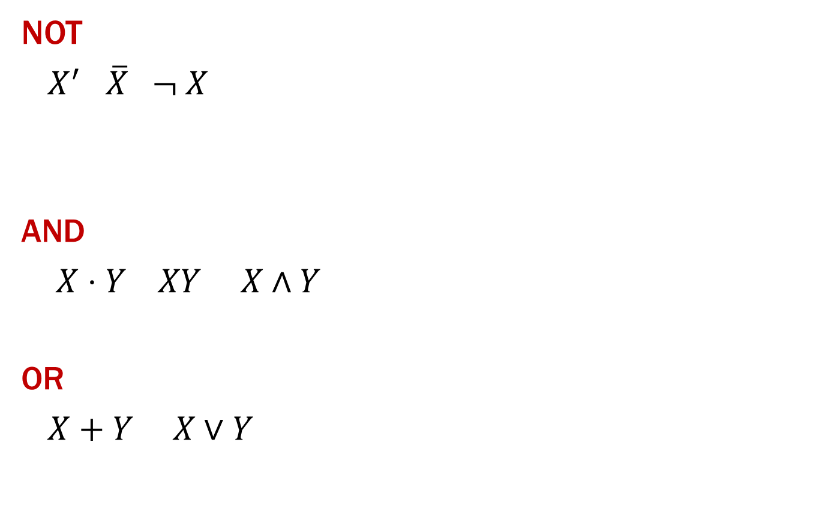
Gates Again!
X Y 0 1 1 0
X
Y
X Y Z 0 0 0 0 1 0 1 0 0
1 1 1
X
Y
Z
X Y Z 0 0 0 0 1 1 1 0 1
1 1 1
X
Y
Z

Slide 5
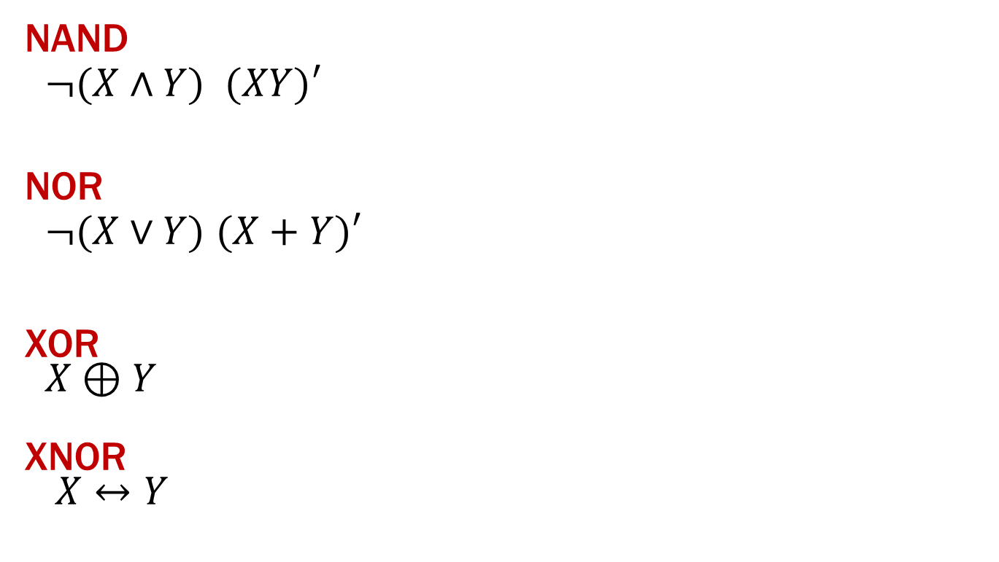
More Gates!
X Y Z 0 0 1 0 1 1 1 0 1
1 1 0
X
Y
Z
X Y Z 0 0 1 0 1 0 1 0 0
1 1 0
X
Z
Y
X Y Z 0 0 0 0 1 1 1 0 1
1 1 0
X
Y
Z
X Y Z 0 0 1 0 1 0 1 0 0
1 1 1
X
Y
Z

Slide 6
A 2-bit Ripple-Carry Adder
A
B
A₀
B₀
A₁
B₁
A₂
B₂
1-Bit Adder
0
C_{in}
C_{out}
C_{in}
C_{out}
C_{in}
C_{out}
C_{in}
C_{out}
Sum₀
Sum₁
Sum₂
Sum

Slide 7
Mapping Truth Tables to Logic Gates
A B C F
0 0 0 0
0 0 1 0
0 1 0 1
0 1 1 1
1 0 0 0
1 0 1 1
1 1 0 0
1 1 1 1
Given a truth table:
Write the Boolean expression
Minimize the Boolean expression
Draw as gates
Map to available gates
1
F = A’BC’+A’BC+AB’C+ABC
= A’B(C’+C)+AC(B’+B)
= A’B+AC
2
3
4

Slide 8
CSE 311: Foundations of Computing
Fall 2014
Lecture 5: Canonical Forms, Predicate Logic

Slide 9
Canonical Forms
Truth table is the unique signature of a Boolean function
The same truth table can have many gate realizations
we’ve seen this already
depends on how good we are at Boolean simplification
Canonical forms
standard forms for a Boolean expression
we all come up with the same expression

Slide 10
Sum-of-Products Canonical Form
also known as Disjunctive Normal Form (DNF)
also known as minterm expansion
F = 001 011 101 110 111
+ A’BC
+ AB’C
+ ABC’
F =
A’B’C
+ ABC
A B C F F’ 0 0 0 0 1
0 0 1 1 0
0 1 0 0 1
0 1 1 1 0
1 0 0 0 1
1 0 1 1 0
1 1 0 1 0
1 1 1 1 0
Notes:
F’ = A’B’C’ + A’BC’ + AB’C’

Slide 11
Sum-of-Products Canonical Form
Product term (or minterm)
ANDed product of literals – input combination for which output is true
each variable appears exactly once, true or inverted (but not both)
A B C minterms 0 0 0 A’B’C’
0 0 1 A’B’C
0 1 0 A’BC’
0 1 1 A’BC
1 0 0 AB’C’
1 0 1 AB’C
1 1 0 ABC’
1 1 1 ABC
F in canonical form: F(A, B, C) = A’B’C + A’BC + AB’C + ABC’ + ABC
canonical form ≠ minimal form F(A, B, C) = A’B’C + A’BC + AB’C + ABC + ABC’
= (A’B’ + A’B + AB’ + AB)C + ABC’
= ((A’ + A)(B’ + B))C + ABC’ = C + ABC’ = ABC’ + C
= AB + C

Slide 12
Product-of-Sums Canonical Form
Also known as Conjunctive Normal Form (CNF)
Also known as maxterm expansion
F = 000 010 100 F =
(A + B + C)
(A + B’ + C)
(A’ + B + C)
A B C F F’ 0 0 0 0 1
0 0 1 1 0
0 1 0 0 1
0 1 1 1 0
1 0 0 0 1
1 0 1 1 0
1 1 0 1 0
1 1 1 1 0
Notes:
F’ = (A + B + C’) (A + B’ + C’) (A’ + B + C’) (A’ + B’ + C) (A’ + B’ + C’)

Slide 13
s-o-p, p-o-s, and de Morgan’s theorem
Complement of function in sum-of-products form:
F’ = A’B’C’ + A’BC’ + AB’C’
Complement again and apply de Morgan’s and get the product-of-sums form:
(F’)’ = (A’B’C’ + A’BC’ + AB’C’)’
F = (A + B + C) (A + B’ + C) (A’ + B + C)

Slide 14
Product-of-Sums Canonical Form
Sum term (or maxterm)
ORed sum of literals – input combination for which output is false
each variable appears exactly once, true or inverted (but not both)
A B C maxterms 0 0 0 A+B+C
0 0 1 A+B+C’
0 1 0 A+B’+C
0 1 1 A+B’+C’
1 0 0 A’+B+C
1 0 1 A’+B+C’
1 1 0 A’+B’+C
1 1 1 A’+B’+C’
F in canonical form: F(A, B, C) = (A + B + C) (A + B’ + C) (A’ + B + C)
canonical form ≠ minimal form F(A, B, C) = (A + B + C) (A + B’ + C) (A’ + B + C)
= (A + B + C) (A + B’ + C)
(A + B + C) (A’ + B + C)
= (A + C) (B + C)

Slide 15
Predicate Logic
Propositional Logic
If the tortoise walks at a rate of one node per step, and the hare walks at a rate of two nodes per step, ...
Predicate Logic
If the tortoise is on node x, and the hare is on node 2x, then …
Prime(65353)

Slide 16
Predicate Logic
Propositional Logic
Allows us to analyze complex propositions in terms of their simpler constituent parts joined by connectives
Predicate Logic
Lets us analyze them at a deeper level…
Prime(65353)

Slide 17
Predicate Logic
Predicate or Propositional Function
A function that returns a truth value, e.g.,
“x is a cat”
“x is prime”
“student x has taken course y”
“x > y”
“x + y = z” or Sum(x, y, z)
“5 < x”
Predicates will have variables or constants as arguments.
Prime(65353)

Slide 18
Domain of Discourse
We must specify a “domain of discourse”, which is the possible things we’re talking about.
“x is a cat”
(e.g., mammals)
“x is prime”
(e.g., numbers)
student x has taken course y”
(e.g., students and courses)
Relate ∀ and ∃ to ∧ and ∨

Slide 19
Quantifiers
∀x P(x)
P(x) is true for every x in the domain
read as “for all x, P of x”
∃x P(x)
There is an x in the domain for which P(x) is true
read as “there exists x, P of x”
Relate ∀ and ∃ to ∧ and ∨

Slide 20
Statements with Quantifiers
∃x Even(x)
∀x Odd(x)
∀x (Even(x) ∨ Odd(x))
∃x (Even(x) ∧ Odd(x))
∀x Greater(x+1, x)
∃x (Even(x) ∧ Prime(x))
Domain:
Positive Integers
Even(x)
Odd(x)
Prime(x)
Greater(x,y)
(or “x>y”)
Equal(x,y)
(or “x=y”)
Sum(x,y,z)

Slide 21
Statements with Quantifiers
Domain:
Positive Integers
∀x ∃y Greater (y, x)
∀x ∃y Greater (x, y)
∀x ∃y (Greater(y, x) ∧ Prime(y))
∀x (Prime(x) → (Equal(x, 2) ∨ Odd(x))
∃x ∃y (Sum(x, 2, y) ∧ Prime(x) ∧ Prime(y))
Even(x)
Odd(x)
Prime(x)
Greater(x,y)
(or “x>y”)
Equal(x,y)
(or “x=y”)
Sum(x,y,z)

Slide 22
English to Predicate Logic
Cat(x)
Red(x)
LikesTofu(x)
“Red cats like tofu”
“Some red cats don’t like tofu”

Slide 23
Negations of Quantifiers
not every positive integer is prime
some positive integer is not prime
prime numbers do not exist
every positive integer is not prime

Slide 24
Negations of Quantifiers
Domain:
Fruit
∀x PurpleFruit(x)
“All fruits are purple”
¬∀x PurpleFruit(x)
“Not all fruits are purple”
How about ∃x PurpleFruit(x)?
“There is a purple fruit”
If it’s the negation, all situations should be covered by a statement and its negation
Consider the domain {Orange}: Neither statement is true!
How about ∃x ¬PurpleFruit(x)?
“There is a fruit that isn’t purple”
PurpleFruit(x)

Slide 25
De Morgan’s Laws for Quantifiers
¬∀x P(x) ≡ ∃x ¬P(x)
¬∃x P(x) ≡ ∀x ¬P(x)

Slide 26
de morgan’s laws for quantifiers
¬∀x P(x) ≡ ∃x ¬ P(x)
¬ ∃x P(x) ≡ ∀x ¬ P(x)
“There is no largest integer”
¬ ∃ x ∀ y ( x ≥ y)
∀ x ¬ ∀y ( x ≥ y)
∀ x ∃ y ¬ ( x ≥ y)
∀ x ∃ y (y > x)
“For every integer there is a larger integer”

Slide 27
scope of quantifiers
example: Notlargest(x) ≡ ∃ y Greater (y, x) ≡ ∃ z Greater (z, x)
truth value:
doesn’t depend on y or z “bound variables”
does depend on x “free variable”
quantifiers only act on free variables of the formula they quantify
∀ x (∃ y (P(x,y) → ∀ x Q(y, x)))

Slide 28
Scope of Quantifiers
∃x (P(x) ∧ Q(x)) vs. ∃x P(x) ∧ ∃x Q(x)

