Slide 1
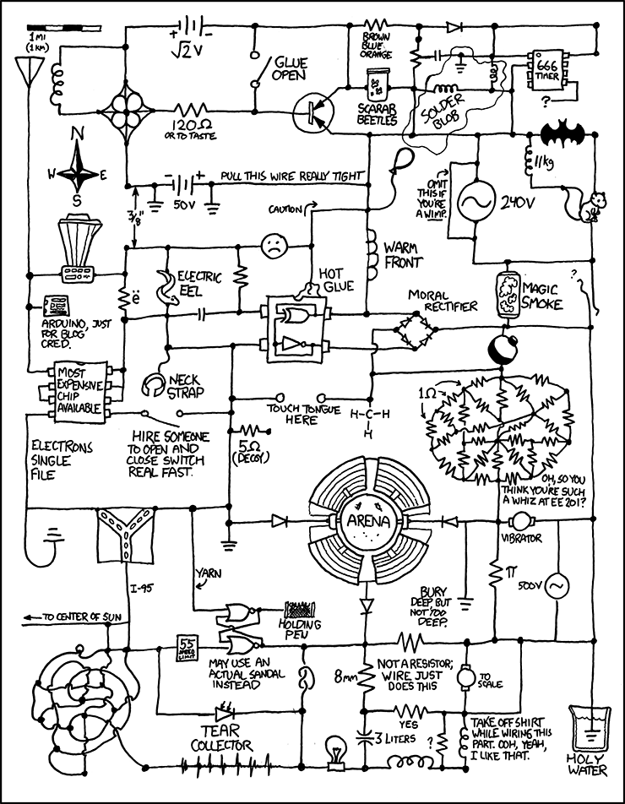

Slide 2
Administrivia
Homework 1 Due Today
Hand in at start of class
Homework 2 Available Online Later Today

Slide 3
A Combinational Logic Example
Sessions of Class:
We would like to compute the number of lectures or quiz sections remaining at the start of a given day of the week.
Inputs: Day of the Week, Lecture/Section flag
Output: Number of sessions left
Examples: Input: (Wednesday, Lecture) Output: 2
Input: (Monday, Section) Output: 1

Slide 4
Implementation in Software
public int classesLeftInMorning(weekday, lecture_flag) {
switch (day) {
case SUNDAY:
case MONDAY:
return lecture_flag ? 3 : 1;
case TUESDAY:
case WEDNESDAY:
return lecture_flag ? 2 : 1;
case THURSDAY:
return lecture_flag ? 1 : 1;
case FRIDAY:
return lecture_flag ? 1 : 0;
case SATURDAY:
return lecture_flag ? 0 : 0;
}
}

Slide 5
Implementation with Combinational Logic
Encoding:
How many bits for each input/output?
Binary number for weekday
One bit for each possible output
Weekday
Lecture?
0
1
2
3

Slide 6
Defining Our Inputs!
public int classesLeftInMorning(weekday, lecture_flag) {
switch (day) {
case SUNDAY:
case MONDAY:
return lecture_flag ? 3 : 1;
case TUESDAY:
case WEDNESDAY:
return lecture_flag ? 2 : 1;
case THURSDAY:
return lecture_flag ? 1 : 1;
case FRIDAY:
return lecture_flag ? 1 : 0;
case SATURDAY:
return lecture_flag ? 0 : 0;
}
}
Weekday | Number | Binary
Sunday | 0 | (000)₂
Monday | 1 | (001)₂
Tuesday | 2 | (010)₂
Wednesday | 3 | (011)₂
Thursday | 4 | (100)₂
Friday | 5 | (101)₂
Saturday | 6 | (110)₂

Slide 7
Converting to a Truth Table!
Weekday | Number | Binary
Sunday | 0 | (000)₂
Monday | 1 | (001)₂
Tuesday | 2 | (010)₂
Wednesday | 3 | (011)₂
Thursday | 4 | (100)₂
Friday | 5 | (101)₂
Saturday | 6 | (110)₂
Weekday | Lecture? | c0 | c1 | c2 | c3
000 | 0 | 0 | 1 | 0 | 0
000 | 1 | 0 | 0 | 0 | 1
001 | 0 | 0 | 1 | 0 | 0
001 | 1 | 0 | 0 | 0 | 1
010 | 0 | 0 | 1 | 0 | 0
010 | 1 | 0 | 0 | 1 | 0
011 | 0 | 0 | 1 | 0 | 0
011 | 1 | 0 | 0 | 1 | 0
100 | - | 0 | 1 | 0 | 0
101 | 0 | 1 | 0 | 0 | 0
101 | 1 | 0 | 1 | 0 | 0
110 | - | 1 | 0 | 0 | 0
111 | - | - | - | - | -

Slide 8
Truth Table to Logic (Part 1)
DAY | d2 d1 d0 | L | c0 | c1 | c2 | c3
SunS | 000 | 0 | 0 | 1 | 0 | 0
SunL | 000 | 1 | 0 | 0 | 0 | 1
MonS | 001 | 0 | 0 | 1 | 0 | 0
MonL | 001 | 1 | 0 | 0 | 0 | 1
TueS | 010 | 0 | 0 | 1 | 0 | 0
TueL | 010 | 1 | 0 | 0 | 1 | 0
WedS | 011 | 0 | 0 | 1 | 0 | 0
WedL | 011 | 1 | 0 | 0 | 1 | 0
Thu | 100 | - | 0 | 1 | 0 | 0
FriS | 101 | 0 | 1 | 0 | 0 | 0
FriL | 101 | 1 | 0 | 1 | 0 | 0
Sat | 110 | - | 1 | 0 | 0 | 0
- | 111 | - | - | - | - | -
c3 = (DAY == SUN and LEC) or (DAY == MON and LEC)
c3 = (d2 == 0 && d1 == 0 && d0 == 0 && L == 1) ||
(d2 == 0 && d1 == 0 && d0 == 1 && L == 1)
c3 = d2’•d1’•d0’•L + d2’•d1’•d0•L

Slide 9
Truth Table to Logic (Part 2)
DAY | d2 d1 d0 | L | c0 | c1 | c2 | c3
SunS | 000 | 0 | 0 | 1 | 0 | 0
SunL | 000 | 1 | 0 | 0 | 0 | 1
MonS | 001 | 0 | 0 | 1 | 0 | 0
MonL | 001 | 1 | 0 | 0 | 0 | 1
TueS | 010 | 0 | 0 | 1 | 0 | 0
TueL | 010 | 1 | 0 | 0 | 1 | 0
WedS | 011 | 0 | 0 | 1 | 0 | 0
WedL | 011 | 1 | 0 | 0 | 1 | 0
Thu | 100 | - | 0 | 1 | 0 | 0
FriS | 101 | 0 | 1 | 0 | 0 | 0
FriL | 101 | 1 | 0 | 1 | 0 | 0
Sat | 110 | - | 1 | 0 | 0 | 0
- | 111 | - | - | - | - | -
c3 = d2’•d1’•d0’•L + d2’•d1’•d0•L
c2 = (DAY == TUE and LEC) or
(DAY == WED and LEC)
c2 = d2’•d1•d0’•L + d2’•d1•d0•L

Slide 10
Truth Table to Logic (Part 3)
DAY | d2 d1 d0 | L | c0 | c1 | c2 | c3
SunS | 000 | 0 | 0 | 1 | 0 | 0
SunL | 000 | 1 | 0 | 0 | 0 | 1
MonS | 001 | 0 | 0 | 1 | 0 | 0
MonL | 001 | 1 | 0 | 0 | 0 | 1
TueS | 010 | 0 | 0 | 1 | 0 | 0
TueL | 010 | 1 | 0 | 0 | 1 | 0
WedS | 011 | 0 | 0 | 1 | 0 | 0
WedL | 011 | 1 | 0 | 0 | 1 | 0
Thu | 100 | - | 0 | 1 | 0 | 0
FriS | 101 | 0 | 1 | 0 | 0 | 0
FriL | 101 | 1 | 0 | 1 | 0 | 0
Sat | 110 | - | 1 | 0 | 0 | 0
- | 111 | - | - | - | - | -
c3 = d2’•d1’•d0’•L + d2’•d1’•d0•L
c2 = d2’•d1 •d0’•L + d2’•d1 •d0•L
c1 = On your homework for next week!
c0 = d2•d1’• d0 •L’ + d2•d1 •d0’

Slide 11
Logic to Gates
DAY | d2 d1 d0 | L | c0 | c1 | c2 | c3
SunS | 000 | 0 | 0 | 1 | 0 | 0
SunL | 000 | 1 | 0 | 0 | 0 | 1
MonS | 001 | 0 | 0 | 1 | 0 | 0
MonL | 001 | 1 | 0 | 0 | 0 | 1
TueS | 010 | 0 | 0 | 1 | 0 | 0
TueL | 010 | 1 | 0 | 0 | 1 | 0
WedS | 011 | 0 | 0 | 1 | 0 | 0
WedL | 011 | 1 | 0 | 0 | 1 | 0
Thu | 100 | - | 0 | 1 | 0 | 0
FriS | 101 | 0 | 1 | 0 | 0 | 0
FriL | 101 | 1 | 0 | 1 | 0 | 0
Sat | 110 | - | 1 | 0 | 0 | 0
- | 111 | - | - | - | - | -
c3 = d2’•d1’•d0’•L + d2’•d1’•d0•L
d2
NOT
AND
d1
NOT
OR
d0
AND
NOT
L
Multi-input AND gates

Slide 12
CSE 311: Foundations of Computing
Fall 2014
Lecture 4: Boolean Algebra and Circuits

Slide 13
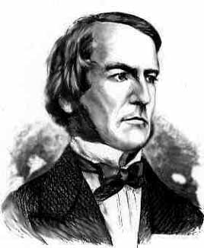
Boolean Algebra
Boolean algebra to circuit design
Boolean algebra
a set of elements B containing {0, 1}
binary operations { + , • }
and a unary operation { ’ }
such that the following axioms hold:
1. the set B contains at least two elements: 0, 1
For any a, b, c in B: 2. closure: a + b is in B a • b is in B 3. commutativity: a + b = b + a a • b = b • a 4. associativity: a + (b + c) = (a + b) + c a • (b • c) = (a • b) • c 5. identity: a + 0 = a a • 1 = a 6. distributivity: a + (b • c) = (a + b) • (a + c) a • (b + c) = (a • b) + (a • c) 7. complementarity: a + a’ = 1 a • a’ = 0

Slide 14
Axioms and Theorems of Boolean Algebra
identity: 1. X + 0 = X 1D. X • 1 = X
null: 2. X + 1 = 1 2D. X • 0 = 0
idempotency: 3. X + X = X 3D. X • X = X
involution: 4. (X’)’ = X
complementarity: 5. X + X’ = 1 5D. X • X’ = 0
commutatively: 6. X + Y = Y + X 6D. X • Y = Y • X
associativity: 7. (X + Y) + Z = X + (Y + Z) 7D. (X • Y) • Z = X • (Y • Z)
distributivity: 8. X • (Y + Z) = (X • Y) + (X • Z) 8D. X + (Y • Z) = (X + Y) • (X + Z)

Slide 15
Axioms and Theorems of Boolean Algebra
uniting: 9. X • Y + X • Y’ = X 9D. (X + Y) • (X + Y’) = X
absorption: 10. X + X • Y = X 10D. X • (X + Y) = X 11. (X + Y’) • Y = X • Y 11D. (X • Y’) + Y = X + Y
factoring: 12. (X + Y) • (X’ + Z) = 12D. X • Y + X’ • Z = X • Z + X’ • Y (X + Z) • (X’ + Y)
consensus: 13. (X • Y) + (Y • Z) + (X’ • Z) = 13D. (X + Y) • (Y + Z) • (X’ + Z) = X • Y + X’ • Z (X + Y) • (X’ + Z)
de Morgan’s: 14. (X + Y + ...)’ = X’ • Y’ • ... 14D. (X • Y • ...)’ = X’ + Y’ + ...

Slide 16
Proving Theorems (Rewriting)
Using the laws of Boolean Algebra:
prove the theorem: X • Y + X • Y’ = X prove the theorem: X + X • Y = X
distributivity (8)
complementarity (5)
identity (1D)
X • Y + X • Y’ = X • (Y + Y’)
= X • (1)
= X
identity (1D)
distributivity (8)
uniting (2)
identity (1D)
X + X • Y = X • 1 + X • Y
= X • (1 + Y)
= X • (1)
= X

Slide 17
Proving Theorems (Truth Table)
Using complete truth table:
For example, de Morgan’s Law:
X Y X’ Y’ (X + Y)’ X’ • Y’
(X + Y)’ = X’ • Y’ NOR is equivalent to AND with inputs complemented
0 0 1 1 0 1 1 0
1 0 0 1
1 1 0 0
(X • Y)’ = X’ + Y’ NAND is equivalent to OR with inputs complemented
X Y X’ Y’ (X • Y)’ X’ + Y’
0 0 1 1
0 1 1 0 1 0 0 1
1 1 0 0

Slide 18
Simplifying using Boolean algebra
c3 = d2’•d1’•d0’•L + d2’•d1’•d0•L
= d2’•d1’•(d0’ + d0)•L
= d2’•d1’•(1)•L
= d2’•d1’•L
d2
NOT
AND
d1
NOT
L

Slide 19
1-bit Binary Adder
Cout
Cin
Inputs: A, B, Carry-in
Outputs: Sum, Carry-out
A A A A A
B B B B B
S S S S S
A B Cin Cout S
0 0 0 0 0 1
0 1 0
0 1 1
1 0 0 1 0 1
1 1 0
1 1 1
0
0
0
1
0
1
1
1
0
1
1
0
1
0
0
1
A
S
B
Cout
Cin
S = A’ B’ Cin + A’ B Cin’ + A B’ Cin’ + A B Cin
Cout = A’ B Cin + A B’ Cin + A B Cin’ + A B Cin

Slide 20
Apply Theorems to Simplify Expressions
The theorems of Boolean algebra can simplify expressions
e.g., full adder’s carry-out function
Cout = A’ B Cin + A B’ Cin + A B Cin’ + A B Cin
= A’ B Cin + A B’ Cin + A B Cin’ + A B Cin + A B Cin
= A’ B Cin + A B Cin + A B’ Cin + A B Cin’ + A B Cin
= (A’ + A) B Cin + A B’ Cin + A B Cin’ + A B Cin
= (1) B Cin + A B’ Cin + A B Cin’ + A B Cin
= B Cin + A B’ Cin + A B Cin’ + A B Cin + A B Cin
= B Cin + A B’ Cin + A B Cin + A B Cin’ + A B Cin
= B Cin + A (B’ + B) Cin + A B Cin’ + A B Cin
= B Cin + A (1) Cin + A B Cin’ + A B Cin
= B Cin + A Cin + A B (Cin’ + Cin)
= B Cin + A Cin + A B (1)
= B Cin + A Cin + A B
adding extra terms creates new factoring opportunities

Slide 21

Gates Again!
NOT
$X^{′} \overline{X} ¬ X$
AND
$X⋅Y XY X∧Y$
OR
$X+Y X∨Y$
X Y 0 1 1 0
X
Y
X Y Z 0 0 0 0 1 0 1 0 0
1 1 1
X
Y
Z
X Y Z 0 0 0 0 1 1 1 0 1
1 1 1
X
Y
Z

Slide 22

More Gates!
X Y Z 0 0 1 0 1 1 1 0 1
1 1 0
X
Z
NAND
$¬(X∧Y)$ $(XY)′$ NOR
$¬(X∨Y)$ $(X+Y)′$
XOR $X⊕Y$
XNOR $X↔Y$
Y
X Y Z 0 0 1 0 1 0 1 0 0
1 1 0
X
Z
Y
X Y Z 0 0 0 0 1 1 1 0 1
1 1 0
X
Y
Z
X Y Z 0 0 1 0 1 0 1 0 0
1 1 1
X
Y
Z

Slide 23
A 2-bit Ripple-Carry Adder
A
B
A₀
B₀
A₁
B₁
A₂
B₂
1-Bit Adder
0
C_{in}
C_{out}
C_{in}
C_{out}
C_{in}
C_{out}
C_{in}
C_{out}
Sum₀
Sum₁
Sum₂
Sum

Slide 24
Mapping Truth Tables to Logic Gates
A B C F
0 0 0 0
0 0 1 0
0 1 0 1
0 1 1 1
1 0 0 0
1 0 1 1
1 1 0 0
1 1 1 1
Given a truth table:
Write the Boolean expression
Minimize the Boolean expression
Draw as gates
Map to available gates
1
F = A’BC’+A’BC+AB’C+ABC
= A’B(C’+C)+AC(B’+B)
= A’B+AC
2
3
4

Slide 25
Canonical Forms
Truth table is the unique signature of a Boolean function
The same truth table can have many gate realizations
we’ve seen this already
depends on how good we are at Boolean simplification
Canonical forms
standard forms for a Boolean expression
we all come up with the same expression

Slide 26
Sum-of-Products Canonical Form
also known as Disjunctive Normal Form (DNF)
also known as minterm expansion
F = 001 011 101 110 111
+ A’BC
+ AB’C
+ ABC’
F =
A’B’C
+ ABC
A B C F F’ 0 0 0 0 1
0 0 1 1 0
0 1 0 0 1
0 1 1 1 0
1 0 0 0 1
1 0 1 1 0
1 1 0 1 0
1 1 1 1 0
Notes:
F’ = A’B’C’ + A’BC’ + AB’C’

Slide 27
Sum-of-Products Canonical Form
Product term (or minterm)
ANDed product of literals – input combination for which output is true
each variable appears exactly once, true or inverted (but not both)
A B C minterms 0 0 0 A’B’C’
0 0 1 A’B’C
0 1 0 A’BC’
0 1 1 A’BC
1 0 0 AB’C’
1 0 1 AB’C
1 1 0 ABC’
1 1 1 ABC
F in canonical form: F(A, B, C) = A’B’C + A’BC + AB’C + ABC’ + ABC
canonical form ≠ minimal form F(A, B, C) = A’B’C + A’BC + AB’C + ABC + ABC’
= (A’B’ + A’B + AB’ + AB)C + ABC’
= ((A’ + A)(B’ + B))C + ABC’ = C + ABC’ = ABC’ + C
= AB + C

Slide 28
Product-of-Sums Canonical Form
Also known as Conjunctive Normal Form (CNF)
Also known as maxterm expansion
F = 000 010 100 F =
(A + B + C)
(A + B’ + C)
(A’ + B + C)
A B C F F’ 0 0 0 0 1
0 0 1 1 0
0 1 0 0 1
0 1 1 1 0
1 0 0 0 1
1 0 1 1 0
1 1 0 1 0
1 1 1 1 0
Notes:
F’ = (A + B + C’) (A + B’ + C’) (A’ + B + C’) (A’ + B’ + C) (A’ + B’ + C’)

Slide 29
s-o-p, p-o-s, and de Morgan’s theorem
Complement of function in sum-of-products form:
F’ = A’B’C’ + A’BC’ + AB’C’
Complement again and apply de Morgan’s and get the product-of-sums form:
(F’)’ = (A’B’C’ + A’BC’ + AB’C’)’
F = (A + B + C) (A + B’ + C) (A’ + B + C)

Slide 30
Product-of-Sums Canonical Form
Sum term (or maxterm)
ORed sum of literals – input combination for which output is false
each variable appears exactly once, true or inverted (but not both)
A B C maxterms 0 0 0 A+B+C
0 0 1 A+B+C’
0 1 0 A+B’+C
0 1 1 A+B’+C’
1 0 0 A’+B+C
1 0 1 A’+B+C’
1 1 0 A’+B’+C
1 1 1 A’+B’+C’
F in canonical form: F(A, B, C) = (A + B + C) (A + B’ + C) (A’ + B + C)
canonical form ≠ minimal form F(A, B, C) = (A + B + C) (A + B’ + C) (A’ + B + C)
= (A + B + C) (A + B’ + C)
(A + B + C) (A’ + B + C)
= (A + C) (B + C)

