Slide 1
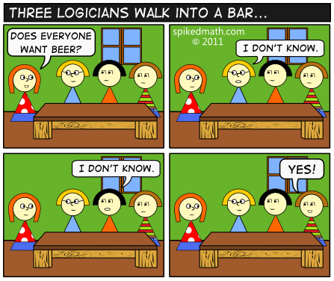
Foundations of Computing I
Fall 2014

Slide 2

More Gates!
X Y Z 0 0 1 0 1 1 1 0 1
1 1 0
X
Z
NAND
$¬(X∧Y)$ NOR
$¬(X∨Y)$
XOR $X⊕Y$
XNOR $X↔Y, X=Y$
Y
X Y Z 0 0 1 0 1 0 1 0 0
1 1 0
X
Z
Y
X Y Z 0 0 0 0 1 1 1 0 1
1 1 0
X
Y
Z
X Y Z 0 0 1 0 1 0 1 0 0
1 1 1
X
Y
Z

Slide 3
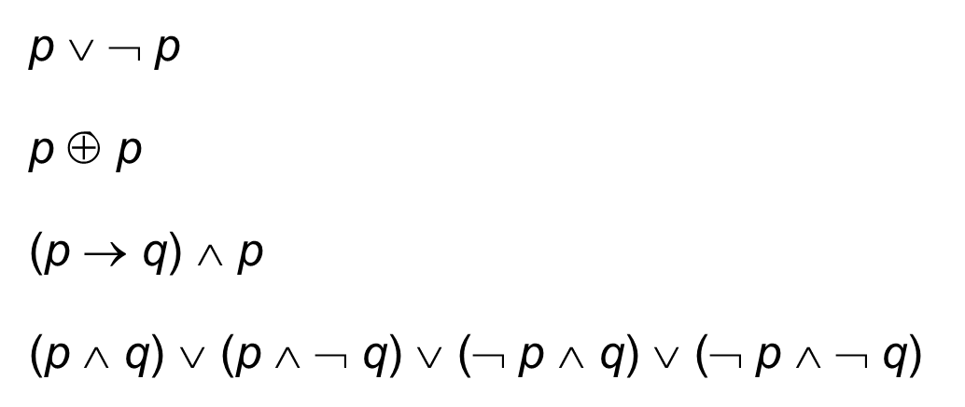
Review: Logical Equivalence
Terminology: A compound proposition is a…
Tautology if it is always true
Contradiction if it is always false
Contingency if it can be either true or false
p ∨ ¬ p
p ⊕ p
(p → q) ∧ p
(p ∧ q) ∨ (p ∧ ¬ q) ∨ (¬ p ∧ q) ∨ (¬ p ∧ ¬ q)
Tautology!
Contradiction!
Contingency (note: in morning lecture the and was an or)!
Tautology!

Slide 4
Review: Logical Equivalence
A and B are logically equivalent if and only if
A ↔ B is a tautology
i.e. A and B have the same truth table
The notation A ≡ B denotes A and B are
logically equivalent
Example: p ≡ ¬¬p
p | ¬p | ¬¬p | p ↔ ¬¬p
T | F | T | T
F | T | F | T

Slide 5
Review: De Morgan’s laws
¬ (p ∧ q) ≡ ¬ p ∨ ¬ q
¬ (p ∨ q) ≡ ¬ p ∧ ¬ q
if (!(front != null && value > front.data))
front = new ListNode(value, front);
else {
ListNode current = front;
while (current.next == null && current.next.data < value))
current = current.next;
current.next = new ListNode(value, current.next);
}
This code inserts value into a sorted linked list.
The first if runs when…front is null or value is smaller than the first item.
The while loop stops when…we’ve reached the end of the list or the next value is bigger.

Slide 6
Review: Law of Implication
(p → q) ≡ (¬ p ∨ q)
p | q | p → q | ¬ p | ¬ p ∨ q | (p → q) ↔ (¬ p ∨ q)
T | T | T | F | T | T
T | F | F | F | F | T
F | T | T | T | T | T
F | F | T | T | T | T

Slide 7
CSE 311: Foundations of Computing
Fall 2013
Lecture 3: Logic and Boolean algebra

Slide 8
Computing Equivalence
Describe an algorithm for computing if two logical expressions/circuits are equivalent.
What is the run time of the algorithm?
Compute the entire truth table for both of them!
There are 2^{n} entries in the column for n variables.

Slide 9
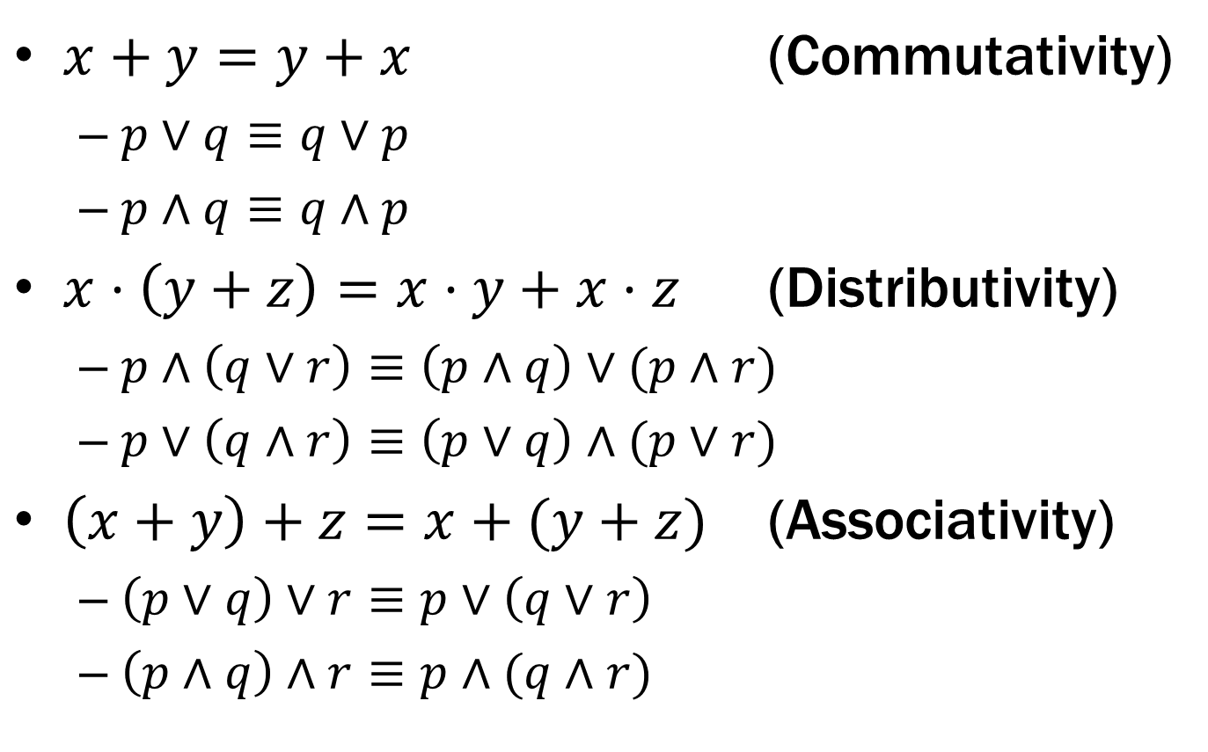

Some Familiar Properties of Arithmetic
$x+y=y+x$ (Commutativity)
$p∨q≡q∨p$
$p∧q≡q∧p$
$x⋅\left(y+z\right)=x⋅y+x⋅z$ (Distributivity)
$p∧\left(q∨r\right)≡\left(p∧q\right)∨(p∧r)$
$p∨\left(q∧r\right)≡\left(p∨q\right)∧(p∨r)$
$\left(x+y\right)+z=x+(y+z)$ (Associativity)
$\left(p∨q\right)∨r≡p∨\left(q∨r\right)$
$\left(p∧q\right)∧r≡p∧(q∧r)$

Slide 10
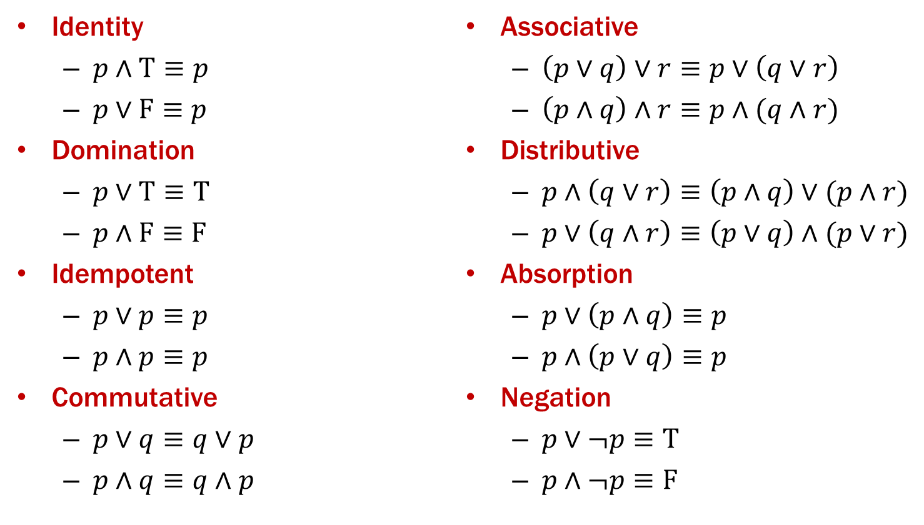
Properties of Logical Connectives
We will always give you this list!

Slide 11
Understanding Connectives
Reflect basic rules of reasoning and logic
Allow manipulation of logical formulas
Simplification
Testing for equivalence
Applications
Query optimization
Search optimization and caching
Artificial Intelligence
Program verification

Slide 12
Some Equivalences Related to Implication
p → q ≡ ¬ p ∨ q
p → q ≡ ¬ q → ¬ p
p ↔ q ≡ (p→ q) ∧ (q → p)
p ↔ q ≡ ¬ p ↔ ¬ q

Slide 13
Some Equivalences Related to Implication
p → q ≡ ¬ p ∨ q
p → q ≡ ¬ q → ¬ p
p ↔ q ≡ (p→ q) ∧ (q → p)
p ↔ q ≡ ¬ p ↔ ¬ q

Slide 14
Logical Proofs
To show P is equivalent to Q
Apply a series of logical equivalences to sub-expressions to convert P to Q
To show P is a tautology
Apply a series of logical equivalences to sub-expressions to convert P to T

Slide 15
Prove this is a Tautology
(p ∧ q) → (p ∨ q)

Slide 16
Prove this is a Tautology
(p ∧ (p → q)) → q

Slide 17
Prove these are not equivalent
(p → q) → r
p → (q → r)

Slide 18
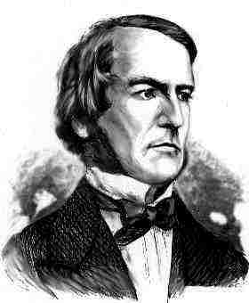
Boolean Logic
Combinational Logic
output = F(input)
Sequential Logic
output_{t} = F(output_{t-1}, input_{t})
output dependent on history
concept of a time step (clock, t)
Boolean Algebra consisting of…
a set of elements B = {0, 1}
binary operations { + , • } (OR, AND)
and a unary operation { ’ } (NOT )

Slide 19
A Combinational Logic Example
Sessions of Class:
We would like to compute the number of lectures or quiz sections remaining at the start of a given day of the week.
Inputs: Day of the Week, Lecture/Section flag
Output: Number of sessions left
Examples: Input: (Wednesday, Lecture) Output: 2
Input: (Monday, Section) Output: 1

Slide 20
Implementation in Software
public int classesLeft (weekday, lecture_flag) {
switch (day) {
case SUNDAY:
case MONDAY:
return lecture_flag ? 3 : 1;
case TUESDAY:
case WEDNESDAY:
return lecture_flag ? 2 : 1;
case THURSDAY:
return lecture_flag ? 1 : 1;
case FRIDAY:
return lecture_flag ? 1 : 0;
case SATURDAY:
return lecture_flag ? 0 : 0;
}
}

Slide 21
Implementation with Combinational Logic
Encoding:
How many bits for each input/output?
Binary number for weekday
One bit for each possible output
Weekday
Lecture?
0
1
2
3

Slide 22
Defining Our Inputs!
public int classesLeft (weekday, lecture_flag) {
switch (day) {
case SUNDAY:
case MONDAY:
return lecture_flag ? 3 : 1;
case TUESDAY:
case WEDNESDAY:
return lecture_flag ? 2 : 1;
case THURSDAY:
return lecture_flag ? 1 : 1;
case FRIDAY:
return lecture_flag ? 1 : 0;
case SATURDAY:
return lecture_flag ? 0 : 0;
}
}
Weekday | Number | Binary
Sunday | 0 | (000)₂
Monday | 1 | (001)₂
Tuesday | 2 | (010)₂
Wednesday | 3 | (011)₂
Thursday | 4 | (100)₂
Friday | 5 | (101)₂
Saturday | 6 | (110)₂

Slide 23
Converting to a Truth Table!
Weekday | Number | Binary
Sunday | 0 | (000)₂
Monday | 1 | (001)₂
Tuesday | 2 | (010)₂
Wednesday | 3 | (011)₂
Thursday | 4 | (100)₂
Friday | 5 | (101)₂
Saturday | 6 | (110)₂
Weekday | Lecture? | c0 | c1 | c2 | c3
000 | 0 | 0 | 1 | 0 | 0
000 | 1 | 0 | 0 | 0 | 1
001 | 0 | 0 | 1 | 0 | 0
001 | 1 | 0 | 0 | 0 | 1
010 | 0 | 0 | 1 | 0 | 0
010 | 1 | 0 | 0 | 1 | 0
011 | 0 | 0 | 1 | 0 | 0
011 | 1 | 0 | 0 | 1 | 0
100 | - | 0 | 1 | 0 | 0
101 | 0 | 1 | 0 | 0 | 0
101 | 1 | 0 | 1 | 0 | 0
110 | - | 1 | 0 | 0 | 0
111 | - | - | - | - | -

Slide 24
Truth Table to Logic (Part 1)
DAY | d2d1d0 | L | c0 | c1 | c2 | c3
SunS | 000 | 0 | 0 | 1 | 0 | 0
SunL | 000 | 1 | 0 | 0 | 0 | 1
MonS | 001 | 0 | 0 | 1 | 0 | 0
MonL | 001 | 1 | 0 | 0 | 0 | 1
TueS | 010 | 0 | 0 | 1 | 0 | 0
TueL | 010 | 1 | 0 | 0 | 1 | 0
WedS | 011 | 0 | 0 | 1 | 0 | 0
WedL | 011 | 1 | 0 | 0 | 1 | 0
Thu | 100 | - | 0 | 1 | 0 | 0
FriS | 101 | 0 | 1 | 0 | 0 | 0
FriL | 101 | 1 | 0 | 1 | 0 | 0
Sat | 110 | - | 1 | 0 | 0 | 0
- | 111 | - | - | - | - | -
c3 = (DAY == SUN and LEC) or (DAY == MON and LEC)
c3 = (d2 == 0 && d1 == 0 && d0 == 0 && L == 1) ||
(d2 == 0 && d1 == 0 && d0 == 1 && L == 1)
c3 = d2’•d1’•d0’•L + d2’•d1’•d0•L

Slide 25
Truth Table to Logic (Part 2)
DAY | d2d1d0 | L | c0 | c1 | c2 | c3
SunS | 000 | 0 | 0 | 1 | 0 | 0
SunL | 000 | 1 | 0 | 0 | 0 | 1
MonS | 001 | 0 | 0 | 1 | 0 | 0
MonL | 001 | 1 | 0 | 0 | 0 | 1
TueS | 010 | 0 | 0 | 1 | 0 | 0
TueL | 010 | 1 | 0 | 0 | 1 | 0
WedS | 011 | 0 | 0 | 1 | 0 | 0
WedL | 011 | 1 | 0 | 0 | 1 | 0
Thu | 100 | - | 0 | 1 | 0 | 0
FriS | 101 | 0 | 1 | 0 | 0 | 0
FriL | 101 | 1 | 0 | 1 | 0 | 0
Sat | 110 | - | 1 | 0 | 0 | 0
- | 111 | - | - | - | - | -
c3 = d2’•d1’•d0’•L + d2’•d1’•d0•L
c2 = (DAY == TUE and LEC) or
(DAY == WED and LEC)
c2 = d2’•d1•d0’•L + d2’•d1•d0•L

Slide 26
Truth Table to Logic (Part 3)
DAY | d2d1d0 | L | c0 | c1 | c2 | c3
SunS | 000 | 0 | 0 | 1 | 0 | 0
SunL | 000 | 1 | 0 | 0 | 0 | 1
MonS | 001 | 0 | 0 | 1 | 0 | 0
MonL | 001 | 1 | 0 | 0 | 0 | 1
TueS | 010 | 0 | 0 | 1 | 0 | 0
TueL | 010 | 1 | 0 | 0 | 1 | 0
WedS | 011 | 0 | 0 | 1 | 0 | 0
WedL | 011 | 1 | 0 | 0 | 1 | 0
Thu | 100 | - | 0 | 1 | 0 | 0
FriS | 101 | 0 | 1 | 0 | 0 | 0
FriL | 101 | 1 | 0 | 1 | 0 | 0
Sat | 110 | - | 1 | 0 | 0 | 0
- | 111 | - | - | - | - | -
c3 = d2’•d1’•d0’•L + d2’•d1’•d0•L
c2 = d2’•d1 •d0’•L + d2’•d1 •d0•L
c1 = On your homework for next week!
c0 = d2•d1’• d0 •L’ + d2•d1 •d0’

Slide 27
Logic to Gates
DAY | d2d1d0 | L | c0 | c1 | c2 | c3
SunS | 000 | 0 | 0 | 1 | 0 | 0
SunL | 000 | 1 | 0 | 0 | 0 | 1
MonS | 001 | 0 | 0 | 1 | 0 | 0
MonL | 001 | 1 | 0 | 0 | 0 | 1
TueS | 010 | 0 | 0 | 1 | 0 | 0
TueL | 010 | 1 | 0 | 0 | 1 | 0
WedS | 011 | 0 | 0 | 1 | 0 | 0
WedL | 011 | 1 | 0 | 0 | 1 | 0
Thu | 100 | - | 0 | 1 | 0 | 0
FriS | 101 | 0 | 1 | 0 | 0 | 0
FriL | 101 | 1 | 0 | 1 | 0 | 0
Sat | 110 | - | 1 | 0 | 0 | 0
- | 111 | - | - | - | - | -
c3 = d2’•d1’•d0’•L + d2’•d1’•d0•L
d2
NOT
AND
d1
NOT
OR
d0
AND
NOT
L
Multi-input AND gates

Slide 28
Combinational Logic
Switches
Basic logic and truth tables
Logic functions
Boolean algebra
Proofs by re-writing and by truth table

