Slide 1
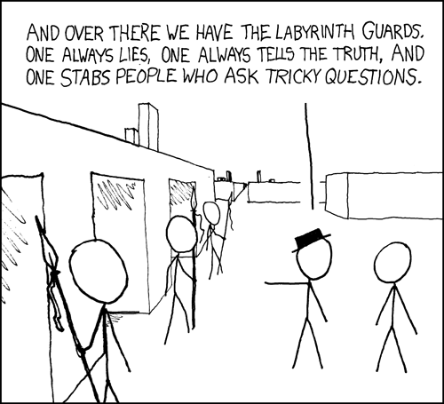

Slide 2
Administrivia
Course Web: http://www.cs.washington.edu/311
Office Hours: 10 hours available; check web
Homework #1: Posted. Turn in (stapled) at the
start of class on Wednesday (Oct 1)
Extra Credit: Not required to get a 4.0.
Counts separately.
In total, may raise grade by ~0.1

Slide 3
Last Time: Logical Connectives
p | q | p ∧ q
T | T | T
T | F | F
F | T | F
F | F | F
p | ¬ p
T | F
F | T
NOT
AND
p | q | p ∨ q
T | T | T
T | F | T
F | T | T
F | F | F
p | q | p ⊕ q
T | T | F
T | F | T
F | T | T
F | F | F
OR
XOR

Slide 4
Last Time: $p→q$
p | q | p → q
F | F | T
F | T | T
T | F | F
T | T | T
“If p, then q” is a promise:
Whenever p is true, then q is true
Ask “has the promise been broken”

Slide 5
Last Time: $p→q$
p | q | p → q
F | F | T
F | T | T
T | F | F
T | T | T
“If p, then q” is a promise:
Whenever p is true, then q is true
Ask “has the promise been broken”
If it’s raining, then I have my umbrella.

Slide 6
Last Time: Related Implications
Implication: p → q
Converse: q → p
Contrapositive: ¬ q → ¬ p
Inverse: ¬ p → ¬ q
How do these relate to each other?

Slide 7
Last Time: $p↔q$
p iff q
p is equivalent to q
p implies q and q implies p
p | q | p ↔ q
T | T | T
T | F | F
F | T | F
F | F | T

Slide 8
CSE 311: Foundations of Computing
Fall 2014
Lecture 2: Digital Circuits & More Logic

Slide 9
Digital Circuits
Computing With Logic
T corresponds to 1 or “high” voltage
F corresponds to 0 or “low” voltage
Gates
Take inputs and produce outputs (functions)
Several kinds of gates
Correspond to propositional connectives (most of them)

Slide 10
And Gate
AND Connective
vs.
AND Gate
p ∧ q
p
AND
OUT
q
p | q | p ∧ q
T | T | T
T | F | F
F | T | F
F | F | F
p | q | OUT
1 | 1 | 1
1 | 0 | 0
0 | 1 | 0
0 | 0 | 0
p
q
AND
OUT
“block looks like D of AND”

Slide 11
Or Gate
OR Connective
vs.
OR Gate
p ∨ q
p
OR
OUT
q
p | q | p ∨ q
T | T | T
T | F | T
F | T | T
F | F | F
p | q | OUT
1 | 1 | 1
1 | 0 | 1
0 | 1 | 1
0 | 0 | 0
p
OR
OUT
q
“arrowhead block looks like V”

Slide 12
Not Gates
NOT Connective
vs.
NOT Gate
¬ p
p
NOT
OUT
Also called
inverter
p | ¬ p
T | F
F | T
p | OUT
1 | 0
0 | 1
p
NOT
OUT

Slide 13
Blobs are Okay!
You may write gates using blobs instead of shapes!
p
q
AND
OUT
p
q
OR
OUT
p
NOT
OUT

Slide 14
Combinational Logic Circuits
NOT
AND
NOT
AND
OR
Values get sent along wires connecting gates

Slide 15
Combinational Logic Circuits
AND
NOT
OR
AND
Wires can send one value to multiple gates!

Slide 16
Logical Equivalence
Terminology: A compound proposition is a…
Tautology if it is always true
Contradiction if it is always false
Contingency if it can be either true or false
p ∨ ¬ p
p ⊕ p
(p → q) ∧ p
(p ∧ q) ∨ (p ∧ ¬ q) ∨ (¬ p ∧ q) ∨ (¬ p ∧ ¬ q)

Slide 17
Logical Equivalence
A and B are logically equivalent if and only if
A ↔ B is a tautology
i.e. A and B have the same truth table
The notation A ≡ B denotes A and B are
logically equivalent
Example: p ≡ ¬ ¬ p
p | ¬ p | ¬ ¬ p | p ↔ ¬ ¬ p

Slide 18
A ↔ B vs. A ≡ B
A ≡ B says that two propositions A and B always mean the same thing
A ↔ B is a single proposition that may be true or false depending on the truth values of the variables in A and B
but A ≡ B and (A ↔ B) ≡ T have the same meaning
Note: Why write A ≡ B and not A=B ?
We use A=B to say that A and B are precisely the same proposition (same sequence of symbols)

Slide 19
De Morgan’s laws
¬ (p ∧ q) ≡ ¬ p ∨ ¬ q
¬ (p ∨ q) ≡ ¬ p ∧ ¬ q
My code compiles or there is a bug.

Slide 20
De Morgan’s laws
Example: ¬ (p ∧ q) ≡ (¬ p ∨ ¬ q)
p | q | ¬ p | ¬ q | ¬ p ∨ ¬ q | p ∧ q | ¬ (p ∧ q) | ¬ (p ∧ q) ↔ (¬ p ∨ ¬ q)
T | T
T | F
F | T
F | F

Slide 21
De Morgan’s laws
¬ (p ∧ q) ≡ ¬ p ∨ ¬ q
¬ (p ∨ q) ≡ ¬ p ∧ ¬ q
if !(front != null && value > front.data)
front = new ListNode(value, front);
else {
ListNode current = front;
while !(current.next == null || current.next.data >= value)
current = current.next;
current.next = new ListNode(value, current.next);
}

Slide 22
Law of Implication
(p → q) ≡ (¬ p ∨ q)
p | q | p → q | ¬ p | ¬ p ∨ q | (p → q) ↔ (¬ p ∨ q)
T | T
T | F
F | T
F | F

Slide 23
Computing Equivalence
Describe an algorithm for computing if two logical expressions/circuits are equivalent.
What is the run time of the algorithm?

Slide 24

Some Familiar Properties of Arithmetic
$x+y=y+x$ (Commutativity)
$x⋅\left(y+z\right)=x⋅y+x⋅z$ (Distributivity)
$\left(x+y\right)+z=x+(y+z)$ (Associativity)
Logic has similar properties!

Slide 25
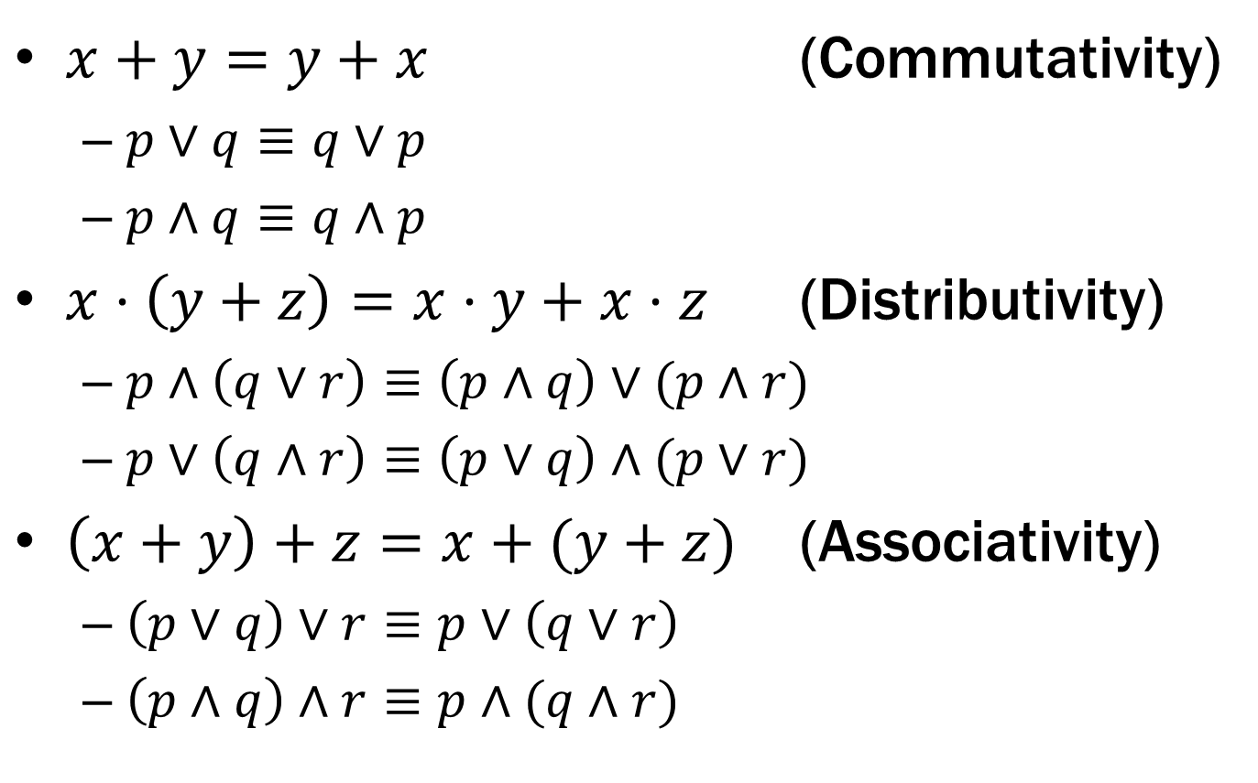
Some Familiar Properties of Arithmetic
$x+y=y+x$ (Commutativity)
$p∨q≡q∨p$
$p∧q≡q∧p$
$x⋅\left(y+z\right)=x⋅y+x⋅z$ (Distributivity)
$p∧\left(q∨r\right)≡\left(p∧q\right)∨(p∧r)$
$p∨\left(q∧r\right)≡\left(p∨q\right)∧(p∨r)$
$\left(x+y\right)+z=x+(y+z)$ (Associativity)
$\left(p∨q\right)∨r≡p∨\left(q∨r\right)$
$\left(p∧q\right)∧r≡p∧(q∧r)$

Slide 26
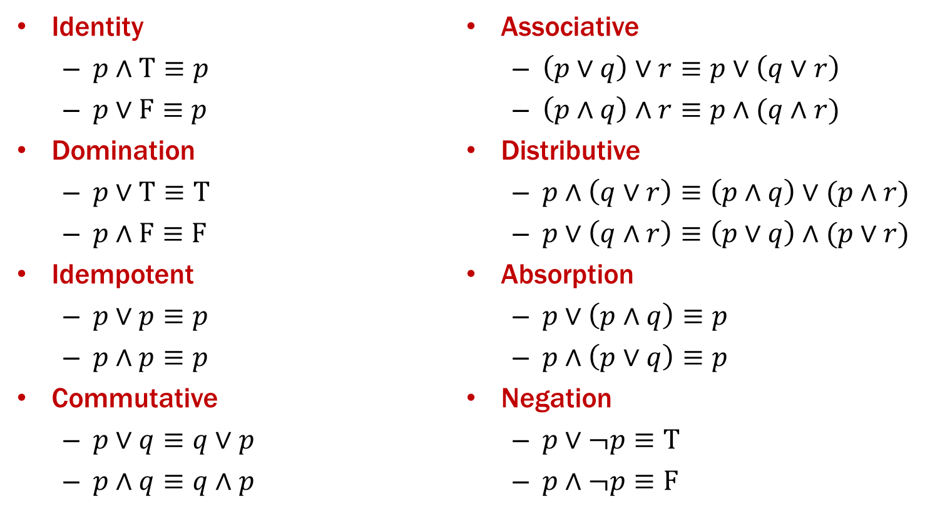
Properties of Logical Connectives
We will always give you this list!
Identity
$p∧\text{T}≡p$
$p∨\text{F}≡p$
Domination
$p∨\text{T}≡\text{T}$
$p∧\text{F}≡\text{F}$
Idempotent
$p∨p≡p$
$p∧p≡p$
Commutative
$p∨q≡q∨p$
$p∧q≡q∧p$
Associative
$\left(p∨q\right)∨r≡p∨\left(q∨r\right)$
$\left(p∧q\right)∧r≡p∧(q∧r)$
Distributive
$p∧\left(q∨r\right)≡\left(p∧q\right)∨(p∧r)$
$p∨\left(q∧r\right)≡\left(p∨q\right)∧(p∨r)$
Absorption
$p∨\left(p∧q\right)≡p$
$p∧\left(p∨q\right)≡p$
Negation
$p∨¬p≡\text{T}$
$p∧¬p≡\text{F}$

Slide 27
Some Equivalences Related to Implication
p → q ≡ ¬ p ∨ q
p → q ≡ ¬ q → ¬ p
p ↔ q ≡ (p→ q) ∧ (q → p)
p ↔ q ≡ ¬ p ↔ ¬ q

Slide 28
Understanding Connectives
Reflect basic rules of reasoning and logic
Allow manipulation of logical formulas
Simplification
Testing for equivalence
Applications
Query optimization
Search optimization and caching
Artificial Intelligence
Program verification

