Slide 1
Foundations of Computing I
CSE
311
Fall 2014

Slide 2
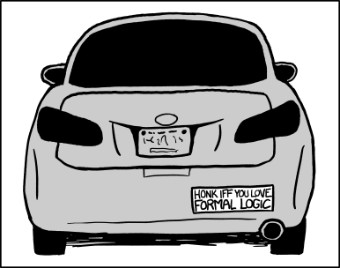
CSE 311: Foundations of Computing I
Fall 2014
Lecture 1: Propositional Logic

Slide 3
Some Perspective
Computer Science
and Engineering
Programming
Theory
CSE 14x
Hardware
CSE 311

Slide 4
About the Course
We will study the theory needed for CSE:
Logic:
How can we describe ideas precisely?
Formal Proofs:
How can we be positive we’re correct?
Number Theory:
How do we keep data secure?
Relations/Relational Algebra:
How do we store information?
Finite State Machines:
How do we design hardware and software?
Turing Machines:
Are there problems computers can’t solve?

Slide 5
About the Course
It’s about perspective!
Example: Sudoku
Given one, solve it by hand
Given most, solve them with a program
Given any, solve it with computer science
Tools for reasoning about difficult problems
Tools for communicating ideas, methods, objectives…
Fundamental structures for computer science

Slide 6
Administrivia
Instructors: Paul Beame and Adam Blank
Teaching assistants:
Antoine Bosselut Nickolas Evans
Akash Gupta Jeffrey Hon
Shawn Lee Elaine Levey
Evan McCarty Yueqi Sheng
Homework:
Due WED at start of class
Write up individually
Exams:
Midterm: Monday, November 3
Final: Monday, December 8
2:30-4:20 or 4:30-6:20
Non-standard time
Quiz Sections: Thursdays
(Optional) Book:
Rosen
Discrete Mathematics
6th or 7th edition
Can buy online for ~$50
Grading (roughly):
50% homework
35% final exam
15% midterm
All course information at http://www.cs.washington.edu/311

Slide 7
Logic: The Language of Reasoning
Why not use English?
Turn right here…
Buffalo buffalo Buffalo buffalo buffalo buffalo Buffalo buffalo
We saw her duck
“Language of Reasoning” like Java or English
Words, sentences, paragraphs, arguments…
Today is about words and sentences

Slide 8
Why Learn A New Language?
Logic, as the “language of reasoning”, will help us…
Be more precise
Be more concise
Figure out what a statement means more quickly

Slide 9
Propositions
A proposition is a statement that
has a truth value, and
is “well-formed”

Slide 10
A proposition is a statement that has a truth value, and is “well-formed”...
Consider these statements:
2 + 2 = 5
The home page renders correctly in IE.
This is the song that never ends…
Turn in your homework on Wednesday.
This statement is false.
Akjsdf?
The Washington State flag is red.
Every positive even integer can be
written as the sum of two primes.

Slide 11
Propositions
A proposition is a statement that
has a truth value, and
is “well-formed”
Propositional Variables: $p, q, r, s, …$
Truth Values: T for true, F for false

Slide 12
A Proposition
“Roger is an orange elephant who has toenails if he has tusks, and has toenails, tusks, or both.”
What does this proposition mean?
It seems to be built out of other, more basic propositions that are sitting inside it! What are they?

Slide 13
How are the basic propositions combined?
“Roger is an orange elephant who has toenails if he has tusks, and has toenails, tusks, or both.”
RElephant : “Roger is an orange elephant”
RTusks : “Roger has tusks”
RToenails : “Roger has toenails”

Slide 14
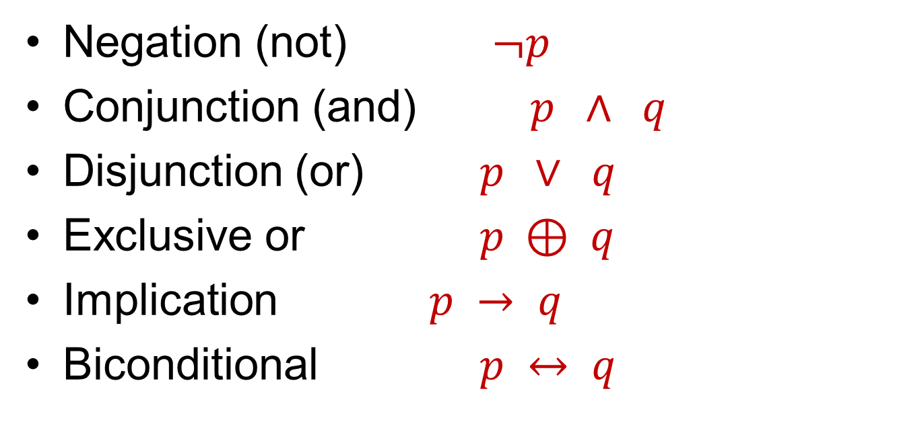
Logical Connectives
Negation (not) $¬p$
Conjunction (and) $p ∧ q$
Disjunction (or) $p ∨ q$
Exclusive or $p ⊕ q$
Implication $p → q$
Biconditional $p ↔ q$

Slide 15
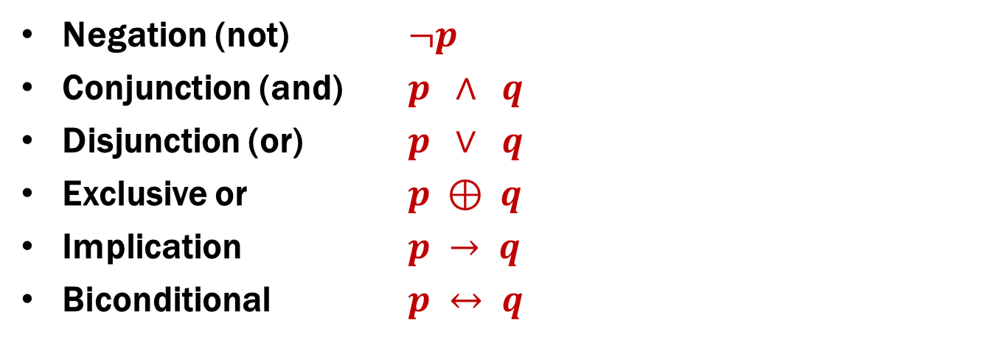
Logical Connectives
Negation (not) $¬p$
Conjunction (and) $p ∧ q$
Disjunction (or) $p ∨ q$
Exclusive or $p ⊕ q$
Implication $p → q$
Biconditional $p ↔ q$
“Roger is an orange elephant who has toenails if he has tusks, and has toenails, tusks, or both.”
RElephant and (RToenails if RTusks) and (RToenails or RTusks or (RToenails and RTusks))

Slide 16
Some Truth Tables
p | ¬p
p | q | p ∧ q
p | q | p ∨ q
p | q | p ⊕ q

Slide 17
$$p → q$$
p | q | p → q
“If p, then q” is a promise:
Whenever p is true, then q is true
Ask “has the promise been broken”
If it’s raining, then I have my umbrella
Suppose it’s not raining…

Slide 18
$$p → q$$
“I am a Pokémon master only if I have collected all 151 Pokémon”
Can we re-phrase this as if p, then q ?

Slide 19
$$p → q$$
p | q | p → q
Implication:
p implies q
whenever p is true q must be true
if p then q
q if p
p is sufficient for q
p only if q

Slide 20
Converse, Contrapositive, Inverse
Implication: p → q
Converse: q → p
Contrapositive: ¬q → ¬p
Inverse: ¬p → ¬q
How do these relate to each other?

Slide 21
Back to Roger’s Sentence
“Roger is an orange elephant who has toenails if he has tusks, and has toenails, tusks, or both.”
RElephant$∧$(RToenails if RTusks)$∧$(RToenails $∨$RTusks $∨$(RToenails $∧$RTusks))
Define shorthand …
p : RElephant
q : RTusks
r : RToenails

Slide 22
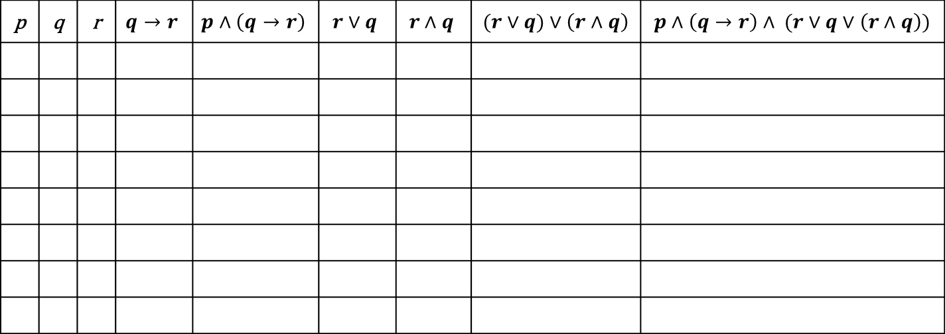
Roger’s Sentence with a Truth Table
p | q | r | $$q→r$$ | $$p∧\left(q→r\right)$$ | $$r∨q$$ | $$r∧q$$ | ($r∨q)∨\left(r∧q\right)$ | $p∧\left(q→r\right)∧ (r∨q∨\left(r∧q\right))$

Slide 23
More about Roger
Roger is only orange if whenever he either has tusks or toenails, he doesn't have tusks and he is an orange elephant.”
RElephant : “Roger is an orange elephant”
RTusks : “Roger has tusks”
RToenails : “Roger has toenails”

Slide 24
More about Roger
Roger is only orange if whenever he either has tusks or toenails, he doesn't have tusks and he is an orange elephant.”
(RElephant only if (whenever (RTusks xor RToenails) then not RTusks)) and RElephant
(RElephant → (whenever (RTusks ⊕ RToenails) then ¬ RTusks)) ∧ RElephant
p : RElephant
q : RTusks
r : RToenails

Slide 25
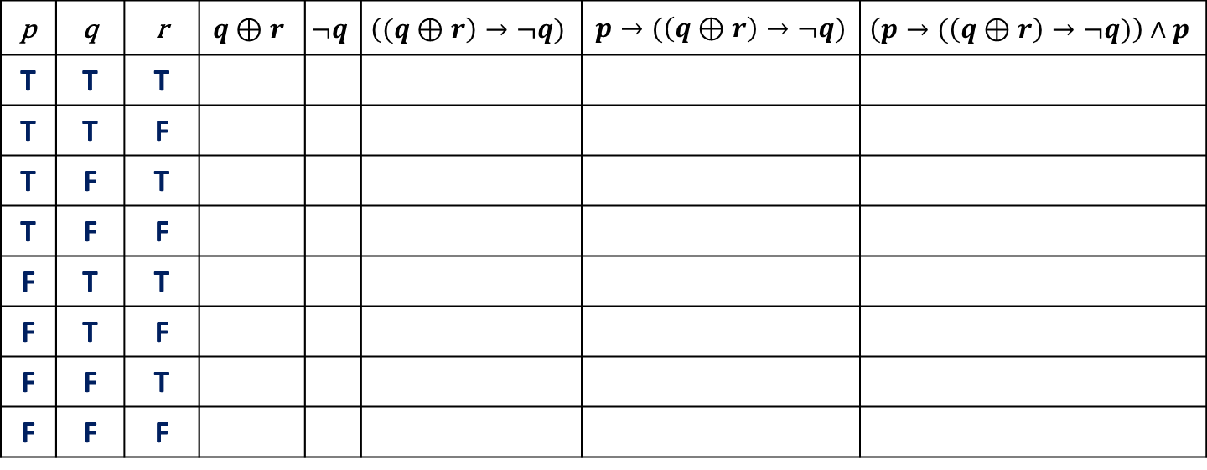
Roger’s Second Sentence with a Truth Table
p | q | r | $$q⊕r$$ | $$¬q$$ | $$\left((q⊕r\right)→¬q)$$ | $p→(\left(q⊕r\right)→¬q)$ | $$\left(p→(\left(q⊕r\right)→¬q)\right)∧p$$
T | T | T
T | T | F
T | F | T
T | F | F
F | T | T
F | T | F
F | F | T
F | F | F

Slide 26
Biconditional: $p ↔ q$
p iff q
p is equivalent to q
p implies q and q implies p
p | q | p ↔ q

