Slide 1
CSE 311 Foundations of Computing I
Lecture 28
Computability Review, Course Summary
Spring 2013

Slide 2
Announcements
Hand in Homework 8 now
Pick up all old homework now
Review session
Sunday, June 9, 4 pm, EEB 125
List of Final Exam Topics and sampling of some typical kinds of exam questions on the web
Bring your questions to the review session!
Final exam
Monday, June 10, 2:30-4:20 pm, MGH 389

Slide 3
What makes the Halting Problem and related problems hard?
Figuring out in some finite time something about what might happen in the infinite # of steps that a general computation might take
e.g. having H(<P>,x) output 0 when P doesn’t halt on x
The following program does exist and won’t generate any contradiction
Function V(x):
if U(x,x) halts then
while (true); /* loop forever */
else
no-op; /* do nothing and halt */
endif

Slide 4
The “Always Halting” problem
Suppose we had a TM A for the Always Halting problem
x
Convert
<Q>
A
1 if P(x) halts
0 if P(x) does not halt
<P>
…
a←x
…
…
Read(a)
…
We designed <Q> based on <P> and x so that:
<Q> always halts ⇔ <P> halts on input x
So.. if A exists then we get a program H for the
ordinary halting problem, which we know can’t exist so A
can’t exist

Slide 5
The “Always ERROR” problem
Suppose we had a TM E for the ERROR problem
Convert’
<R>
1 if Q always halts
0 if Q does not always halt
<Q>
E
Q’s code
…
end of Q
Q’s code
…
end of Q
Print ERROR
We designed <R> based on <Q> so that:
<R> always prints “ERROR” ⇔ <Q> always halts
So.. if E exists then we get a program A for the
Always Halts problem, which we know can’t exist so E
can’t exist

Slide 6
A general phenomenon: Can’t tell a book by its cover
Rice’s Theorem: In general there is no way to tell anything about the input/output (I/O) behavior of a program P just given its code <P>!

Slide 7
Quick lessons
Don’t rely on the idea of improved compilers and programming languages to eliminate major programming errors
truly safe languages can’t possibly do general computation
Document your code!!!!
there is no way you can expect someone else to figure out what your program does with just your code ....since....in general it is provably impossible to do this!

Slide 8
CSE 311 Foundations of Computing I
Spring 2013
Course Summary

Slide 9
About the course
From the CSE catalog:
CSE 311 Foundations of Computing I (4) Examines fundamentals of logic, set theory, induction, and algebraic structures with applications to computing; finite state machines; and limits of computability. Prerequisite: CSE 143; either MATH 126 or MATH 136.
What this course is about:
Foundational structures for the practice of computer science and engineering

Slide 10
Propositional Logic
Statements with truth values
The Washington State flag is red
It snowed in Whistler, BC on January 4, 2011.
Rick Perry won the Iowa straw poll
Space aliens landed in Roswell, New Mexico
If n is an integer greater than two, then the equation a^{n} + b^{n} = c^{n} has no solutions in non-zero integers a, b, and c.
Propositional variables: p, q, r, s, . . .
Truth values: T for true, F for false
Compound propositions
Negation (not) ¬ p
Conjunction (and) p ∧ q
Disjunction (or) p ∨ q
Exclusive or p ⊕ q
Implication p → q
Biconditional p ↔ q

Slide 11
English and Logic
You cannot ride the roller coaster if you are under 4 feet tall unless you are older than 16 years old
q: you can ride the roller coaster
r: you are under 4 feet tall
s: you are older than 16
( r ∧ ¬ s) → ¬ q

Slide 12
Logical equivalence
Terminology: A compound proposition is a
Tautology if it is always true
Contradiction if it is always false
Contingency if it can be either true or false
p ∨ ¬ p
p ⊕ p
(p → q) ∧ p
(p ∧ q) ∨ (p ∧ ¬ q) ∨ (¬ p ∧ q) ∨ (¬ p ∧ ¬ q)

Slide 13
Logical Equivalence
p and q are logically equivalent iff p ↔ q is a tautology
The notation p ≡ q denotes p and q are logically equivalent
De Morgan’s Laws:
¬ (p ∧ q) ≡ ¬ p ∨ ¬ q
¬ (p ∨ q) ≡ ¬ p ∧ ¬ q

Slide 14
Digital Circuits
Computing with logic
T corresponds to 1 or “high” voltage
F corresponds to 0 or “low” voltage
Gates
Take inputs and produce outputs
Functions
Several kinds of gates
Correspond to propositional connectives
Only symmetric ones (order of inputs irrelevant)

Slide 15
Combinational Logic Circuits
AND
OR
AND
Wires can send one value to multiple gates

Slide 16
A simple example: 1-bit binary adder
Cout
Cin
Inputs: A, B, Carry-in
Outputs: Sum, Carry-out
A A A A A
B B B B B
S S S S S
A
S
A B Cin Cout S
0 0 0 0 0 1
0 1 0
0 1 1
1 0 0 1 0 1
1 1 0
1 1 1
B
0
0
0
1
0
1
1
1
Cout
0
1
1
0
1
0
0
1
Cin
Cout = B Cin + A Cin + A B
S = A’ B’ Cin + A’ B Cin’ + A B’ Cin’ + A B Cin = A’ (B’ Cin + B Cin’ ) + A (B’ Cin’ + B Cin )
= A’ Z + A Z’ = A xor Z = A xor (B xor Cin)

Slide 17
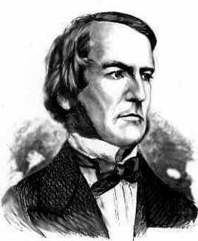
Boolean algebra
An algebraic structure consists of
a set of elements B
binary operations { + , • }
and a unary operation { ’ }
such that the following axioms hold:
1. the set B contains at least two elements: a, b 2. closure: a + b is in B a • b is in B 3. commutativity: a + b = b + a a • b = b • a 4. associativity: a + (b + c) = (a + b) + c a • (b • c) = (a • b) • c 5. identity: a + 0 = a a • 1 = a 6. distributivity: a + (b • c) = (a + b) • (a + c) a • (b + c) = (a • b) + (a • c) 7. complementarity: a + a’ = 1 a • a’ = 0
George Boole – 1854

Slide 18
Sum-of-products canonical forms
Also known as disjunctive normal form
Also known as minterm expansion
F = 001 011 101 110 111
+ A’BC
+ AB’C
+ ABC’
F =
A’B’C
+ ABC
A B C F F’ 0 0 0 0 1
0 0 1 1 0
0 1 0 0 1
0 1 1 1 0
1 0 0 0 1
1 0 1 1 0
1 1 0 1 0
1 1 1 1 0
F’ = A’B’C’ + A’BC’ + AB’C’

Slide 19
Predicate Calculus
Predicate or Propositional Function
A function that returns a truth value
“x is a cat”
“student x has taken course y”
“x > y”
∀ x P(x) : P(x) is true for every x in the domain
∃ x P(x) : There is an x in the domain for which P(x) is true
Prime(65353)

Slide 20
Statements with quantifiers
Domain:
Positive Integers
∀ x (Even(x) ∨ Odd(x))
∃ x (Even(x) ∧ Prime(x))
∀ x ∃ y (Greater(y, x) ∧ Prime(y))
∀ x (Prime(x) → (Equal(x, 2) ∨ Odd(x))
∃ x ∃ y(Equal(x, y + 2) ∧ Prime(x) ∧ Prime(y))
Even(x)
Odd(x)
Prime(x)
Greater(x,y)
Equal(x,y)

Slide 21
Proofs
Start with hypotheses and facts
Use rules of inference to extend set of facts
Result is proved when it is included in the set

Slide 22
Simple Propositional Inference Rules
∴ p ∨¬p
Excluded middle
Two inference rules per binary connective one to eliminate it, one to introduce it.
p ∧ q
∴ p, q
p, q
∴ p ∧ q
p ∨ q , ¬p
∴ q
p
∴ p ∨ q, q ∨ p
p, p→q
∴ q
p⇒q
∴ p→q
Direct Proof Rule

Slide 23
Inference Rules for Quantifiers
P(c) for some c
∴ ∃ x P(x)
∀ x P(x)
∴ P(a) for any a
“Let a be anything”...P(a)
∴ ∀ x P(x)
∃ x P(x)
∴ P(c) for some special c

Slide 24
Even and Odd
Even(x) ≡ ∃y (x=2y)
Odd(x) ≡ ∃y (x=2y+1)
Domain: Integers
Prove: “The square of every odd number is odd”
English proof of: ∀x (Odd(x)→Odd(x²))
Let x be an odd number.
Then x=2k+1 for some integer k (depending on x)
Therefore x²=(2k+1)²= 4k²+4k+1=2(2k²+2k)+1.
Since 2k²+2k is an integer, x² is odd.

Slide 25
Characteristic vectors
Let U = {1, . . ., 10}, represent the set {1,3,4,8,9} with
Bit operations:
0110110100 ∨ 0011010110 = 0111110110
ls –l
drwxr-xr-x ... Documents/
-rw-r--r-- ... file1
1011000110

Slide 26
One-time pad
Alice and Bob privately share random n-bit vector K
Eve does not know K
Later, Alice has n-bit message m to send to Bob
Alice computes C = m ⊕ K
Alice sends C to Bob
Bob computes m = C ⊕ K which is (m ⊕ K) ⊕ K
Eve cannot figure out m from C unless she can guess K

Slide 27
Arithmetic mod 7
a +₇ b = (a + b) mod 7
a ×₇ b = (a × b) mod 7
+ | 0 | 1 | 2 | 3 | 4 | 5 | 6
0 | 0 | 1 | 2 | 3 | 4 | 5 | 6
1 | 1 | 2 | 3 | 4 | 5 | 6 | 0
2 | 2 | 3 | 4 | 5 | 6 | 0 | 1
3 | 3 | 4 | 5 | 6 | 0 | 1 | 2
4 | 4 | 5 | 6 | 0 | 1 | 2 | 3
5 | 5 | 6 | 0 | 1 | 2 | 3 | 4
6 | 6 | 0 | 1 | 2 | 3 | 4 | 5
X | 0 | 1 | 2 | 3 | 4 | 5 | 6
0 | 0 | 0 | 0 | 0 | 0 | 0 | 0
1 | 0 | 1 | 2 | 3 | 4 | 5 | 6
2 | 0 | 2 | 4 | 6 | 1 | 3 | 5
3 | 0 | 3 | 6 | 2 | 5 | 1 | 4
4 | 0 | 4 | 1 | 5 | 2 | 6 | 3
5 | 0 | 5 | 3 | 1 | 6 | 4 | 2
6 | 0 | 6 | 5 | 4 | 3 | 2 | 1

Slide 28
Division Theorem
Let a be an integer and d a positive integer. Then there are unique integers q and r, with 0 ≤ r < d, such that a = dq + r.
q = a div d r = a mod d

Slide 29
Modular Arithmetic
Let a and b be integers, and m be a positive integer. We say a is congruent to b modulo m if m divides a – b. We use the notation a ≡ b (mod m) to indicate that a is congruent to b modulo m.
Let a and b be integers, and let m be a positive integer. Then a ≡ b (mod m) if and only if a mod m = b mod m.
Let m be a positive integer. If a ≡ b (mod m) and
c ≡ d (mod m), then
a + c ≡ b + d (mod m) and
ac ≡ bd (mod m)
Let a and b be integers, and let m be a positive integer. Then a ≡ b (mod m) if and only if
a mod m = b mod m.

Slide 30
Integer representation
Signed integer representation
Suppose -2^{n-1} < x < 2^{n-1}
First bit as the sign, n-1 bits for the value
99: 0110 0011, -18: 1001 0010
Two’s complement representation
Suppose 0 ≤ x < 2^{n-1},
x is represented by the binary representation of x
-x is represented by the binary representation of 2^{n}-x
99: 0110 0011, -18: 1110 1110

Slide 31
Hashing
Map values from a large domain, 0…M-1 in a much smaller domain, 0…n-1
Index lookup
Test for equality
Hash(x) = x mod p
(or Hash(x) = (ax + b) mod p)
Often want the hash function to depend on all of the bits of the data
Collision management

Slide 32
Modular Exponentiation
X | 1 | 2 | 3 | 4 | 5 | 6
1 | 1 | 2 | 3 | 4 | 5 | 6
2 | 2 | 4 | 6 | 1 | 3 | 5
3 | 3 | 6 | 2 | 5 | 1 | 4
4 | 4 | 1 | 5 | 2 | 6 | 3
5 | 5 | 3 | 1 | 6 | 4 | 2
6 | 6 | 5 | 4 | 3 | 2 | 1
a | a¹ | a² | a³ | a⁴ | a⁵ | a⁶
1 | 1 | 1 | 1 | 1 | 1 | 1
2 | 2 | 4 | 1 | 2 | 4 | 1
3 | 3 | 2 | 6 | 4 | 5 | 1
4 | 4 | 2 | 1 | 4 | 2 | 1
5 | 5 | 4 | 6 | 2 | 3 | 1
6 | 6 | 1 | 6 | 1 | 6 | 1
Arithmetic mod 7

Slide 33
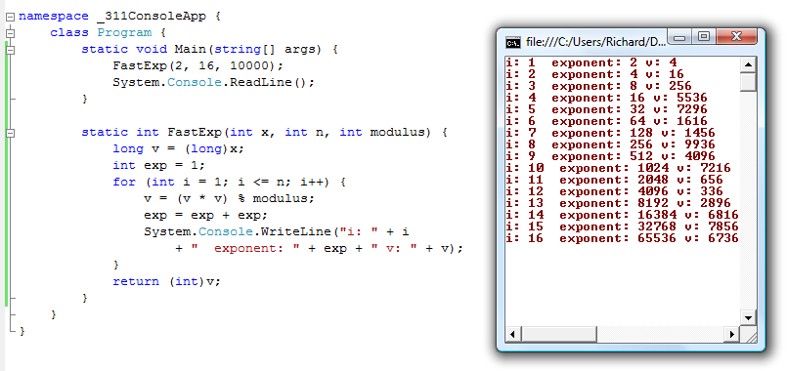
Fast exponentiation Repeated Squaring

Slide 34
Primality
An integer p greater than 1 is called prime if the only positive factors of p are 1 and p.
A positive integer that is greater than 1 and is not prime is called composite.
Fundamental Theorem of Arithmetic: Every positive integer greater than 1 has a unique prime factorization

Slide 35
GCD and Factoring
a = 2³ • 3 • 5² • 7 • 11 = 46,200
b = 2 • 3² • 5³ • 7 • 13 = 204,750
GCD(a, b) = 2^{min(3,1)} • 3^{min(1,2)} • 5^{min(2,3)} • 7^{min(1,1)}
• 11^{min(1,0)} • 13^{min(0,1)}

Slide 36
Euclid’s Algorithm
GCD(x, y) = GCD(y, x mod y)
a = 98, b = 35
int GCD(int a, int b){ /* a >= b, b > 0 */
int tmp;
int x = a;
int y = b;
while (y > 0){
tmp = x % y;
x = y;
y = tmp;
}
return x;
}

Slide 37
Multiplicative Inverse mod m
Suppose GCD(a, m) = 1
By Bézoit’s Theorem, there exist integers s and t such that sa + tm = 1.
s mod m is the multiplicative inverse of a:
1 = (sa + tm) mod m = sa mod m

Slide 38
Induction proofs
P(0)
∀ k (P(k) → P(k+1))
∴ ∀ n P(n)
1. Prove P(0)
Let k be an arbitrary integer ≥ 0
3. Assume that P(k) is true
4. ...
5. Prove P(k+1) is true
P(k) → P(k+1) Direct Proof Rule
7. ∀ k (P(k) → P(k+1)) Intro ∀ from 2-6
8. ∀ n P(n) Induction Rule 1&7

Slide 39
Strong Induction
P(0)
∀ k ((P(0) ∧ P(1) ∧ P(2) ∧ … ∧ P(k)) → P(k+1))
∴ ∀ n P(n)

Slide 40
Recursive definitions of functions
F(0) = 0; F(n + 1) = F(n) + 1;
G(0) = 1; G(n + 1) = 2 × G(n);
0! = 1; (n+1)! = (n+1) × n!
f₀ = 0; f₁ = 1; f_{n} = f_{n-1} + f_{n-2}

Slide 41
Strings
The set Σ* of strings over the alphabet Σ is defined
Basis: λ ∈ S (λ is the empty string)
Recursive: if w ∈ Σ*, x ∈ Σ, then wx ∈ Σ*
Palindromes: strings that are the same backwards and forwards.
Basis: λ is a palindrome and any a ∈ Σ is a palindrome
If p is a palindrome then apa is a palindrome for every a ∈ Σ

Slide 42
Function definitions on recursively defined sets
Len(λ) = 0;
Len(wx) = 1 + Len(w); for w ∈ Σ*, x ∈ Σ
Concat(w, λ) = w for w ∈ Σ*
Concat(w₁,w₂x) = Concat(w₁,w₂)x for w₁, w₂ in Σ*, x ∈ Σ
Prove:
Len(Concat(x,y))=Len(x)+Len(y) for all strings x and y

Slide 43
Rooted Binary trees
Basis: ● is a rooted binary tree
Recursive Step: If and are rooted
binary trees then so is:
T₂
T₁
T₂
T₁

Slide 44
Functions defined on rooted binary trees
size(●)=1
size( ) = 1+size(T₁)+size(T₂)
height(●)=0
height( )=1+max{height(T₁),height(T₂)}
T₁
T₂
T₁
T₂
Prove:
For every rooted binary tree T, size(T) ≤ 2^{height(T)+1} -1

Slide 45
Regular Expressions over Σ
Each is a “pattern” that specifies a set of strings
Basis:
∅, λ are regular expressions
a is a regular expression for any a ∈ Σ
Recursive step:
If A and B are regular expressions then so are:
(A ∪ B)
(AB)
A*

Slide 46
Regular Expressions
0*
0*1*
(0 ∪ 1)*
(0*1*)*
(0 ∪ 1)* 0110 (0 ∪ 1)*
(0 ∪ 1)* (0110 ∪ 100)(0 ∪ 1)*

Slide 47
Context-Free Grammars
Example: S → 0S0 | 1S1 | 0 | 1 | λ
Example: S → 0S | S1 | λ

Slide 48
Sample Context-Free Grammars
Grammar for {0^{n}1^{n} : n≥ 0} all strings with same # of 0’s and 1’s with all 0’s before 1’s.
Example: S → (S) | SS | λ

Slide 49
Building in Precedence in Simple Arithmetic Expressions
E – expression (start symbol)
T – term F – factor I – identifier N - number
E→ T | E+T
T→ F | F*T
F→ (E) | I | N
I → x | y | z
N→ 0 | 1 | 2 | 3 | 4 | 5 | 6 | 7 | 8 | 9

Slide 50
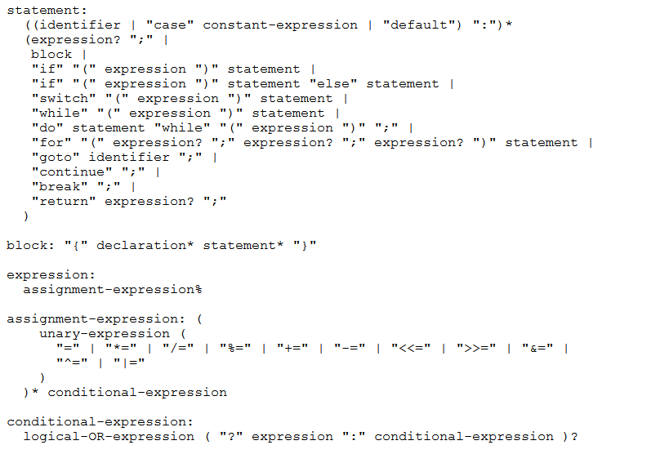
BNF for C

Slide 51
Definition of Relations
Let A and B be sets,
A binary relation from A to B is a subset of A × B
Let A be a set,
A binary relation on A is a subset of A × A
Let R be a relation on A
R is reflexive iff (a,a) ∈ R for every a ∈ A
R is symmetric iff (a,b) ∈ R implies (b, a)∈ R
/
R is antisymmetric iff (a,b) ∈ R and a ≠ b implies (b,a) ∈ R
R is transitive iff (a,b)∈ R and (b, c)∈ R implies (a, c) ∈ R

Slide 52
Combining Relations
Let R be a relation from A to B
Let S be a relation from B to C
The composite of R and S, S ° R is the relation
from A to C defined
S ° R = {(a, c) | ∃ b such that (a,b)∈ R and (b,c)∈ S}

Slide 53
Relations
(a,b)∈ Parent: b is a parent of a
(a,b)∈ Sister: b is a sister of a
Aunt = Sister ° Parent
Grandparent = Parent ° Parent
R² = R ° R = {(a, c) | ∃ b such that (a,b)∈ R and (b,c)∈ R}
R⁰ = {(a,a) | a ∈ A}
R¹ = R
R^{n+1} = R^{n} ° R
S ° R = {(a, c) | ∃ b such that (a,b)∈ R and (b,c)∈ S}

Slide 54
n-ary relations
Let A₁, A₂, …, A_{n} be sets. An n-ary relation on
these sets is a subset of A₁× A₂× . . . × A_{n}.
Student_ID | Name | GPA
328012098 | Knuth | 4.00
481080220 | Von Neuman | 3.78
238082388 | Russell | 3.85
238001920 | Einstein | 2.11
1727017 | Newton | 3.61
348882811 | Karp | 3.98
2921938 | Bernoulli | 3.21
2921939 | Bernoulli | 3.54
Student_ID | Major
328012098 | CS
481080220 | CS
481080220 | Mathematics
238082388 | Philosophy
238001920 | Physics
1727017 | Mathematics
348882811 | CS
1727017 | Physics
2921938 | Mathematics
2921939 | Mathematics

Slide 55
Matrix representation for relations
Relation R on A={a₁, … a_{p}}
{(1, 1), (1, 2), (1, 4), (2,1), (2,3), (3,2), (3, 3) (4,2) (4,3)}
1 | 1 | 0 | 1
1 | 0 | 1 | 0
0 | 0 | 1 | 0
0 | 1 | 1 | 0

Slide 56
Representation of relations
Directed Graph Representation (Digraph)
{(a, b), (a, a), (b, a), (c, a), (c, d), (c, e) (d, e) }
b
c
a
d
e

Slide 57
Paths in relations
Let R be a relation on a set A. There is a path of length n from a to b if and only if (a,b) ∈R^{n}
(a,b) is in the transitive-reflexive closure of R if and only if there is a path from a to b. (Note: by definition, there is a path of length 0 from a to a.)

Slide 58
Finite state machines
States
Transitions on inputs
Start state and finals states
The language recognized by a machine is the set of strings that reach a final state
1
State | 0 | 1
s₀ | s₀ | s₁
s₁ | s₀ | s₂
s₂ | s₀ | s₃
s₃ | s₃ | s₃
0
0
s₀
1
s₁
1
s₂
1
s₃
0
0,1

Slide 59
Accepts strings with an odd number of 1’s and an odd number of 0’s
1
s₀
s₁
1
0
0
0
0
1
s₂
s₃
1

Slide 60
Accept strings with a 1 three positions from the end
0
1
0
1
0
1
0
1
00
01
10
11
1
1
1
0
0
0
0
1
001
1
011
1
0
1
1
1
0
000
1
010
101
0
111
1
0
0
1
0
0
100
0
110

Slide 61
Product construction
Combining FSMs to check two properties at once
New states record states of both FSMs
0,1
0,1
2
s₀
s₁
0
s₁t₀
2
s₀t₁
0
2
1
0
2
1
1
t₁
s₀t₀
2
s₁t₁
2
0
0
1
2
2
1
1
t₀
1
t₂
1
2
2
0
0
s₁t₂
s₀t₂
2
0
1
0

Slide 62
State machines with output
“Tug-of-war”
 | Input |  | Output
State | L | R
s₁ | s₁ | s₂ | Beep
s₂ | s₁ | s₃
s₃ | s₂ | s₄
s₄ | s₃ | s₄ | Beep
R
R
R
L
S₁
S₂
S₃
S₄
R
Beep
Beep
L
L
L

Slide 63
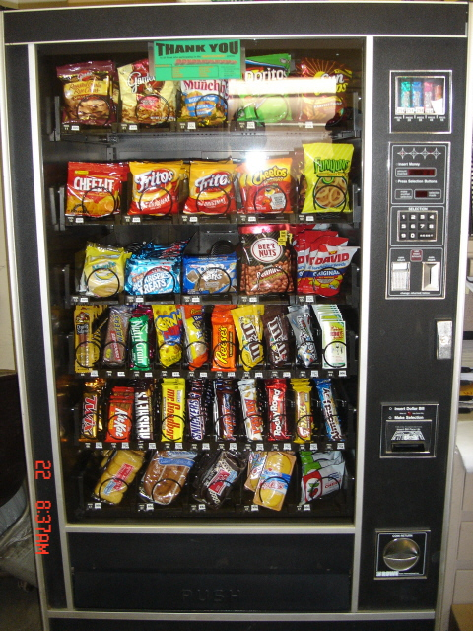
Vending Machine
Enter 15 cents in dimes or nickels
Press S or B for a candy bar

Slide 64
Vending Machine, Final Version
B,S
0
D
N
15
B,S
B,S
B,S
D
D
B
D
0’ B
5
10
S
N
N
N
N
D
15’ N
B
N
B,S
S
D
N
D
0” S
N
B
15” D
S
D

Slide 65
State minimization
Finite State Machines with output at states
0
2
S0 [1]
0
S1
[0]
1
2
3
0
2
3
0
1
S0 [1]
0
S1
[0]
1
⇒
1
0
S2 [1]
S3
[0]
2
1
3
0
1,3
2
3
0
1,2
2
3
3
S2 [1]
S3
[0]
1
1
2
2
2
3
0
S4 [1]
3
S5
[0]
0
1
3

Slide 66
Another way to look at DFAs
Definition: The label of a path in a DFA is the
concatenation of all the labels on its edges in order
Lemma: x is in the language recognized by a DFA iff
x labels a path from the start state to some final state
0
0
s₀
1
s₁
1
s₂
1
s₃
0
0,1

Slide 67
Nondeterministic Finite Automaton (NFA)
Graph with start state, final states, edges labeled by symbols (like DFA) but
Not required to have exactly 1 edge out of each state labeled by each symbol - can have 0 or >1
Also can have edges labeled by empty string λ
Definition: x is in the language recognized by an NFA iff x labels a path from the start state to some final state
s₀
1
s₁
1
s₂
1
s₃
0,1
0,1

Slide 68
Nondeterministic Finite Automaton
s₀
1
s₁
0,1
s₂
0,1
s₃
0,1
Accepts strings with a 1 three positions from the end of the string

Slide 69
Building a NFA from a regular expression
(01 ∪1)*0
0
λ
1
λ
λ
λ
λ
0
λ
λ
λ
λ
1

Slide 70
NFA to DFA: Subset construction
0,1
0
a,b
∅
a
0
1
1
λ
1
1
c
b
0
c
b
0
1
0
0
0,1
1
b,c
a,b,c
NFA
0
DFA

Slide 71
The set B of binary palindromes cannot be recognized by any DFA
Consider the infinite set of strings
S={λ, 0, 00, 000, 0000, ...}
Claim: No two strings in S can end at the same
state of any DFA for B, so no such DFA can exist
Proof: Suppose n≠m and 0^{n} and 0^{m} end at the same state p.
Since 0^{n}10^{n} is in B, following 10^{n} after state p must lead to a final state.
But then the DFA would accept 0^{m}10^{n}
which is a contradiction

Slide 72
Cardinality
A set S is countable iff we can write it as S={s₁, s₂, s₃, ...} indexed by ℕ
Set of integers is countable
{0, 1, -1, 2, -2, 3, -3, 4, . . .}
Set of rationals is countable
“dovetailing”
Σ* is countable
{0,1}* = {0,1,00,01,10,11,000,001,010,011,100,101,...}
Set of all (Java) programs is countable
1/1 | 1/2 | 1/3 | 1/4 | 1/5 | 1/6 | 1/7 | 1/8 | ...
2/1 | 2/2 | 2/3 | 2/4 | 2/5 | 2/6 | 2/7 | 2/8 | ...
3/1 | 3/2 | 3/3 | 3/4 | 3/5 | 3/6 | 3/7 | 3/8 | ...
4/1 | 4/2 | 4/3 | 4/4 | 4/5 | 4/6 | 4/7 | 4/8 | ...
5/1 | 5/2 | 5/3 | 5/4 | 5/5 | 5/6 | 5/7 | ...
6/1 | 6/2 | 6/3 | 6/4 | 6/5 | 6/6 | ...
7/1 | 7/2 | 7/3 | 7/4 | 7/5 | ....
... | ... | ... | ... | ...

Slide 73
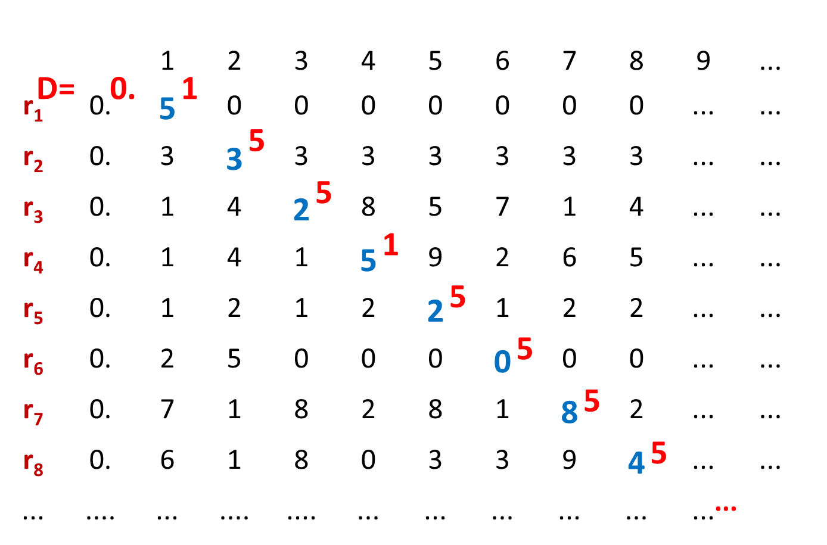
The real numbers are not countable
“diagonalization”

Slide 74
General models of computation
Control structures with infinite storage
Many models
Turing machines
Functional
Recursion
Java programs
Church-Turing Thesis
Any reasonable model of computation that includes all possible algorithms is equivalent in power to a Turing machine

Slide 75
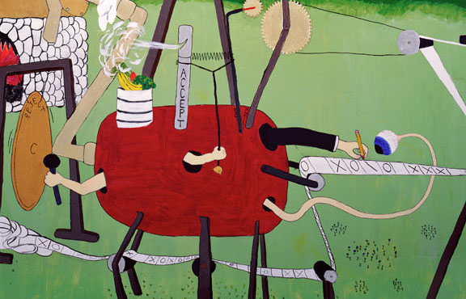
What is a Turing Machine?

Slide 76
Halting Problem
Given: the code of a program P and an input x for P, i.e. given (<P>,x)
Output: 1 if P halts on input x 0 if P does not halt on input x
Theorem (Turing): There is no program that solves the halting problem “The halting problem is undecidable”

Slide 77
Suppose H(<P>,x) solves the Halting problem
Function D(x):
if H(x,x)=1 then
while (true); /* loop forever */
else
no-op; /* do nothing and halt */
endif
Does D halt on input <D>?
D halts on input <D>
⇔ H outputs 1 on input (<D>,<D>)
[since H solves the halting problem and so H(<D>,x) outputs 1 iff D halts on input x]
⇔ D runs forever on input <D>
[since D goes into an infinite loop on x iff H(x,x)=1]

Slide 78
Does a program have a divide by 0 error?
Input: A program <P> and an input string x
Output: 1 if P has a divide by 0 error on input x
0 otherwise
Claim: The divide by zero problem is undecidable

Slide 79
Program equivalence
Input: the codes of two programs, <P> and <Q>
Output: 1 if P produces the same output as Q does on every input
0 otherwise
Claim: The equivalent program problem is undecidable

Slide 80
That’s all folks!

Slide 81
Teaching evaluation
Please answer the questions on both sides of the form. This includes the ABET questions on the back

