Slide 1
CSE 311 Foundations of Computing I
Lecture 25
Pattern Matching, Cardinality, Computability
Spring 2013

Slide 2
Announcements
Reading
7th edition: 2.5 (Cardinality) + p. 201 and 13.5
6th edition: pp. 158-160 (Cardinality)+ p 177 and 12.5
Pick up graded Homework 6
Homework 8 out today, due next Friday

Slide 3
Last Lecture Highlights
DFAs ≡ Regular Expressions
No need to know details of NFAs→RegExpressions
Method for proving no DFAs for languages
e.g. {0^{n}1^{n} : n ≥ 0}, {Palindromes}, {Balanced Parens}
How FSMs/DFAs are used in designing circuits
This was just to give a rough idea

Slide 4
Pattern Matching
Given
a string, s, of n characters
a pattern, p, of m characters
usually m<<n
Find
all occurrences of the pattern p in the string s
Obvious algorithm:
try to see if p matches at each of the positions in s
stop at a failed match and try the next position

Slide 5
String s = x y x x y x y x y y x y x y x y y x y x y x x
Pattern p = x y x y y x y x y x x

Slide 6
String s = x y x x y x y x y y x y x y x y y x y x y x x
x y x y y x y x y x x

Slide 7
String s = x y x x y x y x y y x y x y x y y x y x y x x
x y x y
x y x y y x y x y x x

Slide 8
String s = x y x x y x y x y y x y x y x y y x y x y x x
x y x y
x
x y x y y x y x y x x

Slide 9
String s = x y x x y x y x y y x y x y x y y x y x y x x
x y x y
x
x y
x y x y y x y x y x x

Slide 10
String s = x y x x y x y x y y x y x y x y y x y x y x x
x y x y
x
x y
x y x y y
x y x y y x y x y x x

Slide 11
String s = x y x x y x y x y y x y x y x y y x y x y x x
x y x y
x
x y
x y x y y
x
x y x y y x y x y x x

Slide 12
String s = x y x x y x y x y y x y x y x y y x y x y x x
x y x y
x
x y
x y x y y
x
x y x y y x y x y x x
x y x y y x y x y x x

Slide 13
String s = x y x x y x y x y y x y x y x y y x y x y x x
x y x y
x
x y
x y x y y
x
x y x y y x y x y x x
x
x y x y y x y x y x x

Slide 14
String s = x y x x y x y x y y x y x y x y y x y x y x x
x y x y
x
x y
x y x y y
x
x y x y y x y x y x x
x
x y x
x y x y y x y x y x x

Slide 15
String s = x y x x y x y x y y x y x y x y y x y x y x x
x y x y
x
x y
x y x y y
x
x y x y y x y x y x x
x
x y x
x
x y x y y x y x y x x

Slide 16
String s = x y x x y x y x y y x y x y x y y x y x y x x
x y x y
x
x y
x y x y y
x
x y x y y x y x y x x
x
x y x
x
x
x y x y y x y x y x x

Slide 17
String s = x y x x y x y x y y x y x y x y y x y x y x x
x y x y
x
x y
x y x y y
x
x y x y y x y x y x x
x
x y x
x
x
x y x y y
x y x y y x y x y x x

Slide 18
String s = x y x x y x y x y y x y x y x y y x y x y x x
x y x y
x
x y
x y x y y
x
x y x y y x y x y x x
x
Worst-case time
O(mn)
x y x
x
x
x y x y y
x
x y x y y x y x y x x

Slide 19
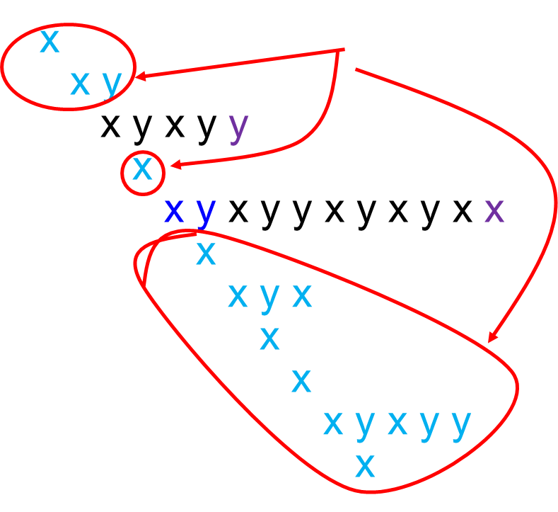
String s = x y x x y x y x y y x y x y x y y x y x y x x
x y x y
Lots of wasted work
x y x y y x y x y x x

Slide 20
Better Pattern Matching via Finite Automata
Build a DFA for the pattern (preprocessing) of size O(m)
Keep track of the ‘longest match currently active’
The DFA will have only m+1 states
Run the DFA on the string n steps
Obvious construction method for DFA will be O(m²) but can be done in O(m) time.
Total O(m+n) time

Slide 21
Building a DFA for the pattern
Pattern p=x y x y y x y x y x x

Slide 22
Preprocessing the pattern
Pattern p=x y x y y x y x y x x

Slide 23
Preprocessing the pattern
Pattern p=x y x y y x y x y x x

Slide 24
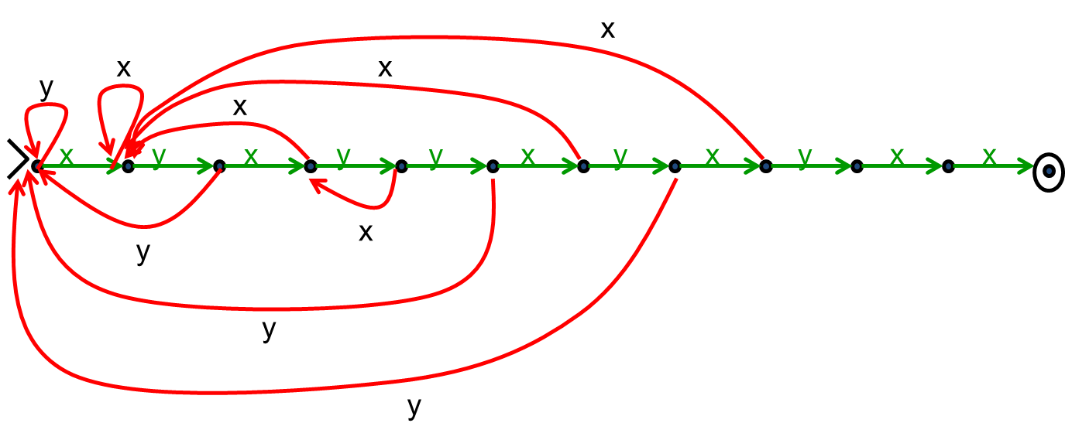
Preprocessing the pattern
Pattern p=x y x y y x y x y x x

Slide 25
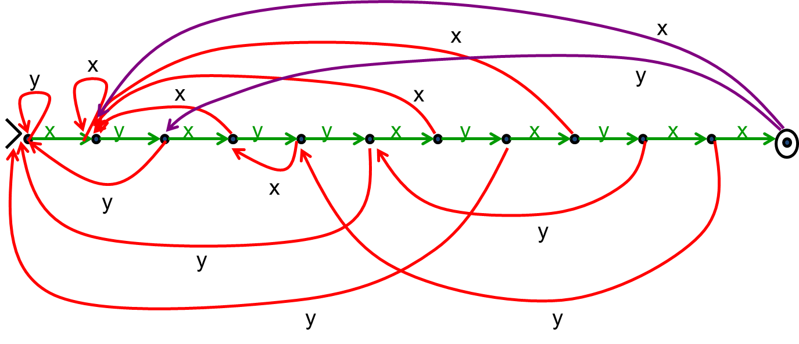
Preprocessing the pattern
Pattern p=x y x y y x y x y x x

Slide 26
Generalizing
Can search for arbitrary combinations of patterns
Not just a single pattern
Build NFA for pattern then convert to DFA ‘on the fly’.
Compare DFA constructed above with subset construction for the obvious NFA.

Slide 27
CSE 311 Foundations of Computing I
Cardinality and Computability

Slide 28
Computing & Mathematics
Computers as we know them grew out of a desire to avoid bugs in mathematical reasoning

Slide 29
A Brief History of Reasoning
Ancient Greece
Deductive logic
Euclid’s Elements
Infinite things are a problem
Zeno’s paradox

Slide 30
A Brief History of Reasoning
1670’s-1800’s Calculus & infinite series
Suddenly infinite stuff really matters
Reasoning about infinite still a problem
Tendency for buggy or hazy proofs
Mid-late 1800’s
Formal mathematical logic
Boole Boolean Algebra
Theory of infinite sets and cardinality
Cantor
“There are more real #’s than rational #’s”

Slide 31
A Brief History of Reasoning
1900
Hilbert's famous speech outlines goal: mechanize all of mathematics 23 problems
1930’s
Gödel, Turing show that Hilbert’s program is impossible.
Gödel’s Incompleteness Theorem
Undecidability of the Halting Problem
Both use ideas from Cantor’s proof about reals & rationals

Slide 32
Starting with Cantor
How big is a set?
If S is finite, we already defined |S| to be the number of elements in S.
What if S is infinite? Are all of these sets the same size?
Natural numbers ℕ
Even natural numbers
Integers ℤ
Rational numbers ℚ
Real numbers ℝ

Slide 33
Cardinality
Def: Two sets A and B are the same size (same cardinality) iff there is a 1-1 and onto function f:A→B
Also applies to infinite sets
a
1
b
2
c
3
d
4
e
5
f
6

Slide 34
Cardinality
The natural numbers and even natural numbers have the same cardinality:
0 1 2 3 4 5 6 7 8 9 10 ...
0 2 4 6 8 10 12 14 16 18 20 ...
n is matched with 2n

Slide 35
Countability
Definition: A set is countable iff it is the same size as some subset of the natural numbers
Equivalent: A set S is countable iff there is an onto function g: ℕ → S
Equivalent: A set S is countable iff we can write S={s₁, s₂, s₃, ...}

Slide 36
The set of all integers is countable

Slide 37
Is the set of positive rational numbers countable?
We can’t do the same thing we did for the integers
Between any two rational numbers there are an infinite number of others

Slide 38
Positive Rational Numbers
1/1 | 1/2 | 1/3 | 1/4 | 1/5 | 1/6 | 1/7 | 1/8 | ...
2/1 | 2/2 | 2/3 | 2/4 | 2/5 | 2/6 | 2/7 | 2/8 | ...
3/1 | 3/2 | 3/3 | 3/4 | 3/5 | 3/6 | 3/7 | 3/8 | ...
4/1 | 4/2 | 4/3 | 4/4 | 4/5 | 4/6 | 4/7 | 4/8 | ...
5/1 | 5/2 | 5/3 | 5/4 | 5/5 | 5/6 | 5/7 | ...
6/1 | 6/2 | 6/3 | 6/4 | 6/5 | 6/6 | ...
7/1 | 7/2 | 7/3 | 7/4 | 7/5 | ....
... | ... | ... | ... | ...

Slide 39
{Positive Rational Numbers} is Countable
1/1 | 1/2 | 1/3 | 1/4 | 1/5 | 1/6 | 1/7 | 1/8 | ...
2/1 | 2/2 | 2/3 | 2/4 | 2/5 | 2/6 | 2/7 | 2/8 | ...
3/1 | 3/2 | 3/3 | 3/4 | 3/5 | 3/6 | 3/7 | 3/8 | ...
4/1 | 4/2 | 4/3 | 4/4 | 4/5 | 4/6 | 4/7 | 4/8 | ...
5/1 | 5/2 | 5/3 | 5/4 | 5/5 | 5/6 | 5/7 | ...
6/1 | 6/2 | 6/3 | 6/4 | 6/5 | 6/6 | ...
7/1 | 7/2 | 7/3 | 7/4 | 7/5 | ....
... | ... | ... | ... | ...

Slide 40
{Positive Rational Numbers} is Countable
ℚ⁺ = {1/1, 2/1,1/2, 3/1,2/2,1/3, 4/1,2/3,3/2,1/4, 5/1,4/2,3/3,2/4,1/5, ...}
List elements in order of
numerator+denominator
breaking ties according to denominator
Only k numbers when the total is k
Technique is called “dovetailing”

Slide 41
Claim: Σ* is countable for every finite Σ

Slide 42
The set of all Java programs is countable

Slide 43
What about the Real Numbers?
Q: Is every set is countable?
A: Theorem [Cantor] The set of real numbers
(even just between 0 and 1) is NOT countable
Proof is by contradiction using a new method called “diagonalization”

Slide 44
Proof by contradiction
Suppose that ℝ^{[0,1)} is countable
Then there is some listing of all elements ℝ^{[0,1)} = { r₁, r₂, r₃, r₄, ... }
We will prove that in such a listing there must be at least one missing element which contradicts statement “ℝ^{[0,1)} is countable”
The missing element will be found by looking at the decimal expansions of r₁, r₂, r₃, r₄, ...

Slide 45
Real numbers between 0 and 1: ℝ^{[0,1)}
Every number between 0 and 1 has an infinite decimal expansion:
1/2 = 0.50000000000000000000000...
1/3 = 0.33333333333333333333333...
1/7 = 0.14285714285714285714285...
π -3 = 0.14159265358979323846264...
1/5 = 0.19999999999999999999999...
= 0.20000000000000000000000...

Slide 46
Representations as decimals
Representation is unique except for the cases that decimal ends in all 0’s or all 9’s.
x = 0.19999999999999999999999...
10x = 1.9999999999999999999999...
9x = 1.8 so x=0.200000000000000000...
Won’t allow the representations ending in all 9’s
All other representations give elements of ℝ^{[0,1)}

Slide 47
Supposed Listing of ℝ^{[0,1)}
 |  | 1 | 2 | 3 | 4 | 5 | 6 | 7 | 8 | 9 | ...
r₁ | 0. | 5 | 0 | 0 | 0 | 0 | 0 | 0 | 0 | ... | ...
r₂ | 0. | 3 | 3 | 3 | 3 | 3 | 3 | 3 | 3 | ... | ...
r₃ | 0. | 1 | 4 | 2 | 8 | 5 | 7 | 1 | 4 | ... | ...
r₄ | 0. | 1 | 4 | 1 | 5 | 9 | 2 | 6 | 5 | ... | ...
r₅ | 0. | 1 | 2 | 1 | 2 | 2 | 1 | 2 | 2 | ... | ...
r₆ | 0. | 2 | 5 | 0 | 0 | 0 | 0 | 0 | 0 | ... | ...
r₇ | 0. | 7 | 1 | 8 | 2 | 8 | 1 | 8 | 2 | ... | ...
r₈ | 0. | 6 | 1 | 8 | 0 | 3 | 3 | 9 | 4 | ... | ...
... | .... | ... | .... | .... | ... | ... | ... | ... | ... | ...

Slide 48
Supposed Listing of ℝ^{[0,1)}
 |  | 1 | 2 | 3 | 4 | 5 | 6 | 7 | 8 | 9 | ...
r₁ | 0. | 5 | 0 | 0 | 0 | 0 | 0 | 0 | 0 | ... | ...
r₂ | 0. | 3 | 3 | 3 | 3 | 3 | 3 | 3 | 3 | ... | ...
r₃ | 0. | 1 | 4 | 2 | 8 | 5 | 7 | 1 | 4 | ... | ...
r₄ | 0. | 1 | 4 | 1 | 5 | 9 | 2 | 6 | 5 | ... | ...
r₅ | 0. | 1 | 2 | 1 | 2 | 2 | 1 | 2 | 2 | ... | ...
r₆ | 0. | 2 | 5 | 0 | 0 | 0 | 0 | 0 | 0 | ... | ...
r₇ | 0. | 7 | 1 | 8 | 2 | 8 | 1 | 8 | 2 | ... | ...
r₈ | 0. | 6 | 1 | 8 | 0 | 3 | 3 | 9 | 4 | ... | ...
... | .... | ... | .... | .... | ... | ... | ... | ... | ... | ...

Slide 49
Flipped Diagonal
 |  | 1
 |  |  | 5
 |  |  |  | 5
 |  |  |  |  | 1
 |  |  |  |  |  | 5
 |  |  |  |  |  |  | 5
 |  |  |  |  |  |  |  | 5
 |  |  |  |  |  |  |  |  | 5
 |  |  |  |  |  |  |  |  |  | ...
Flipping Rule:
If digit is 5, make it 1
If digit is not 5, make it 5
 |  | 1 | 2 | 3 | 4 | 5 | 6 | 7 | 8 | 9 | ...
r₁ | 0. | 5 | 0 | 0 | 0 | 0 | 0 | 0 | 0 | ... | ...
r₂ | 0. | 3 | 3 | 3 | 3 | 3 | 3 | 3 | 3 | ... | ...
r₃ | 0. | 1 | 4 | 2 | 8 | 5 | 7 | 1 | 4 | ... | ...
r₄ | 0. | 1 | 4 | 1 | 5 | 9 | 2 | 6 | 5 | ... | ...
r₅ | 0. | 1 | 2 | 1 | 2 | 2 | 1 | 2 | 2 | ... | ...
r₆ | 0. | 2 | 5 | 0 | 0 | 0 | 0 | 0 | 0 | ... | ...
r₇ | 0. | 7 | 1 | 8 | 2 | 8 | 1 | 8 | 2 | ... | ...
r₈ | 0. | 6 | 1 | 8 | 0 | 3 | 3 | 9 | 4 | ... | ...
... | .... | ... | .... | .... | ... | ... | ... | ... | ... | ...

Slide 50
Flipped Diagonal Number D
 |  | 1 | 2 | 3 | 4 | 5 | 6 | 7 | 8 | 9 | ...
D = | 0. | 1
 |  |  | 5
 |  |  |  | 5
 |  |  |  |  | 1
 |  |  |  |  |  | 5
 |  |  |  |  |  |  | 5
 |  |  |  |  |  |  |  | 5
 |  |  |  |  |  |  |  |  | 5
 |  |  |  |  |  |  |  |  |  | ...
D is in ℝ^{[0,1)}
But for all n, we have
D≠r_{n} since they differ on
n^{th} digit (which is not 0 or 9)
⇒ list was incomplete
⇒ ℝ^{[0,1)} is not countable

Slide 51
The set of all functions f : ℕ→{0,1,...,9} is not countable

Slide 52
Non-computable functions
We have seen that
The set of all (Java) programs is countable
The set of all functions f : ℕ→{0,1,...,9} is not countable
So...
There must be some function f : ℕ→{0,1,...,9} that is not computable by any program!

