Slide 1
CSE 311 Foundations of Computing I
Lecture 21
Finite State Machines
Spring 2013

Slide 2
Announcements
Reading assignments
7th Edition, Sections 13.3 and 13.4
6th Edition, Section 12.3 and 12.4

Slide 3
Last lecture highlights Directed graphs
G = (V, E)
V – vertices
E – edges, order pairs of vertices
Path: v₁, v₂, …, v_{k}, with (v_{i}, v_{i+1}) in E

Slide 4
Last lecture highlights
Let R be a relation on a set A. There is a path of length n from a to b if and only if (a,b) ∈R^{n}
Let R be a relation on a set A. The connectivity relation R* consists of the pairs (a,b) such that there is a path from a to b in R.
Transitive-Reflexive closure: Add the minimum possible number of edges to make the relation transitive and reflexive
The transitive-reflexive closure of a relation R is the connectivity relation R*

Slide 5
Finite state machines
States
Transitions on inputs
Start state and final states
The language recognized by a machine is the set of strings that reach a final state
1
State | 0 | 1
s₀ | s₀ | s₁
s₁ | s₀ | s₂
s₂ | s₀ | s₃
s₃ | s₃ | s₃
0
0
s₀
1
s₁
1
s₂
1
s₃
0
0,1

Slide 6
Applications of Finite State Machines (a.k.a. Finite Automata)
Implementation of regular expression matching in programs like grep
Control structures for sequential logic in digital circuits
Algorithms for communication and cache-coherence protocols
Each agent runs its own FSM
Design specifications for reactive systems
Components are communicating FSMs

Slide 7
Applications of Finite State Machines (a.k.a. Finite Automata)
Formal verification of systems
Is an unsafe state reachable?
Computer games
FSMs provide worlds to explore
Minimization algorithms for FSMs can be extended to more general models used in
Text prediction
Speech recognition

Slide 8
What language does this machine recognize?
1
s₀
s₁
1
0
0
0
0
1
s₂
s₃
1

Slide 9
3 Bit Shift register
001
1
011
1
0
1
1
1
0
000
1
010
101
0
111
1
0
0
1
0
0
100
0
110

Slide 10
0
1
0
1
0
1
0
1
00
01
10
11
1
1
1
0
0
0
0
1
001
1
011
1
0
1
1
1
0
000
1
010
101
0
111
1
0
0
1
0
0
100
0
110

Slide 11
Design a DFA that accepts strings with a 1 three positions from the end

Slide 12
How does the size of a DFA to recognize “10th character is a 1” compare with the size of a DFA to recognize “10th character from the end is 1”?

Slide 13
Strings over {0, 1, 2}*
M₁: Strings with an even number of 2’s
M₂: Strings where the sum of digits mod 3 is 0
s₀
s₁
t₁
t₀
t₂

Slide 14
Recognize strings with an even number of 2’s and a mod 3 sum of 0
s₁t₀
s₀t₁
s₀t₀
s₁t₁
s₁t₂
s₀t₂

Slide 15
State machines with output
“Tug-of-war”
 | Input |  | Output
State | L | R
s₁ | s₁ | s₂ | Beep
s₂ | s₁ | s₃
s₃ | s₂ | s₄
s₄ | s₃ | s₄ | Beep
R
R
R
L
S₁
S₂
S₃
S₄
R
L
L
L

Slide 16
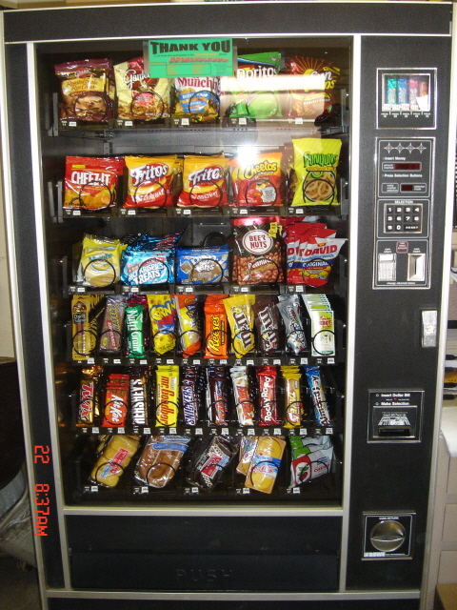
Vending Machine
Enter 15 cents in dimes or nickels
Press S or B for a candy bar

Slide 17
Vending Machine, Version 1
D
D
0
N
5
N
10
N, D
15
B, S
Basic transitions on N (nickel), D (dime), B (butterfinger), S (snickers)

Slide 18
Vending Machine, Version 2
0
D
N
15
D
D
B
0’ B
5
10
S
N
N
N
D
15’ N
B
S
N
D
0” S
Adding output to states: N – Nickel, S – Snickers, B – Butterfinger

Slide 19
Vending Machine, Final Version
B,S
0
D
N
15
B,S
B,S
B,S
D
D
B
D
0’ B
5
10
S
N
N
N
N
D
15’ N
B
N
B,S
S
D
N
D
0” S
N
B
15” D
S
D
Adding additional “unexpected” transitions

