Slide 1
CSE 311 Foundations of Computing I
Lecture 18
Recursive Definitions: Regular Expressions,
Context-Free Grammars and Languages
Spring 2013

Slide 2
Announcements
Reading assignments
7th Edition, pp. 878-880 and pp. 851-855
6th Edition, pp. 817-819 and pp. 789-793
For Wednesday, May 15
7th Edition, Section 9.1 and pp. 594-601
6th Edition, Section 8.1 and pp. 541-548

Slide 3
Languages: Sets of Strings
Sets of strings that satisfy special properties are called languages. Examples:
English sentences
Syntactically correct Java/C/C++ programs
Σ∗ = All strings over alphabet Σ
Palindromes over Σ
Binary strings that don’t have a 0 after a 1
Legal variable names. keywords in Java/C/C++
Binary strings with an equal # of 0’s and 1’s

Slide 4
Regular expressions
Regular expressions over Σ
Basis:
∅, λ are regular expressions
a is a regular expression for any a ∈ Σ
Recursive step:
If A and B are regular expressions then so are:
(A ∪ B)
(AB)
A*

Slide 5
Each regular expression is a “pattern”
λ matches the empty string
a matches the one character string a
(A ∪ B) matches all strings that either A matches or B matches (or both)
(AB) matches all strings that have a first part that A matches followed by a second part that B matches
A* matches all strings that have any number of strings (even 0) that A matches, one after another

Slide 6
Examples
001*
0*1*
(0 ∪ 1)0(0 ∪ 1)0
(0*1*)*
(0 ∪ 1)* 0110 (0 ∪ 1)*
(00 ∪ 11)* (01010 ∪ 10001)(0 ∪ 1)*

Slide 7
Regular expressions in practice
Used to define the “tokens”: e.g., legal variable names, keywords in programming languages and compilers
Used in grep, a program that does pattern matching searches in UNIX/LINUX
Pattern matching using regular expressions is an essential feature of hypertext scripting language PHP used for web programming
Also in text processing programming language Perl

Slide 8
Regular Expressions in PHP
int preg_match ( string $pattern , string $subject,...)
$pattern syntax:
[01] a 0 or a 1 ^ start of string $ end of string
[0-9] any single digit \. period \, comma \- minus
. any single character
ab a followed by b (AB)
(a|b) a or b (A ∪ B) a? zero or one of a (A ∪ λ) a* zero or more of a A*
a+ one or more of a AA*
e.g. ^[\-+]?[0-9]*(\.|\,)?[0-9]+$
General form of decimal number e.g. 9.12 or -9,8 (Europe)

Slide 9
More examples
All binary strings that have an even # of 1’s
All binary strings that don’t contain 101

Slide 10
Fact: Not all sets of strings can be specified by regular expressions
Even some easy things like
Palindromes
Strings with equal number of 0’s and 1’s
But also more complicated structures in programming languages
Matched parentheses
Properly formed arithmetic expressions
Etc.

Slide 11
Context Free Grammars
A Context-Free Grammar (CFG) is given by a finite set of substitution rules involving
A finite set V of variables that can be replaced
Alphabet Σ of terminal symbols that can’t be replaced
One variable, usually S, is called the start symbol
The rules involving a variable A are written as
A → w₁ | w₂ | ... | w_{k} where each w_{i} is a string of variables and terminals – that is w_{i} ∈ (V ∪ Σ)∗

Slide 12
How Context-Free Grammars generate strings
Begin with start symbol S
If there is some variable A in the current string you can replace it by one of the w’s in the rules for A
Write this as xAy ⇒ xwy
Repeat until no variables left
The set of strings the CFG generates are all strings produced in this way that have no variables

Slide 13
Sample Context-Free Grammars
Example: S → 0S0 | 1S1 | 0 | 1 | λ
Example: S → 0S | S1 | λ

Slide 14
Sample Context-Free Grammars
Grammar for {0^{n}1^{n} : n≥ 0} all strings with same # of 0’s and 1’s with all 0’s before 1’s.
Example: S → (S) | SS | λ

Slide 15
Simple Arithmetic Expressions
E→ E+E | E$∗$E | (E) | x | y | z | 0 | 1 | 2 | 3 | 4 | 5 | 6 | 7 | 8 | 9
Generate (2$∗$x) + y
Generate x+y$∗$z in two fundamentally different ways

Slide 16
Context-Free Grammars and recursively-defined sets of strings
A CFG with the start symbol S as its only variable recursively defines the set of strings of terminals that S can generate
A CFG with more than one variable is a simultaneous recursive definition of the sets of strings generated by each of its variables
Sometimes necessary to use more than one

Slide 17
Building in Precedence in Simple Arithmetic Expressions
E – expression (start symbol)
T – term F – factor I – identifier N - number
E→ T | E+T
T→ F | F$∗$T
F→ (E) | I | N
I → x | y | z
N→ 0 | 1 | 2 | 3 | 4 | 5 | 6 | 7 | 8 | 9

Slide 18
Another name for CFGs
BNF (Backus-Naur Form) grammars
Originally used to define programming languages
Variables denoted by long names in angle brackets, e.g.
<identifier>, <if-then-else-statement>, <assignment-statement>, <condition>
::= used instead of →

Slide 19
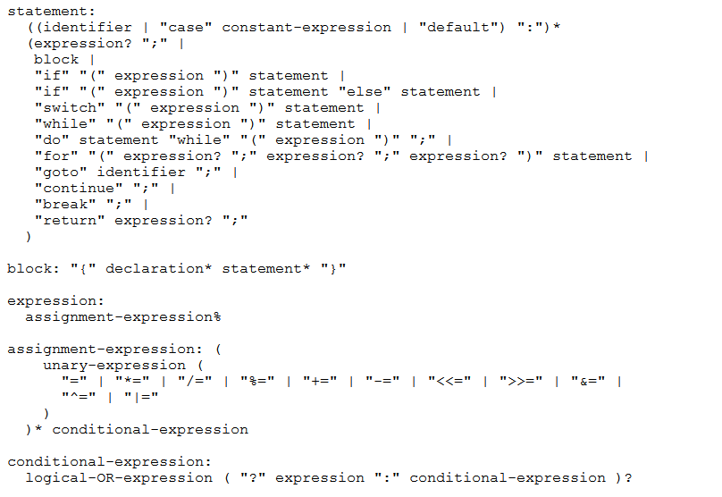
BNF for C

Slide 20
Parse Trees
Back to middle school:
<sentence>::=<noun phrase><verb phrase>
<noun phrase>::=<article><adjective><noun>
<verb phrase>::=<verb><adverb>|<verb><object>
<object>::=<noun phrase>
Parse:
The yellow duck squeaked loudly
The red truck hit a parked car

