Slide 1
CSE 311 Foundations of Computing I
Lecture 16
Recursively Defined Sets
and Structural Induction
Spring 2013

Slide 2
Announcements
Reading assignments
Today:
5.3 7th Edition
5.3 6th Edition
Midterm Friday, May 10, MGH 389
Closed book, closed notes
Tables of inference rules and equivalences will be included on test
Sample questions from old midterms are now posted

Slide 3
Induction
Mathematical Induction
Induction proof layout:
Let P(n) be “ “. By induction we will show that P(n) is true for every n≥0
Base Case: Prove P(0)
Inductive Hypothesis: Assume that P(k) is true for some arbitrary integer k ≥ 0
Inductive Step: Prove that P(k+1) is true using Inductive Hypothesis that P(k) is true
Conclusion: Result follows by induction
P(0)
∀ k≥0 (P(k) → P(k+1))
∴ ∀ n≥0 P(n)

Slide 4
Strong Induction
P(0)
∀ k (∀ j ((0≤j ≤k) → P(j)) → P(k+1))
∀ n P(n)
Strong Induction proof layout:
Let P(n) be “…”. By induction we will show that P(n) is true for every n≥0
Base Case: Prove P(0)
Inductive Hypothesis: Assume that for some arbitrary integer k ≥ 0 we have P(j) true for every integer j with 0 ≤ j ≤ k.
Inductive Step: Prove that P(k+1) is true using Inductive Hypothesis that P(0),…,P(k) are true
Conclusion: Result follows by induction

Slide 5
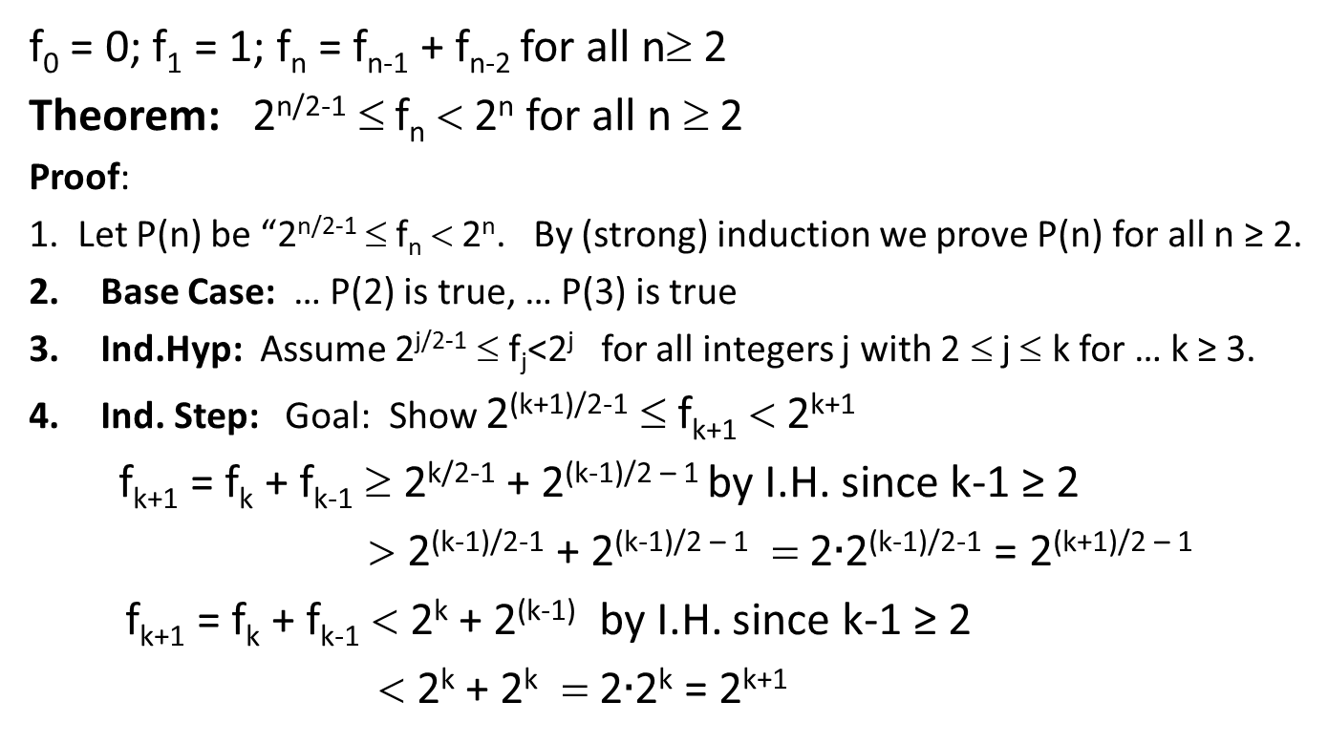
Bounding the Fibonacci Numbers How we did it last time
f₀ = 0; f₁ = 1; f_{n} = f_{n-1} + f_{n-2} for all n≥ 2
Theorem: 2^{n/2-1} ≤ f_{n} < 2^{n} for all n ≥ 2
Proof:
1. Let P(n) be “2^{n/2-1} ≤ f_{n} < 2^{n}. By (strong) induction we prove P(n) for all n ≥ 2.
Base Case: … P(2) is true, … P(3) is true
Ind.Hyp: Assume 2^{j/2-1} ≤ f_{j}<2^{j} for all integers j with 2 ≤ j ≤ k for … k ≥ 3.
Ind. Step: Goal: Show 2^{(k+1)/2-1} ≤ f_{k+1} < 2^{k+1}
f_{k+1} = f_{k} + f_{k-1} ≥ 2^{k/2-1} + 2^{(k-1)/2 – 1} by I.H. since k-1 ≥ 2
> 2^{(k-1)/2-1} + 2^{(k-1)/2 – 1} = 2$∙$2^{(k-1)/2-1} = 2^{(k+1)/2 – 1}
f_{k+1} = f_{k} + f_{k-1} < 2^{k} + 2^{(k-1)} by I.H. since k-1 ≥ 2
< 2^{k} + 2^{k} = 2$∙$2^{k} = 2^{k+1}

Slide 6
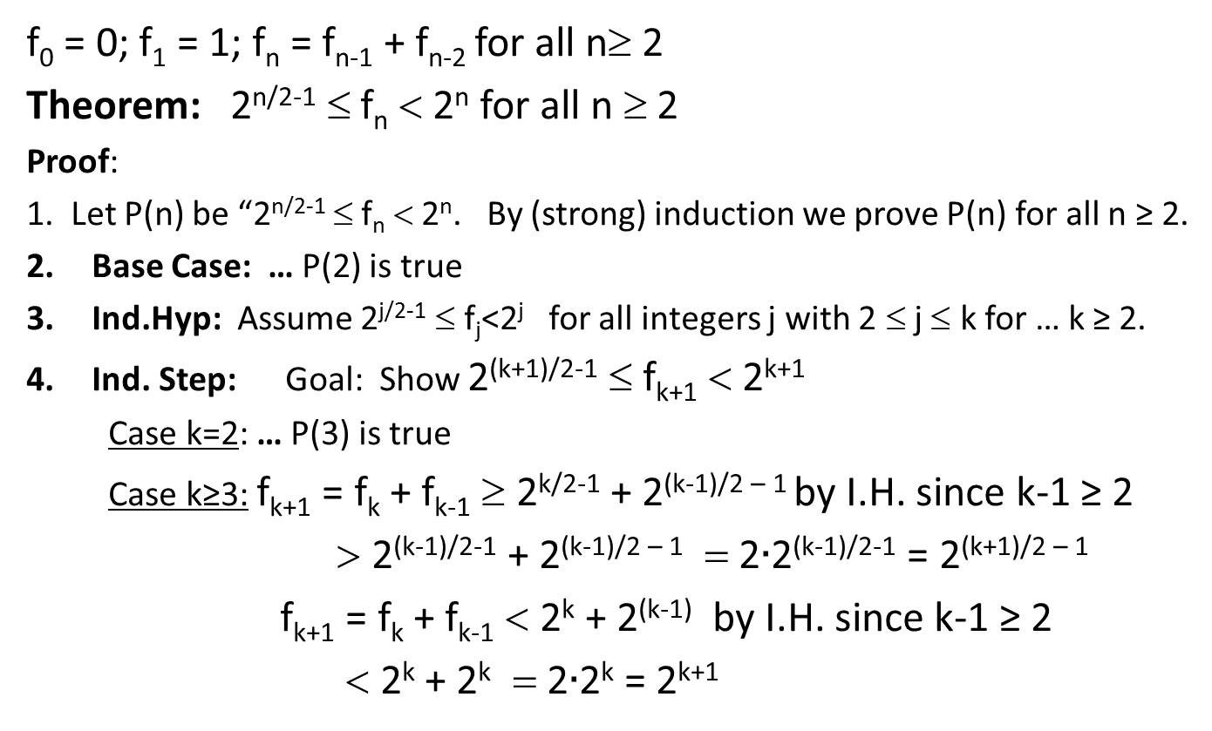
Bounding the Fibonacci Numbers Alternative Layout
f₀ = 0; f₁ = 1; f_{n} = f_{n-1} + f_{n-2} for all n≥ 2
Theorem: 2^{n/2-1} ≤ f_{n} < 2^{n} for all n ≥ 2
Proof:
1. Let P(n) be “2^{n/2-1} ≤ f_{n} < 2^{n}. By (strong) induction we prove P(n) for all n ≥ 2.
Base Case: … P(2) is true
Ind.Hyp: Assume 2^{j/2-1} ≤ f_{j}<2^{j} for all integers j with 2 ≤ j ≤ k for … k ≥ 2.
Ind. Step: Goal: Show 2^{(k+1)/2-1} ≤ f_{k+1} < 2^{k+1}
Case k=2: … P(3) is true
Case k≥3: f_{k+1} = f_{k} + f_{k-1} ≥ 2^{k/2-1} + 2^{(k-1)/2 – 1} by I.H. since k-1 ≥ 2
> 2^{(k-1)/2-1} + 2^{(k-1)/2 – 1} = 2$∙$2^{(k-1)/2-1} = 2^{(k+1)/2 – 1}
f_{k+1} = f_{k} + f_{k-1} < 2^{k} + 2^{(k-1)} by I.H. since k-1 ≥ 2
< 2^{k} + 2^{k} = 2$∙$2^{k} = 2^{k+1}

Slide 7
Recursive Definitions of Sets
Recursive definition
Basis step: 0 ∈ S
Recursive step: if x ∈ S, then x + 2 ∈ S
Exclusion rule: Every element in S follows from basis steps and a finite number of recursive steps

Slide 8
Recursive definitions of sets
Basis: 6 ∈ S; 15 ∈ S;
Recursive: if x, y ∈ S, then x + y ∈ S;
Basis: [1, 1, 0] ∈ S, [0, 1, 1] ∈ S;
Recursive:
if [x, y, z] ∈ S, α in ℝ, then [α x, α y, α z] ∈ S
if [x₁, y₁, z₁], [x₂, y₂, z₂] ∈ S
then [x₁ + x₂, y₁ + y₂, z₁ + z₂] ∈ S
Powers of 3

Slide 9
Recursive Definitions of Sets: General Form
Recursive definition
Basis step: Some specific elements are in S
Recursive step: Given some existing named elements in S some new objects constructed from these named elements are also in S.
Exclusion rule: Every element in S follows from basis steps and a finite number of recursive steps

Slide 10
Strings
An alphabet Σ is any finite set of characters.
The set Σ* of strings over the alphabet Σ is defined by
Basis: λ ∈ Σ* (λ is the empty string)
Recursive: if w ∈ Σ*, a ∈ Σ, then wa ∈ Σ*

Slide 11
Palindromes
Palindromes are strings that are the same backwards and forwards
Basis: λ is a palindrome and any a ∈ Σ is a palindrome
Recursive step: If p is a palindrome then apa is a palindrome for every a ∈ Σ

Slide 12
All binary strings with no 1’s before 0’s

Slide 13
Function definitions on recursively defined sets
len (λ) = 0;
len (wa) = 1 + len(w); for w ∈ Σ*, a ∈ Σ
Reversal:
λ^{R} = λ
(wa)^{R} = aw^{R} for w ∈ Σ*, a ∈ Σ
Concatenation:
x • λ = x for x ∈ Σ*
x • wa = (x • w)a for x, w ∈ Σ*, a ∈ Σ

Slide 14
Rooted Binary trees
Basis: • is a rooted binary tree
Recursive Step: If and are rooted
binary trees then so is:
T₂
T₁
T₂
T₁

Slide 15
Functions defined on rooted binary trees
size(•)=1
size( ) = 1+size(T₁)+size(T₂)
height(•)=0
height( )=1+max{height(T₁),height(T₂)}
T₁
T₂
T₁
T₂

Slide 16
Structural Induction: proving properties of recursively defined sets
How to prove ∀x∈S. P(x) is true:
Base Case: Show that P is true for all specific elements of S mentioned in the Basis step
Inductive Hypothesis: Assume that P is true for some arbitrary values of each of the existing named elements mentioned in the Recursive step
Inductive Step: Prove that P holds for each of the new elements constructed in the Recursive step using the named elements mentioned in the Inductive Hypothesis
Conclude that ∀x∈S. P(x)

Slide 17
Structural Induction versus Ordinary Induction
Ordinary induction is a special case of structural induction:
Recursive Definition of ℕ
Basis: 0 ∈ ℕ
Recursive Step: If k ∈ ℕ then k+1 ∈ ℕ
Structural induction follows from ordinary induction
Let Q(n) be true iff for all x∈S that take n Recursive steps to be constructed, P(x) is true.

Slide 18
Using Structural Induction
Let S be given by
Basis: 6 ∈ S; 15 ∈ S;
Recursive: if x, y ∈ S, then x + y ∈ S.
Claim: Every element of S is divisible by 3

Slide 19
Structural Induction for strings
Let S be a set of strings over {a,b} defined as follows
Basis: a $∈$ S
Recursive:
If w ∈ S then aw ∈ S and baw ∈ S
If u ∈ S and v ∈ S then uv ∈ S
Claim: if w ∈ S then w has more a’s than b’s

Slide 20
len(x•y)=len(x)+len(y) for all strings x and y
Let P(w) be “len(x•w)=len(x)+len(w)”

