Slide 1
CSE 311: Foundations of Computing
Fall 2013
Lecture 29: Wrap up

Slide 2
announcements
Hand in Homework 9 now
Pick up all old homework and exams now
Review session
Sunday, 3pm, EEB 125
List of Final Exam Topics and sampling of some typical kinds of exam questions on the web
Bring your questions to the review session!
Final exam
Monday, 2:30-4:20 pm or 4:30-6:20, Kane 220
Fill in Catalyst Survey by Sunday, 3pm to choose.

Slide 3
highlights: halting problem
x
1 if P(x) halts
0 if P(x) does not halt
H
<P>
HALT

Slide 4
highlights: “always halts” problem
1 if Q always halts
0 if Q sometimes does not halt
<Q>
A
HALT

Slide 5
the “always ERROR” problem
Given: <R>, the code of a program R
Output: 1 if R always prints ERROR 0 if R does not always print ERROR

Slide 6
the “always ERROR” problem
1 if Q always halts
0 if Q does not always halt
HALT
<Q>
A
Suppose we had a TM E for the ERROR problem
Convert’
<R>
1 if Q always halts
0 if Q does not always halt
<Q>
E
Q’s code
…
end of Q
Q’s code
…
end of Q
Print ERROR

Slide 7
program equivalence
Input: the codes of two programs, <P> and <Q>
Output: 1 if P produces the same output as Q does on every input
0 otherwise

Slide 8
general phenomenon: can’t tell a book by its cover
Rice’s Theorem: In general there is no way to tell anything about the input/output (I/O) behavior of a program P just given its code <P>!

Slide 9
quick lessons
Don’t rely on the idea of improved compilers and programming languages to eliminate major programming errors
truly safe languages can’t possibly do general computation
Document your code!!!!
there is no way you can expect someone else to figure out what your program does with just your code ....since....in general it is provably impossible to do this!

Slide 10
CSE 311: Foundations of Computing
Fall 2013
The “5 minute” version

Slide 11
about the course
From the CSE catalog:
CSE 311 Foundations of Computing I (4) Examines fundamentals of logic, set theory, induction, and algebraic structures with applications to computing; finite state machines; and limits of computability. Prerequisite: CSE 143; either MATH 126 or MATH 136.
What this course is about:
Foundational structures for the practice of computer science and engineering

Slide 12
propositional logic
Statements with truth values
The Washington State flag is red
It snowed in Whistler, BC on January 4, 2011.
Rick Perry won the Iowa straw poll
Space aliens landed in Roswell, New Mexico
If n is an integer greater than two, then the equation a^{n} + b^{n} = c^{n} has no solutions in non-zero integers a, b, and c.
Propositional variables: p, q, r, s, . . .
Truth values: T for true, F for false
Compound propositions
Negation (not) ¬ p
Conjunction (and) p ∧ q
Disjunction (or) p ∨ q
Exclusive or p ⊕ q
Implication p → q
Biconditional p ↔ q

Slide 13
english and logic
You cannot ride the roller coaster if you are under 4 feet tall unless you are older than 16 years old
q: you can ride the roller coaster
r: you are under 4 feet tall
s: you are older than 16
( r ∧ ¬ s) → ¬ q

Slide 14
logical equivalence
Terminology: A compound proposition is a
Tautology if it is always true
Contradiction if it is always false
Contingency if it can be either true or false
p ∨ ¬ p
p ⊕ p
(p → q) ∧ p
(p ∧ q) ∨ (p ∧ ¬ q) ∨ (¬ p ∧ q) ∨ (¬ p ∧ ¬ q)

Slide 15
logical equivalence
p and q are logically equivalent iff p ↔ q is a tautology
The notation p ≡ q denotes p and q are logically equivalent
De Morgan’s Laws:
¬ (p ∧ q) ≡ ¬ p ∨ ¬ q
¬ (p ∨ q) ≡ ¬ p ∧ ¬ q

Slide 16
digital circuits
Computing with logic
T corresponds to 1 or “high” voltage
F corresponds to 0 or “low” voltage
Gates
Take inputs and produce outputs
Functions
Several kinds of gates
Correspond to propositional connectives
Only symmetric ones (order of inputs irrelevant)

Slide 17
combinational logic circuits
AND
OR
AND
Wires can send one value to multiple gates

Slide 18
a simple example: 1-bit binary adder
Cout
Cin
Inputs: A, B, Carry-in
Outputs: Sum, Carry-out
A A A A A
B B B B B
S S S S S
A
S
A B Cin Cout S
0 0 0 0 0 1
0 1 0
0 1 1
1 0 0 1 0 1
1 1 0
1 1 1
B
0
0
0
1
0
1
1
1
Cout
0
1
1
0
1
0
0
1
Cin
Cout = B Cin + A Cin + A B
S = A’ B’ Cin + A’ B Cin’ + A B’ Cin’ + A B Cin = A’ (B’ Cin + B Cin’ ) + A (B’ Cin’ + B Cin )
= A’ Z + A Z’ = A xor Z = A xor (B xor Cin)

Slide 19
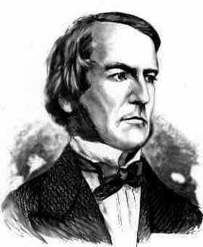
boolean algebra
An algebraic structure consists of
a set of elements B
binary operations { + , • }
and a unary operation { ’ }
such that the following axioms hold:
1. the set B contains at least two elements: a, b 2. closure: a + b is in B a • b is in B 3. commutativity: a + b = b + a a • b = b • a 4. associativity: a + (b + c) = (a + b) + c a • (b • c) = (a • b) • c 5. identity: a + 0 = a a • 1 = a 6. distributivity: a + (b • c) = (a + b) • (a + c) a • (b + c) = (a • b) + (a • c) 7. complementarity: a + a’ = 1 a • a’ = 0
George Boole – 1854

Slide 20
sum-of-products canonical forms
Also known as disjunctive normal form
Also known as minterm expansion
F = 001 011 101 110 111
+ A’BC
+ AB’C
+ ABC’
F =
A’B’C
+ ABC
A B C F F’ 0 0 0 0 1
0 0 1 1 0
0 1 0 0 1
0 1 1 1 0
1 0 0 0 1
1 0 1 1 0
1 1 0 1 0
1 1 1 1 0
F’ = A’B’C’ + A’BC’ + AB’C’

Slide 21
predicate calculus
Predicate or Propositional Function
A function that returns a truth value
“x is a cat”
“student x has taken course y”
“x > y”
∀ x P(x) : P(x) is true for every x in the domain
∃ x P(x) : There is an x in the domain for which P(x) is true
Prime(65353)

Slide 22
statements with quantifiers
Domain:
Positive Integers
∀ x (Even(x) ∨ Odd(x))
∃ x (Even(x) ∧ Prime(x))
∀ x ∃ y (Greater(y, x) ∧ Prime(y))
∀ x (Prime(x) → (Equal(x, 2) ∨ Odd(x))
∃ x ∃ y(Equal(x, y + 2) ∧ Prime(x) ∧ Prime(y))
Even(x)
Odd(x)
Prime(x)
Greater(x,y)
Equal(x,y)

Slide 23
proofs
Start with hypotheses and facts
Use rules of inference to extend set of facts
Result is proved when it is included in the set

Slide 24
simple propositional inference rules
∴ p ∨¬p
Excluded middle
Two inference rules per binary connective one to eliminate it, one to introduce it.
p ∧ q
∴ p, q
p, q
∴ p ∧ q
p ∨ q , ¬p
∴ q
p
∴ p ∨ q, q ∨ p
p, p→q
∴ q
p⇒q
∴ p→q
Direct Proof Rule

Slide 25
inference rules for quantifiers
P(c) for some c
∴ ∃ x P(x)
∀ x P(x)
∴ P(a) for any a
“Let a be anything”...P(a)
∴ ∀ x P(x)
∃ x P(x)
∴ P(c) for some special c

Slide 26
even and odd
Even(x) ≡ ∃y (x=2y)
Odd(x) ≡ ∃y (x=2y+1)
Domain: Integers
Prove: “The square of every odd number is odd”
English proof of: ∀x (Odd(x)→Odd(x²))
Let x be an odd number.
Then x=2k+1 for some integer k (depending on x)
Therefore x²=(2k+1)²= 4k²+4k+1=2(2k²+2k)+1.
Since 2k²+2k is an integer, x² is odd.

Slide 27
characteristic vectors
Let U = {1, . . ., 10}, represent the set {1,3,4,8,9} with
Bit operations:
0110110100 ∨ 0011010110 = 0111110110
ls –l
drwxr-xr-x ... Documents/
-rw-r--r-- ... file1
1011000110

Slide 28
one-time pad
Alice and Bob privately share random n-bit vector K
Eve does not know K
Later, Alice has n-bit message m to send to Bob
Alice computes C = m ⊕ K
Alice sends C to Bob
Bob computes m = C ⊕ K which is (m ⊕ K) ⊕ K
Eve cannot figure out m from C unless she can guess K

Slide 29
arithmetic mod 7
a +₇ b = (a + b) mod 7
a ×₇ b = (a × b) mod 7
+ | 0 | 1 | 2 | 3 | 4 | 5 | 6
0 | 0 | 1 | 2 | 3 | 4 | 5 | 6
1 | 1 | 2 | 3 | 4 | 5 | 6 | 0
2 | 2 | 3 | 4 | 5 | 6 | 0 | 1
3 | 3 | 4 | 5 | 6 | 0 | 1 | 2
4 | 4 | 5 | 6 | 0 | 1 | 2 | 3
5 | 5 | 6 | 0 | 1 | 2 | 3 | 4
6 | 6 | 0 | 1 | 2 | 3 | 4 | 5
X | 0 | 1 | 2 | 3 | 4 | 5 | 6
0 | 0 | 0 | 0 | 0 | 0 | 0 | 0
1 | 0 | 1 | 2 | 3 | 4 | 5 | 6
2 | 0 | 2 | 4 | 6 | 1 | 3 | 5
3 | 0 | 3 | 6 | 2 | 5 | 1 | 4
4 | 0 | 4 | 1 | 5 | 2 | 6 | 3
5 | 0 | 5 | 3 | 1 | 6 | 4 | 2
6 | 0 | 6 | 5 | 4 | 3 | 2 | 1

Slide 30
division theorem
Let a be an integer and d a positive integer. Then there are unique integers q and r, with 0 ≤ r < d, such that a = dq + r.
q = a div d r = a mod d

Slide 31
modular arithmetic
Let a and b be integers, and m be a positive integer. We say a is congruent to b modulo m if m divides a – b. We use the notation a ≡ b (mod m) to indicate that a is congruent to b modulo m.
Let a and b be integers, and let m be a positive integer. Then a ≡ b (mod m) if and only if a mod m = b mod m.
Let m be a positive integer. If a ≡ b (mod m) and
c ≡ d (mod m), then
a + c ≡ b + d (mod m) and
ac ≡ bd (mod m)
Let a and b be integers, and let m be a positive integer. Then a ≡ b (mod m) if and only if
a mod m = b mod m.

Slide 32
integer representation
Signed integer representation
Suppose -2^{n-1} < x < 2^{n-1}
First bit as the sign, n-1 bits for the value
99: 0110 0011, -18: 1001 0010
Two’s complement representation
Suppose 0 ≤ x < 2^{n-1},
x is represented by the binary representation of x
-x is represented by the binary representation of 2^{n}-x
99: 0110 0011, -18: 1110 1110

Slide 33
hashing
Map values from a large domain, 0…M-1 in a much smaller domain, 0…n-1
Index lookup
Test for equality
Hash(x) = x mod p
(or Hash(x) = (ax + b) mod p)
Often want the hash function to depend on all of the bits of the data
Collision management

Slide 34
modular exponentiation
X | 1 | 2 | 3 | 4 | 5 | 6
1 | 1 | 2 | 3 | 4 | 5 | 6
2 | 2 | 4 | 6 | 1 | 3 | 5
3 | 3 | 6 | 2 | 5 | 1 | 4
4 | 4 | 1 | 5 | 2 | 6 | 3
5 | 5 | 3 | 1 | 6 | 4 | 2
6 | 6 | 5 | 4 | 3 | 2 | 1
a | a¹ | a² | a³ | a⁴ | a⁵ | a⁶
1 | 1 | 1 | 1 | 1 | 1 | 1
2 | 2 | 4 | 1 | 2 | 4 | 1
3 | 3 | 2 | 6 | 4 | 5 | 1
4 | 4 | 2 | 1 | 4 | 2 | 1
5 | 5 | 4 | 6 | 2 | 3 | 1
6 | 6 | 1 | 6 | 1 | 6 | 1
Arithmetic mod 7

Slide 35
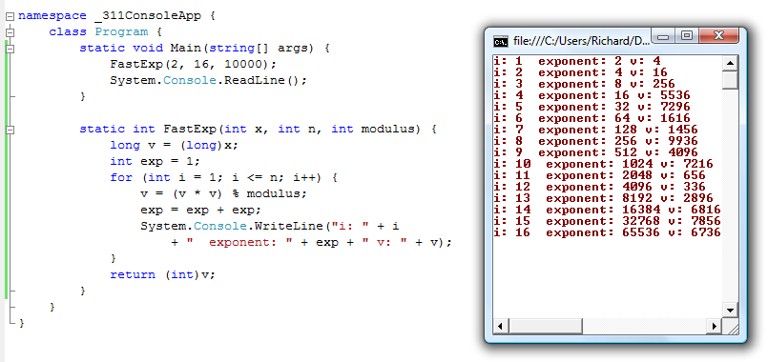
fast exponentiation: repeated squaring

Slide 36
primality
An integer p greater than 1 is called prime if the only positive factors of p are 1 and p.
A positive integer that is greater than 1 and is not prime is called composite.
Fundamental Theorem of Arithmetic: Every positive integer greater than 1 has a unique prime factorization

Slide 37
gcd and factoring
a = 2³ • 3 • 5² • 7 • 11 = 46,200
b = 2 • 3² • 5³ • 7 • 13 = 204,750
GCD(a, b) = 2^{min(3,1)} • 3^{min(1,2)} • 5^{min(2,3)} • 7^{min(1,1)}
• 11^{min(1,0)} • 13^{min(0,1)}

Slide 38
euclid’s algorithm
GCD(x, y) = GCD(y, x mod y)
a = 98, b = 35
int GCD(int a, int b){ /* a >= b, b > 0 */
int tmp;
int x = a;
int y = b;
while (y > 0){
tmp = x % y;
x = y;
y = tmp;
}
return x;
}

Slide 39
multiplicative inverse mod m
Suppose GCD(a, m) = 1
By Bézout’s Theorem, there exist integers s and t such that sa + tm = 1.
s mod m is the multiplicative inverse of a:
1 = (sa + tm) mod m = sa mod m

Slide 40
induction proofs
P(0)
∀ k (P(k) → P(k+1))
∴ ∀ n P(n)
1. Prove P(0)
Let k be an arbitrary integer ≥ 0
3. Assume that P(k) is true
4. ...
5. Prove P(k+1) is true
P(k) → P(k+1) Direct Proof Rule
7. ∀ k (P(k) → P(k+1)) Intro ∀ from 2-6
8. ∀ n P(n) Induction Rule 1&7

Slide 41
strong induction
$P\left(0\right)$
$$∀k \left(\left(P\left(0\right)∧P\left(1\right)∧P\left(2\right)∧⋯∧P\left(k\right)\right)→P\left(k+1\right)\right)$$
$∴∀n P(n)$
By induction we will show that $P(n)$is true for every $n≥0$
Base Case: Prove $P(0)$
Inductive Hypothesis: Assume that for some arbitrary integer $k ≥ 0$, $P(j)$ is true for every $j$ from $0$ to $k$
Inductive Step: Prove that $P(k+1)$is true using the Inductive Hypothesis (that $P(j)$ is true for all values $ k$)
Conclusion: Result follows by induction

Slide 42
recursive definitions of functions
F(0) = 0; F(n + 1) = F(n) + 1;
G(0) = 1; G(n + 1) = 2 × G(n);
0! = 1; (n+1)! = (n+1) × n!
f₀ = 0; f₁ = 1; f_{n} = f_{n-1} + f_{n-2}

Slide 43
strings
The set Σ* of strings over the alphabet Σ is defined
Basis: λ ∈ S (λ is the empty string)
Recursive: if w ∈ Σ*, x ∈ Σ, then wx ∈ Σ*
Palindromes: strings that are the same backwards and forwards.
Basis: λ is a palindrome and any a ∈ Σ is a palindrome
If p is a palindrome then apa is a palindrome for every a ∈ Σ

Slide 44
function definitions on recursively defined sets
Len(λ) = 0;
Len(wx) = 1 + Len(w); for w ∈ Σ*, x ∈ Σ
Concat(w, λ) = w for w ∈ Σ*
Concat(w₁,w₂x) = Concat(w₁,w₂)x for w₁, w₂ in Σ*, x ∈ Σ
Prove:
Len(Concat(x,y))=Len(x)+Len(y) for all strings x and y

Slide 45
rooted binary trees
Basis: ● is a rooted binary tree
Recursive Step: If and are rooted
binary trees then so is:
T₂
T₁
T₂
T₁

Slide 46
functions defined on rooted binary trees
size(●)=1
size( ) = 1+size(T₁)+size(T₂)
height(●)=0
height( )=1+max{height(T₁),height(T₂)}
T₁
T₂
T₁
T₂
Prove:
For every rooted binary tree T, size(T) ≤ 2^{height(T)+1} -1

Slide 47
structural induction
How to prove $x∈S, P(x)$is true:
Base Case: Show that $P$ is true for all specific elements of $S$ mentioned in the Basis step
Inductive Hypothesis: Assume that $P$ is true for some arbitrary values of each of the existing named elements mentioned in the Recursive step
Inductive Step: Prove that$P$holds for each of the new elements constructed in the Recursive step using the named elements mentioned in the Inductive Hypothesis
Conclude that $x∈S, P(x)$

Slide 48
regular expressions over Σ
Each is a “pattern” that specifies a set of strings
Basis:
∅, λ are regular expressions
a is a regular expression for any a ∈ Σ
Recursive step:
If A and B are regular expressions then so are:
(A ∪ B)
(AB)
A*

Slide 49
regular expressions
0*
0*1*
(0 ∪ 1)*
(0*1*)*
(0 ∪ 1)* 0110 (0 ∪ 1)*
(0 ∪ 1)* (0110 ∪ 100)(0 ∪ 1)*

Slide 50
context-free grammars
Example: S → 0S0 | 1S1 | 0 | 1 | λ
Example: S → 0S | S1 | λ

Slide 51
context-free grammars
Grammar for {0^{n}1^{n} : n≥ 0} all strings with same # of 0’s and 1’s with all 0’s before 1’s.
Example: S → (S) | SS | λ

Slide 52
precedence in simple arithmetic expressions
E – expression (start symbol)
T – term F – factor I – identifier N - number
E→ T | E+T
T→ F | F*T
F→ (E) | I | N
I → x | y | z
N→ 0 | 1 | 2 | 3 | 4 | 5 | 6 | 7 | 8 | 9

Slide 53
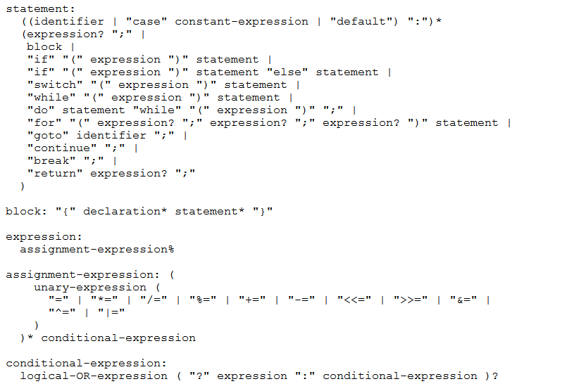
bnf grammar for c

Slide 54
definitions for relations
Let A and B be sets,
A binary relation from A to B is a subset of A × B
Let A be a set,
A binary relation on A is a subset of A × A
Let R be a relation on A
R is reflexive iff (a,a) ∈ R for every a ∈ A
R is symmetric iff (a,b) ∈ R implies (b, a)∈ R
R is antisymmetric iff (a,b) ∈ R and a ≠ b implies (b,a) ∉ R
R is transitive iff (a,b)∈ R and (b, c)∈ R implies (a, c) ∈ R

Slide 55
combining relations
Let R be a relation from A to B
Let S be a relation from B to C
The composite of R and S, S ° R is the relation
from A to C defined
S ° R = {(a, c) | ∃ b such that (a,b)∈ R and (b,c)∈ S}

Slide 56
relations
(a,b)∈ Parent: b is a parent of a
(a,b)∈ Sister: b is a sister of a
Aunt = Sister ° Parent
Grandparent = Parent ° Parent
R² = R ° R = {(a, c) | ∃ b such that (a,b)∈ R and (b,c)∈ R}
R⁰ = {(a,a) | a ∈ A}
R¹ = R
R^{n+1} = R^{n} ° R
S ° R = {(a, c) | ∃ b such that (a,b)∈ R and (b,c)∈ S}

Slide 57
n-ary relations
Let A₁, A₂, …, A_{n} be sets. An n-ary relation on
these sets is a subset of A₁× A₂× . . . × A_{n}.
Student_ID | Name | GPA
328012098 | Knuth | 4.00
481080220 | Von Neuman | 3.78
238082388 | Russell | 3.85
238001920 | Einstein | 2.11
1727017 | Newton | 3.61
348882811 | Karp | 3.98
2921938 | Bernoulli | 3.21
2921939 | Bernoulli | 3.54
Student_ID | Major
328012098 | CS
481080220 | CS
481080220 | Mathematics
238082388 | Philosophy
238001920 | Physics
1727017 | Mathematics
348882811 | CS
1727017 | Physics
2921938 | Mathematics
2921939 | Mathematics

Slide 58
matrix representation for relations
Relation R on A={a₁, … a_{p}}
{(1, 1), (1, 2), (1, 4), (2,1), (2,3), (3,2), (3, 3) (4,2) (4,3)}
1 | 1 | 0 | 1
1 | 0 | 1 | 0
0 | 0 | 1 | 0
0 | 1 | 1 | 0

Slide 59
representation of relations
Directed Graph Representation (Digraph)
{(a, b), (a, a), (b, a), (c, a), (c, d), (c, e) (d, e) }
b
c
a
d
e

Slide 60
paths in relations
Let R be a relation on a set A. There is a path of length n from a to b if and only if (a,b) ∈R^{n}
(a,b) is in the transitive-reflexive closure of R if and only if there is a path from a to b. (Note: by definition, there is a path of length 0 from a to a.)

Slide 61
finite state machines
States
Transitions on inputs
Start state and finals states
The language recognized by a machine is the set of strings that reach a final state
1
State | 0 | 1
s₀ | s₀ | s₁
s₁ | s₀ | s₂
s₂ | s₀ | s₃
s₃ | s₃ | s₃
0
0
s₀
1
s₁
1
s₂
1
s₃
0
0,1

Slide 62
accept strings with odd # of 1’s and odd # of 0’s
1
s₀
s₁
1
0
0
0
0
1
s₂
s₃
1

Slide 63
accept strings with a 1 three positions from the end
001
1
011
1
0
1
1
1
0
000
1
010
101
0
111
1
0
0
1
0
0
100
0
110

Slide 64
product construction
Combining FSMs to check two properties at once
New states record states of both FSMs
0,1
0,1
2
s₀
s₁
0
s₁t₀
2
s₀t₁
0
2
1
0
2
1
1
t₁
s₀t₀
2
s₁t₁
2
0
0
1
2
2
1
1
t₀
1
t₂
1
2
2
0
0
s₁t₂
s₀t₂
2
0
1
0

Slide 65
state machines with output
“Tug-of-war”
 | Input |  | Output
State | L | R
s₁ | s₁ | s₂ | Beep
s₂ | s₁ | s₃
s₃ | s₂ | s₄
s₄ | s₃ | s₄ | Beep
R
R
R
L
S₁
S₂
S₃
S₄
R
Beep
Beep
L
L
L

Slide 66
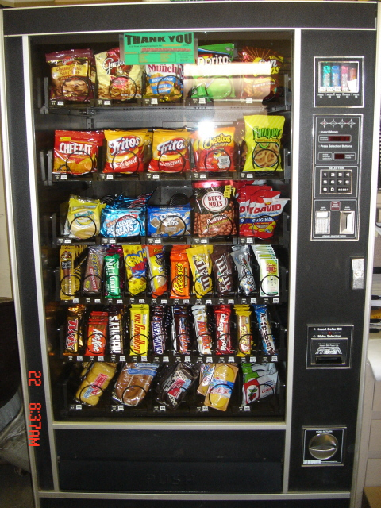
vending machine
Enter 15 cents in dimes or nickels
Press S or B for a candy bar

Slide 67
vending machine, final version
B,S
0
D
N
15
B,S
B,S
B,S
D
D
B
D
0’ B
5
10
S
N
N
N
N
D
15’ N
B
N
B,S
S
D
N
D
0” S
N
B
15” D
S
D

Slide 68
state minimization
Finite State Machines with output at states
0
2
S0 [1]
0
S1
[0]
1
2
3
0
2
3
0
1
S0 [1]
0
S1
[0]
1
⇒
1
0
S2 [1]
S3
[0]
2
1
3
0
1,3
2
3
0
1,2
2
3
3
S2 [1]
S3
[0]
1
1
2
2
2
3
0
S4 [1]
3
S5
[0]
0
1
3

Slide 69
another way to look at DFAs
Definition: The label of a path in a DFA is the
concatenation of all the labels on its edges in order
Lemma: x is in the language recognized by a DFA iff
x labels a path from the start state to some final state
0
0
s₀
1
s₁
1
s₂
1
s₃
0
0,1

Slide 70
nondeterministic finite automaton (NFA)
Graph with start state, final states, edges labeled by symbols (like DFA) but
Not required to have exactly 1 edge out of each state labeled by each symbol - can have 0 or >1
Also can have edges labeled by empty string λ
Definition: x is in the language recognized by an NFA iff x labels a path from the start state to some final state
s₀
1
s₁
1
s₂
1
s₃
0,1
0,1

Slide 71
nondeterministic finite automaton
s₀
1
s₁
0,1
s₂
0,1
s₃
0,1
Accepts strings with a 1 three positions from the end of the string

Slide 72
building a NFA from a regular expression
(01 ∪1)*0
0
λ
1
λ
λ
λ
λ
0
λ
λ
λ
λ
1

Slide 73
NFA to DFA: subset construction
0,1
0
a,b
∅
a
0
1
1
λ
1
1
c
b
0
c
b
0
1
0
0
0,1
1
b,c
a,b,c
NFA
0
DFA

Slide 74
binary palindromes B cannot be recognized by any DFA
Consider the infinite set of strings
S={λ, 0, 00, 000, 0000, ...}
Claim: No two strings in S can end at the same
state of any DFA for B, so no such DFA can exist
Proof: Suppose n≠m and 0^{n} and 0^{m} end at the same state p.
Since 0^{n}10^{n} is in B, following 10^{n} after state p must lead to a final state.
But then the DFA would accept 0^{m}10^{n}
which is a contradiction

Slide 75
cardinality
A set S is countable iff we can write it as S={s₁, s₂, s₃, ...} indexed by ℕ
Set of integers is countable
{0, 1, -1, 2, -2, 3, -3, 4, . . .}
Set of rationals is countable
“dovetailing”
Σ* is countable
{0,1}* = {0,1,00,01,10,11,000,001,010,011,100,101,...}
Set of all (Java) programs is countable
1/1 | 1/2 | 1/3 | 1/4 | 1/5 | 1/6 | 1/7 | 1/8 | ...
2/1 | 2/2 | 2/3 | 2/4 | 2/5 | 2/6 | 2/7 | 2/8 | ...
3/1 | 3/2 | 3/3 | 3/4 | 3/5 | 3/6 | 3/7 | 3/8 | ...
4/1 | 4/2 | 4/3 | 4/4 | 4/5 | 4/6 | 4/7 | 4/8 | ...
5/1 | 5/2 | 5/3 | 5/4 | 5/5 | 5/6 | 5/7 | ...
6/1 | 6/2 | 6/3 | 6/4 | 6/5 | 6/6 | ...
7/1 | 7/2 | 7/3 | 7/4 | 7/5 | ....
... | ... | ... | ... | ...

Slide 76
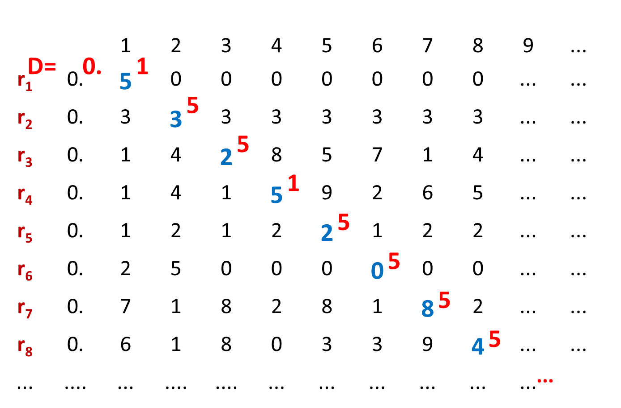
the real numbers are not countable
“diagonalization”

Slide 77
general models of computation
Control structures with infinite storage
Many models
Turing machines
Functional
Recursion
Java programs
Church-Turing Thesis
Any reasonable model of computation that includes all possible algorithms is equivalent in power to a Turing machine

Slide 78
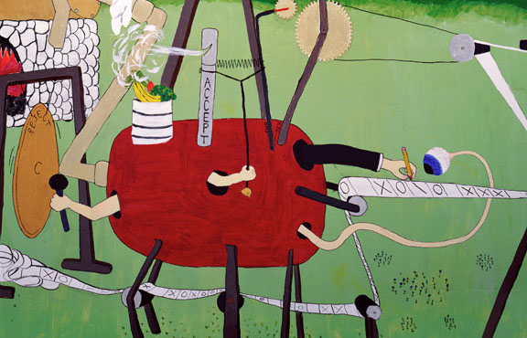
what is a turing machine?

Slide 79
universal turing machine
The Universal Turing Machine U
Takes as input: (<P>,x) where <P> is the code
of a program and x is an input string
Simulates P on input x
Same as a Program Interpreter
input
output
x
output
x
P
U
P(x)
P(x)
<P>

Slide 80
halting problem
Given: the code of a program P and an input x for P, i.e. given (<P>,x)
Output: 1 if P halts on input x 0 if P does not halt on input x
Theorem (Turing): There is no program that solves the halting problem “The halting problem is undecidable”

Slide 81
suppose H(<P>,x) solves the halting problem
Function D(x):
if H(x,x)=1 then
while (true); /* loop forever */
else
no-op; /* do nothing and halt */
endif
Does D halt on input <D>?
D halts on input <D>
⇔ H outputs 1 on input (<D>,<D>)
[since H solves the halting problem and so H(<D>,x) outputs 1 iff D halts on input x]
⇔ D runs forever on input <D>
[since D goes into an infinite loop on x iff H(x,x)=1]

Slide 82
program equivalence
Input: the codes of two programs, <P> and <Q>
Output: 1 if P produces the same output as Q does on every input
0 otherwise
The equivalent program problem is undecidable

Slide 83
That’s all folks!

Slide 84
Teaching evaluation
Please answer the questions on both sides of the form. This includes the ABET questions on the back

