Slide 1
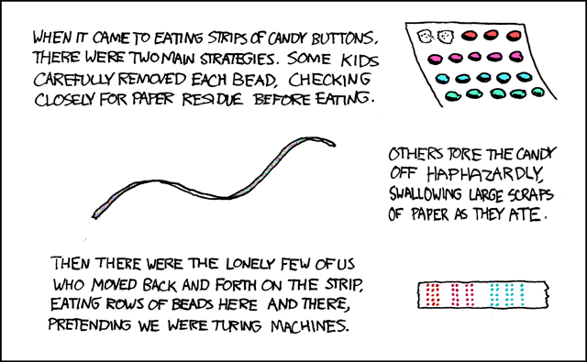
CSE 311: Foundations of Computing
Fall 2013
Lecture 27: Turing machines and decidability

Slide 2
highlights
Cardinality
A set S is countable iff we can write it as S={s₁, s₂, s₃, ...} indexed by ℕ
Set of rationals is countable
“dovetailing”
Σ* is countable
{0,1}* = {λ,0,1,00,01,10,11,000,001,010,011,100,101,...}
Set of all (Java) programs is countable
1/1 | 1/2 | 1/3 | 1/4 | 1/5 | 1/6 | 1/7 | 1/8 | ...
2/1 | 2/2 | 2/3 | 2/4 | 2/5 | 2/6 | 2/7 | 2/8 | ...
3/1 | 3/2 | 3/3 | 3/4 | 3/5 | 3/6 | 3/7 | 3/8 | ...
4/1 | 4/2 | 4/3 | 4/4 | 4/5 | 4/6 | 4/7 | 4/8 | ...
5/1 | 5/2 | 5/3 | 5/4 | 5/5 | 5/6 | 5/7 | ...
6/1 | 6/2 | 6/3 | 6/4 | 6/5 | 6/6 | ...
7/1 | 7/2 | 7/3 | 7/4 | 7/5 | ....
... | ... | ... | ... | ...

Slide 3
what about the real numbers?
Q: Is every set is countable?
A: Theorem [Cantor] The set of real numbers
(even just between 0 and 1) is NOT countable
Proof is by contradiction using a new method called diagonalization

Slide 4
proof by contradiction
Suppose that ℝ^{[0,1)} is countable
Then there is some listing of all elements ℝ^{[0,1)} = { r₁, r₂, r₃, r₄, ... }
We will prove that in such a listing there must be at least one missing element which contradicts statement “ℝ^{[0,1)} is countable”
The missing element will be found by looking at the decimal expansions of r₁, r₂, r₃, r₄, ...

Slide 5
real numbers between 0 and 1: ℝ^{[0,1)}
Every number between 0 and 1 has an infinite decimal expansion:
1/2 = 0.50000000000000000000000...
1/3 = 0.33333333333333333333333...
1/7 = 0.14285714285714285714285...
π -3 = 0.14159265358979323846264...
1/5 = 0.19999999999999999999999...
= 0.20000000000000000000000...

Slide 6
representations of real numbers as decimals
Representation is unique except for the cases that decimal ends in all 0’s or all 9’s.
x = 0.19999999999999999999999...
10x = 1.9999999999999999999999...
9x = 1.8 so
x=0.200000000000000000...
Won’t allow the representations ending in all 9’s
All other representations give different elements of ℝ^{[0,1)}

Slide 7
supposed listing of ℝ^{[0,1)}
 |  | 1 | 2 | 3 | 4 | 5 | 6 | 7 | 8 | 9 | ...
r₁ | 0. | 5 | 0 | 0 | 0 | 0 | 0 | 0 | 0 | ... | ...
r₂ | 0. | 3 | 3 | 3 | 3 | 3 | 3 | 3 | 3 | ... | ...
r₃ | 0. | 1 | 4 | 2 | 8 | 5 | 7 | 1 | 4 | ... | ...
r₄ | 0. | 1 | 4 | 1 | 5 | 9 | 2 | 6 | 5 | ... | ...
r₅ | 0. | 1 | 2 | 1 | 2 | 2 | 1 | 2 | 2 | ... | ...
r₆ | 0. | 2 | 5 | 0 | 0 | 0 | 0 | 0 | 0 | ... | ...
r₇ | 0. | 7 | 1 | 8 | 2 | 8 | 1 | 8 | 2 | ... | ...
r₈ | 0. | 6 | 1 | 8 | 0 | 3 | 3 | 9 | 4 | ... | ...
... | .... | ... | .... | .... | ... | ... | ... | ... | ... | ...

Slide 8
supposed listing of ℝ^{[0,1)}
 |  | 1 | 2 | 3 | 4 | 5 | 6 | 7 | 8 | 9 | ...
r₁ | 0. | 5 | 0 | 0 | 0 | 0 | 0 | 0 | 0 | ... | ...
r₂ | 0. | 3 | 3 | 3 | 3 | 3 | 3 | 3 | 3 | ... | ...
r₃ | 0. | 1 | 4 | 2 | 8 | 5 | 7 | 1 | 4 | ... | ...
r₄ | 0. | 1 | 4 | 1 | 5 | 9 | 2 | 6 | 5 | ... | ...
r₅ | 0. | 1 | 2 | 1 | 2 | 2 | 1 | 2 | 2 | ... | ...
r₆ | 0. | 2 | 5 | 0 | 0 | 0 | 0 | 0 | 0 | ... | ...
r₇ | 0. | 7 | 1 | 8 | 2 | 8 | 1 | 8 | 2 | ... | ...
r₈ | 0. | 6 | 1 | 8 | 0 | 3 | 3 | 9 | 4 | ... | ...
... | .... | ... | .... | .... | ... | ... | ... | ... | ... | ...

Slide 9
flipped diagonal
 |  | 1
 |  |  | 5
 |  |  |  | 5
 |  |  |  |  | 1
 |  |  |  |  |  | 5
 |  |  |  |  |  |  | 5
 |  |  |  |  |  |  |  | 5
 |  |  |  |  |  |  |  |  | 5
 |  |  |  |  |  |  |  |  |  | ...
Flipping Rule:
If digit is 5, make it 1
If digit is not 5, make it 5
 |  | 1 | 2 | 3 | 4 | 5 | 6 | 7 | 8 | 9 | ...
r₁ | 0. | 5 | 0 | 0 | 0 | 0 | 0 | 0 | 0 | ... | ...
r₂ | 0. | 3 | 3 | 3 | 3 | 3 | 3 | 3 | 3 | ... | ...
r₃ | 0. | 1 | 4 | 2 | 8 | 5 | 7 | 1 | 4 | ... | ...
r₄ | 0. | 1 | 4 | 1 | 5 | 9 | 2 | 6 | 5 | ... | ...
r₅ | 0. | 1 | 2 | 1 | 2 | 2 | 1 | 2 | 2 | ... | ...
r₆ | 0. | 2 | 5 | 0 | 0 | 0 | 0 | 0 | 0 | ... | ...
r₇ | 0. | 7 | 1 | 8 | 2 | 8 | 1 | 8 | 2 | ... | ...
r₈ | 0. | 6 | 1 | 8 | 0 | 3 | 3 | 9 | 4 | ... | ...
... | .... | ... | .... | .... | ... | ... | ... | ... | ... | ...

Slide 10
flipped diagonal number D
 |  | 1 | 2 | 3 | 4 | 5 | 6 | 7 | 8 | 9 | ...
D = | 0. | 1
 |  |  | 5
 |  |  |  | 5
 |  |  |  |  | 1
 |  |  |  |  |  | 5
 |  |  |  |  |  |  | 5
 |  |  |  |  |  |  |  | 5
 |  |  |  |  |  |  |  |  | 5
 |  |  |  |  |  |  |  |  |  | ...
D is in ℝ^{[0,1)}
But for all n, we have
D≠r_{n} since they differ on
n^{th} digit (which is not 9)
⇒ list was incomplete
⇒ ℝ^{[0,1)} is not countable

Slide 11
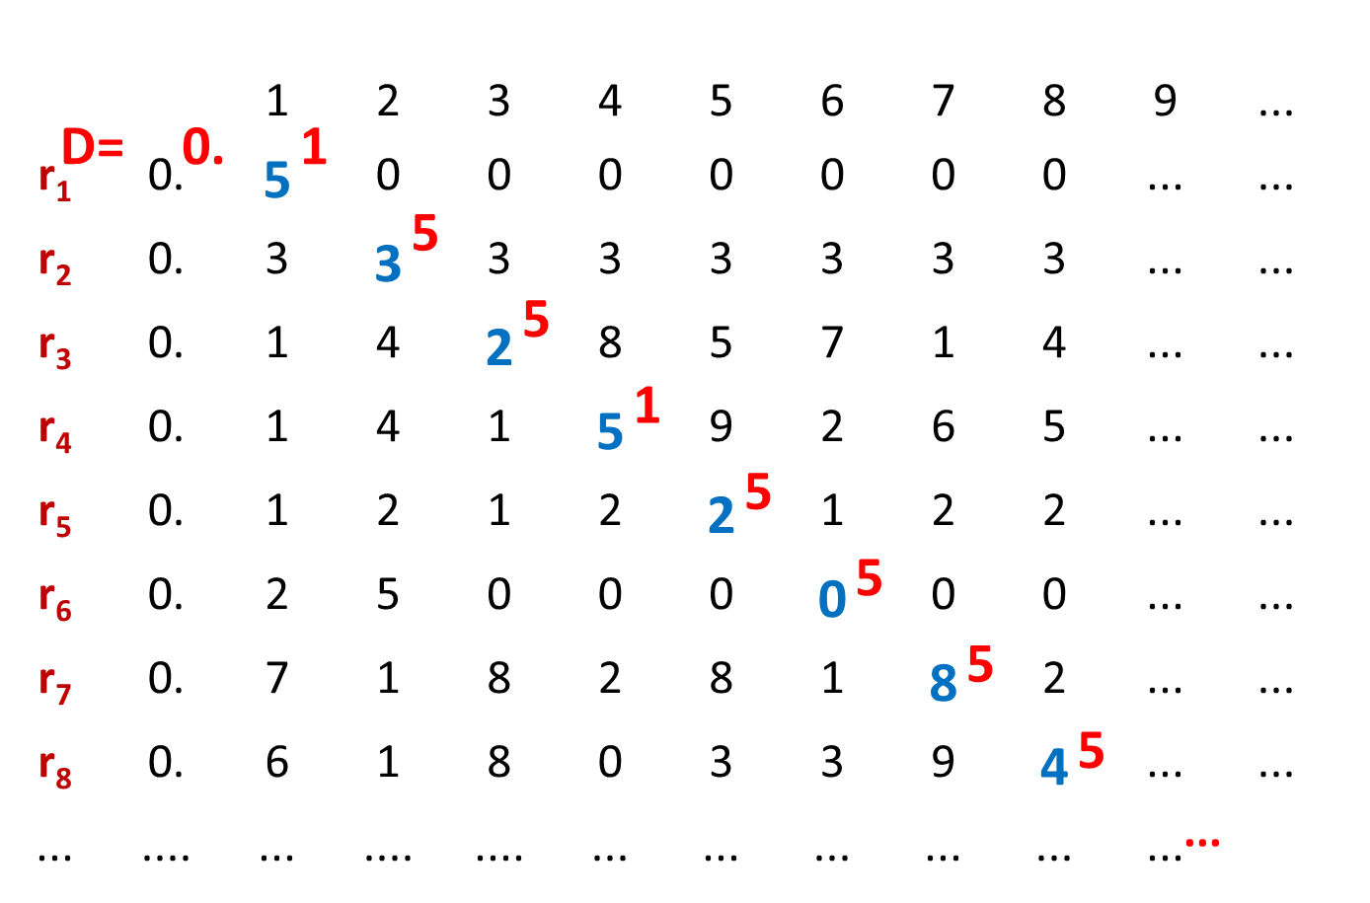
why doesn’t this show that the rationals aren’t countable?
The set of real numbers is not countable
flipped diagonal number D

Slide 12
the set of all functions f : ℕ→{0,1,...,9} is not countable

Slide 13
highlights
There exist functions that cannot be computed by any program
The set of all functions f : ℕ→{0,1,...,9} is not countable
The set of all (Java/C/C++) programs is countable
So there are simply more functions than programs

Slide 14
do we care?
Are any of these functions, ones that we would actually want to compute?
The argument does not even give any example of something that can’t be done, it just says that such an example exists
We haven’t used much of anything about what computers (programs or people) can do
Once we figure that out, we’ll be able to show that some of these functions are really important

Slide 15
before Java…more from our brief history of reasoning
1930’s
How can we formalize what algorithms are possible?
Turing machines (Turing, Post)
basis of modern computers
Lambda Calculus (Church)
basis for functional programming
μ-recursive functions (Kleene)
alternative functional programming basis
All
are
equivalent!

Slide 16
turing machines
Church-Turing Thesis
Any reasonable model of computation that includes all possible algorithms is equivalent in power to a Turing machine
Evidence
Intuitive justification
Huge numbers of equivalent models to TM’s based on radically different ideas

Slide 17
components of Turing’s intuitive model of computation
Finite Control
Brain/CPU that has only a finite # of possible “states of mind”
Recording medium
An unlimited supply of blank “scratch paper” on which to write & read symbols, each chosen from a finite set of possibilities
Input also supplied on the scratch paper
Focus of attention
Finite control can only focus on a small portion of the recording medium at once
Focus of attention can only shift a small amount at a time

Slide 18
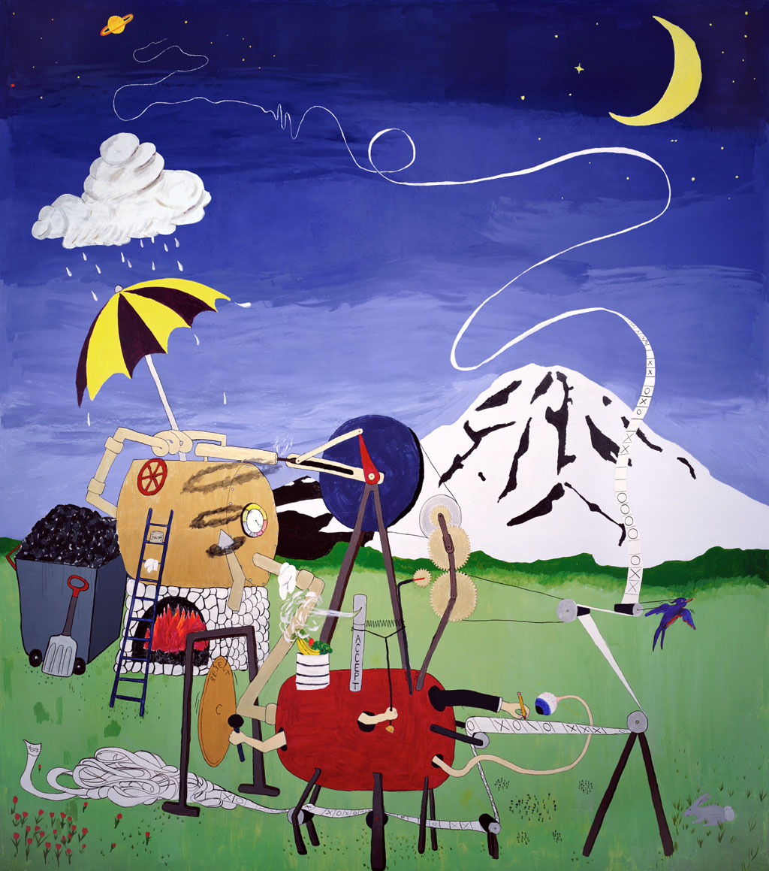
what is a Turing machine?

Slide 19
what is a Turing machine?
Recording medium
An infinite read/write “tape” marked off into cells
Each cell can store one symbol or be “blank”
Tape is initially all blank except a few cells of the tape containing the input string
Read/write head can scan one cell of the tape - starts on input
In each step, a Turing machine
Reads the currently scanned symbol
Based on state of mind and scanned symbol
Overwrites symbol in scanned cell
Moves read/write head left or right one cell
Changes to a new state
Each Turing Machine is specified by its finite set of rules

Slide 20
sample Turing machine
 | _ | 0 | 1
s₁ | (1,s₃) | (1,s₂) | (0,s₂)
s₂ | (H,s₃) | (R,s₁) | (R,s₁)
s₃ | (H,s₃) | (R,s₃) | (R,s₃)
_ | _ | 1 | 1 | 0 | 1 | 1 | _ | _

Slide 21
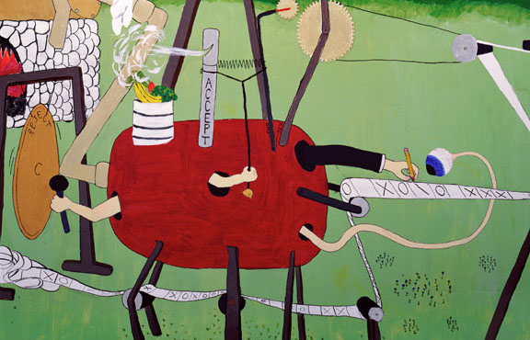
what is a Turing machine?

Slide 22
turing machine ≡ ideal Java/C program
Ideal C/C++/Java programs
Just like the C/C++/Java you’re used to programming with, except you never run out of memory
constructor methods always succeed
malloc never fails
Equivalent to Turing machines except a lot easier to program !
Turing machine definition is useful for breaking computation down into simplest steps
We only care about high level so we use programs

Slide 23
turing’s big idea: machines as data
Original Turing machine definition
A different “machine” M for each task
Each machine M is defined by a finite set of possible operations on finite set of symbols
M has a finite description as a sequence of symbols, its “code”
You already are used to this idea:
We’ll write <P> for the code of program P
i.e. <P> is the program text as a sequence of ASCII symbols and P is what actually executes

Slide 24
turing’s idea: a universal turing machine
A Turing machine interpreter U
On input <P> and its input x, U outputs the same thing as P does on input x
At each step it decodes which operation P would have performed and simulates it.
One Turing machine is enough
Basis for modern stored-program computer
Von Neumann studied Turing’s UTM design
input
output
x
output
x
P
U
P(x)
P(x)
<P>

Slide 25
halting problem
Given: the code of a program P and an input x for P, i.e. given (<P>,x)
Output: 1 if P halts on input x 0 if P does not halt on input x
Theorem (Turing): There is no program that solves the halting problem “The halting problem is undecidable”

Slide 26
proof by contradiction
Suppose that H is a Turing machine that solves the Halting problem
Function D(x):
if H(x,x)=1 then
while (true); /* loop forever */
else
no-op; /* do nothing and halt */
endif
What does D do on input <D>?
Does it halt?

Slide 27
proof by contradiction
Function D(x):
if H(x,x)=1 then
while (true); /* loop forever */
else
no-op; /* do nothing and halt */
Endif`
Does D halt on input <D>?
D halts on input <D>
⇔ H outputs 1 on input (<D>,<D>)
[since H solves the halting problem and so H(<D>,x) outputs 1 iff D halts on input x]
⇔ D runs forever on input <D>
[since D goes into an infinite loop on x iff H(x,x)=1]
This is contradiction. Our only assumption was that H exists.

Slide 28
that’s it!
We proved that there is no computer program that can solve the Halting Problem.
This tells us that there is no compiler that can check our programs and guarantee to find any infinite loops they might have

