Slide 1
CSE 311: Foundations of Computing
Fall 2013
Lecture 25: Non-regularity and limits of FSMs

Slide 2
highlights
NFAs from Regular Expressions
(01 ∪1)*0
0
λ
1
λ
λ
λ
λ
0
λ
λ
λ
λ
1

Slide 3
highlights
“Subset construction”: NFA to DFA
0,1
0
a,b
∅
a
1
0
1
λ
1
c
1
b
0
c
b
0
0
1
0,1
0
1
b,c
a,b,c
0
NFA
DFA

Slide 4
1 in third position from end
A
1
B
0,1
C
0,1
D
0,1
1
1
{A, B, C, D}
{A, B, C}
0
1
0
0
{A, C, D}
1
{A}
{A, B}
1
1
0
0
{A, B, D}
1
0
{A, C}
1
0
{A, D}
0

Slide 5
redrawing
A
1
B
0,1
C
0,1
D
0,1
1
{A,B}
{A,B,C}
1
0
1
1
1
0
{A}
1
{A,C}
{A,B,D}
0
{A,B,C,D}
1
0
0
1
0
0
{A,D}
0
{A,C,D}

Slide 6
DFAs ≡ regular expressions
We have shown how to build an optimal DFA for every regular expression
Build NFA
Convert NFA to DFA using subset construction
Minimize resulting DFA
Theorem: A language is recognized by a DFA if and
only if it has a regular expression

Slide 7
generalized NFAs
Like NFAs but allow
Parallel edges
Regular Expressions as edge labels
NFAs already have edges labeled λ or a
An edge labeled by A can be followed by reading a string of input chars that is in the language represented by A
A string x is accepted iff there is a path from start to final state labeled by a regular expression whose language contains x

Slide 8
starting from an NFA
Add new start state and final state
λ
λ
λ
Then eliminate original states one by one, keeping the same language, until it looks like:
Final regular expression will be A
A

Slide 9
only two simplification rules
Rule 1: For any two states q₁ and q₂ with parallel edges (possibly q₁=q₂), replace
Rule 2: Eliminate non-start/final state q₃ by replacing all
for every pair of states q₁, q₂ (even if q₁=q₂)
A
A⋃B
q₁
q₂
by
q₁
q₂
B
B
q₁
A
q₃
C
q₂
by
AB*C
q₂
q₁

Slide 10
converting an NFA to a regular expression
Consider the DFA for the mod 3 sum
Accept strings from {0,1,2}* where the digits mod 3 sum of the digits is 0
0
t₁
1
1
2
2
0
0
t₀
2
t₂
1

Slide 11
splicing out a node
Label edges with regular expressions
t₀→t₁→t₀ : 10*2
t₀→t₁→t₂ : 10*1
t₂→t₁→t₀ : 20*2
t₂→t₁→t₂ : 20*1
0
t₁
s
1
1
λ
2
2
0
0
t₀
2
t₂
1
λ
f

Slide 12
finite automaton without t₁
s
R₁: 0 ∪ 10*2
R₂: 2 ∪ 10*1
R₃: 1 ∪ 20*2
R₄: 0 ∪ 20*1
R₅: R₁ ∪ R₂R₄*R₃
λ
R₂
R₄
R₁
t₀
t₂
R₃
λ
f
s
λ
R₅
λ
t₀
f
Final regular expression:
(0 ∪ 10*2 ∪ (2 ∪ 10*1)(0 ∪ 20*1)*(1 ∪ 20*2))*

Slide 13
what can finite state machines do?
We’ve seen how we can get DFAs to recognize all regular languages
What about some other languages we can generate with CFGs?
{ $0^{n}1^{n} :n≥0$ } ?
binary palindromes?
strings of balanced parentheses?

Slide 14
A={$0^{n}1^{n} :n≥0$} cannot be recognized by any DFA
Consider the infinite set of strings
S={λ, 0, 00, 000, 0000, ...}
Claim: No two strings in S can end at the same state
of any DFA for A
Proof:
Suppose n≠m and 0^{n} and 0^{m} end at the same state p of some DFA for A.
Since 0^{n}1^{n} is in A, following 1^{n} after state p must lead to a final state.
But then the DFA would also accept 0^{m}1^{n}
which is a contradiction to the DFA recognizing A.
Given claim, the # of states of any DFA for A must be ≥ |S| which is not finite, which is impossible for a DFA.

Slide 15
B = {binary palindromes} can’t be recognized by any DFA
Consider the infinite set of strings
S={λ, 0, 00, 000, 0000, ...}={0^{n} : n ≥ 0}
Claim: No two strings in S can end at the same
state of any DFA for B
Proof:
Suppose n≠m and 0^{n} and 0^{m} end at the same state p of some DFA for B.
Since 0^{n}10^{n} is in B, following 10^{n} after state p must lead to
a final state.
But then the DFA would also accept 0^{m}10^{n} which is not in B
and is a contradiction since the DFA recognizes B.
Given claim, the # of states of any DFA for B must be ≥ |S| which is not finite, which is impossible for a DFA.

Slide 16
general: how to show language L has no DFA
Find a “hard” infinite set S={s₀,s₁,...,s_{n},...} of strings that might be prefixes of strings in L
Show that S is hard by showing that no two strings s_{n}≠s_{m} in S can end at the same state of any DFA recognizing L
For each pair s_{n}≠s_{m} find an extender string t depending on n,m so that exactly one of s_{n}t and s_{m}t is in L
Conclude that any DFA for L would need ≥ |S|states which is not finite, and so impossible

Slide 17
P = {strings of balanced parentheses}

Slide 18
pattern matching
Given
a string, s, of n characters
a pattern, p, of m characters
usually m<<n
Find
all occurrences of the pattern p in the string s
Obvious algorithm:
try to see if p matches at each of the positions in s
stop at a failed match and try the next position

Slide 19
string s = x y x x y x y x y y x y x y x y y x y x y x x
pattern p = x y x y y x y x y x x

Slide 20
string s = x y x x y x y x y y x y x y x y y x y x y x x
x y x y y x y x y x x

Slide 21
string s = x y x x y x y x y y x y x y x y y x y x y x x
x y x y
x y x y y x y x y x x

Slide 22
string s = x y x x y x y x y y x y x y x y y x y x y x x
x y x y
x
x y x y y x y x y x x

Slide 23
string s = x y x x y x y x y y x y x y x y y x y x y x x
x y x y
x
x y
x y x y y x y x y x x

Slide 24
string s = x y x x y x y x y y x y x y x y y x y x y x x
x y x y
x
x y
x y x y y
x y x y y x y x y x x

Slide 25
string s = x y x x y x y x y y x y x y x y y x y x y x x
x y x y
x
x y
x y x y y
x
x y x y y x y x y x x

Slide 26
string s = x y x x y x y x y y x y x y x y y x y x y x x
x y x y
x
x y
x y x y y
x
x y x y y x y x y x x
x y x y y x y x y x x

Slide 27
String s = x y x x y x y x y y x y x y x y y x y x y x x
x y x y
x
x y
x y x y y
x
x y x y y x y x y x x
x
x y x y y x y x y x x

Slide 28
string s = x y x x y x y x y y x y x y x y y x y x y x x
x y x y
x
x y
x y x y y
x
x y x y y x y x y x x
x
x y x
x y x y y x y x y x x

Slide 29
string s = x y x x y x y x y y x y x y x y y x y x y x x
x y x y
x
x y
x y x y y
x
x y x y y x y x y x x
x
x y x
x
x y x y y x y x y x x

Slide 30
string s = x y x x y x y x y y x y x y x y y x y x y x x
x y x y
x
x y
x y x y y
x
x y x y y x y x y x x
x
x y x
x
x
x y x y y x y x y x x

Slide 31
string s = x y x x y x y x y y x y x y x y y x y x y x x
x y x y
x
x y
x y x y y
x
x y x y y x y x y x x
x
x y x
x
x
x y x y y
x y x y y x y x y x x

Slide 32
string s = x y x x y x y x y y x y x y x y y x y x y x x
x y x y
x
x y
x y x y y
x
x y x y y x y x y x x
x
Worst-case time
O(mn)
x y x
x
x
x y x y y
x
x y x y y x y x y x x

Slide 33
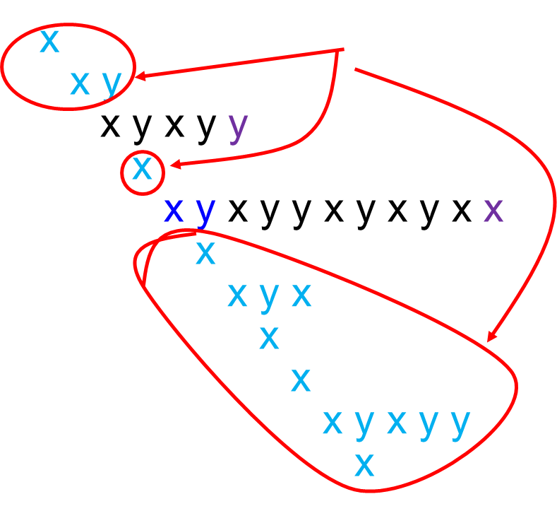
string s = x y x x y x y x y y x y x y x y y x y x y x x
x y x y
Lots of wasted work
x y x y y x y x y x x

Slide 34
better pattern matching via finite automata
Build a DFA for the pattern (preprocessing) of size O(m)
Keep track of the ‘longest match currently active’
The DFA will have only m+1 states
Run the DFA on the string n steps
Obvious construction method for DFA will be O(m²) but can be done in O(m) time.
Total O(m+n) time

Slide 35
building a DFA for the pattern
pattern p=x y x y y x y x y x x

Slide 36
preprocessing the pattern
pattern p=x y x y y x y x y x x

Slide 37
preprocessing the pattern
pattern p=x y x y y x y x y x x

Slide 38
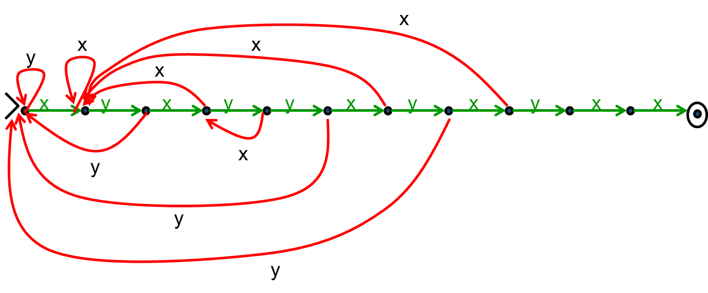
preprocessing the pattern
pattern p=x y x y y x y x y x x

Slide 39
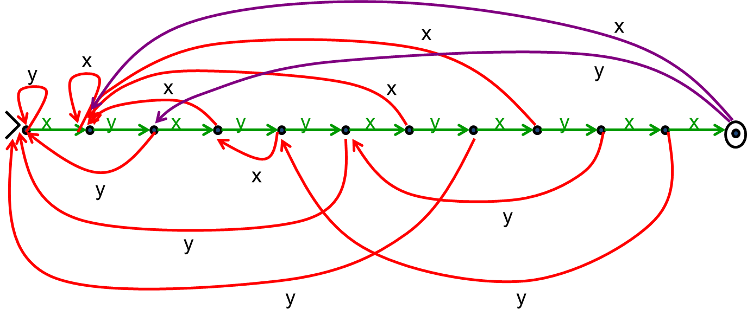
preprocessing the pattern
pattern p=x y x y y x y x y x x

Slide 40
generalizing
Can search for arbitrary combinations of patterns
Not just a single pattern
Build NFA for pattern then convert to DFA ‘on the fly’.
Compare DFA constructed above with subset construction for the obvious NFA.

