Slide 1
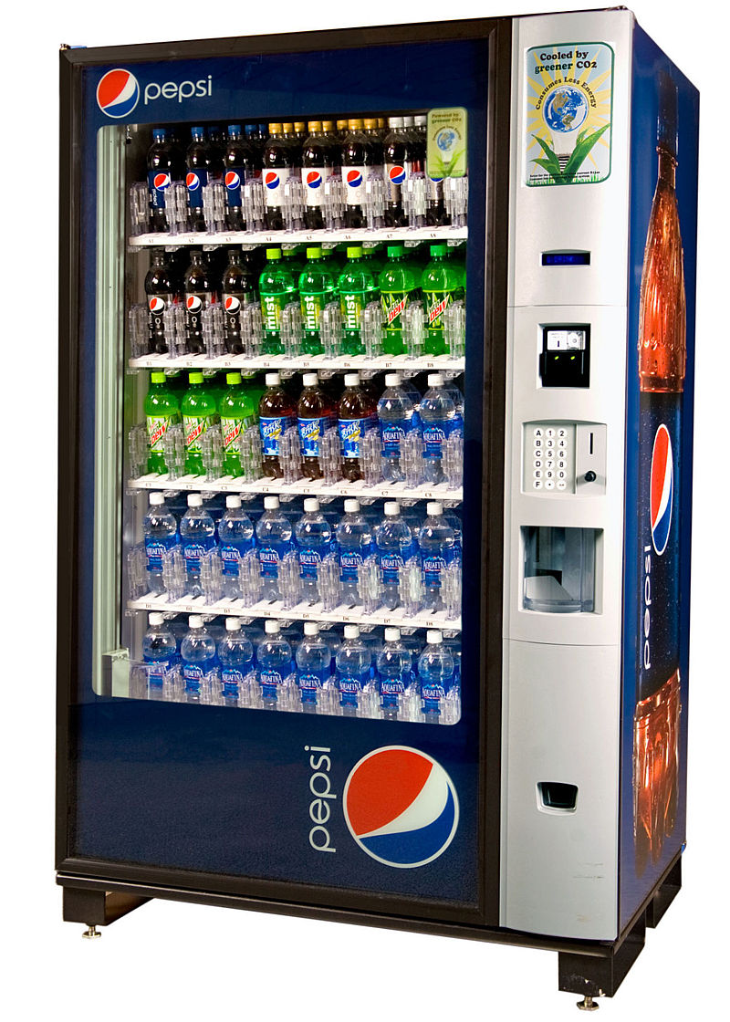
CSE 311: Foundations of Computing
Fall 2013
Lecture 23: Finite state machines and minimization

Slide 2
FSM highlights
Finite state machines
States, transitions, start state, final states
Languages recognized by FSMs
R
0
0
0
0,1
s₀
1
s₁
1
s₂
1
s₃
s₀
0,1
s₁
0,1
s₂
1
A
0
0,1
0,1
001
1
011
1
0
1
1
1
0
000
1
010
101
0
111
1
0
0
0
1
0
100
0
110

Slide 3
FSM highlights
Combining FSMs to check two properties at once
New states record states of both FSMs
0,1
0,1
2
s₀
s₁
0
s₁t₀
2
s₀t₁
0
2
1
0
2
1
1
t₁
s₀t₀
2
s₁t₁
2
0
0
1
2
2
1
1
t₀
1
t₂
1
2
2
0
0
s₁t₂
s₀t₂
2
0
1
0

Slide 4
state machines with output
“Tug-of-war”
 | Input |  | Output
State | L | R
s₁ | s₁ | s₂ | Beep
s₂ | s₁ | s₃
s₃ | s₂ | s₄
s₄ | s₃ | s₄ | Beep
R
R
R
L
S₁
S₂
S₃
S₄
R
L
L
L

Slide 5
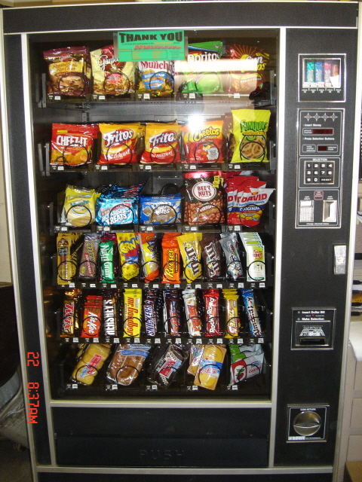
vending machine
Enter 15 cents in dimes or nickels
Press S or B for a candy bar

Slide 6
vending machine, v0.1
D
D
0
N
5
N
10
N, D
15
B, S
Basic transitions on N (nickel), D (dime), B (butterfinger), S (snickers)

Slide 7
vending machine, v0.2
0
D
N
15
D
D
B
0’ B
5
10
S
N
N
N
D
15’ N
B
S
N
D
0” S
Adding output to states: N – Nickel, S – Snickers, B – Butterfinger

Slide 8
vending machine, v1.0
B,S
0
D
N
15
B,S
B,S
B,S
D
D
B
D
0’ B
5
10
S
N
N
N
N
D
15’ N
B
N
B,S
S
D
N
D
0” S
N
B
15” D
S
D
Adding additional “unexpected” transitions

Slide 9
state minimization
Many different FSMs (DFAs) for the same problem
Take a given FSM and try to reduce its state set by combining states
Algorithm will always produce the unique minimal equivalent machine (up to renaming of states) but we won’t prove this

Slide 10
state minimization algorithm
Put states into groups based on their outputs (or whether they are final states or not)
Repeat the following until no change happens
If there is a symbol s so that not all states in a group G agree on which group s leads to, split G into smaller groups based on which group the states go to on s
s
G₂
s
G₁
s
s
G₃

Slide 11
state minimization example
present next state output state 0 1 2 3 S0 S0 S1 S2 S3 1 S1 S0 S3 S1 S5 0 S2 S1 S3 S2 S4 1 S3 S1 S0 S4 S5 0 S4 S0 S1 S2 S5 1 S5 S1 S4 S0 S5 0
0
2
S0 [1]
0
S1
[0]
1
2
3
3
0
1
0
1
S2 [1]
S3
[0]
state transition table
1
2
3
2
3
Put states into groups based on their
outputs (or whether they are final states
or not)
1
2
2
S4 [1]
3
S5
[0]
0
0
1
3

Slide 12
state minimization example
present next state output state 0 1 2 3 S0 S0 S1 S2 S3 1 S1 S0 S3 S1 S5 0 S2 S1 S3 S2 S4 1 S3 S1 S0 S4 S5 0 S4 S0 S1 S2 S5 1 S5 S1 S4 S0 S5 0
0
2
S0 [1]
0
S1
[0]
1
2
3
3
0
1
0
1
state transition table
S2 [1]
S3
[0]
1
2
Put states into groups based on their
outputs (or whether they are final states
or not)
2
3
3
1
2
2
S4 [1]
3
S5
[0]
0
0
1
3

Slide 13
state minimization example
present next state output state 0 1 2 3 S0 S0 S1 S2 S3 1 S1 S0 S3 S1 S5 0 S2 S1 S3 S2 S4 1 S3 S1 S0 S4 S5 0 S4 S0 S1 S2 S5 1 S5 S1 S4 S0 S5 0
0
2
S0 [1]
0
S1
[0]
1
2
3
3
0
1
0
1
state transition table
S2 [1]
S3
[0]
1
2
Put states into groups based on their
outputs (or whether they are final states
or not)
2
3
3
1
2
2
S4 [1]
3
S5
[0]
0
If there is a symbol s so that not all states in
a group G agree on which group s leads to,
split G based on which group the states go
to on s
0
1
3

Slide 14
state minimization example
present next state output state 0 1 2 3 S0 S0 S1 S2 S3 1 S1 S0 S3 S1 S5 0 S2 S1 S3 S2 S4 1 S3 S1 S0 S4 S5 0 S4 S0 S1 S2 S5 1 S5 S1 S4 S0 S5 0
0
2
S0 [1]
0
S1
[0]
1
2
3
3
0
1
0
1
state transition table
S2 [1]
S3
[0]
1
2
Put states into groups based on their
outputs (or whether they are final states
or not)
2
3
3
1
2
2
S4 [1]
3
S5
[0]
0
If there is a symbol s so that not all states in
a group G agree on which group s leads to,
split G based on which group the states go
to on s
0
1
3

Slide 15
state minimization example
present next state output state 0 1 2 3 S0 S0 S1 S2 S3 1 S1 S0 S3 S1 S5 0 S2 S1 S3 S2 S4 1 S3 S1 S0 S4 S5 0 S4 S0 S1 S2 S5 1 S5 S1 S4 S0 S5 0
0
2
S0 [1]
0
S1
[0]
1
2
3
3
0
1
0
1
state transition table
S2 [1]
S3
[0]
1
2
Put states into groups based on their
outputs (or whether they are final states
or not)
2
3
3
1
2
2
S4 [1]
3
S5
[0]
0
0
If there is a symbol s so that not all states in
a group G agree on which group s leads to,
split G based on which group the states go
to on s
1
3

Slide 16
state minimization example
present next state output state 0 1 2 3 S0 S0 S1 S2 S3 1 S1 S0 S3 S1 S5 0 S2 S1 S3 S2 S4 1 S3 S1 S0 S4 S5 0 S4 S0 S1 S2 S5 1 S5 S1 S4 S0 S5 0
0
2
S0 [1]
0
S1
[0]
1
2
3
3
0
1
0
1
state transition table
S2 [1]
S3
[0]
1
2
Put states into groups based on their
outputs (or whether they are final states
or not)
2
3
3
1
2
2
S4 [1]
3
S5
[0]
0
If there is a symbol s so that not all states in
a group G agree on which group s leads to,
split G based on which group the states go
to on s
0
1
3

Slide 17
state minimization example
present next state output state 0 1 2 3 S0 S0 S1 S2 S3 1 S1 S0 S3 S1 S5 0 S2 S1 S3 S2 S4 1 S3 S1 S0 S4 S5 0 S4 S0 S1 S2 S5 1 S5 S1 S4 S0 S5 0
0
2
S0 [1]
0
S1
[0]
1
2
3
3
0
1
0
1
state transition table
S2 [1]
S3
[0]
1
2
Put states into groups based on their
outputs (or whether they are final states
or not)
2
3
3
1
2
2
S4 [1]
3
S5
[0]
0
If there is a symbol s so that not all states in
a group G agree on which group s leads to,
split G based on which group the states go
to on s
0
1
3

Slide 18
state minimization example
present next state output state 0 1 2 3 S0 S0 S1 S2 S3 1 S1 S0 S3 S1 S5 0 S2 S1 S3 S2 S4 1 S3 S1 S0 S4 S5 0 S4 S0 S1 S2 S5 1 S5 S1 S4 S0 S5 0
0
2
S0 [1]
0
S1
[0]
1
2
3
3
0
1
0
1
state transition table
S2 [1]
S3
[0]
1
2
3
2
3
1
Can combine states S0-S4 and
S3-S5.
In table replace all S4 with S0
and all S5 with S3
2
2
S4 [1]
3
S5
[0]
0
0
1
3

Slide 19
minimized machine
present next state output state 0 1 2 3 S0 S0 S1 S2 S3 1 S1 S0 S3 S1 S3 0 S2 S1 S3 S2 S0 1 S3 S1 S0 S0 S3 0
0
2
S0 [1]
0
S1
[0]
1
2
3
0
1,3
3
1,2
state transition table
0
S2 [1]
S3
[0]
1
2
3

Slide 20
another way to look at DFAs
Definition: The label of a path in a DFA is the
concatenation of all the labels on its edges in order
Lemma: x is in the language recognized by a DFA iff
x labels a path from the start state to some final state
0
0
s₀
1
s₁
1
s₂
1
s₃
0
0,1

Slide 21
nondeterministic finite automaton (NFA)
Graph with start state, final states, edges labeled by symbols (like DFA) but
Not required to have exactly 1 edge out of each state labeled by each symbol--- can have 0 or >1
Also can have edges labeled by empty string λ
Definition: x is in the language recognized by an NFA if and only if x labels a path from the start state to some final state
s₀
1
s₁
1
s₂
1
s₃
0,1
0,1

Slide 22
goal: NFA to recognize...
binary strings with even # of 1’s that contain the substring 111

