Slide 1
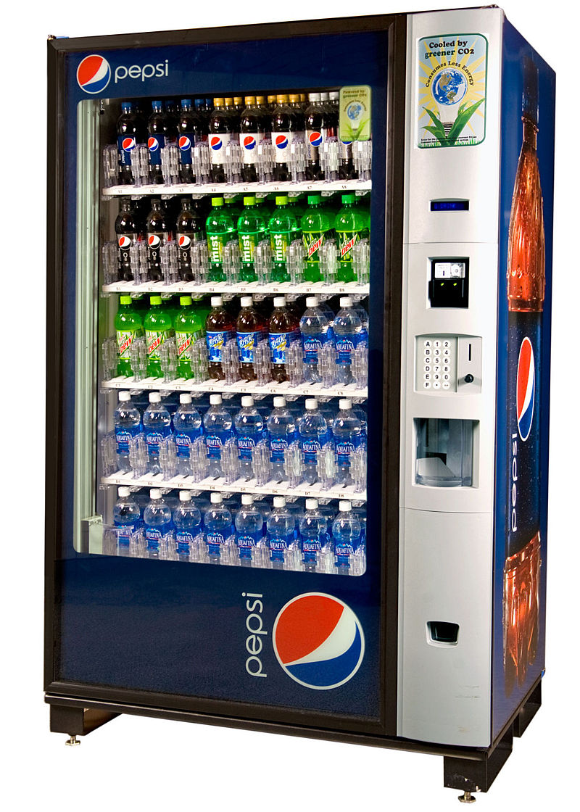
CSE 311: Foundations of Computing
Fall 2013
Lecture 22: Finite state machines (aka DFAs)

Slide 2
highlights: directed graphs
V – vertices
E – edges, order pairs of vertices
G = (V, E)
Path: v₀, v₁, …, v_{k}, with (v_{i}, v_{i+1}) in E
Simple Path
Cycle
Simple Cycle

Slide 3
highlights: relations
Let R be a relation on a set A. There is a path of length n from a to b if and only if (a,b) ∈R^{n}
Let R be a relation on a set A. The connectivity relation R* consists of the pairs (a,b) such that there is a path from a to b in R.
Transitive-Reflexive closure: Add the minimum possible number of edges to make the relation transitive and reflexive
The transitive-reflexive closure of a relation R is the connectivity relation R*

Slide 4
n-ary relations
Let A₁, A₂, …, A_{n} be sets. An n-ary relation on
these sets is a subset of A₁× A₂ × $⋯$× A_{n}.

Slide 5
relational databases
STUDENT
Student_Name | ID_Number | Office | GPA
Knuth | 328012098 | 022 | 4.00
Von Neuman | 481080220 | 555 | 3.78
Russell | 238082388 | 022 | 3.85
Einstein | 238001920 | 022 | 2.11
Newton | 1727017 | 333 | 3.61
Karp | 348882811 | 022 | 3.98
Bernoulli | 2921938 | 022 | 3.21

Slide 6
relational databases
STUDENT
Student_Name | ID_Number | Office | GPA | Course
Knuth | 328012098 | 022 | 4.00 | CSE311
Knuth | 328012098 | 022 | 4.00 | CSE351
Von Neuman | 481080220 | 555 | 3.78 | CSE311
Russell | 238082388 | 022 | 3.85 | CSE312
Russell | 238082388 | 022 | 3.85 | CSE344
Russell | 238082388 | 022 | 3.85 | CSE351
Newton | 1727017 | 333 | 3.61 | CSE312
Karp | 348882811 | 022 | 3.98 | CSE311
Karp | 348882811 | 022 | 3.98 | CSE312
Karp | 348882811 | 022 | 3.98 | CSE344
Karp | 348882811 | 022 | 3.98 | CSE351
Bernoulli | 2921938 | 022 | 3.21 | CSE351
What’s not so nice?
Notes:
What’s wrong:
Redundant data: we repeat all the GPAs and all the Office numbers
Missing data: we lost Einstein

Slide 7
relational databases
STUDENT
TAKES
Student_Name | ID_Number | Office | GPA
Knuth | 328012098 | 022 | 4.00
Von Neuman | 481080220 | 555 | 3.78
Russell | 238082388 | 022 | 3.85
Einstein | 238001920 | 022 | 2.11
Newton | 1727017 | 333 | 3.61
Karp | 348882811 | 022 | 3.98
Bernoulli | 2921938 | 022 | 3.21
ID_Number | Course
328012098 | CSE311
328012098 | CSE351
481080220 | CSE311
238082388 | CSE312
238082388 | CSE344
238082388 | CSE351
1727017 | CSE312
348882811 | CSE311
348882811 | CSE312
348882811 | CSE344
348882811 | CSE351
2921938 | CSE351
Better

Slide 8
database operations: projection
Office
022
555
333
Find all offices: $Π_{Office}\left(STUDENT\right)$
Office | GPA
022 | 4.00
555 | 3.78
022 | 3.85
022 | 2.11
333 | 3.61
022 | 3.98
022 | 3.21
Find offices and GPAs: $Π_{Office, GPA}\left(STUDENT\right)$

Slide 9
database operations: selection
Find students with GPA > 3.9 : σ_{GPA>3.9}(STUDENT)
Student_Name | ID_Number | Office | GPA
Knuth | 328012098 | 022 | 4.00
Karp | 348882811 | 022 | 3.98
Retrieve the name and GPA for students with GPA > 3.9: Π_{Student_Name,GPA}(σ_{GPA>3.9}(STUDENT))
Student_Name | GPA
Knuth | 4.00
Karp | 3.98

Slide 10
database operations: natural join
Student ⋈ Takes
Student_Name | ID_Number | Office | GPA | Course
Knuth | 328012098 | 022 | 4.00 | CSE311
Knuth | 328012098 | 022 | 4.00 | CSE351
Von Neuman | 481080220 | 555 | 3.78 | CSE311
Russell | 238082388 | 022 | 3.85 | CSE312
Russell | 238082388 | 022 | 3.85 | CSE344
Russell | 238082388 | 022 | 3.85 | CSE351
Newton | 1727017 | 333 | 3.61 | CSE312
Karp | 348882811 | 022 | 3.98 | CSE311
Karp | 348882811 | 022 | 3.98 | CSE312
Karp | 348882811 | 022 | 3.98 | CSE344
Karp | 348882811 | 022 | 3.98 | CSE351
Bernoulli | 2921938 | 022 | 3.21 | CSE351

Slide 11
finite state machines
States
Transitions on inputs
Start state and final states
The language recognized by a machine is the set of strings that reach a final state
0
0
State | 0 | 1
s₀ | s₀ | s₁
s₁ | s₀ | s₂
s₂ | s₀ | s₃
s₃ | s₃ | s₃
s₀
1
s₁
1
s₂
1
s₃
0
0,1

Slide 12
applications of FSMs (a.k.a. finite automata)
Implementation of regular expression matching in programs like grep
Control structures for sequential logic in digital circuits
Algorithms for communication and cache-coherence protocols
Each agent runs its own FSM
Design specifications for reactive systems
Components are communicating FSMs

Slide 13
applications of FSMs (a.k.a. finite automata)
Formal verification of systems
Is an unsafe state reachable?
Computer games
FSMs provide worlds to explore
Minimization algorithms for FSMs can be extended to more general models used in
Text prediction
Speech recognition

Slide 14
what language does this machine recognize?
1
s₀
s₁
1
0
0
0
0
1
s₂
s₃
1

Slide 15
3 bit shift register
001
1
011
1
0
1
1
1
0
000
1
010
101
0
111
1
0
0
1
0
0
100
0
110

Slide 16
0
1
0
1
0
1
0
1
00
01
10
11
1
1
1
0
0
0
0
1
001
1
011
1
0
1
1
1
0
000
1
010
101
0
111
1
0
0
1
0
0
100
0
110

Slide 17
goal: FSM that accepts strings with a 1 three positions from the end

Slide 18
question
How does the size of a DFA to recognize “10th character is a 1” compare with the size of a DFA to recognize “10th character from the end is 1”?

Slide 19
strings over {0, 1, 2}*
M₁: Strings with an even number of 2’s
M₂: Strings where the sum of digits mod 3 is 0
s₀
s₁
t₁
t₀
t₂

Slide 20
strings with an even number of 2’s and a mod 3 sum of 0
s₁t₀
s₀t₁
s₀t₀
s₁t₁
s₁t₂
s₀t₂

Slide 21
state machines with output
“Tug-of-war”
 | Input |  | Output
State | L | R
s₁ | s₁ | s₂ | Beep
s₂ | s₁ | s₃
s₃ | s₂ | s₄
s₄ | s₃ | s₄ | Beep
R
R
R
L
S₁
S₂
S₃
S₄
R
L
L
L

Slide 22
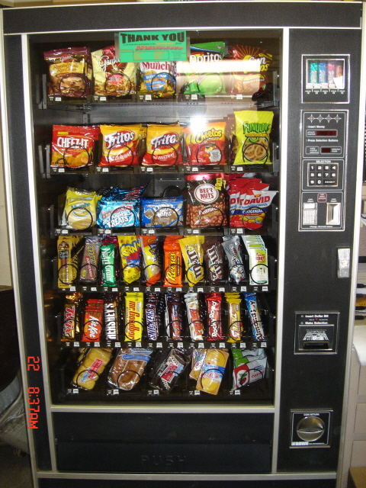
vending machine
Enter 15 cents in dimes or nickels
Press S or B for a candy bar

Slide 23
vending machine, v0.1
D
D
0
N
5
N
10
N, D
15
B, S
Basic transitions on N (nickel), D (dime), B (butterfinger), S (snickers)

Slide 24
vending machine, v0.2
0
D
N
15
D
D
B
0’ B
5
10
S
N
N
N
D
15’ N
B
S
N
D
0” S
Adding output to states: N – Nickel, S – Snickers, B – Butterfinger

Slide 25
vending machine, v1.0
B,S
0
D
N
15
B,S
B,S
B,S
D
D
B
D
0’ B
5
10
S
N
N
N
N
D
15’ N
B
N
B,S
S
D
N
D
0” S
N
B
15” D
S
D
Adding additional “unexpected” transitions

