Slide 1
CSE 311: Foundations of Computing
Fall 2013
Lecture 21: Relations and directed graphs

Slide 2
announcements
Reading assignments
7th Edition, 9.1 and pp. 594-601
6th Edition, 8.1 and pp. 541-548

Slide 3
relations
Let A and B be sets,
A binary relation from A to B is a subset of A × B
Let A be a set,
A binary relation on A is a subset of A × A

Slide 4
relation examples
R₁ = {(a, 1), (a, 2), (b, 1), (b, 3), (c, 3)}
R₂ = {(x, y) | x ≡ y (mod 5) }
R₃ = {(c₁, c₂) | c₁ is a prerequisite of c₂ }
R₄ = {(s, c) | student s had taken course c }

Slide 5
properties of relations
Let R be a relation on A.
R is reflexive iff (a,a) ∈ R for every a ∈ A
R is symmetric iff (a,b) ∈ R implies (b, a)∈ R
R is antisymmetric iff (a,b) ∈ R and a ≠ b implies (b,a) $∉$ R
R is transitive iff (a,b)∈ R and (b, c)∈ R implies (a, c) ∈ R

Slide 6
combining relations
Let R be a relation from A to B.
Let S be a relation from B to C.
The composite of R and S, S $∘$ R is the relation
from A to C defined by:
S $∘$ R = {(a, c) | ∃ b such that (a,b)∈ R and (b,c)∈ S}

Slide 7
examples
(a,b) ∈ Parent: b is a parent of a
(a,b) ∈ Sister: b is a sister of a
What is Sister $∘$ Parent?
What is Parent $∘$ Sister?
S $∘$ R = {(a, c) | ∃ b such that (a,b)∈ R and (b,c)∈ S}

Slide 8
examples
Using the relations: Parent, Child, Brother, Sister, Sibling, Father, Mother, Husband, Wife express:
Uncle: b is an uncle of a
Cousin: b is a cousin of a

Slide 9
powers of a relation
$R^{2} =R∘R$
$=\{\left(a,c\right)∣∃b such that \left(a,b\right)∈R and \left(b,c\right)∈R \}$
$R^{0} =\{\left(a,a\right)∣a∈A\}$
$R^{1} =R$
$R^{n+1}=$ $R^{n}$ $∘$ $R$

Slide 10
matrix representation
Relation $R$ on $A=\{a_{1},…, a_{p}\}$
{(1, 1), (1, 2), (1, 4), (2,1), (2,3), (3,2), (3, 3), (4,2), (4,3)}

Slide 11
directed graphs
V – vertices
E – edges, ordered pairs of vertices
G = (V, E)
Path: v₀, v₁, …, v_{k}, with (v_{i}, v_{i+1}) in E
Simple Path
Cycle
Simple Cycle

Slide 12
representation of relations
Directed Graph Representation (Digraph)
{(a, b), (a, a), (b, a), (c, a), (c, d), (c, e) (d, e) }
b
c
a
d
e

Slide 13
composite relation using digraph representation
If $S=\left\{\left(2,2\right), \left(2,3\right), \left(3,1\right)\right\}$ and $R=\{\left(1,2\right),\left(2,1\right),\left(1,3\right)\}$
Compute $S∘R$

Slide 14
paths in relations
Let R be a relation on a set A. There is a path of length n from a to b if and only if (a,b) ∈ R^{n}

Slide 15
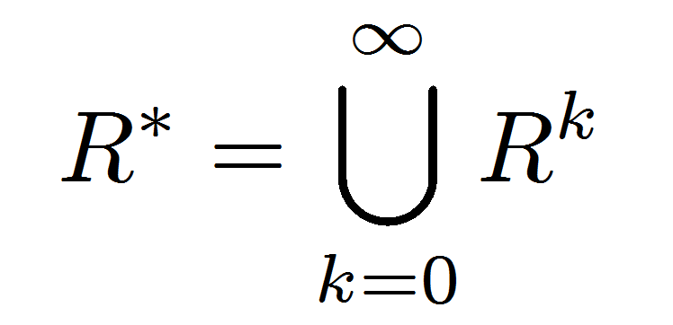
connectivity relation
Let R be a relation on a set A. The connectivity relation R* consists of the pairs (a,b) such that there is a path from a to b
in R.
Note: The text uses the wrong definition of this quantity.
What the text defines (ignoring k=0) is usually called R⁺

Slide 16
properties of relations
Let R be a relation on A.
R is reflexive iff (a,a) ∈ R for every a ∈ A
R is symmetric iff (a,b) ∈ R implies (b, a)∈ R
R is transitive iff (a,b)∈ R and (b, c)∈ R implies (a, c) ∈ R

Slide 17
transitive-reflexive closure
Add the minimum possible number of edges to make the relation transitive and reflexive
The transitive-reflexive closure of a relation R is the connectivity relation R*

Slide 18
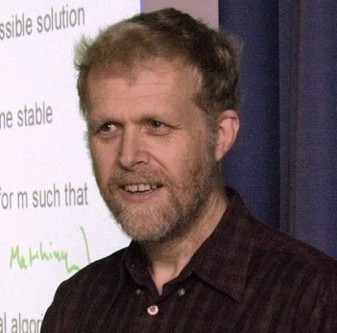
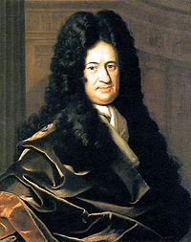
how is Anderson related to Ber noul?

Slide 19
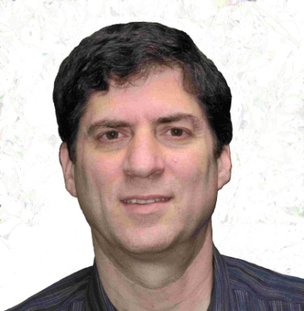
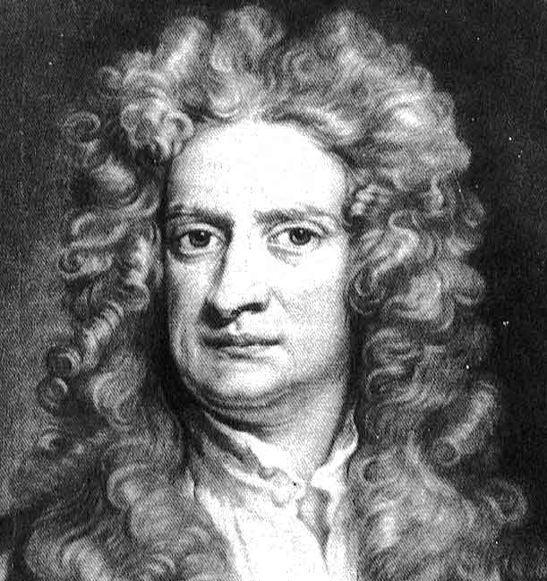
how is Anderson related to Bernoul?

Slide 20
http://genealogy.math.ndsu.nodak.edu/

Slide 21
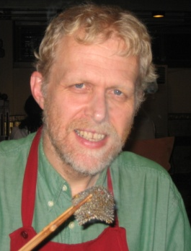
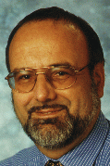
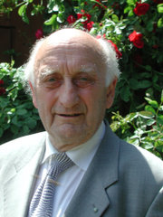
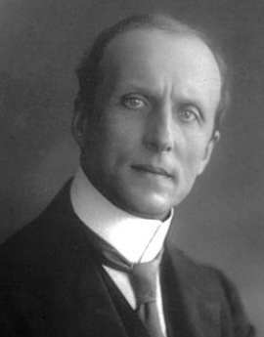
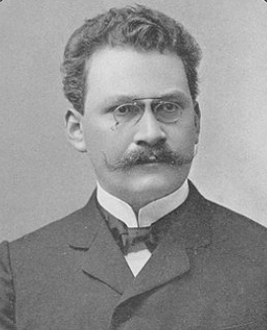
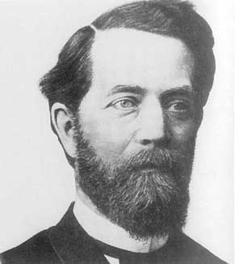
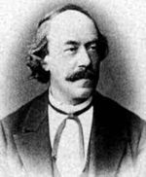
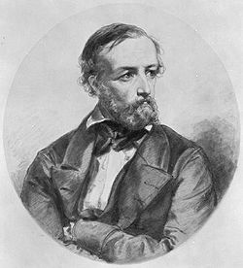
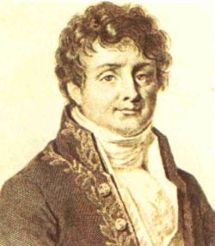
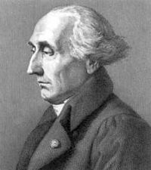
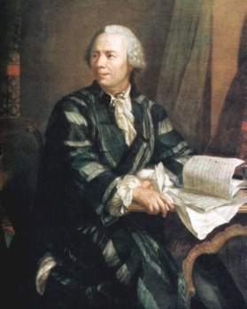
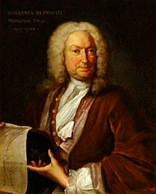
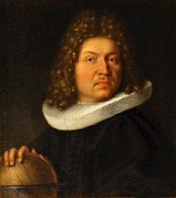
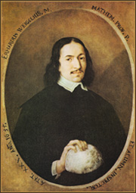
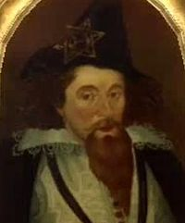
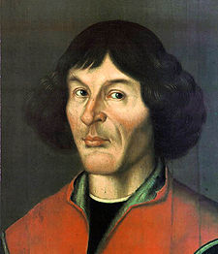
Anderson
Mayr
Bauer
Caratheodory
Minkowski
Klein
Lipschitz
Dirichlet
Fourier
Lagrange
Euler
Johann Bernoulli
Jacob Bernoulli
Leibniz
Weigel
Rheticus
Copernicus

Slide 22
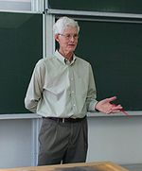
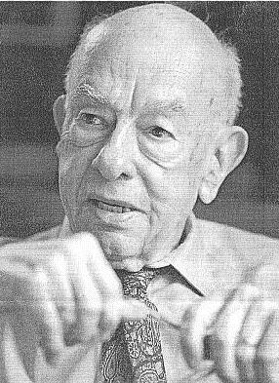
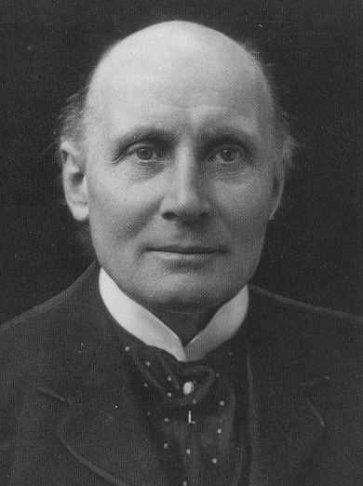
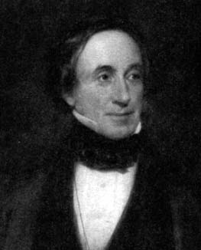
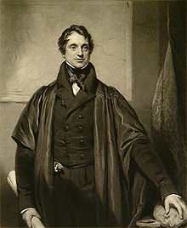
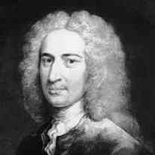
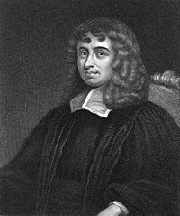
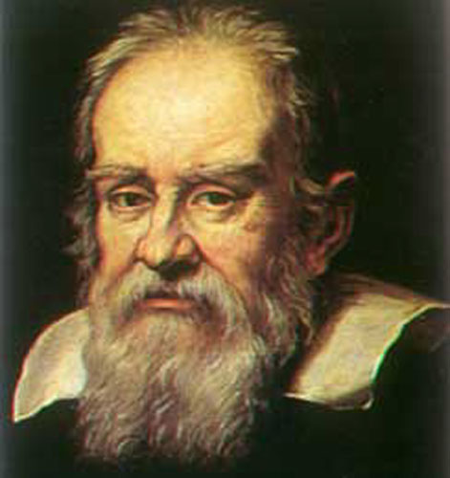
Beame
Cook
Quine
Whitehead
Hopkins
Sedgewick
Smith
Newton
Barrow
Galileo

Slide 23
Nicolaus Copernicus
Georg Rheticus
Moritz Steinmetz
Christoph Meurer
Philipp Muller
Erhard Weigel
Gottfried Leibniz
Noclas Malebranache
Jacob Bernoulli
Johann Bernoulli
Leonhard Euler
Joseph Lagrange
Jean-Baptiste Fourier
Gustav Dirichlet
Rudolf Lipschitz
Felix Klein
C. L. Ferdinand Lindemann Herman Minkowski
Constantin Caratheodory Georg Aumann
Friedrich Bauer
Manfred Paul
Ernst Mayr Richard Anderson
Galileo Galilei
Vincenzo Viviani
Issac Barrow
Isaac Newton
Roger Cotes
Robert Smith
Walter Taylor
Stephen Whisson
Thomas Postlethwaite
Thomas Jones
Adam Sedgewick
William Hopkins
Edward Routh
Alfred North Whitehead
Willard Quine
Hao Wang
Stephen Cook
Paul Beame

Slide 24
n-ary relations
Let A₁, A₂, …, A_{n} be sets. An n-ary relation on
these sets is a subset of A₁× A₂ × $⋯$× A_{n}.

Slide 25
relational databases
STUDENT
Student_Name | ID_Number | Office | GPA
Knuth | 328012098 | 022 | 4.00
Von Neuman | 481080220 | 555 | 3.78
Russell | 238082388 | 022 | 3.85
Einstein | 238001920 | 022 | 2.11
Newton | 1727017 | 333 | 3.61
Karp | 348882811 | 022 | 3.98
Bernoulli | 2921938 | 022 | 3.21

Slide 26
relational databases
STUDENT
Student_Name | ID_Number | Office | GPA | Course
Knuth | 328012098 | 022 | 4.00 | CSE311
Knuth | 328012098 | 022 | 4.00 | CSE351
Von Neuman | 481080220 | 555 | 3.78 | CSE311
Russell | 238082388 | 022 | 3.85 | CSE312
Russell | 238082388 | 022 | 3.85 | CSE344
Russell | 238082388 | 022 | 3.85 | CSE351
Newton | 1727017 | 333 | 3.61 | CSE312
Karp | 348882811 | 022 | 3.98 | CSE311
Karp | 348882811 | 022 | 3.98 | CSE312
Karp | 348882811 | 022 | 3.98 | CSE344
Karp | 348882811 | 022 | 3.98 | CSE351
Bernoulli | 2921938 | 022 | 3.21 | CSE351
What’s not so nice?
Notes:
What’s wrong:
Redundant data: we repeat all the GPAs and all the Office numbers
Missing data: we lost Einstein

Slide 27
relational databases
STUDENT
TAKES
Student_Name | ID_Number | Office | GPA
Knuth | 328012098 | 022 | 4.00
Von Neuman | 481080220 | 555 | 3.78
Russell | 238082388 | 022 | 3.85
Einstein | 238001920 | 022 | 2.11
Newton | 1727017 | 333 | 3.61
Karp | 348882811 | 022 | 3.98
Bernoulli | 2921938 | 022 | 3.21
ID_Number | Course
328012098 | CSE311
328012098 | CSE351
481080220 | CSE311
238082388 | CSE312
238082388 | CSE344
238082388 | CSE351
1727017 | CSE312
348882811 | CSE311
348882811 | CSE312
348882811 | CSE344
348882811 | CSE351
2921938 | CSE351
Better

Slide 28
database operations: projection
Office
022
555
333
Find all offices: $Π_{Office}\left(STUDENT\right)$
Office | GPA
022 | 4.00
555 | 3.78
022 | 3.85
022 | 2.11
333 | 3.61
022 | 3.98
022 | 3.21
Find offices and GPAs: $Π_{Office, GPA}\left(STUDENT\right)$

Slide 29
database operations: selection
Find students with GPA > 3.9 : σ_{GPA>3.9}(STUDENT)
Student_Name | ID_Number | Office | GPA
Knuth | 328012098 | 022 | 4.00
Karp | 348882811 | 022 | 3.98
Retrieve the name and GPA for students with GPA > 3.9: Π_{Student_Name,GPA}(σ_{GPA>3.9}(STUDENT))
Student_Name | GPA
Knuth | 4.00
Karp | 3.98

Slide 30
database operations: natural join
Student ⋈ Takes
Student_Name | ID_Number | Office | GPA | Course
Knuth | 328012098 | 022 | 4.00 | CSE311
Knuth | 328012098 | 022 | 4.00 | CSE351
Von Neuman | 481080220 | 555 | 3.78 | CSE311
Russell | 238082388 | 022 | 3.85 | CSE312
Russell | 238082388 | 022 | 3.85 | CSE344
Russell | 238082388 | 022 | 3.85 | CSE351
Newton | 1727017 | 333 | 3.61 | CSE312
Karp | 348882811 | 022 | 3.98 | CSE311
Karp | 348882811 | 022 | 3.98 | CSE312
Karp | 348882811 | 022 | 3.98 | CSE344
Karp | 348882811 | 022 | 3.98 | CSE351
Bernoulli | 2921938 | 022 | 3.21 | CSE351

