Slide 1
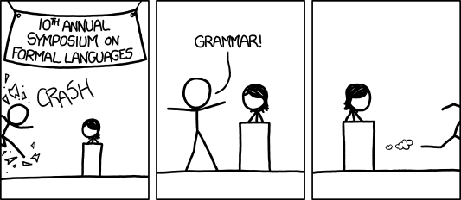
CSE 311: Foundations of Computing
Fall 2013
Lecture 20: Context-free grammars/Relations

Slide 2
announcements
Reading assignments
7th Edition, pp. 851-855
6th Edition, pp. 789-793
Today and Friday
7th Edition, Section 9.1 and pp. 594-601
6th Edition, Section 8.1 and pp. 541-548

Slide 3
more examples
All binary strings that don’t contain 101

Slide 4
review: the limitations of regular expressions
Not all languages can be specified by regular expressions
Even some easy things like
Palindromes
Strings with equal number of 0’s and 1’s
But also more complicated structures in programming languages
Matched parentheses
Properly formed arithmetic expressions
etc.

Slide 5
review: context free grammars
A Context-Free Grammar (CFG) is given by a finite set of substitution rules involving
A finite set V of variables that can be replaced
Alphabet Σ of terminal symbols that can’t be replaced
One variable, usually S, is called the start symbol
The rules involving a variable A are written as
A → w₁ | w₂ | $⋯$ | w_{k}
where each w_{i} is a string of variables and terminals – that is w_{i} ∈ (V ∪ Σ)∗

Slide 6
review: how CFGs generate strings
Begin with start symbol S
If there is some variable A in the current string you can replace it by one of the w’s in the rules for A
A → w₁ | w₂ | $⋯$ | w_{k}
Write this as xAy ⇒ xw_{i}y
Repeat until no variables left
The set of strings the CFG generates are all strings produced in this way that have no variables

Slide 7
review: sample context-free grammars
Example: S → 0S0 | 1S1 | 0 | 1 | λ
Example: S → 0S | S1 | λ

Slide 8
review: sample context-free grammars
Grammar for $\left\{0^{n}1^{n}:n≥0\right\}$
(all strings with same # of 0’s and 1’s with all 0’s before 1’s)
Example: S → (S) | SS | λ

Slide 9
simple arithmetic expressions
E→ E+E | E$∗$E | (E) | x | y | z | 0 | 1 | 2 | 3 | 4
| 5 | 6 | 7 | 8 | 9
Generate (2$∗$x) + y
Generate x+y$∗$z in two fundamentally different ways

Slide 10
CFGs and recursively-defined sets of strings
A CFG with the start symbol S as its only variable recursively defines the set of strings of terminals that S can generate
A CFG with more than one variable is a simultaneous recursive definition of the sets of strings generated by each of its variables
Sometimes necessary to use more than one

Slide 11
building precedence in simple arithmetic expressions
E – expression (start symbol)
T – term F – factor I – identifier N - number
E → T | E+T
T → F | F$∗$T
F → (E) | I | N
I → x | y | z
N → 0 | 1 | 2 | 3 | 4 | 5 | 6 | 7 | 8 | 9

Slide 12
another name for CFGs
BNF (Backus-Naur Form) grammars
Originally used to define programming languages
Variables denoted by long names in angle brackets, e.g.
<identifier>, <if-then-else-statement>, <assignment-statement>, <condition>
$∷=$ used instead of →

Slide 13
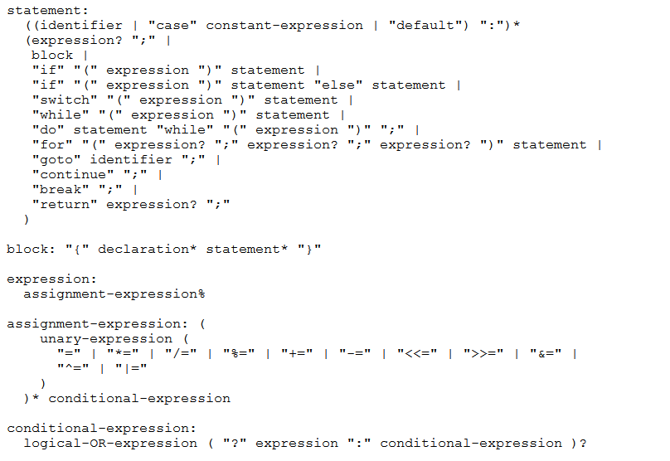
BNF for C

Slide 14
parse trees
Back to middle school:
<sentence>$∷=$<noun phrase><verb phrase>
<noun phrase>$∷=$<article><adjective><noun>
<verb phrase>$∷=$<verb><adverb>|<verb><object>
<object>$∷=$<noun phrase>
Parse:
The yellow duck squeaked loudly
The red truck hit a parked car

Slide 15
relations
Let A and B be sets,
A binary relation from A to B is a subset of A × B
Let A be a set,
A binary relation on A is a subset of A × A

Slide 16
relation examples
R₁ = {(a, 1), (a, 2), (b, 1), (b, 3), (c, 3)}
R₂ = {(x, y) | x ≡ y (mod 5) }
R₃ = {(c₁, c₂) | c₁ is a prerequisite of c₂ }
R₄ = {(s, c) | student s had taken course c }

Slide 17
properties of relations
Let R be a relation on A.
R is reflexive iff (a,a) ∈ R for every a ∈ A
R is symmetric iff (a,b) ∈ R implies (b, a)∈ R
R is antisymmetric iff (a,b) ∈ R and a ≠ b implies (b,a) ∉ R
R is transitive iff (a,b)∈ R and (b, c)∈ R implies (a, c) ∈ R

Slide 18
combining relations
Let R be a relation from A to B.
Let S be a relation from B to C.
The composite of R and S, S $∘$ R is the relation
from A to C defined by:
S $∘$ R = {(a, c) | ∃ b such that (a,b)∈ R and (b,c)∈ S}

Slide 19
examples
(a,b) ∈ Parent: b is a parent of a
(a,b) ∈ Sister: b is a sister of a
What is Sister $∘$ Parent?
What is Parent $∘$ Sister?
S $∘$ R = {(a, c) | ∃ b such that (a,b)∈ R and (b,c)∈ S}

Slide 20
examples
Using the relations: Parent, Child, Brother, Sister, Sibling, Father, Mother, Husband, Wife express:
Uncle: b is an uncle of a
Cousin: b is a cousin of a

