Slide 1
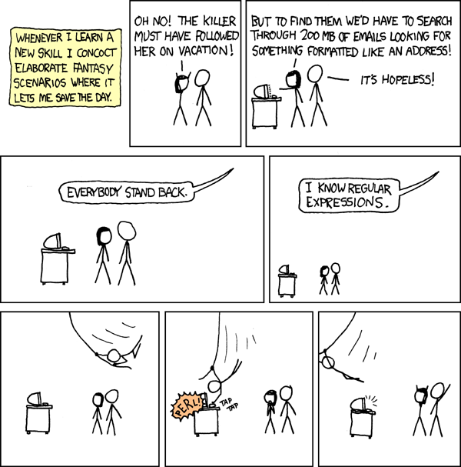
CSE 311: Foundations of Computing
Fall 2013
Lecture 18: Structural induction, regular expressions

Slide 2
announcements
Reading assignment
7th Edition, pp. 878-880 and pp. 851-855
6th Edition, pp. 817-819 and pp. 789-793
Midterm back today
Average 73%
Graded Homework 5 back Friday
Homework 6 out later today

Slide 3
review: structural induction
How to prove $x∈S, P(x)$is true:
Base Case: Show that $P$ is true for all specific elements of $S$ mentioned in the Basis step
Inductive Hypothesis: Assume that $P$ is true for some arbitrary values of each of the existing named elements mentioned in the Recursive step
Inductive Step: Prove that$P$holds for each of the new elements constructed in the Recursive step using the named elements mentioned in the Inductive Hypothesis
Conclude that $x∈S, P(x)$

Slide 4
review: rooted binary trees
Basis: • is a rooted binary tree
Recursive step: If and are
rooted binary trees
then so is:
T₁
T₂
T₂
T₁

Slide 5
functions defined on rooted binary trees
size(•)=1
size( ) = 1+size(T₁)+size(T₂)
height(•)=0
height( )=1+max{height(T₁),height(T₂)}
T₁
T₂
T₁
T₂

Slide 6
for every rooted binary tree $T$, $size(T)≤2^{height(T)+1}−1$

Slide 7
for every rooted binary tree $T$, $size(T)≤2^{height(T)+1}−1$

Slide 8
languages: sets of strings
Sets of strings that satisfy special properties are called languages. Examples:
English sentences
Syntactically correct Java/C/C++ programs
Σ∗ = All strings over alphabet Σ
Palindromes over Σ
Binary strings that don’t have a 0 after a 1
Legal variable names. keywords in Java/C/C++
Binary strings with an equal # of 0’s and 1’s

Slide 9
regular expressions
Regular expressions over Σ
Basis:
∅, λ are regular expressions
a is a regular expression for any a ∈ Σ
Recursive step:
If A and B are regular expressions then so are:
(A ∪ B)
(AB)
A*

Slide 10
each regular expression is a “pattern”
λ matches the empty string
a matches the one character string a
(A ∪ B) matches all strings that either A matches or B matches (or both)
(AB) matches all strings that have a first part that A matches followed by a second part that B matches
A* matches all strings that have any number of strings (even 0) that A matches, one after another

Slide 11
examples
001*
0*1*
(0 ∪ 1)0(0 ∪ 1)0
(0*1*)*
(0 ∪ 1)* 0110 (0 ∪ 1)*
(00 ∪ 11)* (01010 ∪ 10001)(0 ∪ 1)*

Slide 12
regular expressions in practice
Used to define the “tokens”: e.g., legal variable names, keywords in programming languages and compilers
Used in grep, a program that does pattern matching searches in UNIX/LINUX
Pattern matching using regular expressions is an essential feature of hypertext scripting language PHP used for web programming
Also in text processing programming language Perl

Slide 13
regular expressions in php
int preg_match ( string $pattern , string $subject,...)
$pattern syntax:
[01] a 0 or a 1 ^ start of string $ end of string
[0-9] any single digit \. period \, comma \- minus
. any single character
ab a followed by b (AB)
(a|b) a or b (A ∪ B) a? zero or one of a (A ∪ λ) a* zero or more of a A*
a+ one or more of a AA*
e.g. ^[\-+]?[0-9]*(\.|\,)?[0-9]+$
General form of decimal number e.g. 9.12 or -9,8 (Europe)

Slide 14
more examples
All binary strings that have an even # of 1’s
All binary strings that don’t contain 101

