Slide 1
CSE 311: Foundations of Computing
Fall 2013
Lecture 17: Recursive definitions and structural induction

Slide 2
announcements
Reading assignment
Induction
5.3, 7th edition
4.3, 6th edition
Homework 5 solutions out today
Midterm
Monday, November 4th, IN CLASS
Topics: Everything up to ordinary induction and
recursive definition of functions
Sample questions from old midterms now posted.
Solutions posted later today.
Review sessions: Today 3:30, Sunday 4:00 in EEB 125

Slide 3
review: recursive definition of sets
Recursive definition
Basis step: $0  S$
Recursive step: if $x  S$, then $x+2  S$
Exclusion rule: Every element in $S$ follows from basis steps and a finite number of recursive steps

Slide 4
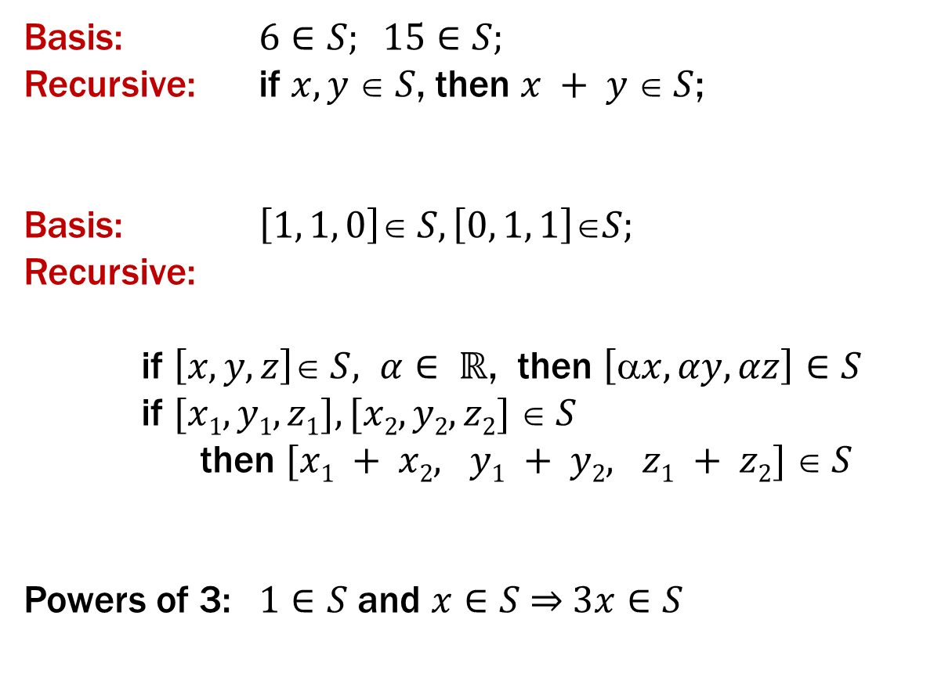
review: recursive definitions of sets
Basis: $6∈S; 15∈S;$
Recursive: if $x, y  S$, then $x + y  S$;
Basis: $\left[1, 1, 0\right]∈ S, \left[0, 1, 1\right]∈S;$
Recursive:
if $\left[x, y, z\right]∈ S, α∈ ℝ$, then $\left[x, αy, αz\right]∈S$
if $[x1, y1, z1], [x2, y2, z2]  S$
then $[x1 + x2, y1 + y2, z1 + z2]  S$
Powers of 3: $1∈S$ and $x∈S \overset{⇒}{ } 3x∈S$

Slide 5
recursive definitions of sets: general form
Recursive definition
Basis step: Some specific elements are in $S$
Recursive step: Given some existing named elements in $S$ some new objects constructed from these named elements are also in $S$.
Exclusion rule: Every element in $S$follows from basis steps and a finite number of recursive steps

Slide 6
review: strings
An alphabet Σ is any finite set of characters
The set Σ* of strings over the alphabet Σ is defined by
Basis: λ ∈ Σ* (λ is the empty string)
Recursive: if $w$ ∈ Σ*, $a$ ∈ Σ, then $wa$ ∈ Σ*

Slide 7
review: palindromes
Palindromes are strings that are the same backwards and forwards
Basis:
λ is a palindrome and any $a$∈ Σ is a palindrome
Recursive step:
If $p∈Σ^{∗}$ is a palindrome then $apa$ is a
palindrome for every $a∈$ Σ

Slide 8
review: all binary strings with no 1’s before 0’s

Slide 9
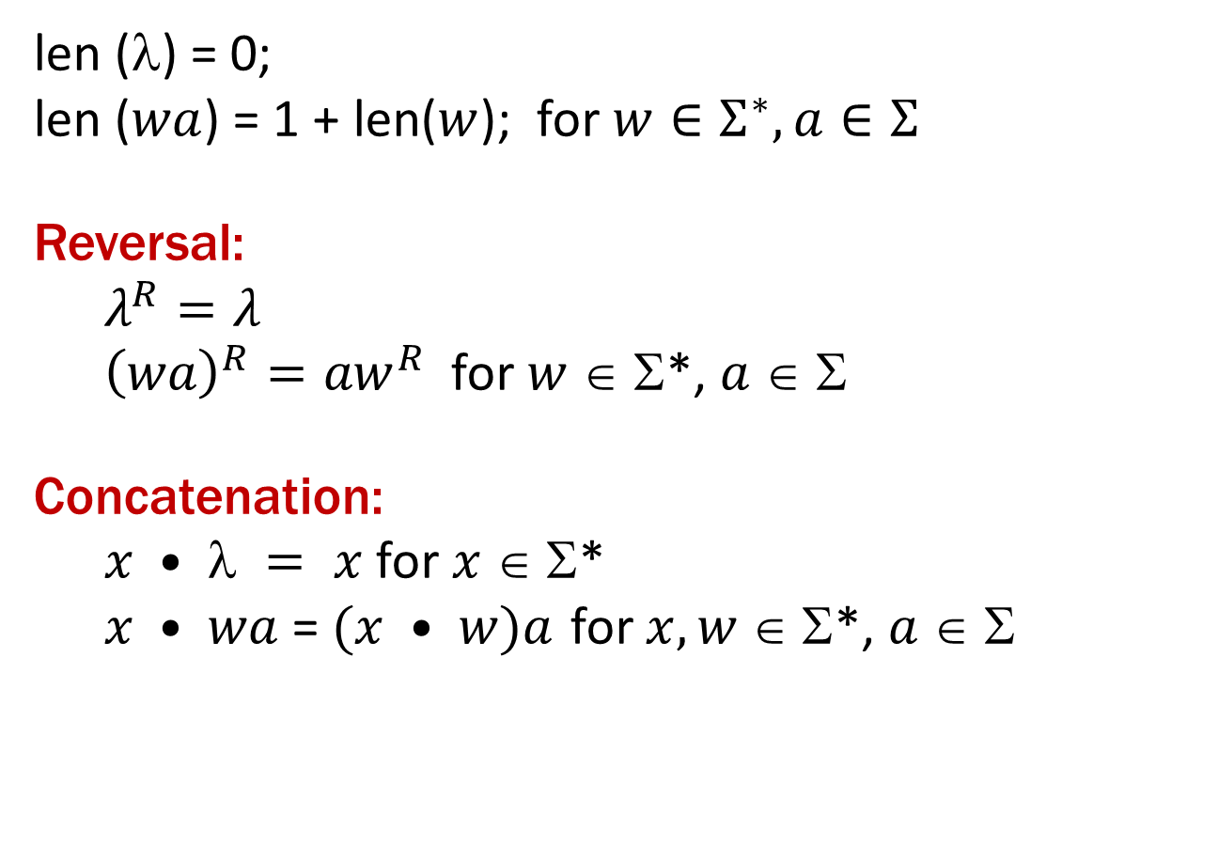
function definitions on recursively defined sets
len (λ) = 0;
len ($wa$) = 1 + len($w$); for $w∈Σ^{∗}, a∈Σ$
Reversal:
$λ^{R}=λ$
${\left(wa\right)}^{R}={aw}^{R}$ for $w$ ∈ Σ*, $a$ ∈ Σ
Concatenation:
$x •  = x$for $x $ Σ*
$x • wa$= $(x • w)a$ for $x, w $Σ*, $a  $

Slide 10
rooted binary trees
Basis: • is a rooted binary tree
Recursive step: If and are
rooted binary trees
then so is:
T₁
T₂
T₂
T₁

Slide 11
functions defined on rooted binary trees
size(•)=1
size( ) = 1+size(T₁)+size(T₂)
height(•)=0
height( )=1+max{height(T₁),height(T₂)}
T₁
T₂
T₁
T₂

Slide 12
structural induction
How to prove $x∈S, P(x)$is true:
Base Case: Show that $P$ is true for all specific elements of $S$ mentioned in the Basis step
Inductive Hypothesis: Assume that $P$ is true for some arbitrary values of each of the existing named elements mentioned in the Recursive step
Inductive Step: Prove that$P$holds for each of the new elements constructed in the Recursive step using the named elements mentioned in the Inductive Hypothesis
Conclude that $x∈S, P(x)$

Slide 13
structural induction vs. ordinary induction
Ordinary induction is a special case of structural induction:
Recursive definition of ℕ
Basis: 0 ∈ ℕ
Recursive Step: If k ∈ ℕ then k+1 ∈ ℕ
Structural induction follows from ordinary induction:
Let $Q(n)$ be true iff for all $x∈S$that take
$n$recursive steps to be constructed, $P(x)$ is true.

Slide 14
using structural induction
Let $S$ be given by
Basis: $6  S; 15∈ S;$
Recursive: if $x, y∈S$, then $x + y∈S$.
Claim: Every element of $S$ is divisible by $3$.

Slide 15
Claim: Every element of $S$ is divisible by $3$.

Slide 16
structural induction for strings
Let $S$ be a set of strings over $\{a,b\}$defined as follows
Basis: $a∈S$
Recursive:
If $w∈S$then $aw∈S$and $baw∈S$
If $u∈S$and $v∈S$then $uv∈S$
Claim: If $w∈S$then $w$ has more $a$’s than $b$’s

Slide 17
Claim: If $w∈S$then $w$ has more $a$’s than $b$’s
Basis: $a∈S$
Recursive: If $w∈S$then $aw∈S$and $baw∈S$
If $u∈S$and $v∈S$then $uv∈S$

Slide 18
function definitions on recursively defined sets
len (λ) = 0;
len ($wa$) = 1 + len($w$); for $w∈Σ^{∗}, a∈Σ$
Reversal:
$λ^{R}=λ$
${\left(wa\right)}^{R}={aw}^{R}$ for $w$ ∈ Σ*, $a$ ∈ Σ
Concatenation:
$x •  = x$for $x $ Σ*
$x • wa$= $(x • w)a$ for $x, w $Σ*, $a  $

Slide 19
$len(x•y)=len(x)+len(y)$for all strings $x$ and $y$
Let $P(y)$be “$len(x•y)=len(x)+len(y)$ for all strings $x$”

Slide 20
$len(x•y)=len(x)+len(y)$for all strings $x$ and $y$
Let $P(y)$be “$len(x•y)=len(x)+len(y)$ for all strings $x$”

Slide 21
functions defined on rooted binary trees
size(•)=1
size( ) = 1+size(T₁)+size(T₂)
height(•)=0
height( )=1+max{height(T₁),height(T₂)}
T₁
T₂
T₁
T₂

Slide 22
For every rooted binary tree $T$, $size(T)≤2^{height(T)+1}−1$

Slide 23
For every rooted binary tree $T$, $size(T)≤2^{height(T)+1}−1$

