Slide 1
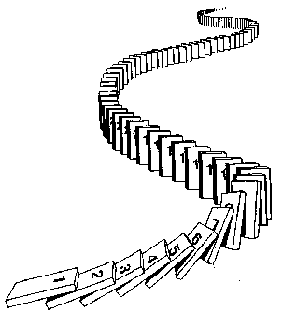
CSE 311: Foundations of Computing
Fall 2013
Lecture 15: Strong Induction & Recursion

Slide 2
announcements
Reading assignment
Induction
5.1-5.2, 7th edition
4.1-4.2, 6th edition

Slide 3
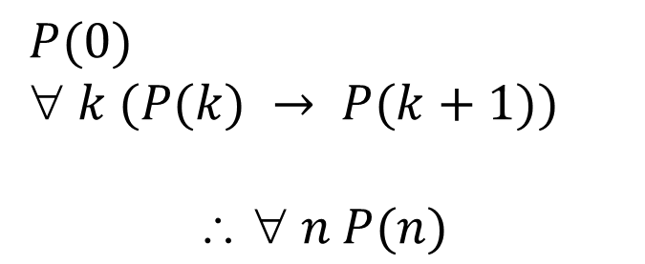
review: using the induction rule in a formal proof
$P(0)$
$ k (P(k) → P(k+1))$
$$  n P(n)$$
Base Case
1. Prove P(0)
Let k be an arbitrary integer ≥ 0
3. Assume that P(k) is true
4. ...
5. Prove P(k+1) is true
P(k) → P(k+1) Direct Proof Rule
7. ∀ k (P(k) → P(k+1)) Intro ∀ from 2-6
8. ∀ n P(n) Induction Rule 1&7
Inductive
Hypothesis
Inductive
Step
Conclusion

Slide 4
review: 5 steps to inductive proofs in english
Proof:
1. “By induction we will show that P(n) is true for every n≥0.”
2. “Base Case:” Prove P(0)
3. “Inductive Hypothesis:”
Assume P(k) is true for some arbitrary integer k ≥ 0”
4. “Inductive Step:” Want to prove that P(k+1) is true:
Use the goal to figure out what you need.
Make sure you are using I.H. and point out where you are using it. (Don’t assume P(k+1) !!)
5. “Conclusion: Result follows by induction”

Slide 5
harmonic numbers
$$H_{m}=1+\frac{1}{2}+\frac{1}{3}+\frac{1}{4}+⋯+\frac{1}{m}=\sum_{i=1}^{m}{\frac{1}{i}}$$
Prove that $H_{2^{n}}≥1+\frac{n}{2}$ for all $n≥1.$

Slide 6
Prove that $H_{2^{n}}≥1+\frac{n}{2}$ for all $n≥1.$

Slide 7
checkerboard tiling
Prove that a 2^{n} × 2^{n} checkerboard with one
square removed can be tiled with:

Slide 8
strong induction
$P\left(0\right)$
$$∀k \left(\left(P\left(0\right)∧P\left(1\right)∧P\left(2\right)∧⋯∧P\left(k\right)\right)→P\left(k+1\right)\right)$$
$∴∀n P(n)$
Follows from ordinary induction applied to
$$Q\left(n\right)= P\left(0\right) ∧ P\left(1\right) ∧ P\left(2\right) ∧⋯∧ P(n)$$

Slide 9
strong induction english proofs
By induction we will show that $P(n)$is true for every $n≥0$
Base Case: Prove $P(0)$
Inductive Hypothesis: Assume that for some arbitrary integer $k ≥ 0$, $P(j)$ is true for every $j$ from $0$ to $k$
Inductive Step: Prove that $P(k+1)$is true using the Inductive Hypothesis (that $P(j)$ is true for all values $ k$)
Conclusion: Result follows by induction

Slide 10
every integer $≥2$ is the product of primes

Slide 11
every integer $≥2$ is the product of primes

Slide 12
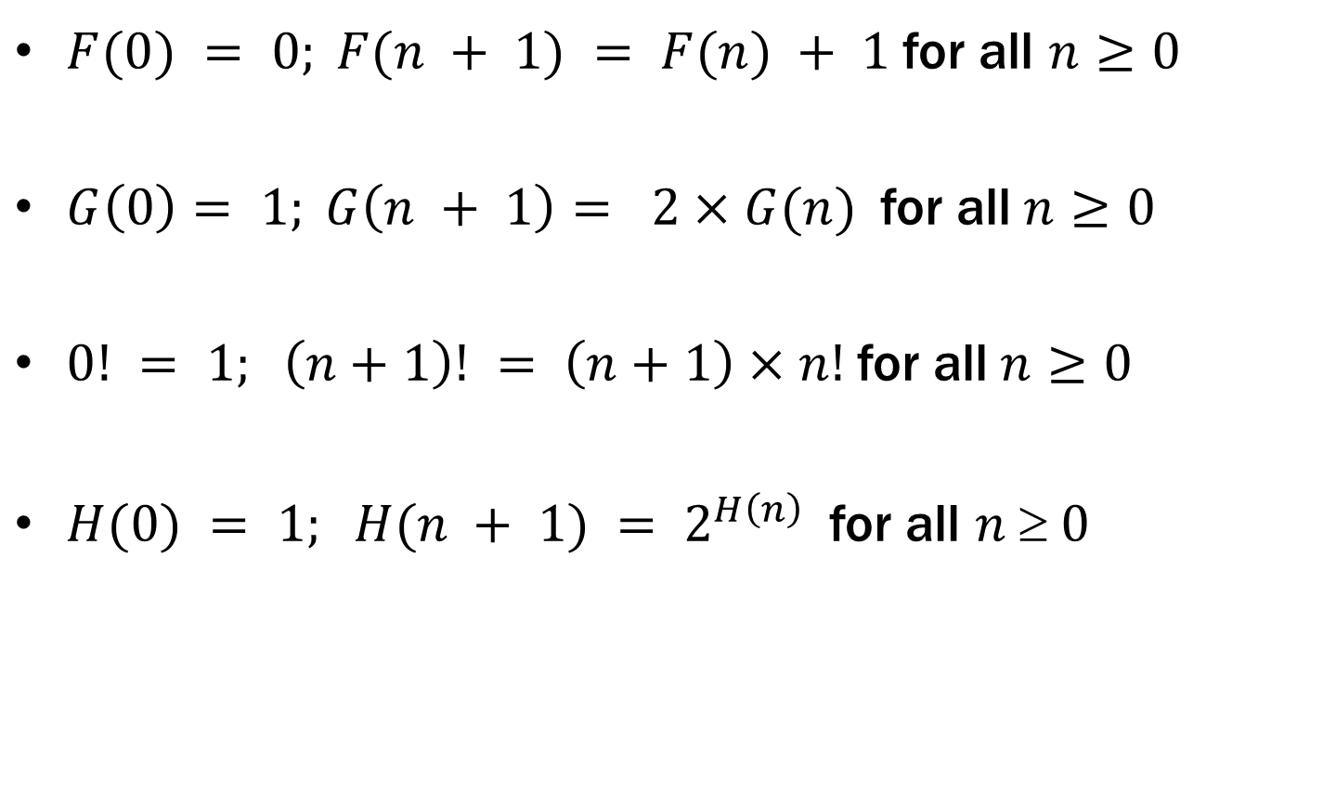
recursive definitions of functions
$F(0) = 0; F(n + 1) = F(n) + 1$for all $n≥0$
$G\left(0\right)= 1; G\left(n + 1\right)= 2×G(n)$for all$n≥0$
$0! = 1; \left(n+1\right)! = \left(n+1\right)×n!$for all$n≥0$
$H(0) = 1; H(n + 1) = 2^{H\left(n\right)}$for all $n  0$

Slide 13
fibonacci numbers
$f_{0}=0$
$f_{1}=1$
$f_{n}=f_{n−1}+f_{n−2}$ for all $n≥2$

Slide 14
bounding the fibonacci numbers
Theorem: $2^{\frac{n}{2}−1}≤f_{n}<2^{n}$ for all $n≥2.$

Slide 15
Theorem: $2^{\frac{n}{2}−1}≤f_{n}<2^{n}$ for all $n≥2.$

Slide 16
running time of euclid’s algorithm
Theorem: Suppose that Euclid’s algorithm takes$n$steps for $gcd⁡(a,b)$ with $a>b$, then$a ≥f_{n+1}$
Set $r_{n+1}=a, r_{n}=b$ then Euclid’s algorithm computes
$r_{n+1}=q_{n}r_{n}+r_{n−1}$
$r_{n} =q_{n−1}r_{n−1}+r_{n−2}$
$⋮$
$r_{3} =q_{2}r_{2}+1$
$r_{2} =q_{1}r_{1}$
each quotient $q_{i}≥1$
$r_{1}≥1$

