Slide 1
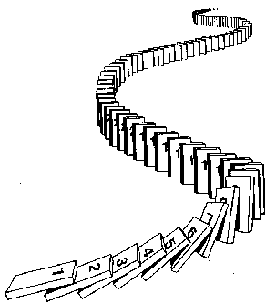
CSE 311: Foundations of Computing
Fall 2013
Lecture 14: Mathematical Induction

Slide 2
announcements
Reading assignment
Induction
5.1-5.2, 7th edition
4.1-4.2, 6th edition

Slide 3
mathematical induction
Method for proving statements about all integers $n≥0$.
Part of sound logical inference that applies only in the domain of integers
Not like scientific induction which is more like a guess from examples
Particularly useful for reasoning about programs since the statement might be “after n times through this loop, property P(n) holds”

Slide 4
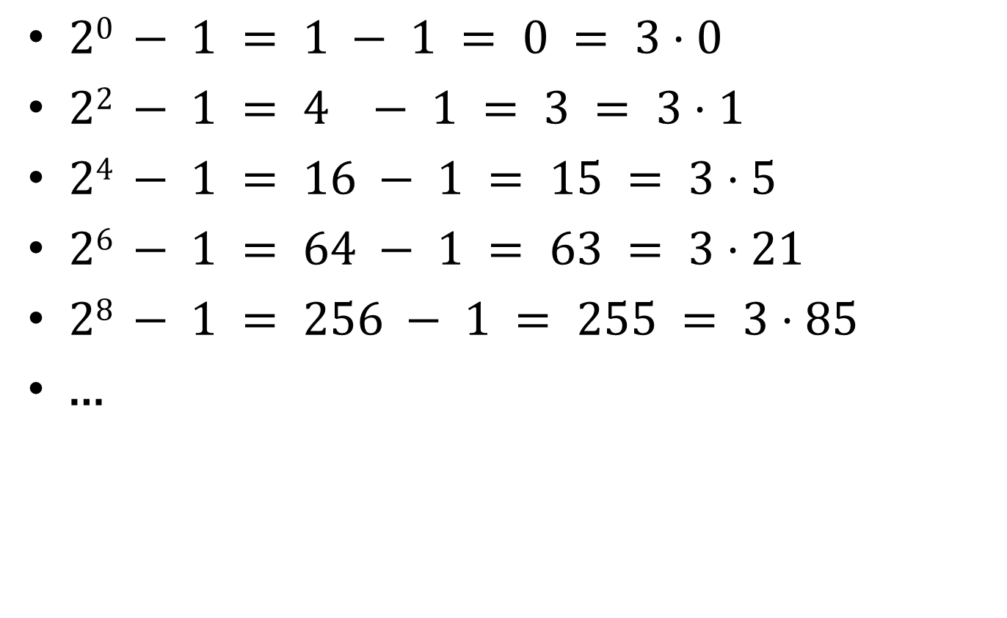
finding a pattern
$20 − 1 = 1 − 1 = 0 = 3⋅0$
$22 − 1 = 4 − 1 = 3 = 3⋅1$
$24 − 1 = 16 − 1 = 15 = 3⋅5$
$26 − 1 = 64 − 1 = 63 = 3⋅21$
$28 − 1 = 256 − 1 = 255 = 3⋅85$
…

Slide 5
how do you prove it?
Want to prove $3∣2^{2n}−1$ for all integers $n≥0$
$n=0$
$n=1$
$n=2$
$n=3$
$⋯$
Examples to show its true
P(0)
P(k) → P(k+1)

Slide 6
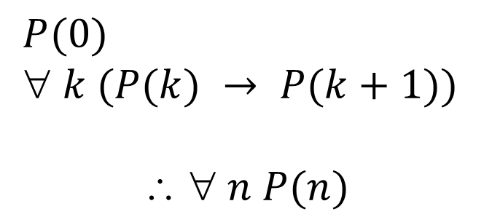
induction as a rule of Inference
Domain: integers ≥ 0
$P(0)$
$ k (P(k) → P(k+1))$
$$  n P(n)$$
Formal steps
Show P(0)
Assume P(k), Prove P(k+1), Conclude P(k)→ P(k+1)
Conclude ∀ k (P(k)→ P(k+1))
Conclude ∀ n P(n)

Slide 7
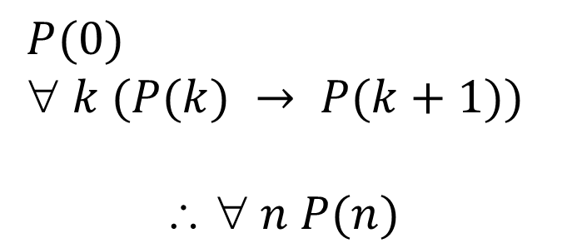
using the induction rule in a formal proof
$P(0)$
$ k (P(k) → P(k+1))$
$$  n P(n)$$
1. Prove P(0)
Let k be an arbitrary integer ≥ 0
3. Assume that P(k) is true
4. ...
5. Prove P(k+1) is true
P(k) → P(k+1) Direct Proof Rule
7. ∀ k (P(k) → P(k+1)) Intro ∀ from 2-6
8. ∀ n P(n) Induction Rule 1&7

Slide 8
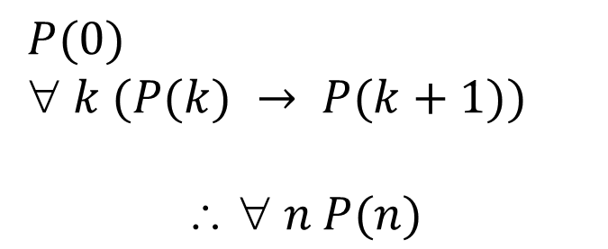
using the induction rule in a formal proof
$P(0)$
$ k (P(k) → P(k+1))$
$$  n P(n)$$
Base Case
1. Prove P(0)
Let k be an arbitrary integer ≥ 0
3. Assume that P(k) is true
4. ...
5. Prove P(k+1) is true
P(k) → P(k+1) Direct Proof Rule
7. ∀ k (P(k) → P(k+1)) Intro ∀ from 2-6
8. ∀ n P(n) Induction Rule 1&7
Inductive
Hypothesis
Inductive
Step
Conclusion

Slide 9
5 steps to inductive proofs in english
Proof:
1. “By induction we will show that P(n) is true for every n≥0.”
2. “Base Case:” Prove P(0)
3. “Inductive Hypothesis:”
Assume P(k) is true for some arbitrary integer k ≥ 0”
4. “Inductive Step:” Want to prove that P(k+1) is true:
Use the goal to figure out what you need.
Make sure you are using I.H. and point out where you are using it. (Don’t assume P(k+1) !!)
5. “Conclusion: Result follows by induction”

Slide 10

induction example
Want to prove $3∣2^{2n}−1$ for all $n ≥ 0$.
Examples to show its true
P(0)
P(k) → P(k+1)

Slide 11
$3∣2^{2n}−1$ for all $n ≥ 0$.
Examples to show its true
P(0)
P(k) → P(k+1)

Slide 12
geometric sum
$1 + 2 + 4 +⋯+ 2n =2^{n+1} – 1$for all $n ≥ 0$

Slide 13
$1 + 2 + 4 +⋯+ 2n =2^{n+1} – 1$for all $n ≥ 0$

Slide 14
sum of first $n$ numbers
$$1+2+⋯+n=\sum_{i=1}^{n}{i}=\frac{n\left(n+1\right)}{2}$$
For all $n≥1$:

Slide 15
For all $n≥1: 1+2+⋯+n=\sum_{i=1}^{n}{i}=\frac{n\left(n+1\right)}{2}$

Slide 16
harmonic numbers
$$H_{m}=1+\frac{1}{2}+\frac{1}{3}+\frac{1}{4}+⋯+\frac{1}{m}=\sum_{i=1}^{m}{\frac{1}{i}}$$
Prove that $H_{2^{n}}≥1+\frac{n}{2}$ for all $n≥1.$

Slide 17
Prove that $H_{2^{n}}≥1+\frac{n}{2}$ for all $n≥1.$

Slide 18
checkerboard tiling
Prove that a 2^{n} × 2^{n} checkerboard with one
square removed can be tiled with:

Slide 19
strong induction
$P\left(0\right)$
$$∀k \left(\left(P\left(0\right)∧P\left(1\right)∧P\left(2\right)∧⋯∧P\left(k\right)\right)→P\left(k+1\right)\right)$$
$∴∀n P(n)$
Follows from ordinary induction applied to
$$Q\left(n\right)= P\left(0\right) ∧ P\left(1\right) ∧ P\left(2\right) ∧⋯∧ P(n)$$

Slide 20
strong induction english proofs
By induction we will show that $P(n)$is true for every $n≥0$
Base Case: Prove $P(0)$
Inductive Hypothesis: Assume that for some arbitrary integer $k ≥ 0$, $P(j)$ is true for every $j$ from $0$ to $k$
Inductive Step: Prove that $P(k+1)$is true using the Inductive Hypothesis (that $P(j)$ is true for all values $ k$)
Conclusion: Result follows by induction

Slide 21
every integer $≥ 2$ is the product of primes

Slide 22
every integer $≥ 2$ is the product of primes

Slide 23
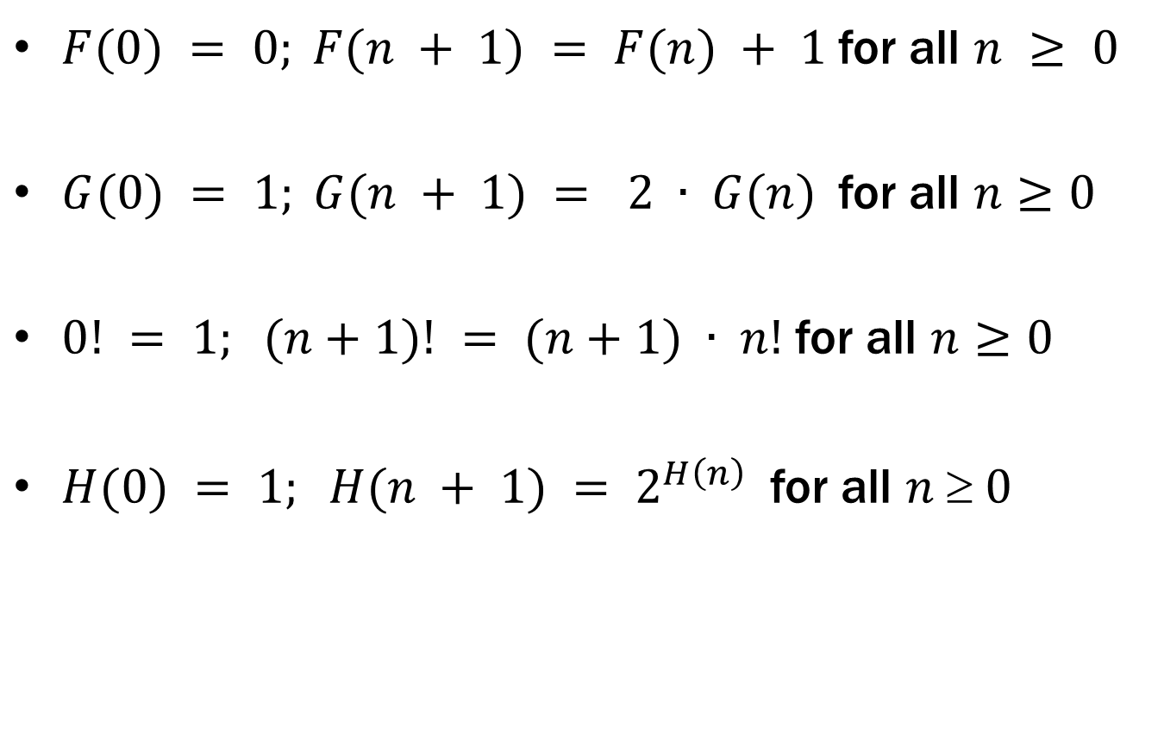
recursive definitions of functions
$F(0) = 0; F(n + 1) = F(n) + 1$for all $n ≥ 0$
$G(0) = 1; G(n + 1) = 2 ∙ G(n)$for all $n≥0$
$0! = 1; (n+1)! = (n+1) ∙ n!$for all $n≥0$
$H(0) = 1; H(n + 1) = 2^{H\left(n\right)}$for all $n  0$

Slide 24
fibonacci numbers
$f_{0}=0$
$f_{1}=1$
$f_{n}=f_{n−1}+f_{n−2}$ for all $n≥2$

Slide 25
bounding the fibonacci numbers
Theorem: $2^{\frac{n}{2}−1}≤f_{n}<2^{n}$ for all $n≥2.$

Slide 26
Theorem: $2^{n/2−1}≤f_{n}<2^{n}$ for all $n≥2.$

