Slide 1
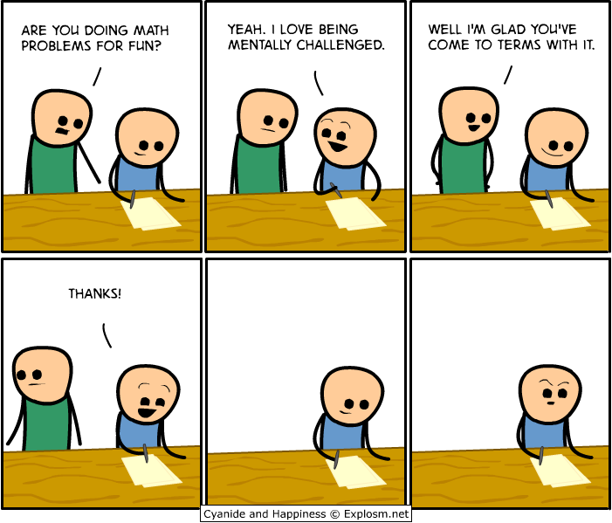
CSE 311: Foundations of Computing
Fall 2013
Lecture 13: Modular inverses, induction

Slide 2
announcements
Reading assignment
Induction
5.1-5.2, 7th edition
4.1-4.2, 6th edition

Slide 3
review: GCD
a = 2³ • 3 • 5² • 7 • 11 = 46,200
b = 2 • 3² • 5³ • 7 • 13 = 204,750
GCD(a, b) = 2^{min(3,1)} • 3^{min(1,2)} • 5^{min(2,3)} • 7^{min(1,1)} • 11^{min(1,0)} • 13^{min(0,1)}
Factoring is expensive!
Can we compute GCD(a,b) without factoring?
If a and b are positive integers, then gcd(a,b) = gcd(b, a mod b)

Slide 4
review: euclid’s algorithm
Repeatedly use the $GCD$ fact to reduce numbers
until you get $GCD\left(x,0\right)=x.$
GCD(660,126)= ?
660 = 5 • 126 + 30 GCD(660,126) = GCD(126,30)
126 = 4 • 30 + 6 = GCD(30,6)
30 = 5 • 6 + 0 = GCD(6,0)
= 6

Slide 5
bézout’s theorem
If a and b are positive integers, then there exist integers s and t such that
gcd(a,b) = sa + tb.

Slide 6
extended euclid algorithm
Can use Euclid’s Algorithm to find $s, t$ such that
$\gcd\left(a,b\right)=sa+tb$
e.g. gcd(35,27): 35 = 1 • 27 + 8 35 - 1 • 27 = 8
27= 3 • 8 + 3 27- 3 • 8 = 3
8 = 2 • 3 + 2 8 - 2 • 3 = 2
3 = 1 • 2 + 1 3 - 1 • 2 = 1
2 = 2 • 1 + 0
Substitute back from the bottom
1= 3 - 1 • 2 = 3 – 1 (8 - 2 • 3) = (-1) • 8 + 3 • 3
= (-1) • 8 + 3 (27- 3 • 8 ) = 3 • 27 + (-10) • 8
=

Slide 7
multiplicative inverse $mod m$
Suppose $GCD\left(a,m\right)=1$
By Bézout’s Theorem, there exist integers $s$ and $t$
such that $sa+tm=1.$
$s mod m$ is the multiplicative inverse of $a$:
$1=\left(sa+tm\right) mod m=sa mod m$

Slide 8
solving modular equations
Solving $ax≡b (mod m)$ for unknown $x$ when $\gcd\left(a,m\right)=1$.
Find $s$ such that $sa+tm=1$
Compute $a^{−1}=s mod m$, the multiplicative inverse of $a$ modulo $m$
Set $x=\left(a^{−1}⋅b\right) mod m$

Slide 9
multiplicative cipher: $f(x) = ax mod m$
For a multiplicative cipher to be invertible:
$f\left(x\right)=ax mod m :\left\{0,…,m−1\right\}→\{0,…,m−1\}$
must be one-to-one and onto
Lemma: If there is an integer $b$ such that
$ab mod m = 1$, then the function $f(x) = ax mod m$is one-to-one and onto.

Slide 10
example
Solve: $7x≡1 (mod 26)$

Slide 11
mathematical induction
Method for proving statements about all integers $n≥0$.
Part of sound logical inference that applies only in the domain of integers
Not like scientific induction which is more like a guess from examples
Particularly useful for reasoning about programs since the statement might be “after n times through this loop, property P(n) holds”

Slide 12
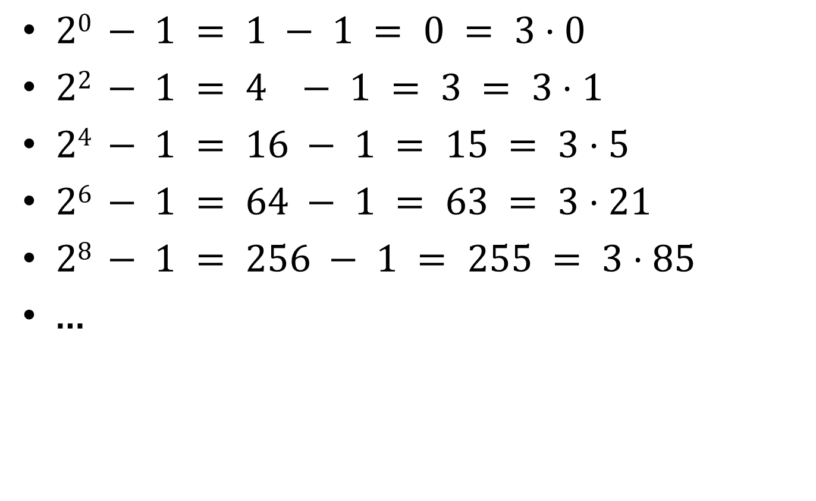
finding a pattern
$20 − 1 = 1 − 1 = 0 = 3⋅0$
$22 − 1 = 4 − 1 = 3 = 3⋅1$
$24 − 1 = 16 − 1 = 15 = 3⋅5$
$26 − 1 = 64 − 1 = 63 = 3⋅21$
$28 − 1 = 256 − 1 = 255 = 3⋅85$
…

Slide 13
how do you prove it?
Want to prove $3∣2^{2n}−1$ for all integers $n≥0$
$n=0$
$n=1$
$n=2$
$n=3$
$⋯$
Examples to show its true
P(0)
P(k) → P(k+1)

Slide 14
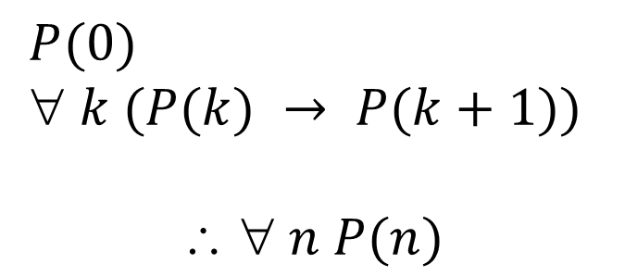
induction as a rule of Inference
Domain: integers ≥ 0
$P(0)$
$ k (P(k) → P(k+1))$
$$  n P(n)$$
Formal steps
Show P(0)
Assume P(k), Prove P(k+1), Conclude P(k)→ P(k+1)
Conclude ∀ k (P(k)→ P(k+1))
Conclude ∀ n P(n)

Slide 15
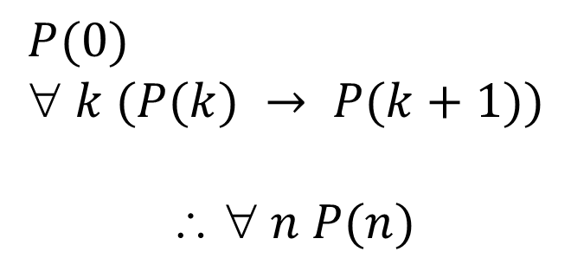
using the induction rule in a formal proof
$P(0)$
$ k (P(k) → P(k+1))$
$$  n P(n)$$
1. Prove P(0)
Let k be an arbitrary integer ≥ 0
3. Assume that P(k) is true
4. ...
5. Prove P(k+1) is true
P(k) → P(k+1) Direct Proof Rule
7. ∀ k (P(k) → P(k+1)) Intro ∀ from 2-6
8. ∀ n P(n) Induction Rule 1&7

Slide 16
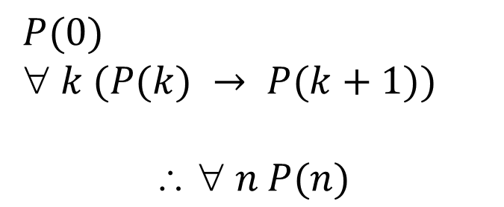
using the induction rule in a formal proof
$P(0)$
$ k (P(k) → P(k+1))$
$$  n P(n)$$
Base Case
1. Prove P(0)
Let k be an arbitrary integer ≥ 0
3. Assume that P(k) is true
4. ...
5. Prove P(k+1) is true
P(k) → P(k+1) Direct Proof Rule
7. ∀ k (P(k) → P(k+1)) Intro ∀ from 2-6
8. ∀ n P(n) Induction Rule 1&7
Inductive
Hypothesis
Inductive
Step
Conclusion

Slide 17
5 steps to inductive proofs in english
Proof:
1. “By induction we will show that P(n) is true for every n≥0.”
2. “Base Case:” Prove P(0)
3. “Inductive Hypothesis:”
Assume P(k) is true for some arbitrary integer k ≥ 0”
4. “Inductive Step:” Want to prove that P(k+1) is true:
Use the goal to figure out what you need.
Make sure you are using I.H. and point out where you are using it. (Don’t assume P(k+1) !!)
5. “Conclusion: Result follows by induction”

Slide 18

induction example
Want to prove $3∣2^{2n}−1$ for all $n ≥ 0$.
Examples to show its true
P(0)
P(k) → P(k+1)

Slide 19
$3∣2^{2n}−1$ for all $n ≥ 0$.
Examples to show its true
P(0)
P(k) → P(k+1)

Slide 20
geometric sum
$1 + 2 + 4 +⋯+ 2n =2^{n+1} – 1$for all $n ≥ 0$

Slide 21
$1 + 2 + 4 +⋯+ 2n =2^{n+1} – 1$for all $n ≥ 0$

Slide 22
sum of first $n$ numbers
$$1+2+⋯+n=\sum_{i=1}^{n}{i}=\frac{n\left(n+1\right)}{2}$$
For all $n≥1$:

Slide 23
For all $n≥1: 1+2+⋯+n=\sum_{i=1}^{n}{i}=\frac{n\left(n+1\right)}{2}$

