Slide 1
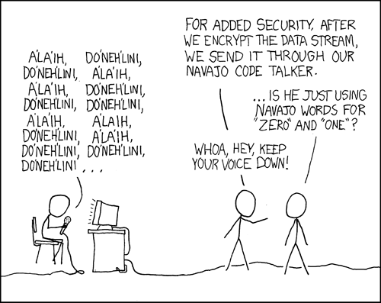
CSE 311: Foundations of Computing
Fall 2013
Lecture 10: Functions, Modular arithmetic

Slide 2
announcements
Reading assignment
Modular arithmetic
4.1-4.2, 7th edition
3.4-3.5, 6th edition
Homework 3 due now
Graded Homework 2 and Solutions available
Homework 4 out later today

Slide 3
review: set theory
$x∈A$: “x is an element of A”
$x∉A$ : ¬ ($x∈A$)
$$A⊆B≡∀x (x∈A→x∈B)$$
$A=B$ $↔\left(A⊆B∧B⊆A\right)$
$$A∪B=\{ x :\left(x∈A\right)∨\left(x ∈B \right)\}$$
$$A∩B=\{ x :\left(x∈A\right)∧\left(x∈B\right)\}$$
$$𝒫(A)=\{ B:B⊆A\}$$
$$A×B=\{(a,b):a∈A,b∈B\}$$
Some applications: Characteristic vectors, private key cryptography

Slide 4
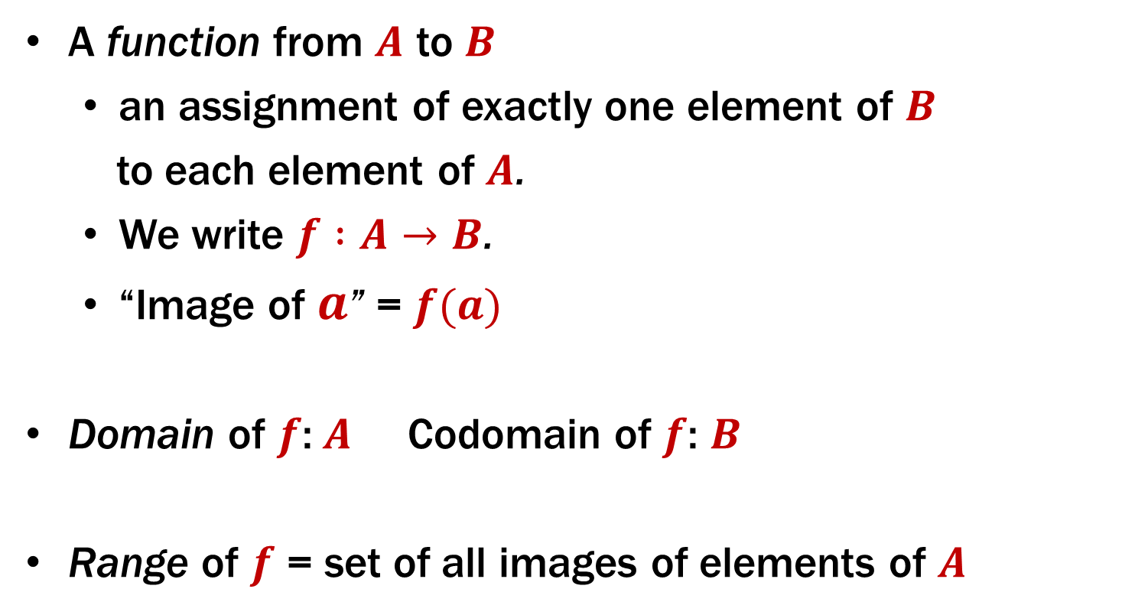
functions review
A function from $A$ to $B$
an assignment of exactly one element of $B$
to each element of $A$.
We write $f :A→B$.
“Image of $a$” = $f(a)$
Domain of $f$:$A$ Codomain of $f$: $B$
Range of $f$ = set of all images of elements of $A$

Slide 5

image, preimage
$A B$
a
1
b
2
c
3
d
4
e

Slide 6
is this a function? one-to-one? onto?
a
1
b
2
c
3
d
4
e
5
6

Slide 7
number theory (and applications to computing)
Branch of Mathematics with direct relevance to computing
Many significant applications
Cryptography
Hashing
Security
Important tool set

Slide 8
modular arithmetic
Arithmetic over a finite domain
In computing, almost all computations are over a finite domain

Slide 9
what are the values computed?
public void Test1() {
byte x = 250;
byte y = 20;
byte z = (byte) (x + y);
Console.WriteLine(z);
}
public void Test2() {
sbyte x = 120;
sbyte y = 20;
sbyte z = (sbyte) (x + y);
Console.WriteLine(z);
}
[-128, 127]
14
-116

Slide 10
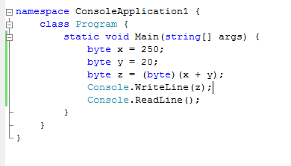
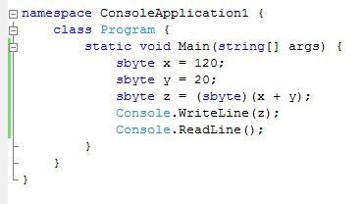
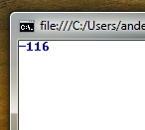
what are the values computed?

Slide 11
divisibility
Integers a, b, with a ≠ 0, we say that a divides b if there is an integer k such that b = ka. The notation a | b denotes “a divides b.”

Slide 12
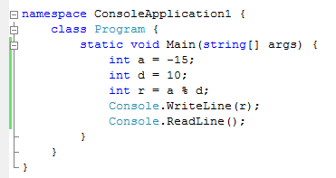
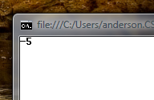
division theorem
Let a be an integer and d a positive integer. Then there are unique integers q and r, with 0 ≤ r < d, such that a = dq + r.
q = a div d r = a mod d
Note: r ≥ 0 even if a < 0. Not quite the same as a%d

Slide 13
arithmetic mod 7
a +₇ b = (a + b) mod 7
a ×₇ b = (a × b) mod 7
+ | 0 | 1 | 2 | 3 | 4 | 5 | 6
0
1
2
3
4
5
6
X | 0 | 1 | 2 | 3 | 4 | 5 | 6
0
1
2
3
4
5
6

Slide 14
modular arithmetic
Let a and b be integers, and m be a positive integer. We say a is congruent to b modulo m if m divides a – b. We use the notation a ≡ b (mod m) to indicate that a is congruent to b modulo m.

Slide 15
modular arithmetic
Let a and b be integers, and let m be a positive integer. Then a ≡ b (mod m) if and only if
a mod m = b mod m.

Slide 16
modular arithmetic
Let m be a positive integer. If a ≡ b (mod m) and c ≡ d (mod m), then
a + c ≡ b + d (mod m) and
ac ≡ bd (mod m)

Slide 17
example
Let n be an integer.
Prove that n² ≡ 0 (mod 4) or n² ≡ 1 (mod 4)

Slide 18
n-bit unsigned integer representation
Represent integer x as sum of powers of 2:
If $x=\sum_{i=0}^{n−1}{b_{i}2^{i}}$where each b_{i} ∈ {0,1}
then representation is b_{n-1}...b₂ b₁ b₀
99 = 64 + 32 + 2 + 1
18 = 16 + 2
For n = 8:
99: 0110 0011
18: 0001 0010

Slide 19
signed integer representation
n-bit signed integers
Suppose $−2^{n−1}<x<2^{n−1}$
First bit as the sign, n-1 bits for the value
99 = 64 + 32 + 2 + 1
18 = 16 + 2
For n = 8:
99: 0110 0011
-18: 1001 0010
Any problems with this representation?

Slide 20
two’s complement representation
n bit signed integers, first bit will still be the sign bit
Suppose $0≤x<2^{n−1}$,
$x$ is represented by the binary representation of $x$
Suppose $0≤x≤2^{n−1}$,
$−x$ is represented by the binary representation of $2^{n}−x$
99 = 64 + 32 + 2 + 1
18 = 16 + 2
For n = 8:
99: 0110 0011
-18: 1110 1110
Key property: Twos complement representation of any number y
is equivalent to y mod 2^{n} so arithmetic works mod 2^{n}

Slide 21
signed vs two’s complement
 | -7 | -6 | -5 | -4 | -3 | -2 | -1 | 0 | 1 | 2 | 3 | 4 | 5 | 6 | 7
 | 1111 | 1110 | 1101 | 1100 | 1011 | 1010 | 1001 | 0000 | 0001 | 0010 | 0011 | 0100 | 0101 | 0110 | 0111
Signed
-8 | -7 | -6 | -5 | -4 | -3 | -2 | -1 | 0 | 1 | 2 | 3 | 4 | 5 | 6 | 7
1000 | 1001 | 1010 | 1011 | 1100 | 1101 | 1110 | 1111 | 0000 | 0001 | 0010 | 0011 | 0100 | 0101 | 0110 | 0111
Two’s complement

Slide 22
two’s complement representation
For $0<x≤2^{n−1}$, $−x$ is represented by the binary representation of $2^{n}−x$
To compute this: Flip the bits of $x$ then add 1:
All 1’s string is $2^{n}−1$, so
Flip the bits of $x$ ≡ replace $x$ by $2^{n}−1−x$

