Slide 1
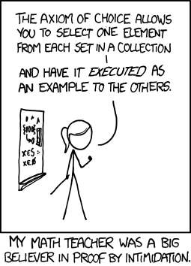
CSE 311: Foundations of Computing
Fall 2013
Lecture 8: Proofs and Set theory

Slide 2
announcements
Reading assignment
Logical inference
1.6-1.7 7th Edition
1.5-1.7 6th Edition
Set theory
2.1-2.3 (both editions)

Slide 3
review: proofs
Start with hypotheses and facts
Use rules of inference to extend set of facts
Result is proved when it is included in the set
Fact 2
Statement
Hypothesis 1
Fact 1
Hypothesis 2
Statement
Result
Hypothesis 3

Slide 4
review: an inference rule--- Modus Ponens
If p and p → q are both true then q must be true
Write this rule as
Given:
If it is Wednesday then you have a 311 class today.
It is Wednesday.
Therefore, by modus ponens:
You have a 311 class today.
p, p → q
∴ q

Slide 5
review: inference rules
Each inference rule is written as:
...which means that if both A and B
are true then you can infer C and
you can infer D.
For rule to be correct (A ∧ B) → C and
(A ∧ B) → D must be a tautologies
Sometimes rules don’t need anything to start with. These rules are called axioms:
e.g. Excluded Middle Axiom
A, B
∴ C,D
∴ p ∨¬p

Slide 6
review: simple propositional inference rules
Excluded middle plus two inference rules per binary connective, one to eliminate it and one to introduce it
p ∧ q
∴ p, q
p, q
∴ p ∧ q
p ∨ q , ¬p
∴ q
p
∴ p ∨ q, q ∨ p
p, p → q
∴ q
p ⇒ q
∴ p → q
Direct Proof Rule
Not like other rules

Slide 7
review: direct proof of an implication
p ⇒ q denotes a proof of q given p as an assumption
The direct proof rule:
If you have such a proof then you can conclude
that p → q is true
proof subroutine
Example: 1. p assumption 2. p ∨ q intro for ∨ from 1 3. p → (p ∨ q) direct proof rule

Slide 8
review: proofs using the direct proof rule
Show that p → r follows from q and (p ∧ q) → r
1. q given
(p ∧ q) → r given
3. p assumption
4. p ∧ q from 1 and 3 via Intro ∧ rule 5. r modus ponens from 2 and 4
6. p → r direct proof rule
Notes:
p = Song paused
q = Premium user
r = maintain buffer

Slide 9
review: inference rules for quantifiers
P(c) for some c
∀x P(x)
∴ ∃x P(x)
∴ P(a) for any a
“Let a be anything*”...P(a)
∃x P(x)
∴ ∀x P(x)
∴ P(c) for some special c
* in the domain of P

Slide 10
review: proofs using quantifiers
“There exists an even prime number”
Prime(x): x is an integer > 1 and x is not a multiple of any integer strictly
between 1 and x
Notes:
Start with Prime(2), Even(2)

Slide 11
even and odd
Even(x) ≡ ∃y (x=2y)
Odd(x) ≡ ∃y (x=2y+1)
Domain: Integers
Prove: “The square of every even number is even.”
Formal proof of: ∀x (Even(x) → Even(x²))

Slide 12
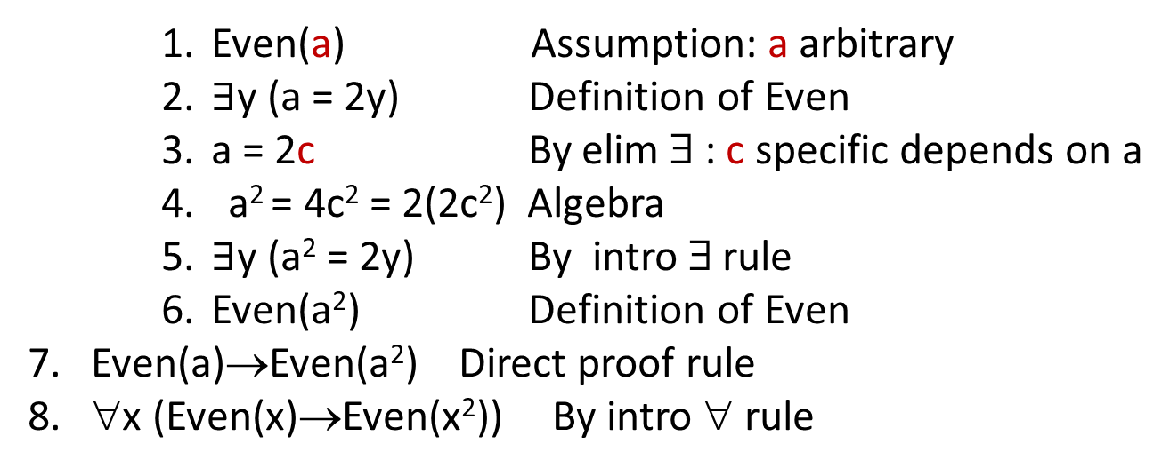
even and odd
Even(x) ≡ ∃y (x=2y)
Odd(x) ≡ ∃y (x=2y+1)
Domain: Integers
Prove: “The square of every even number is even.”
Formal proof of: ∀x (Even(x) → Even(x²))
Even(a) Assumption: a arbitrary
$∃$y (a = 2y) Definition of Even
a = 2c By elim ∃ : c specific depends on a
a² = 4c² = 2(2c²) Algebra
$∃$y (a² = 2y) By intro ∃ rule
Even(a²) Definition of Even
7. Even(a)→Even(a²) Direct proof rule
8. ∀x (Even(x)→Even(x²)) By intro ∀ rule

Slide 13
even and odd
Even(x) ≡ ∃y (x=2y)
Odd(x) ≡ ∃y (x=2y+1)
Domain: Integers
Prove: “The square of every odd number is odd.”
English proof of: ∀x (Odd(x)→Odd(x²))
Let x be an odd number.
Then x=2k+1 for some integer k (depending on x)
Therefore x²=(2k+1)²= 4k²+4k+1=2(2k²+2k)+1.
Since 2k²+2k is an integer, x² is odd.

Slide 14
proof by contradiction: one way to prove ¬p
If we assume p and derive False (a contradiction), then we have proved ¬p.
1. p assumption
...
3. F
4. p → F direct Proof rule
5. ¬p ∨ F equivalence from 4
6. ¬p equivalence from 5

Slide 15
even and odd
Even(x) ≡ ∃y (x=2y)
Odd(x) ≡ ∃y (x=2y+1)
Domain: Integers
Prove: “No number is both even and odd.”
English proof: ¬ ∃x (Even(x)∧Odd(x))
≡∀x ¬(Even(x)∧Odd(x))
Let x be any integer and suppose that it is both even and odd. Then x=2k for some integer k and x=2n+1 for some integer n. Therefore 2k=2n+1 and hence k=n+½.
But two integers cannot differ by ½ so this is a contradiction.

Slide 16
rational numbers
A real number x is rational iff there exist integers p and q with q≠0 such that x=p/q.
Prove: If x and y are rational then xy is rational
Rational(x) ≡ ∃p ∃q ((x=p/q) ∧ Integer(p) ∧ Integer(q) ∧ q≠0)
∀x ∀y ((Rational(x) ∧ Rational(y)) → Rational(xy))
Domain: Real numbers

Slide 17
rational numbers
A real number x is rational iff there exist integers p and q with q≠0 such that x=p/q.
Prove:
If x and y are rational then xy is rational
If x and y are rational then x+y is rational
Rational(x) ≡ ∃p ∃q ((x=p/q) ∧ Integer(p) ∧ Integer(q) ∧ q≠0)

Slide 18
rational numbers
A real number x is rational iff there exist integers p and q with q≠0 such that x=p/q.
Prove:
If x and y are rational then xy is rational
If x and y are rational then x+y is rational
If x and y are rational then x/y is rational
Rational(x) ≡ ∃p ∃q ((x=p/q) ∧ Integer(p) ∧ Integer(q) ∧ q≠0)

Slide 19
counterexamples
To disprove ∀x P(x) find a counterexample:
some c such that ¬P(c)
works because this implies ∃x ¬P(x) which is equivalent to ¬∀x P(x)

Slide 20
proofs
Formal proofs follow simple well-defined rules and should be easy to check
In the same way that code should be easy to execute
English proofs correspond to those rules but are designed to be easier for humans to read
Easily checkable in principle
Simple proof strategies already do a lot
Later we will cover a specific strategy that applies to loops and recursion (mathematical induction)

Slide 21
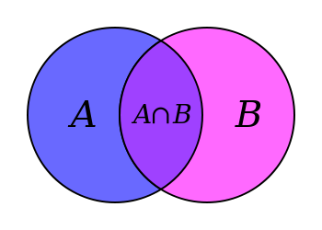
set theory
Formal treatment dates from late 19th century
Direct ties between set theory and logic
Important foundational language

Slide 22
definition: a set is an unordered collection of objects
x ∈ A : “x is an element of A”
“x is a member of A”
“x is in A”
x ∈ A : ¬ (x ∈ A)
/
$$A= \{ 1, 2, 7, cat, dog, φ, α \}$$
Give some examples:
Finite sets,
Multiple domains
N, Z, Q, R
Emptyset
Sets containing sets
$$cat∈A$$
$$fish∉A$$

Slide 23
definitions
A and B are equal if they have the same elements
A is a subset of B if every element of A is also in B
A = B ≡ ∀ x (x ∈ A ↔ x ∈ B)
A ⊆ B ≡ ∀ x (x ∈ A → x ∈ B)
A ⊂ B

Slide 24
empty set and power set
Empty set $∅$ does not contain any elements
Power set of a set A = set of all subsets of A
$$𝒫\left(A\right)=\{ B :B⊆A \}$$

Slide 25
cartesian product
$$A×B=\{ \left(a,b\right):a∈A, b∈B \}$$

Slide 26
set operations
$$A∪B=\{ x :\left(x∈A\right)∨\left(x ∈B \right)\}$$
union
$$A∩B=\{ x :\left(x∈A\right)∧\left(x∈B\right)\}$$
intersection
$$A−B=\{ x :\left(x∈A\right)∧\left(x∉B\right)\}$$
set difference
$$A⊕B=\{ x :\left(x∈A\right)⊕\left(x∈B\right)\}$$
symmetric
difference
$\overline{A }=\left\{ x :x∉A \right\}$
(with respect to universe U)
complement

Slide 27
it’s Boolean algebra again
Definition for ∪ based on ∨
Definition for ∩ based on ∧
Complement works like ¬

Slide 28
De Morgan’s Laws
$$\overline{A∪B}=\overline{A}∩\overline{B}$$
$$\overline{A∩B}=\overline{A}∪\overline{B}$$
Proof technique:
To show C = D show
x ∈ C → x ∈ D and
x ∈ D → x ∈ C
Prove A ∪ B = A ∩ B
Begin with x ∈ A ∪ B ↔ x ∈ A ∨ x ∈ B

Slide 29
distributive laws
$$A∩\left(B∪C\right)=\left(A∩B\right)∪\left(A∩C\right)$$
$$A∪\left(B∩C\right)=\left(A∪B\right)∩\left(A ∪C\right)$$
A
B
A
B
C
C

