Slide 1
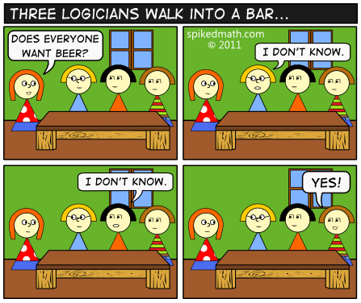
CSE 311: Foundations of Computing
Fall 2013
Lecture 3: Logic and Boolean algebra

Slide 2
announcements
Reading assignments
Propositional Logic
1.1 -1.3 7th Edition
1.1 -1.2 6th Edition
Boolean Algebra
12.1 – 12.3 7th Edition
11.1 – 11.3 6th Edition

Slide 3
combinational logic circuits
Design a circuit to compute the majority of 3 bits.
What about majority of 5 bits?

Slide 4

some other gates
X Y Z 0 0 1 0 1 1 1 0 1
1 1 0
X
Z
NAND
$¬X∧¬Y$ NOR
$¬X∨¬Y$
XOR $X⊕Y$
XNOR $X↔Y, X=Y$
Y
X Y Z 0 0 1 0 1 0 1 0 0
1 1 0
X
Z
Y
X Y Z 0 0 0 0 1 1 1 0 1
1 1 0
X
Y
Z
X Y Z 0 0 1 0 1 0 1 0 0
1 1 1
X
Y
Z

Slide 5
review: logical equivalence
Terminology: A compound proposition is a
Tautology if it is always true
Contradiction if it is always false
Contingency if it can be either true or false
p ∨ ¬ p
p ⊕ p
(p → q) ∧ p
(p ∧ q) ∨ (p ∧ ¬ q) ∨ (¬ p ∧ q) ∨ (¬ p ∧ ¬ q)

Slide 6
review: logical equivalence
p and q are logically equivalent if and only if
p ↔ q is a tautology
i.e. p and q have the same truth table
The notation p ≡ q denotes p and q are
logically equivalent
Example: p ≡ ¬ ¬ p
p | ¬ p | ¬ ¬ p | p ↔ ¬ ¬ p

Slide 7
review: De Morgan’s laws
¬ (p ∧ q) ≡ ¬ p ∨ ¬ q
¬ (p ∨ q) ≡ ¬ p ∧ ¬ q
What are the negations of:
The Yankees and the Phillies will play
in the World Series.
It will rain today or it will snow on New Year’s Day.

Slide 8
review: De Morgan’s laws
Example: ¬ (p ∧ q) ≡ (¬ p ∨ ¬ q)
p | q | ¬ p | ¬ q | ¬ p ∨ ¬ q | p ∧ q | ¬ (p ∧ q) | ¬ (p ∧ q) ↔ (¬ p ∨ ¬ q)
T | T
T | F
F | T
F | F

Slide 9
review: Law of Implication
(p → q) ≡ (¬ p ∨ q)
p | q | p → q | ¬ p | ¬ p ∨ q | (p → q) ↔ (¬ p ∨ q)
T | T
T | F
F | T
F | F

Slide 10
understanding connectives
Reflect basic rules of reasoning and logic
Allow manipulation of logical formulas
Simplification
Testing for equivalence
Applications
Query optimization
Search optimization and caching
Artificial Intelligence
Program verification

Slide 11
review: properties of logical connectives
Identity
Domination
Idempotent
Commutative
Associative
Distributive
Absorption
Negation
De Morgan’s Laws
Textbook: 1.3 7th Edition/1.2 6th Edition, Table 6

Slide 12
some equivalences related to implication
p → q ≡ ¬ p ∨ q
p → q ≡ ¬ q → ¬ p
p ∨ q ≡ ¬ p → q
p ∧ q ≡ ¬ (p → ¬ q)
p ↔ q ≡ (p→ q) ∧ (q → p)
p ↔ q ≡ ¬ p ↔ ¬ q
p ↔ q ≡ (p ∧ q) ∨ (¬ p ∧ ¬ q)
¬ (p ↔ q) ≡ p ↔ ¬ q

Slide 13
some equivalences related to implication
p → q ≡ ¬ q → ¬ p

Slide 14
logical proofs
To show P is equivalent to Q
Apply a series of logical equivalences to subexpressions to convert P to Q
To show P is a tautology
Apply a series of logical equivalences to subexpressions to convert P to T

Slide 15
prove this is a tautology
(p ∧ q) → (p ∨ q)

Slide 16
prove this is a tautology
(p ∧ (p → q)) → q

Slide 17
proving non-equivalence
(p → q) → r
p → (q → r)

Slide 18
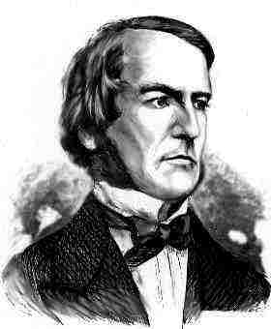
boolean logic
Combinational logic
$output_{t}=F\left(input_{t}\right)$
Sequential logic
$output_{t}=F\left(output_{t−1}, input_{t}\right)$
output dependent on history
concept of a time step (clock)
An algebraic structure consists of
a set of elements B = {0, 1}
binary operations { + , • } (OR, AND)
and a unary operation { ’ } (NOT )

Slide 19
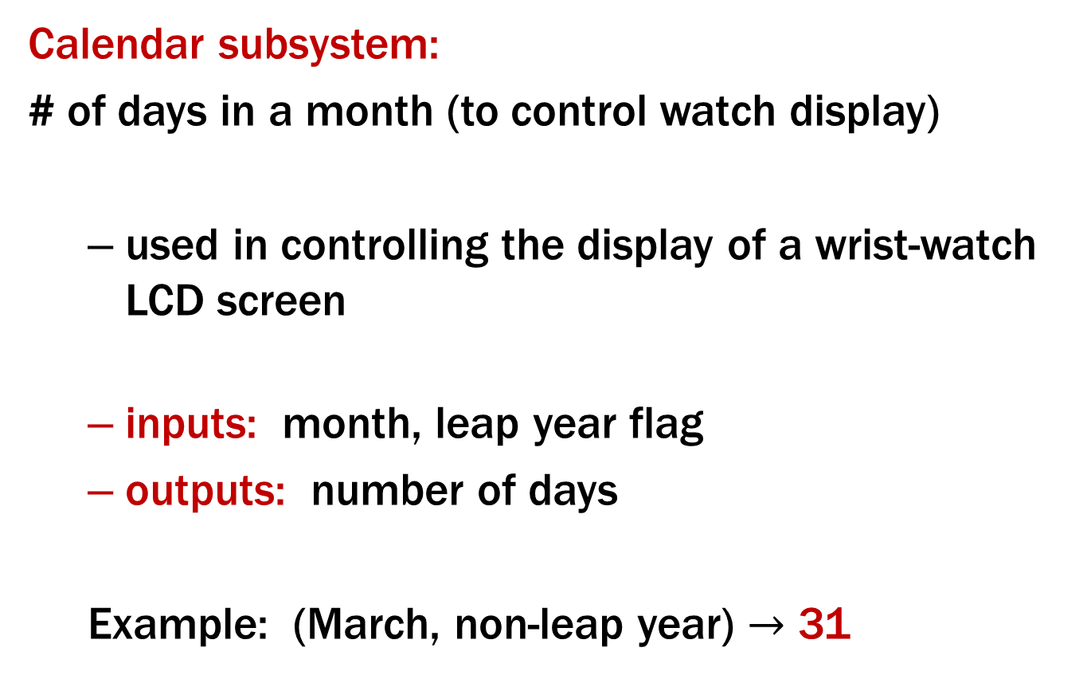
a quick combinational logic example
Calendar subsystem:
# of days in a month (to control watch display)
used in controlling the display of a wrist-watch LCD screen
inputs: month, leap year flag
outputs: number of days
Example: (March, non-leap year) $→$ 31

Slide 20
implementation in software
integer number_of_days (month, leap_year_flag){
switch (month) {
case 1: return (31);
case 2: if (leap_year_flag == 1) then
return (29) else return (28);
case 3: return (31);
...
case 12: return (31);
default: return (0);
}
}

Slide 21
implementation with combinatorial logic
Encoding:
- how many bits for each input/output?
- binary number for month
- four wires for 28, 29, 30, and 31
month leap d28 d29 d30 d31 0000 – – – – – 0001 – 0 0 0 1 0010 0 1 0 0 0 0010 1 0 1 0 0 0011 – 0 0 0 1 0100 – 0 0 1 0 0101 – 0 0 0 1 0110 – 0 0 1 0 0111 – 0 0 0 1 1000 – 0 0 0 1 1001 – 0 0 1 0 1010 – 0 0 0 1 1011 – 0 0 1 0 1100 – 0 0 0 1 1101 – – – – – 1110 – – – – – 1111 – – – – –
month
leap
d28
d29
d30
d31

Slide 22
implementation with combinatorial logic
Truth-table to logic to switches to gates
d28 = “1 when month=0010 and leap=0”
d28 = m8'•m4'•m2•m1'•leap‘
d31 = “1 when month=0001 or month=0011 or ... month=1100”
d31 = (m8'•m4'•m2'•m1) + (m8'•m4'•m2•m1) +
... + (m8•m4•m2'•m1')
d31 = can we simplify more?
month leap d28 d29 d30 d31 0000 – – – – – 0001 – 0 0 0 1 0010 0 1 0 0 0 0010 1 0 1 0 0 0011 – 0 0 0 1 0100 – 0 0 1 0 ... 1100 – 0 0 0 1 1101 – – – – – 111– – – – – –

Slide 23
implementation with combinatorial logic
d28 = m8'•m4'•m2•m1'•leap’
d29 = m8'•m4'•m2•m1'•leap
d30 = (m8'•m4•m2'•m1') + (m8'•m4•m2•m1') + (m8•m4'•m2'•m1) + (m8•m4'•m2•m1) = (m8'•m4•m1') + (m8•m4'•m1)
d31 = (m8'•m4'•m2'•m1) + (m8'•m4'•m2•m1) + (m8'•m4•m2'•m1) + (m8'•m4•m2•m1) + (m8•m4'•m2'•m1') + (m8•m4'•m2•m1') + (m8•m4•m2'•m1')

Slide 24
combinational logic
Switches
Basic logic and truth tables
Logic functions
Boolean algebra
Proofs by re-writing and by truth table

