Slide 1
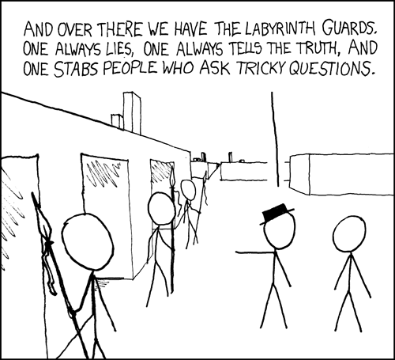
CSE 311: Foundations of Computing
Fall 2013
Lecture 2: Propositional logic

Slide 2
administrative
Course web: http://www.cs.washington.edu/311
Office hours: 10 hours available; check web
Homework #1: Posted. Turn in (stapled) at the
start of class on Wednesday (Oct 2)
Extra credit: Not required to get a 4.0.
Counts separately.
In total, may raise grade by ~0.1

Slide 3
recall: connectives
p | q | p ∧ q
T | T | T
T | F | F
F | T | F
F | F | F
p | ¬ p
T | F
F | T
NOT
AND
p | q | p ∨ q
T | T | T
T | F | T
F | T | T
F | F | F
p | q | p ⊕ q
T | T | F
T | F | T
F | T | T
F | F | F
OR
XOR

Slide 4
recall: $p→q$
p | q | p → q
F | F | T
F | T | T
T | F | F
T | T | T
Implication:
p implies q
whenever p is true q must be true
if p then q
q if p
p is sufficient for q
p only if q

Slide 5
$$\text{recall}\text{:} p→q$$
p | q | p → q
F | F | T
F | T | T
T | F | F
T | T | T
Implication:
p implies q
whenever p is true q must be true
if p then q
q if p
p is sufficient for q
p only if q
“If you behave, then I’ll buy you ice cream.”
What if you don’t behave?

Slide 6
recall: converse, contrapositive, inverse
Implication: p → q
Converse: q → p
Contrapositive: ¬ q → ¬ p
Inverse: ¬ p → ¬ q
Are these the same?

Slide 7
recall: Biconditional: $p↔q$
p iff q
p is equivalent to q
p implies q and q implies p
p | q | p ↔ q
T | T | T
T | F | F
F | T | F
F | F | T

Slide 8
recall: English and logic
You cannot ride the roller coaster if you are under 4 feet tall unless you are older than 16 years old.
q: you can ride the roller coaster
r: you are under 4 feet tall
s: you are older than 16

Slide 9
digital circuits
Computing with logic
T corresponds to 1 or “high” voltage
F corresponds to 0 or “low” voltage
Gates
Take inputs and produce outputs (functions)
Several kinds of gates
Correspond to propositional connectives
Only symmetric ones (order of inputs irrelevant)

Slide 10
gates
AND connective
p ∧ q
AND gate
p | q | p ∧ q
T | T | T
T | F | F
F | T | F
F | F | F
p | q | out
1 | 1 | 1
1 | 0 | 0
0 | 1 | 0
0 | 0 | 0
p
q
out
p
q
AND
out
“block looks like D of AND”

Slide 11
gates
OR connective
p ∨ q
OR gate
p | q | p ∨ q
T | T | T
T | F | T
F | T | T
F | F | F
p | q | out
1 | 1 | 1
1 | 0 | 1
0 | 1 | 1
0 | 0 | 0
p
out
q
p
OR
out
q
“arrowhead block looks like V”

Slide 12
gates
NOT connective
¬ p
NOT gate (inverter)
p | ¬ p
T | F
F | T
p | out
1 | 0
0 | 1
p
out
Bubble most important
for this diagram
p
NOT
out

Slide 13
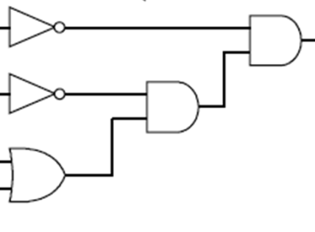
combinational logic circuits
AND
AND
OR
Values get sent along wires connecting gates

Slide 14
combinational logic circuits
AND
OR
AND
Wires can send one value to multiple gates

Slide 15
logical equivalence
Terminology: A compound proposition is a
Tautology if it is always true
Contradiction if it is always false
Contingency if it can be either true or false
p ∨ ¬ p
p ⊕ p
(p → q) ∧ p
(p ∧ q) ∨ (p ∧ ¬ q) ∨ (¬ p ∧ q) ∨ (¬ p ∧ ¬ q)

Slide 16
logical equivalence
p and q are logically equivalent if and only if
p ↔ q is a tautology
i.e. p and q have the same truth table
The notation p ≡ q denotes p and q are
logically equivalent
Example: p ≡ ¬ ¬ p
p | ¬ p | ¬ ¬ p | p ↔ ¬ ¬ p

Slide 17
De Morgan’s laws
¬ (p ∧ q) ≡ ¬ p ∨ ¬ q
¬ (p ∨ q) ≡ ¬ p ∧ ¬ q
What are the negations of:
The Yankees and the Phillies will play
in the World Series.
It will rain today or it will snow on New Year’s Day.

Slide 18
De Morgan’s laws
Example: ¬ (p ∧ q) ≡ (¬ p ∨ ¬ q)
p | q | ¬ p | ¬ q | ¬ p ∨ ¬ q | p ∧ q | ¬ (p ∧ q) | ¬ (p ∧ q) ↔ (¬ p ∨ ¬ q)
T | T
T | F
F | T
F | F

Slide 19
Law of Implication
(p → q) ≡ (¬ p ∨ q)
p | q | p → q | ¬ p | ¬ p ∨ q | (p → q) ↔ (¬ p ∨ q)
T | T
T | F
F | T
F | F

Slide 20
computing equivalence
Describe an algorithm for computing if two logical expressions/circuits are equivalent.
What is the run time of the algorithm?

Slide 21
properties of logical connectives
Identity
Domination
Idempotent
Commutative
Associative
Distributive
Absorption
Negation

Slide 22
some equivalences related to implication
p → q ≡ ¬ p ∨ q
p → q ≡ ¬ q → ¬ p
p ∨ q ≡ ¬ p → q
p ∧ q ≡ ¬ (p → ¬ q)
p ↔ q ≡ (p→ q) ∧ (q → p)
p ↔ q ≡ ¬ p ↔ ¬ q
p ↔ q ≡ (p ∧ q) ∨ (¬ p ∧ ¬ q)
¬ (p ↔ q) ≡ p ↔ ¬ q

Slide 23
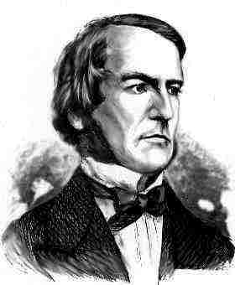
going crazy yet? so did they...
George Boole
(of Boolean logic)

Slide 24
understanding connectives
Reflect basic rules of reasoning and logic
Allow manipulation of logical formulas
Simplification
Testing for equivalence
Applications
Query optimization
Search optimization and caching
Artificial Intelligence
Program verification

Slide 25
logical proofs
To show P is equivalent to Q
Apply a series of logical equivalences to subexpressions to convert P to Q
To show P is a tautology
Apply a series of logical equivalences to subexpressions to convert P to T

Slide 26
prove this is a tautology
(p ∧ q) → (p ∨ q)

Slide 27
proving non-equivalence
(p → q) → r
p → (q → r)

