Slide 1
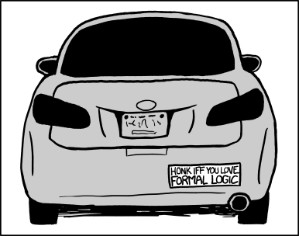
CSE 311: Foundations of Computing
Fall 2013
Lecture 1: Propositional logic

Slide 2
about the course
We will study…
Logic
Formal proofs
Set theory and functions
Basic number theory
Induction
CS structures: regular expressions, grammars, graphs, finite state machines
A little computability theory
To form a solid foundation for further study of CSE

Slide 3
about the course
Why?
Basis for thinking correctly and abstractly
Communicating precisely (formal specifications)
Correctness of programs
Representing knowledge
- Algorithm design
Reasoning about huge inputs / big data
Understanding what problems are hard to solve

Slide 4
administration
Instructors: Paul Beame and James Lee
Teaching assistants:
Emily Behrendt
Armando Diaz Tolentino
Hanchuan Li
Vincent Liew
Jianghong Shi
King Xia
Homework:
Due WED at start of class
Write up individually
Exams:
Midterm: November 4th
Final: December 9th 2:30-4:20 or 4:30-6:20
Non-standard time
Quiz sections: Thursdays
Not tomorrow
Grading:
50% homework
35% final exam
15% midterm
Book: Rosen
Discrete Mathematics
6th or 7th edition
All course information at http://www.cs.washington.edu/311

Slide 5
propositions
A statement that has a truth value
Which of the following are propositions?
The Washington State flag is red.
It snowed in Whistler, BC on January 4, 2011.
The home page renders correctly in Internet Explorer.
Space aliens landed in Roswell, New Mexico.
Turn your homework in on Wednesday.
Who let the dogs out?
If $n$ is an integer greater than two, then the equation $a^{n}+b^{n}=c^{n}$ has no solutions in non-zero integers $a$, $b$, and $c$.
Every even integer can be written as the sum of two primes.
This statement is false.
Propositional variables: $p, q, r, s$
Truth values: T for true, F for false

Slide 6
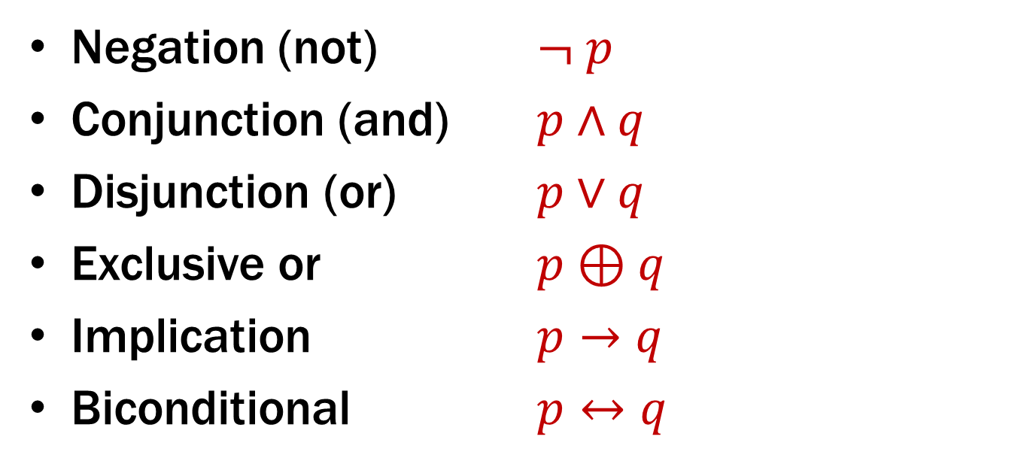
compound propositions
Negation (not) $¬ p$
Conjunction (and) $p∧q$
Disjunction (or) $p∨q$
Exclusive or $p⊕q$
Implication $p→q$
Biconditional $p↔q$

Slide 7
compound propositions
Negation (not) $¬ p$
Conjunction (and) $p∧q$
Disjunction (or) $p∨q$
Exclusive or $p⊕q$
Implication $p→q$
Biconditional $p↔q$
$p=$ It is raining.
$q=$ I feel sad.

Slide 8
truth tables
p | ¬ p
p | q | p ∧ q
p | q | p ∨ q
p | q | p ⊕ q

Slide 9
understanding complex propositions
Either Henry gets on base and Reggie hits a home run, or Fernando wins the game.
Atomic propositions
h: Henry gets on base
r: Reggie hits a home run
f: Fernando wins the game
(h ∧ r) ⊕ ¬ f

Slide 10
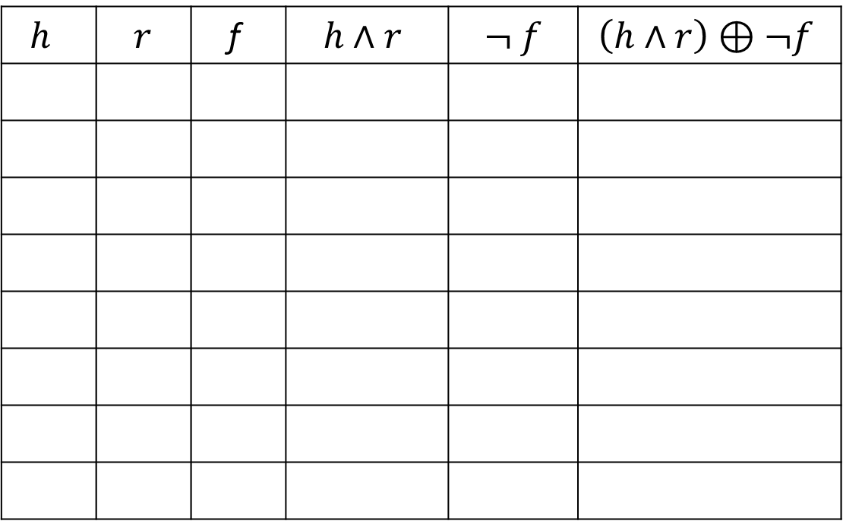
complex propositions with a truth table
$h$ | $r$ | f | $h∧r$ | $$¬ f$$ | $\left(h∧r\right)⊕¬f$

Slide 11
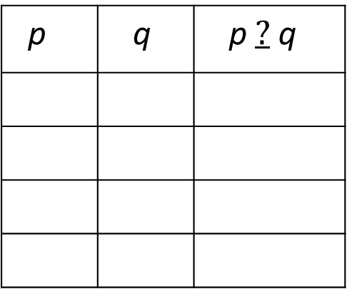
aside: how many…?
How many different binary operators are there on atomic propositions?
p | q | p $?$ q

Slide 12
$$p→q$$
p | q | p → q
Implication:
p implies q
whenever p is true q must be true
if p then q
q if p
p is sufficient for q
p only if q
*If pigs could whistle then horses could fly.

Slide 13
converse, contrapositive, inverse
Implication: p → q
Converse: q → p
Contrapositive: ¬ q → ¬ p
Inverse: ¬ p → ¬ q
Are these the same?
Example
p: “x is divisible by 2”
q: “x is divisible by 4”

Slide 14
Biconditional: $p↔q$
p iff q
p is equivalent to q
p implies q and q implies p
p | q | p ↔ q

Slide 15
English and logic
You cannot ride the roller coaster if you are under 4 feet tall unless you are older than 16 years old.
q: you can ride the roller coaster
r: you are under 4 feet tall
s: you are older than 16
( r ∧ ¬ s) → ¬ q
q → (¬ r ∨ s )
s → ¬ ( r → q )

