Slide 1
CSE 311 Foundations of Computing I
Lecture 30
Computability: Other Undecidable Problems
Autumn 2012

Slide 2
Announcements
Reading
7th edition: p. 201 and 13.5
6th edition: p. 177 and 12.5
5th edition: p. 222 and 11.5
Topic list and sample final exam problems have been posted
Comprehensive final, roughly 67% of material post midterm
Review session, Saturday, December 8, 10 am – noon, EEB 125
Final exam, Monday, December 10
2:30-4:20 pm or 4:30-6:20 pm, Kane 220.

Slide 3
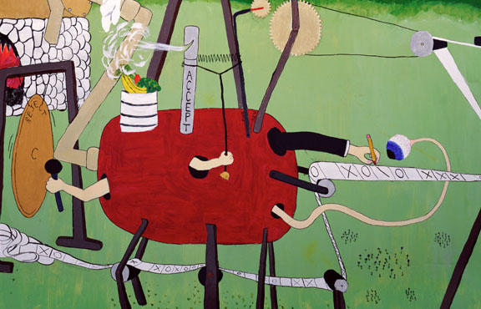
Last lecture highlights
Turing machine = Finite control + Recording Medium + Focus of attention
Finite Control: program P
Recording Medium
input x
 | _ | 0 | 1
s₁ | (1,s₃) | (1,s₂) | (0,s₂)
s₂ | (H,s₃) | (R,s₁) | (R,s₁)
s₃ | (H,s₃) | (R,s₃) | (R,s₃)
_ | _ | 1 | 1 | 0 | 1 | 1 | _ | _
_ | _ | 0 | 1 | 0 | 1 | 1 | _ | _
……
output
_ | _ | 0 | 0 | 1 | 0 | 0 | 1 | _

Slide 4
Last lecture highlights
The Universal Turing Machine U
Takes as input: (<P>,x) where <P> is the code of a program and x is an input string
Simulates P on input x
Same as a Program Interpreter
input
output
x
output
x
P
U
P(x)
P(x)
<P>

Slide 5
Last lecture highlights
Program P
input x
 | _ | 0 | 1
s₁ | (1,s₃) | (1,s₂) | (0,s₂)
s₂ | (H,s₃) | (R,s₁) | (R,s₁)
s₃ | (H,s₃) | (R,s₃) | (R,s₃)
_ | _ | 1 | 1 | 0 | 1 | 1 | _ | _
Universal TM U
Program code <P>
input x
 | _ | 0 | 1 | ( | ) | s | 2 | 3 | …
s₁
s₂
 | …
( | 1 | , | s | 3 | ) | ( | 1 | . . . . | 1 | 1 | 0 | 1 | 1 | _ | _
output
( | 1 | , | s | 3 | ) | ( | 1 | . . . . | 0 | 0 | 1 | 0 | 0 | 1 | _

Slide 6
Programs about Program Properties
The Universal TM takes a program code <P> as input, and an input x, and interprets P on x
Step by step by step by step…
Can we write a TM that takes a program code <P> as input and checks some property of the program?
Does P ever return the output “ERROR”?
Does P always return the output “ERROR”?
Does P halt on input x?

Slide 7
Halting Problem
Given: the code of a program P and an input x for P, i.e. given (<P>,x)
Output: 1 if P halts on input x 0 if P does not halt on input x
Theorem (Turing): There is no program that solves the halting problem “The halting problem is undecidable”

Slide 8
Proof by contradiction
Suppose that H is a Turing machine that solves the Halting problem
Function D(x):
if H(x,x)=1 then
while (true); /* loop forever */
else
no-op; /* do nothing and halt */
endif
What does D do on input <D>?
Does it halt?

Slide 9
Does D halt on input <D>?
Function D(x):
if H(x,x)=1 then
while (true); /* loop forever */
else
no-op; /* do nothing and halt */
endif
D halts on input <D>
⇔ H outputs 1 on input (<D>,<D>)
[since H solves the halting problem and so H(<D>,x) outputs 1 iff D halts on input x]
⇔ D runs forever on input <D>
[since D goes into an infinite loop on x iff H(x,x)=1]

Slide 10
That’s it!
We proved that there is no computer program that can solve the Halting Problem.
This tells us that there is no compiler that can check our programs and guarantee to find any infinite loops they might have

Slide 11
SCOOPING THE LOOP SNOOPER A proof that the Halting Problem is undecidable by Geoffrey K. Pullum (U. Edinburgh)
No general procedure for bug checks succeeds. Now, I won’t just assert that, I’ll show where it leads: I will prove that although you might work till you drop, you cannot tell if computation will stop.
For imagine we have a procedure called P that for specified input permits you to see whether specified source code, with all of its faults, defines a routine that eventually halts.
You feed in your program, with suitable data, and P gets to work, and a little while later (in finite compute time) correctly infers whether infinite looping behavior occurs...

Slide 12
SCOOPING THE LOOP SNOOPER
...
Here’s the trick that I’ll use -- and it’s simple to do. I’ll define a procedure, which I will call Q, that will use P’s predictions of halting success to stir up a terrible logical mess.
...
And this program called Q wouldn’t stay on the shelf; I would ask it to forecast its run on itself. When it reads its own source code, just what will it do? What’s the looping behavior of Q run on Q?
...
Full poem at:
http://www.lel.ed.ac.uk/~gpullum/loopsnoop.html

Slide 13
Halting Problem
x
1 if P(x) halts
0 if P(x) does not halt
H
<P>
HALT

Slide 14
The “Always Halting” problem
Given: <Q>, the code of a program Q
Output: 1 if Q halts on every input 0 if not.
Claim: the “always halts” problem is undecidable
Proof idea:
Show we could solve the Halting Problem if we had a solution for the “always halts” problem.
No program solving for Halting Problem exists ⇒ no program solving the “always halts” problem exists

Slide 15
The “Always Halting” problem
x
1 if P(x) halts
0 if P(x) does not halt
HALT
H
<P>
Suppose we had a TM A for the Always Halting problem
x
Program Q(x’)
… ignore x’
… run P on x
<Q>
A
1 if P(x) halts
0 if P(x) does not halt
<P>

Slide 16
The “Always ERROR” problem
Given: <R>, the code of a program R
Output: 1 if R always prints ERROR 0 if R does not always print ERROR

Slide 17
The “Always ERROR” problem
1 if Q always halts
0 if Q does not always halt
HALT
<Q>
A
Suppose we had a TM E for the ERROR problem
Program R(x)
Run Q on x
Print “ERROR”
Halt
1 if Q always halts
0 if Q does not always halt
<Q>
<R>
E

Slide 18
Pitfalls
Not every problem on programs is undecidable! Which of these is decidable?
Input <P> and x Output: 1 if P prints “ERROR” on x after less than 100 steps 0 otherwise
Input <P> and x Output: 1 if P prints “ERROR” on x after more than 100 steps 0 otherwise

