Slide 1
CSE 311 Foundations of Computing I
Lecture 24
Finite State Machines
Autumn 2012

Slide 2
Announcements
Reading assignments
7th Edition, Sections 13.3 and 13.4
6th Edition, Section 12.3 and 12.4
5th Edition, Section 11.3 and 11.4
Homework 9 will be posted today
Due date, Friday November 30

Slide 3
Last lecture highlights
Finite state machines
States, transitions, start state, final states
Languages recognized by FSMs
0
1
0
1
R
0
1
0
1
0
0,1
00
01
10
11
0,1
0,1
1
1
s₀
s₁
s₂
A
1
1
0
0
0
0
1
0,1
001
1
011
1
0
1
1
1
0
000
1
010
101
0
111
1
0
0
0
1
0
100
0
110

Slide 4
Non-determinism
A non-deterministic finite automaton (NFA) allows multiple outputs to have the same label
A string s is accepted by a NFA if there is some path through the NFA with labels s that reaches an accepting state
s₀
1
s₁
0,1
s₂
0,1
A
0,1

Slide 5
Strings over {0, 1, 2}*
M₁: Strings with an even number of 2’s
M₂: Strings where the sum of digits mod 3 is 0
s₀
s₁
t₁
t₀
t₂

Slide 6
Recognize strings with an even number of 2’s and a mod 3 sum of 0
s₁t₀
s₀t₁
s₀t₀
s₁t₁
s₁t₂
s₀t₂

Slide 7
State machines with output
“Tug-of-war”
 | Input |  | Output
State | L | R
s₁ | s₁ | s₂ | Beep
s₂ | s₁ | s₃
s₃ | s₂ | s₄
s₄ | s₃ | s₄ | Beep
R
R
R
L
S₁
S₂
S₃
S₄
R
L
L
L

Slide 8
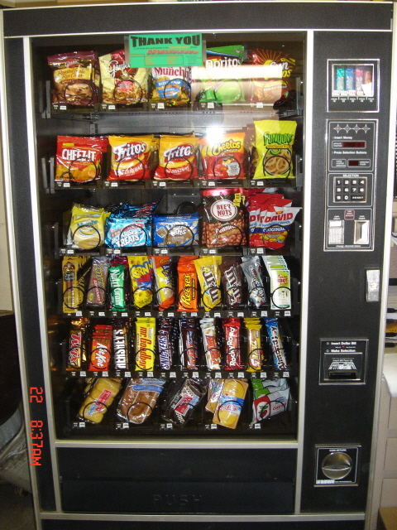
Vending Machine
Enter 15 cents in dimes or nickels
Press S or B for a candy bar

Slide 9
Vending Machine, Version 1
D
D
0
N
5
N
10
N, D
15
B, S
Basic transitions on N (nickel), D (dime), B (butterfinger), S (snickers)

Slide 10
Vending Machine, Version 2
0
D
N
15
D
D
B
0’ B
5
10
S
N
N
N
D
15’ N
B
S
N
D
0” S
Adding output to states: N – Nickel, S – Snickers, B – Butterfinger

Slide 11
Vending Machine, Final Version
B,S
0
D
N
15
B,S
B,S
B,S
D
B
D
D
0’ B
5
10
S
N
N
N
N
D
15’ N
B
N
B,S
S
D
N
D
0” S
N
B
15” D
S
D
Adding additional “unexpected” transitions

Slide 12
Vending Machine, Final Version
Slide from Nov 21, 2011 Lecture
B,S
0
D
N
15
B,S
B,S
B,S
D
D
B
D
0’ B
5
10
S
N
N
N
N
D
15’ N
B
N
S
D
B,S
N
D
0” S
N
B
15” D
S
D
Find the bug!

Slide 13
Another way to look at DFAs
Definition: The label of a path in a DFA is the
concatenation of all the labels on its edges in order
Lemma: x is in the language recognized by a DFA iff
x labels a path from the start state to some final state
0
0
s₀
1
s₁
1
s₂
1
s₃
0
0,1

Slide 14
Nondeterministic Finite Automaton (NFA)
Graph with start state, final states, edges labeled by symbols (like DFA) but
Not required to have exactly 1 edge out of each state labeled by each symbol - can have 0 or >1
Also can have edges labeled by empty string λ
Definition: x is in the language recognized by an NFA iff x labels a path from the start state to some final state
s₀
1
s₁
1
s₂
1
s₃
0,1
0,1

Slide 15
Design an NFA to recognize the set of binary strings that contain 111 or have an even # of 1’s

Slide 16
Three ways of thinking about NFAs
Outside observer: Is there a path labeled by x from the start state to some final state?
Perfect guesser: The NFA has input x and whenever there is a choice of what to do it magically guesses a good one (if one exists)
Parallel exploration: The NFA computation runs all possible computations on x step-by-step at the same time in parallel

