Slide 1
CSE 311 Foundations of Computing I
Lecture 22
Relations, Database
Autumn 2012
TexPoint fonts used in EMF.
Read the TexPoint manual before you delete this box.: AAAAAA

Slide 2
Announcements
Reading assignments
7th Edition, Sections 9.3 and 13.3
6th Edition, Section 8.3 and 12.3
5th Edition, Section 7.3 and 11.3

Slide 3
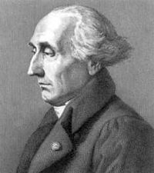
Lecture highlights
Let A and B be sets,
A binary relation from A to B is a subset of A × B
S ° R = {(a, c) | ∃ b such that (a,b)∈ R and (b,c)∈ S}
R¹ = R; R^{n+1} = R^{n} ° R
Matrix and graph representation of relations

Slide 4
Paths in relations
Let R be a relation on a set A. There is a path of length n from a to b if and only if (a,b) ∈R^{n}

Slide 5
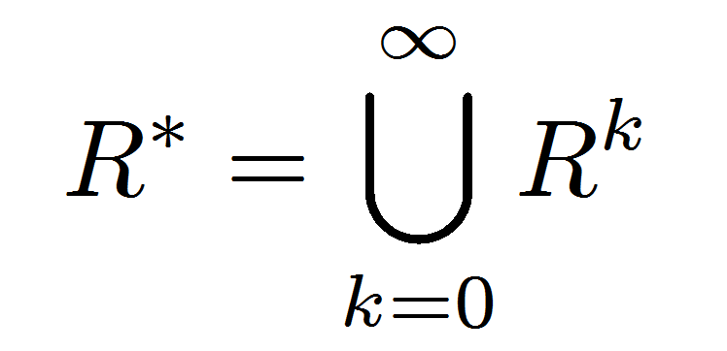
Connectivity relation
Let R be a relation on a set A. The connectivity relation R* consists of the pairs (a,b) such that there is a path from a to b in R.

Slide 6
Transitive-Reflexive Closure
Add the minimum possible number of edges to make the relation transitive and reflexive
The transitive-reflexive closure of a relation R is the connectivity relation R*

Slide 7
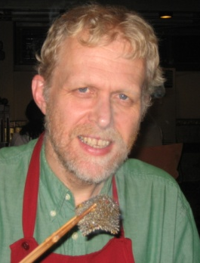
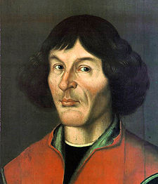
How is Anderson related to Bernoulli?
Copernicus
Anderson

Slide 8
How is Anderson related to Bernoulli?
Suciu
Copernicus

Slide 9
http://genealogy.math.ndsu.nodak.edu/

Slide 10
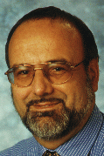
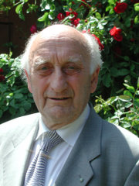
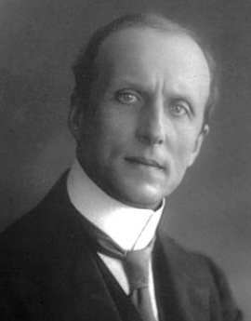
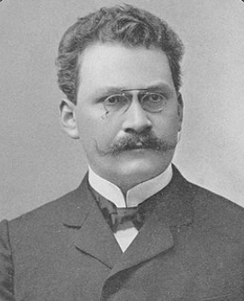
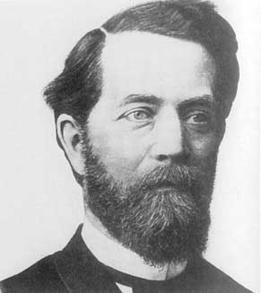
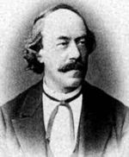
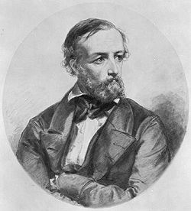
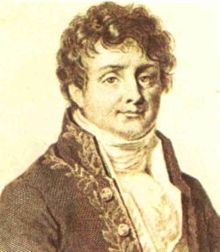
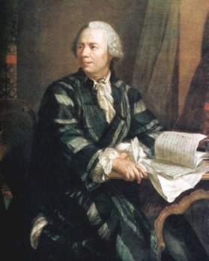
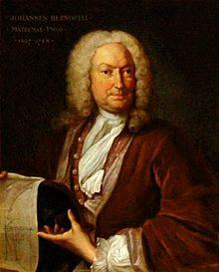
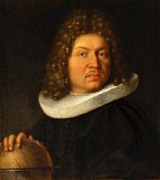
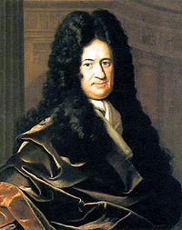
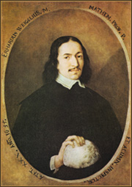
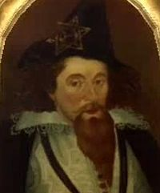
Anderson
Mayr
Bauer
Caratheodory
Minkowski
Klein
Lipschitz
Dirichlet
Fourier
Lagrange
Euler
Johann Bernoulli
Jacob Bernoulli
Leibniz
Weigel
Rheticus
Copernicus

Slide 11
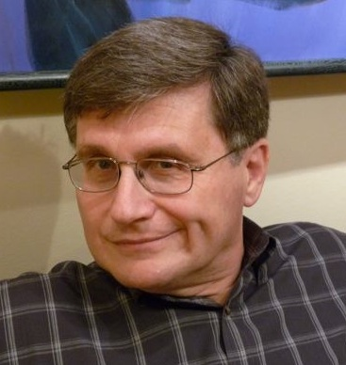
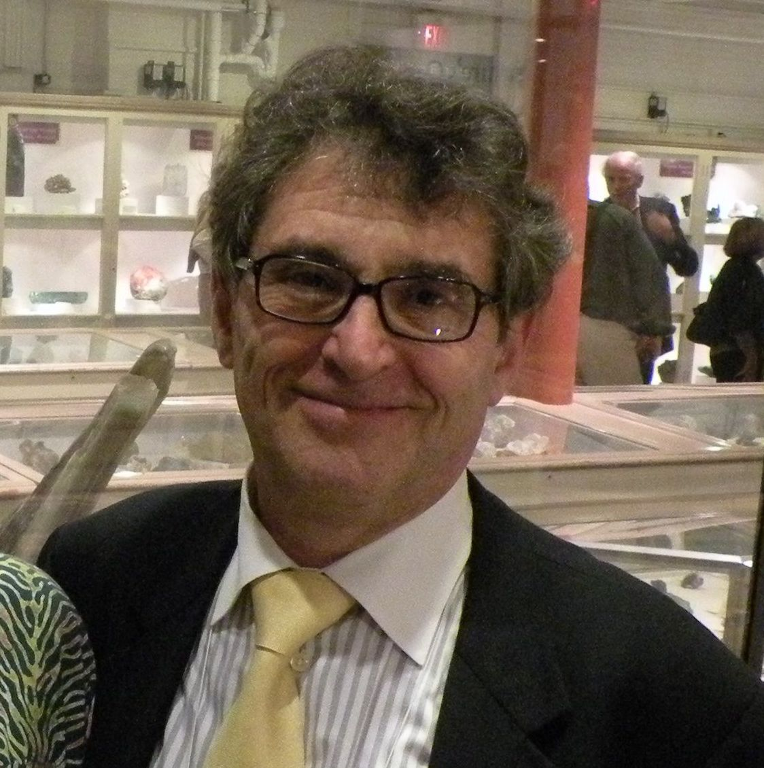
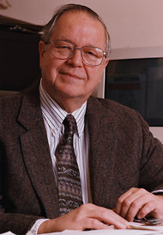
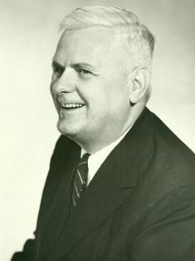
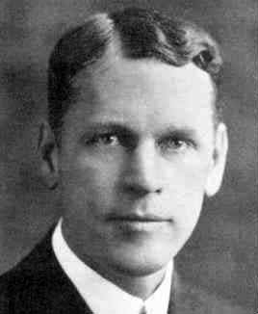
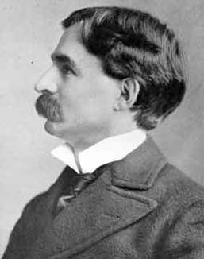
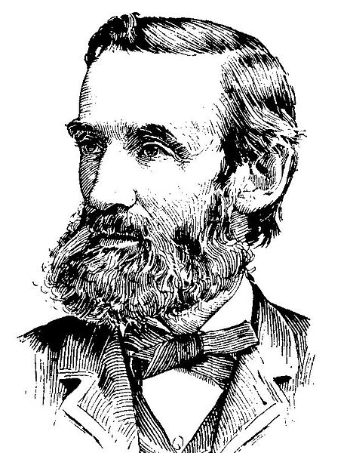
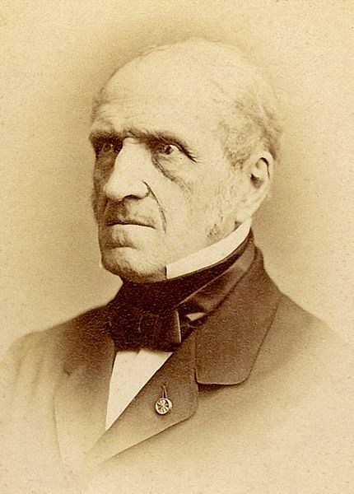
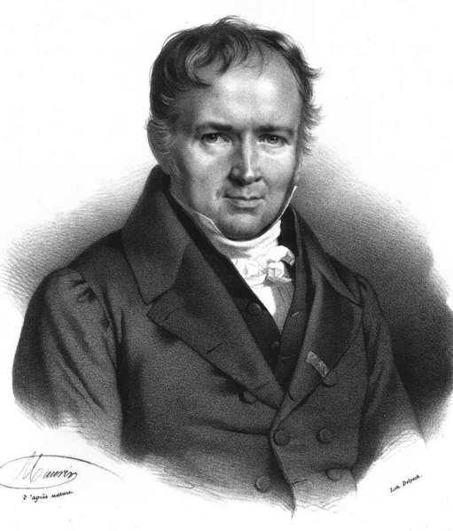
Suciu
Tannen
Meyer
Fischer
Rogers
Church
Veblen
Moore
H.A.Newton
Chasles
Poisson
Lagrange
Euler
Johann Bernoulli
Jacob Bernoulli

Slide 12
Nicolaus Copernicus
Georg Rheticus
Moritz Steinmetz
Christoph Meurer
Philipp Muller
Erhard Weigel
Gottfried Leibniz
Noclas Malebranache
Jacob Bernoulli
Johann Bernoulli
Leonhard Euler
Joseph Lagrange
Jean-Baptiste Fourier
Gustav Dirichlet
Rudolf Lipschitz
Felix Klein
C. L. Ferdinand Lindemann Herman Minkowski
Constantin Caratheodory Georg Aumann
Friedrich Bauer
Manfred Paul
Ernst Mayr Richard Anderson
Nicolaus Copernicus
Georg Rheticus
Moritz Steinmetz
Christoph Meurer
Philipp Muller
Erhard Weigel
Gottfried Leibniz
Noclas Malebranache
Jacob Bernoulli
Johann Bernoulli
Leonhard Euler
Joseph Lagrange
Michel Chasles
H. A. (Hubert Anson) Newton
E. H. (Eliakim Hastings) Moore
Oswald Veblen
Alonzo Church
Hartley Rogers, Jr.
Patrick Carl Fischer
Albert Ronald da Silva Meyer
Val Tannen
Dan Suciu

Slide 13
n-ary relations
Let A₁, A₂, …, A_{n} be sets. An n-ary relation on
these sets is a subset of A₁× A₂× . . . × A_{n}.

Slide 14
Relational databases
STUDENT
Student_Name | ID_Number | Office | GPA
Knuth | 328012098 | 022 | 4.00
Von Neuman | 481080220 | 555 | 3.78
Russell | 238082388 | 022 | 3.85
Einstein | 238001920 | 022 | 2.11
Newton | 1727017 | 333 | 3.61
Karp | 348882811 | 022 | 3.98
Bernoulli | 2921938 | 022 | 3.21

Slide 15
Relational databases
STUDENT
Student_Name | ID_Number | Office | GPA | Course
Knuth | 328012098 | 022 | 4.00 | CSE311
Knuth | 328012098 | 022 | 4.00 | CSE351
Von Neuman | 481080220 | 555 | 3.78 | CSE311
Russell | 238082388 | 022 | 3.85 | CSE312
Russell | 238082388 | 022 | 3.85 | CSE344
Russell | 238082388 | 022 | 3.85 | CSE351
Newton | 1727017 | 333 | 3.61 | CSE312
Karp | 348882811 | 022 | 3.98 | CSE311
Karp | 348882811 | 022 | 3.98 | CSE312
Karp | 348882811 | 022 | 3.98 | CSE344
Karp | 348882811 | 022 | 3.98 | CSE351
Bernoulli | 2921938 | 022 | 3.21 | CSE351
What wrong?
Notes:
What’s wrong:
Redundant data: we repeat all the GPAs and all the Office numbers
Missing data: we lost Einstein

Slide 16
Relational databases
TAKES
STUDENT
ID_Number | Course
328012098 | CSE311
328012098 | CSE351
481080220 | CSE311
238082388 | CSE312
238082388 | CSE344
238082388 | CSE351
1727017 | CSE312
348882811 | CSE311
348882811 | CSE312
348882811 | CSE344
348882811 | CSE351
2921938 | CSE351
Student_Name | ID_Number | Office | GPA
Knuth | 328012098 | 022 | 4.00
Von Neuman | 481080220 | 555 | 3.78
Russell | 238082388 | 022 | 3.85
Einstein | 238001920 | 022 | 2.11
Newton | 1727017 | 333 | 3.61
Karp | 348882811 | 022 | 3.98
Bernoulli | 2921938 | 022 | 3.21
Better

Slide 17
Database Operations: Projection
Office
022
555
333
Find all offices: Π_{Office}(STUDENT)
Office | GPA
022 | 4.00
555 | 3.78
022 | 3.85
022 | 2.11
333 | 3.61
022 | 3.98
022 | 3.21
Find offices and GPAs: Π_{Office,GPA}(STUDENT)

Slide 18
Database Operations: Selection
Find students with GPA > 3.9 : σ_{GPA>3.9}(STUDENT)
Student_Name | ID_Number | Office | GPA
Knuth | 328012098 | 022 | 4.00
Karp | 348882811 | 022 | 3.98
Retrieve the name and GPA for students with GPA > 3.9 : Π_{Student_Name,GPA}(σ_{GPA>3.9}(STUDENT))
Student_Name | GPA
Knuth | 4.00
Karp | 3.98

Slide 19
Database Operations: Natural Join
Student ⋈ Takes
Student_Name | ID_Number | Office | GPA | Course
Knuth | 328012098 | 022 | 4.00 | CSE311
Knuth | 328012098 | 022 | 4.00 | CSE351
Von Neuman | 481080220 | 555 | 3.78 | CSE311
Russell | 238082388 | 022 | 3.85 | CSE312
Russell | 238082388 | 022 | 3.85 | CSE344
Russell | 238082388 | 022 | 3.85 | CSE351
Newton | 1727017 | 333 | 3.61 | CSE312
Karp | 348882811 | 022 | 3.98 | CSE311
Karp | 348882811 | 022 | 3.98 | CSE312
Karp | 348882811 | 022 | 3.98 | CSE344
Karp | 348882811 | 022 | 3.98 | CSE351
Bernoulli | 2921938 | 022 | 3.21 | CSE351

Slide 20
Disambiguating Attribute Names
Names of students who share an office with Einstein:
Π_{STUDENT1.Student_Name}(STUDENT ⋈STUDENT1.Office = STUDENT2.Office (σ_{Student_Name=‘Einstein’}(STUDENT)))
STUDENT
STUDENT
Student_Name | ID_Number | Office | GPA
Knuth | 328012098 | 022 | 4.00
Von Neuman | 481080220 | 555 | 3.78
Russell | 238082388 | 022 | 3.85
Einstein | 238001920 | 022 | 2.11
Newton | 1727017 | 333 | 3.61
Karp | 348882811 | 022 | 3.98
Bernoulli | 2921938 | 022 | 3.21
Student_Name | ID_Number | Office | GPA
Knuth | 328012098 | 022 | 4.00
Von Neuman | 481080220 | 555 | 3.78
Russell | 238082388 | 022 | 3.85
Einstein | 238001920 | 022 | 2.11
Newton | 1727017 | 333 | 3.61
Karp | 348882811 | 022 | 3.98
Bernoulli | 2921938 | 022 | 3.21
Student_Name
Knuth
Russell
Einstein
Karp
Bernoulli
Answer:

Slide 21
Database Operations: Relational Algebra
Find the names and GPAs of all students who take 311
Find the names of all students who take at least two courses
Notes:
Π_{Student_Name,GPA}(STUDENT ⋈ (σ_{Course=‘311’}(TAKES)))
Π_{Student_Name}(σ_{TAKES1.course ≠ TAKES2.course}(STUDENT ⋈STUDENT.ID_Number = TAKES1.ID_Number (TAKES) ⋈STUDENT.ID_Number = TAKES2.ID_Number (TAKES)))

Slide 22
Database Operations: SQL
Find the names and GPAs of all students who take 311
SELECT DISTINCT Student_name, GPA
FROM STUDENT Natural Join TAKES
WHERE Course = ‘CSE311’
Find the names of all students who take at least two courses
SELECT DISTINCT Student_name, GPA
FROM STUDENT s, TAKES t1, TAKES t2
WHERE s.ID_number = t1.ID_number and s.ID_number = t2.ID_number and t1.course != t2.course
Notes:
Cut and paste intosqlite3:
create table STUDENT (Student_Name text, ID_Number int, Office text, GPA float);
create table TAKES(ID_Number int, course text);
insert into STUDENT values('Knuth', 328012098, 22, 4);
insert into STUDENT values('Von Neuman', 481080220, 555 , 3.78);
insert into STUDENT values('Russell', 238082388, 22, 3.85);
insert into STUDENT values('Einstein', 238001920, 22, 2.11);
insert into STUDENT values('Newton', 1727017, 333 , 3.61);
insert into STUDENT values('Karp', 348882811, 22, 3.98);
insert into STUDENT values('Bernoulli', 2921938, 22, 3.21);
insert into TAKES values(328012098, 'CSE311');
insert into TAKES values(328012098, 'CSE351');
insert into TAKES values(481080220, 'CSE311');
insert into TAKES values(238082388, 'CSE312');
insert into TAKES values(238082388, 'CSE344');
insert into TAKES values(238082388, 'CSE351');
insert into TAKES values(1727017, 'CSE312');
insert into TAKES values(348882811, 'CSE311');
insert into TAKES values(348882811, 'CSE312');
insert into TAKES values(348882811, 'CSE344');
insert into TAKES values(348882811, 'CSE351');
insert into TAKES values(2921938, 'CSE351');
SELECT DISTINCT Student_name, GPA
FROM STUDENT Natural Join TAKES
WHERE Course = 'CSE311';
SELECT DISTINCT Student_name, GPA
FROM STUDENT s, TAKES t1, TAKES t2
WHERE s.ID_number = t1.ID_number
and s.ID_number = t2.ID_number
and t1.course != t2.course;

Slide 23
Relational Databases: Keys
An attribute is a key if all its values in the database are always distinct
Student_Name | ID_Number | Office | GPA
Knuth | 328012098 | 022 | 4.00
Von Neuman | 481080220 | 555 | 3.78
Russell | 238082388 | 022 | 3.85
Einstein | 238001920 | 022 | 2.11
Newton | 1727017 | 333 | 3.61
Karp | 348882811 | 022 | 3.98
Bernoulli | 2921938 | 022 | 3.21
Which attribute is the key?
Why is Student_Name not a key?

Slide 24
Relational Databases: Relationships
STUDENT
Student_Name | ID_Number | Office
Knuth | 328012098 | 022
Von Neuman | 481080220 | 555
Russell | 238082388 | 022
Einstein | 238001920 | 022
Newton | 1727017 | 333
Karp | 348882811 | 022
Bernoulli | 2921938 | 022
PROJECT
PRJ_ID | Project_Name | Due_date
P331 | “Flying cyphers” | 11/2012
P004 | “Virtual induction” | 12/2012
P901 | “Binary bots” | 12/2012
ID_Number | PRJ_ID
2921938 | P004
2921938 | P901
1727017 | P901
WORKS_ON is a relationship between students and project
Who works on what?

Slide 25
Types of Relationships in Relational Databases
one-one:
many-one
many-many
1
2
3
a
b
c
d
What type is WORKS_ON?
ID_Number | PRJ_ID
2921938 | P004
2921938 | P901
1727017 | P901
1
2
3
a
b
c
d
1
2
3
a
b
c
d

