Slide 1
CSE 311 Foundations of Computing I
Lecture 20
Context-Free Grammars and Languages
Autumn 2012

Slide 2
Announcements
Reading Assignment
7th Edition, Section 9.1 and pp. 594-601
6th Edition, Section 8.1 and pp. 541-548
5th Edition, Section 7.1 and pp. 493-500

Slide 3
Highlight from last lecture: Regular expressions
Regular expressions over Σ
Basis:
∅, λ are regular expressions
a is a regular expression for any a ∈ Σ
Recursive step:
If A and B are regular expressions then so are:
(A ∪ B)
(AB)
A*

Slide 4
More examples
All binary strings that don’t contain 101

Slide 5
Regular expressions can’t specify everything we might want
Even some easy things like palindromes
More complicated structures in programming languages
Matched parentheses
Properly formed arithmetic expressions
Etc.

Slide 6
Context Free Grammars
A Context-Free Grammar (CFG) is given by a finite set of substitution rules involving
A finite set V of variables that can be replaced
Alphabet Σ of terminal symbols that can’t be replaced
One variable, usually S, is called the start symbol
The rules involving a variable A are written as
A → w₁ | w₂ | ... | w_{k} where each w_{i} is a string of variables and terminals – that is w_{i} ∈ (V ∪ Σ)∗

Slide 7
How Context-Free Grammars generate strings
Begin with start symbol S
If there is some variable A in the current string you can replace it by one of the w’s in the rules for A
Write this as xAy ⇒ xwy
Repeat until no variables left
The set of strings the CFG generates are all strings produced in this way that have no variables

Slide 8
Sample Context-Free Grammars
Example: S → 0S0 | 1S1 | 0 | 1 | λ
Example: S → 0S | S1 | λ

Slide 9
Sample Context-Free Grammars
Grammar for {0^{n}1^{n} : n≥ 0} all strings with same # of 0’s and 1’s with all 0’s before 1’s.
Example: S → (S) | SS | λ

Slide 10
Simple Arithmetic Expressions
E→ E+E | E$∗$E | (E) | x | y | z | 0 | 1 | 2 | 3 | 4 | 5 | 6 | 7 | 8 | 9
Generate (2$∗$x) + y
Generate x+y$∗$z in two fundamentally different ways

Slide 11
Context-Free Grammars and recursively-defined sets of strings
A CFG with the start symbol S as its only variable recursively defines the set of strings of terminals that S can generate
A CFG with more than one variable is a simultaneous recursive definition of the sets of strings generated by each of its variables
Sometimes necessary to use more than one

Slide 12
Building in Precedence in Simple Arithmetic Expressions
E – expression (start symbol)
T – term F – factor I – identifier N - number
E→ T | E+T
T→ F | F$∗$T
F→ (E) | I | N
I → x | y | z
N→ 0 | 1 | 2 | 3 | 4 | 5 | 6 | 7 | 8 | 9

Slide 13
Another name for CFGs
BNF (Backus-Naur Form) grammars
Originally used to define programming languages
Variables denoted by long names in angle brackets, e.g.
<identifier>, <if-then-else-statement>, <assignment-statement>, <condition>
::= used instead of →

Slide 14
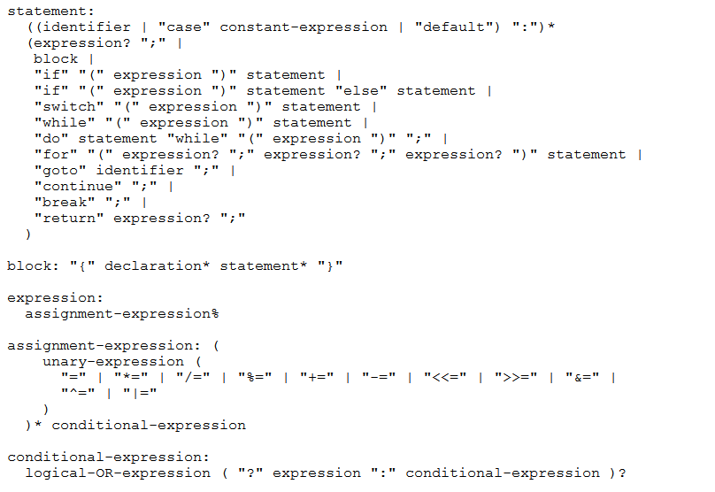
BNF for C

Slide 15
Parse Trees
Back to middle school:
<sentence>::=<noun phrase><verb phrase>
<noun phrase>::=<article><adjective><noun>
<verb phrase>::=<verb><adverb>|<verb><object>
<object>::=<noun phrase>
Parse:
The yellow duck squeaked loudly
The red truck hit a parked car

