Slide 1
CSE 311 Foundations of Computing I
Lecture 19
Recursive Definitions: Context-Free Grammars and Languages
Autumn 2012

Slide 2
Announcements
Reading assignments
7th Edition, pp. 878-880 and pp. 851-855
6th Edition, pp. 817-819 and pp. 789-793
5th Edition, pp. 766 and pp. 743-748
For Friday, November 9
7th Edition, Section 9.1 and pp. 594-601
6th Edition, Section 8.1 and pp. 541-548
5th Edition, Section 7.1 and pp. 493-500

Slide 3
Highlight from last lecture: Structural Induction
How to prove ∀x∈S. P(x) is true:
Base Case: Show that P is true for all specific elements of S mentioned in the Basis step
Inductive Hypothesis: Assume that P is true for some arbitrary values of each of the existing named elements mentioned in the Recursive step
Inductive Step: Prove that P holds for each of the new elements constructed in the Recursive step using the named elements mentioned in the Inductive Hypothesis
Conclude that ∀x∈S. P(x)

Slide 4
Rooted Binary trees
Basis: • is a rooted binary tree
Recursive Step: If and are rooted
binary trees then so is:
T₂
T₁
T₂
T₁

Slide 5
Functions defined on rooted binary trees
size(•)=1
size( ) = 1+size(T₁)+size(T₂)
height(•)=0
height( )=1+max{height(T₁),height(T₂)}
T₁
T₂
T₁
T₂

Slide 6
For every rooted binary tree T size(T) ≤ 2^{height(T)+1} -1

Slide 7
Languages: Sets of Strings
Sets of strings that satisfy special properties are called languages. Examples:
English sentences
Syntactically correct Java/C/C++ programs
All strings over alphabet Σ
Palindromes over Σ
Binary strings that don’t have a 0 after a 1
Legal variable names. keywords in Java/C/C++
Binary strings with an equal # of 0’s and 1’s (HW6)

Slide 8
Regular expressions
Regular expressions over Σ
Basis:
∅, λ are regular expressions
a is a regular expression for any a ∈ Σ
Recursive step:
If A and B are regular expressions then so are:
(A ∪ B)
(AB)
A*

Slide 9
Each regular expression is a “pattern”
λ matches the empty string
a matches the one character string a
(A ∪ B) matches all strings that either A matches or B matches (or both)
(AB) matches all strings that have a first part that A matches followed by a second part that B matches
A* matches all strings that have any number of strings (even 0) that A matches, one after another

Slide 10
Examples
001*
0*1*
(0 ∪ 1)0(0 ∪ 1)0
(0*1*)*
(0 ∪ 1)* 0110 (0 ∪ 1)*
(00 ∪ 11)* (01010 ∪ 10001)(0 ∪ 1)*

Slide 11
Regular expressions in practice
Used to define the “tokens”: e.g., legal variable names, keywords in programming languages and compilers
Used in grep, a program that does pattern matching searches in UNIX/LINUX
Pattern matching using regular expressions is an essential feature of hypertext scripting language PHP used for web programming
Also in text processing programming language Perl

Slide 12
Regular Expressions in PHP
int preg_match ( string $pattern , string $subject,...)
$pattern syntax:
[01] a 0 or a 1 ^ start of string $ end of string
[0-9] any single digit \. period \, comma \- minus
. any single character
ab a followed by b (AB)
(a|b) a or b (A ∪ B) a? zero or one of a (A ∪ λ) a* zero or more of a A*
a+ one or more of a AA*
e.g. ^[\-+]?[0-9]*(\.|\,)?[0-9]+$
General form of decimal number e.g. 9.12 or -9,8 (Europe)

Slide 13
More examples
All binary strings that have an even # of 1’s
All binary strings that don’t contain 101

Slide 14
Regular expressions can’t specify everything we might want
Even some easy things like palindromes
More complicated structures in programming languages
Matched parentheses
Properly formed arithmetic expressions
Etc.

Slide 15
Context Free Grammars
A Context-Free Grammar (CFG) is given by a finite set of substitution rules involving
A finite set V of variables that can be replaced
Alphabet Σ of terminal symbols that can’t be replaced
One variable, usually S, is called the start symbol
The rules involving a variable A are written as
A → w₁ | w₂ | ... | w_{k} where each w_{i} is a string of variables and terminals – that is w_{i} ∈ (V ∪ Σ)∗

Slide 16
How Context-Free Grammars generate strings
Begin with start symbol S
If there is some variable A in the current string you can replace it by one of the w’s in the rules for A
Write this as xAy ⇒ xwy
Repeat until no variables left
The set of strings the CFG generates are all strings produced in this way that have no variables

Slide 17
Sample Context-Free Grammars
Example: S → 0S0 | 1S1 | 0 | 1 | λ
Example: S → 0S | S1 | λ

Slide 18
Sample Context-Free Grammars
Grammar for {0^{n}1^{n} : n≥ 0} all strings with same # of 0’s and 1’s with all 0’s before 1’s.
Example: S → (S) | SS | λ

Slide 19
Simple Arithmetic Expressions
E→ E+E | E$∗$E | (E) | x | y | z | 0 | 1 | 2 | 3 | 4 | 5 | 6 | 7 | 8 | 9
Generate (2$∗$x) + y
Generate x+y$∗$z in two fundamentally different ways

Slide 20
Context-Free Grammars and recursively-defined sets of strings
A CFG with the start symbol S as its only variable recursively defines the set of strings of terminals that S can generate
A CFG with more than one variable is a simultaneous recursive definition of the sets of strings generated by each of its variables
Sometimes necessary to use more than one

Slide 21
Building in Precedence in Simple Arithmetic Expressions
E – expression (start symbol)
T – term F – factor I – identifier N - number
E→ T | E+T
T→ F | F$∗$T
F→ (E) | I | N
I → x | y | z
N→ 0 | 1 | 2 | 3 | 4 | 5 | 6 | 7 | 8 | 9

Slide 22
Another name for CFGs
BNF (Backus-Naur Form) grammars
Originally used to define programming languages
Variables denoted by long names in angle brackets, e.g.
<identifier>, <if-then-else-statement>, <assignment-statement>, <condition>
::= used instead of →

Slide 23
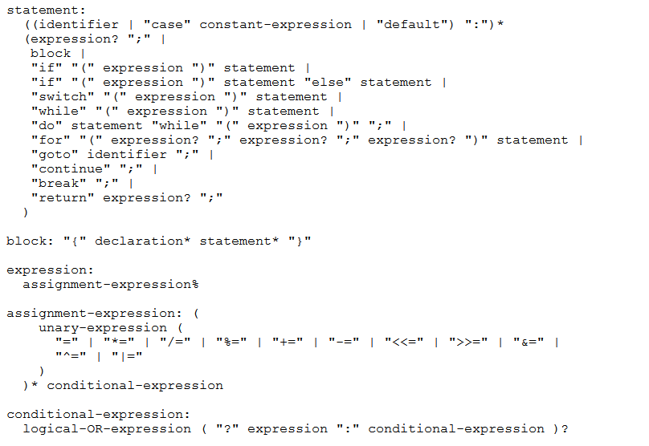
BNF for C

Slide 24
Parse Trees
Back to middle school:
<sentence>::=<noun phrase><verb phrase>
<noun phrase>::=<article><adjective><noun>
<verb phrase>::=<verb><adverb>|<verb><object>
<object>::=<noun phrase>
Parse:
The yellow duck squeaked loudly
The red truck hit a parked car

