Slide 1
CSE 311 Foundations of Computing I
Lecture 17
Recursive Definitions and Structural Induction
Autumn 2012

Slide 2
Announcements
Reading assignments
Today:
5.3 7th Edition
4.3 6th Edition
3.4 5th Edition (not all there)
Homework 6 posted
Midterm Friday, Nov 2
Closed book, closed notes
Practice midterm available on the Web
Extra office hours Thursday (midterm review)
3:30 pm, Dan Suciu, Gowen 201
4:30 pm, Richard Anderson, Gowen 201

Slide 3
Highlights from last lecture
Strong Induction
Strong Induction proof layout:
By induction we will show that P(n) is true for every n≥0
Base Case: Prove P(0)
Inductive Hypothesis: Assume that for some arbitrary integer k ≥ 0, P(j) is true for every j from 0 to k
Inductive Step: Prove that P(k+1) is true using Inductive Hypothesis that P(j) is true for all values ≤ k
Conclusion: Result follows by induction
P(0)
∀ k ((P(0) ∧ P(1) ∧ P(2) ∧ … ∧ P(k)) → P(k+1))
∴ ∀ n P(n)

Slide 4
Fibonacci Numbers
f₀ = 0; f₁ = 1; f_{n} = f_{n-1} + f_{n-2}

Slide 5
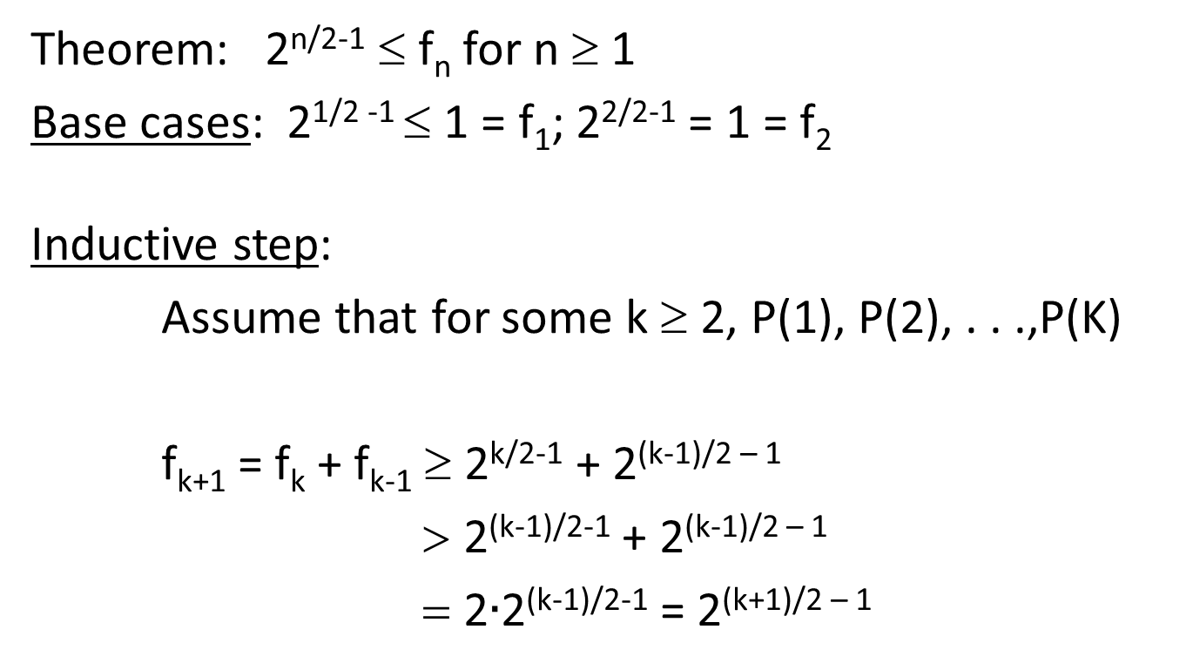
Bounding the Fibonacci Numbers
Theorem: 2^{n/2-1} ≤ f_{n} for n ≥ 1
Base cases: 2^{1/2 -1} ≤ 1 = f₁; 2^{2/2-1} = 1 = f₂
Inductive step:
Assume that for some k ≥ 2, P(1), P(2), . . .,P(K)
f_{k+1} = f_{k} + f_{k-1} ≥ 2^{k/2-1} + 2^{(k-1)/2 – 1}
> 2^{(k-1)/2-1} + 2^{(k-1)/2 – 1}
= 2$∙$2^{(k-1)/2-1} = 2^{(k+1)/2 – 1}

Slide 6
Recursive Definitions of Sets
Recursive definition
Basis step: 0 ∈ S
Recursive step: if x ∈ S, then x + 2 ∈ S
Exclusion rule: Every element in S follows from basis steps and a finite number of recursive steps

Slide 7
Recursive definitions of sets
Basis: 6 ∈ S; 15 ∈ S;
Recursive: if x, y ∈ S, then x + y ∈ S;
Basis: [1, 1, 0] ∈ S, [0, 1, 1] ∈ S;
Recursive:
if [x, y, z] ∈ S, α in R, then [α x, α y, α z] ∈ S
if [x₁, y₁, z₁], [x₂, y₂, z₂] ∈ S
then [x₁ + x₂, y₁ + y₂, z₁ + z₂] ∈ S
Powers of 3

Slide 8
Recursive Definitions of Sets: General Form
Recursive definition
Basis step: Some specific elements are in S
Recursive step: Given some existing named elements in S some new objects constructed from these named elements are also in S.
Exclusion rule: Every element in S follows from basis steps and a finite number of recursive steps

Slide 9
Strings
An alphabet Σ is any finite set of characters.
The set Σ* of strings over the alphabet Σ is defined by
Basis: λ ∈ Σ* (λ is the empty string)
Recursive: if w ∈ Σ*, x ∈ Σ, then wx ∈ Σ*

Slide 10
Palindromes
Palindromes are strings that are the same backwards and forwards
Basis: λ is a palindrome and any a ∈ Σ is a palindrome
Recursive step: If p is a palindrome then apa is a palindrome for every a ∈ Σ

Slide 11
All binary strings with no 1’s before 0’s

Slide 12
Function definitions on recursively defined sets
len (λ) = 0;
len (wa) = 1 + len(w); for w ∈ Σ*, a ∈ Σ
Reversal:
λ^{R} = λ
(wa)^{R} = aw^{R} for w ∈ Σ*, a ∈ Σ
Concatenation:
x • λ = x for x ∈ Σ*
x • wa = (x • w)a for x, w ∈ Σ*, a ∈ Σ

Slide 13
Rooted Binary trees
Basis: • is a rooted binary tree
Recursive Step: If and are rooted
binary trees then so is:
T₂
T₁
T₂
T₁

Slide 14
Functions defined on rooted binary trees
size(•)=1
size( ) = 1+size(T₁)+size(T₂)
height(•)=0
height( )=1+max{height(T₁),height(T₂)}
T₁
T₂
T₁
T₂

