Slide 1
CSE 311 Foundations of Computing I
Lecture 11
Modular Arithmetic
Autumn 2012

Slide 2
Announcements
Reading assignments
Today and Friday:
4.1-4.3 7th Edition
3.5, 3.6 6th Edition
2.5, 2.6 up to p. 191 5th Edition
Homework 4
Available now

Slide 3
Highlights from last lecture: Set Theory
x ∈ A : “x is an element of A”
x ∈ A : ¬ (x ∈ A)
/
A = B ≡ ∀ x (x ∈ A ↔ x ∈ B)
$$(A⊆B ∧B ⊆A) →A=B$$
A ∪ B = { x | (x ∈ A) ∨ (x ∈ B) }

Slide 4
Applications of Set Theory
Implementation: Characteristic Vector
Private Key Cryptography
Unix File Permissions

Slide 5
Russell’s Paradox
S = { x | x ∈ x }
/

Slide 6
Functions review
A function from A to B
an assignment of exactly one element of B to each element of A.
We write f: A→B.
“Image of a” = f(a)
Domain of f : A
Range of f = set of all images of elements of A

Slide 7
Image, Preimage
A B
a
1
b
2
c
3
d
4
e

Slide 8
Is this a function? one-to-one? onto?
a
1
b
2
c
3
d
4
e
5
6

Slide 9
Number Theory (and applications to computing)
Branch of Mathematics with direct relevance to computing
Many significant applications
Cryptography
Hashing
Security
Important tool set

Slide 10
Modular Arithmetic
Arithmetic over a finite domain
In computing, almost all computations are over a finite domain

Slide 11
What are the values computed?
[-128, 127]
public void Test1() {
byte x = 250;
byte y = 20;
byte z = (byte) (x + y);
Console.WriteLine(z);
}
public void Test2() {
sbyte x = 120;
sbyte y = 20;
sbyte z = (sbyte) (x + y);
Console.WriteLine(z);
}
14
-116

Slide 12
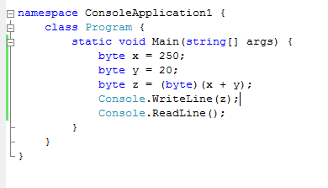
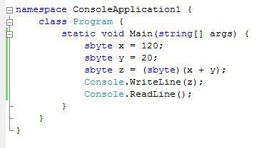
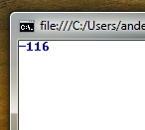

Slide 13
Arithmetic mod 7
a +₇ b = (a + b) mod 7
a ×₇ b = (a × b) mod 7
+ | 0 | 1 | 2 | 3 | 4 | 5 | 6
0
1
2
3
4
5
6
X | 0 | 1 | 2 | 3 | 4 | 5 | 6
0
1
2
3
4
5
6

Slide 14
Divisibility
Integers a, b, with a ≠ 0, we say that a divides b is there is an integer k such that b = ak. The notation a | b denotes a divides b.

Slide 15
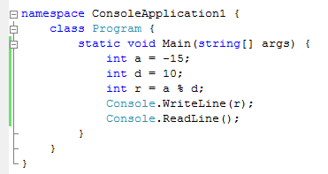
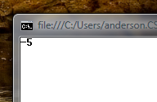
Division Theorem
Let a be an integer and d a positive integer. Then there are unique integers q and r, with 0 ≤ r < d, such that a = dq + r.
q = a div d r = a mod d
Note: r ≥ 0 even if a < 0. Not quite the same as a%d

Slide 16
Modular Arithmetic
Let a and b be integers, and m be a positive integer. We say a is congruent to b modulo m if m divides a – b. We use the notation a ≡ b (mod m) to indicate that a is congruent to b modulo m.

Slide 17
Modular arithmetic
Let a and b be integers, and let m be a positive integer. Then a ≡ b (mod m) if and only if
a mod m = b mod m.

Slide 18
Modular arithmetic
Let m be a positive integer. If a ≡ b (mod m) and c ≡ d (mod m), then
a + c ≡ b + d (mod m) and
ac ≡ bd (mod m)

Slide 19
Example
Let n be an integer, prove that n² ≡ 0 (mod 4) or n² ≡ 1 (mod 4)

Slide 20
n-bit Unsigned Integer Representation
Represent integer x as sum of powers of 2:
If x = Σ_{i=0} b_{i} 2^{i} where each b_{i} ∈ {0,1}
then representation is b_{n-1}...b₂ b₁ b₀
99 = 64 + 32 + 2 + 1
18 = 16 + 2
For n = 8:
99: 0110 0011
18: 0001 0010
n-1

Slide 21
Signed integer representation
n-bit signed integers
Suppose -2^{n-1} < x < 2^{n-1}
First bit as the sign, n-1 bits for the value
99 = 64 + 32 + 2 + 1
18 = 16 + 2
For n = 8:
99: 0110 0011
-18: 1001 0010
Any problems with this representation?

Slide 22
Two’s complement representation
n bit signed integers, first bit will still be the sign bit
Suppose 0 ≤ x < 2^{n-1}, x is represented by the binary representation of x
Suppose 0 < x ≤ 2^{n-1}, -x is represented by the binary representation of 2^{n}-x
99 = 64 + 32 + 2 + 1
18 = 16 + 2
For n = 8:
99: 0110 0011
-18: 1110 1110
Key property: Two’s complement representation of any number y
is equivalent to y mod 2^{n} so arithmetic works mod 2^{n}

Slide 23
Signed vs Two’s complement
 | -7 | -6 | -5 | -4 | -3 | -2 | -1 | 0 | 1 | 2 | 3 | 4 | 5 | 6 | 7
 | 1111 | 1110 | 1101 | 1100 | 1011 | 1010 | 1001 | 0000 | 0001 | 0010 | 0011 | 0100 | 0101 | 0110 | 0111
Signed
-8 | -7 | -6 | -5 | -4 | -3 | -2 | -1 | 0 | 1 | 2 | 3 | 4 | 5 | 6 | 7
1000 | 1001 | 1010 | 1011 | 1100 | 1101 | 1110 | 1111 | 0000 | 0001 | 0010 | 0011 | 0100 | 0101 | 0110 | 0111
Two’s complement

Slide 24
Two’s complement representation
Suppose 0 < x ≤ 2^{n-1}, -x is represented by the binary representation of 2^{n}-x
To compute this: Flip the bits of x then add 1:
All 1’s string is 2^{n}-1 so
Flip the bits of x ≡ replace x by 2^{n}-1-x

