Slide 1
Subversion is an open source version control system. Social Implications Friday
David Notkin  Autumn 2009  CSE303 Lecture 22

Slide 2
Recall: Groups and users
command | description
chmod | change permissions for a file
umask | set default permissions for new files
groups | list the groups to which a user belongs
chgrp | change the group associated with a file
setting groups on files: chgrp group filename
chgrp -R cse303k * (set group to cse303k)
permission codes: chmod who(+-)what filename
chmod -R g+rwX * (group can read/write)

Slide 3
Version control
Software that tracks and manages changes to a set of source code files and resources.
Helps teams to work together on code projects
a shared copy of all code files that all users can access
keeps current versions of all files, and backups of past versions
can see what files others have modified and view the changes
manages conflicts when multiple users modify the same file

Slide 4
Repositories
repository: Central location storing a copy of all files.
check in: adding a new file to the repository
check out: downloading a file from the repo to edit it
you don't edit files directly in the repo; you edit a local working copy -- once finished, you check in a new version of the file
commit: checking in a new version of a file(s) that were checked out
revert: undoing any changes to a file(s) that were checked out
update: downloading the latest versions of all files that have been recently committed by other users

Slide 5
Subversion (svn)
command | description
svnadmin | make administrative changes to an SVN repository
svn | interact with an SVN repository
Subversion: a relatively modern version control system
supports folders, better renaming, atomic commits, good branching
currently the most popular free open-source version control system
installing in Ubuntu:
$ sudo apt-get install subversion
creating a repository:
$ svnadmin create path
http://svnbook.red-bean.com/ (look for Quick Start Guide)

Slide 6
SVN commands
command | description
svn add files | schedule files to be added at next commit
svn ci [files] | commit / check in changed files
svn co files | check out
svn help [command] | get help info about a particular command
svn import directory | adds a directory into repo as a project
svn merge source path | merge changes
svn revert files | restore local copy to repo's version
svn resolve source path | resolve merging conflicts
svn update [files] | update local copy to latest version
others: blame, changelist, cleanup, diff, export, ls/mv/rm/mkdir, lock/unlock, log, propset

Slide 7
Setting up a repo
on attu, create the overall repository:
$ svnadmin create repo
from attu, add initial files into the repo (optional):
$ svn import units-1.87 file:///homes/iws/notkin/dn- repo/test -m "Initial Import"
give the repo read/write permissions to your cse303 group
$ chgrp -R mygroup repo
$ chmod -R g+rwX,o-rwx repo

Slide 8
Adding files to a repo
on your computer, set up a local copy of the repo
$ svn co svn+ssh://attu.cs.washington.edu/foldername
or, if you're setting up your local copy on attu:
$ svn checkout file:///homes/iws/notkin/dn-repo/
after checkout, your local copy "remembers" where the repo is
copy your own files into the repo's folder and add them:
$ svn add filename
common error: people forget to add files (won't compile for others)
added files are not really sent to server until commit
$ svn ci filename -m "checkin message"
put source code and resources into repo (no .o files, executables)

Slide 9
Committing changes
updating (to retrieve any changes others have made):
$ svn update
examining your changes before commit:
$ svn status
$ svn diff filename
$ svn revert filename
committing your changes to the server:
$ svn ci -m "added O(1) sorting feature"

Slide 10
Commands I executed on attu
svnadmin create dn-repo
svn import units-1.87 file:///homes/iws/notkin/dn-repo/test -m "Initial Import"
svn checkout file:///homes/iws/notkin/dn-repo/
svn update file:///homes/iws/notkin/dn-repo/
svn update
svn commit -m "new"
svn list
svn checkout file:///homes/iws/notkin/dn-repo/
svn list
svn commit -m "try again"
svn update

Slide 11
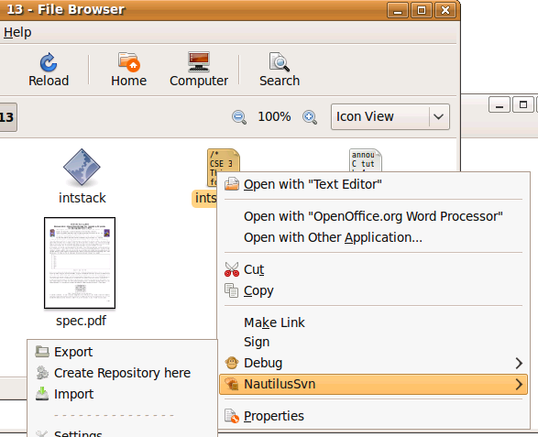
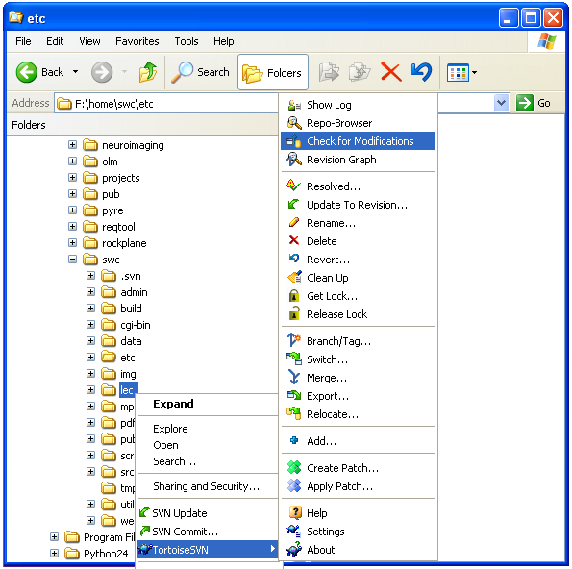
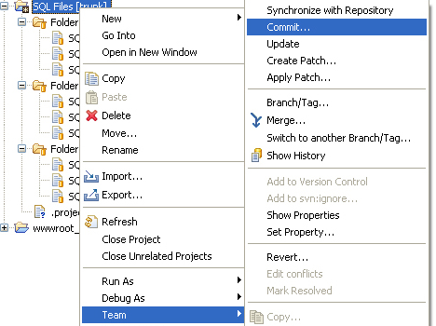
Shell/IDE integration
Linux:
NautilusSVN
Windows:
TortoiseSVN
Eclipse:
Subclipse

Slide 12
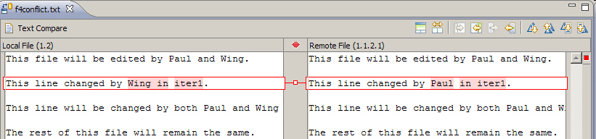
Merging and conflicts
Merge: Changes applied at same time to same files
happens when two users check out same file(s), both change it, and:
both commit, or
one changes it and commits; the other changes it and updates
conflict: when the system is unable to reconcile merged changes
resolve: user intervention to repair a conflict. Possible ways:
combining the changes manually in some way
selecting one change in favor of the other
reverting both changes (less likely)

Slide 13
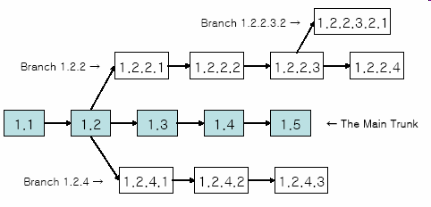
Branches
branch (fork): A second copy of the files in a repository
the two copies may be developed in different ways independently
given its own version number in the version control system
eventually be merged
trunk (mainline, baseline): the main code copy, not part of any fork

Slide 14
Social implications Friday
What electronic activities can and should be monitored?
Does it matter if you’re at home, at work, at school, at a public library, etc.?
Does it matter what you are doing?
Does it matter why you are being monitored?
How do *you* decide what to put on Facebook or equivalent?

Slide 15
Questions?

