Slide 1
bash today, C tomorrow
Quick reprise: debugging, performance
What’s homework 2B? (yes, it’s posted)
Some looks at solutions to 2A
David Notkin  Autumn 2009  CSE303 Lecture 7

Slide 2
Debugging
“Debugging is important, especially since the shell is so sensitive to details. I recommend two things: (a) trying your commands individually in the command-line as you're trying to build your shell scripts; and (b) assigning and echoing ‘unnecessary’ variables in your scripts that can be used to help see what's happening step-by-step.”
When things don’t work, what do you do?

Slide 3
Performance
I'm not worried about performance (within a little bit of reason) on 2A. Bill Wulf, who served as president of the National Academy of Engineering for over a decade, once said something like: “More mistakes are made by premature optimization than for any other reason including sheer ignorance.”
OK, maybe it doesn’t work right, but at least it’s really fast.
Well, if it doesn’t have to work right, I can make it even faster!

Slide 4
Algorithmic complexity
When dealing with a lot of data, what is usually most important about performance is the underlying algorithmic complexity
Very roughly, how many times do you need to touch each data item
Examples
Finding a number in an unsorted list: linear search
Finding a number in a sorted list: linear or binary search
Sorting a list: O(N²) vs. O(N log N)
HW2: if you touch every entry in the dictionary many times for each input string, that might be a problem – there are 479,829 entries

Slide 5
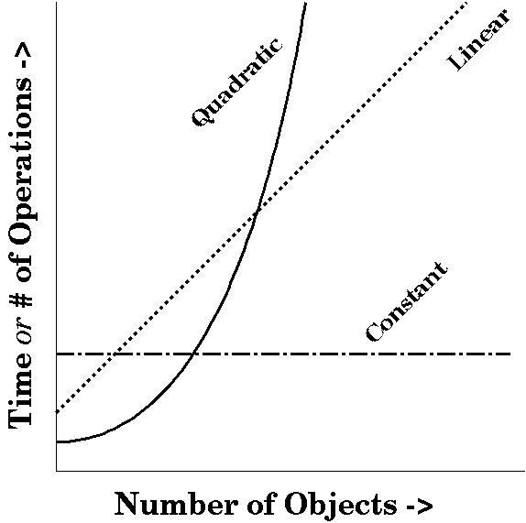
http://www.cs.bath.ac.uk/~jjb/here/CM10135/CM10135_Lecture3_2004.html

Slide 6
Performance: one more thing
Once you get the algorithmic complexity “right”, there can still be many ways to improve performance
A classic example is that some arithmetic operations are faster to execute than others but are equivalent
x*2 vs. x+x
vs. left-shift x
001101010 => 011010100 [106*2= 212]
Another classic example is that some operations are faster than others to execute – for example, creating (“forking”) a new process in Unix is generally more expensive than computing in the same process
These, however, require some actual knowledge about the costs factors you face – without that (or at least significant experience), you’re likely to guess wrong about what is costly

Slide 7
Questions?

