Slide 1
Introduction to Data Programming
CSE 160
University of Washington
Autumn 2022
Ruth Anderson
Slides based on previous versions by Michael Ernst and earlier versions by Bill Howe

Slide 2
Agenda for Today
What is this course?
Course logistics
Python!

Slide 3
Welcome to CSE 160!
CSE 160 teaches core programming concepts with an emphasis on real data manipulation tasks from science, engineering, and business
Goal by the end of the quarter: Given a data source and a problem description, you can independently write a complete, useful program to solve the problem

Slide 4
Aside: Is CSE 160 the course for you?
See email sent to class
For students with no prior programming experience:
CSE 121 – CS1, in Java, pre-req for CSE 122
CSE 160 – CS1, in Python, (offered 22au, 23wi & 23sp)
For students with some programming experience
CSE 163 – CS2, in Python, (offered 23wi & 23sp)
Can be taken after CSE 160 or CSE 142/122
First few weeks cover the basics of Python
You will not get credit for CSE 160 if you have already taken CSE 143 (or any 300 level or higher CSE course)
CSE 160 is a challenging (and fun!) course

Slide 5
Course staff
Lecturer:
Ruth Anderson
TAs:
Amanda Ong
Aayushi Modi
Emily Chang
Katherine Juarez
Jason Li
Paolo Pan
Pranav Kamath
Sierrah Bessler
Sneh Gupta
Therese Pacio
Tyler Nguyen
Wisdom Ikezogwo
Xinyan Li
Zoe Kaputa
Ask us for help!

Slide 6
Learning Objectives
Computational problem-solving
Writing a program will become your “go-to” solution for data analysis tasks
Basic Python proficiency
Including experience with relevant libraries for data manipulation, scientific computing, and visualization.
Experience working with real datasets
astronomy, biology, linguistics, oceanography, open government, social networks, and more.
You will see that these are easy to process with a program, and that doing so yields insight.

Slide 7
What this course is not
A “skills course” in Python
…though you will become proficient in the basics of the Python programming language
…and you will gain experience with some important Python libraries
A data analysis / “data science” / data visualization course
There will be very little statistics knowledge assumed or taught
A “big data” course
Datasets will all fit comfortably in memory
No parallel programming

Slide 8
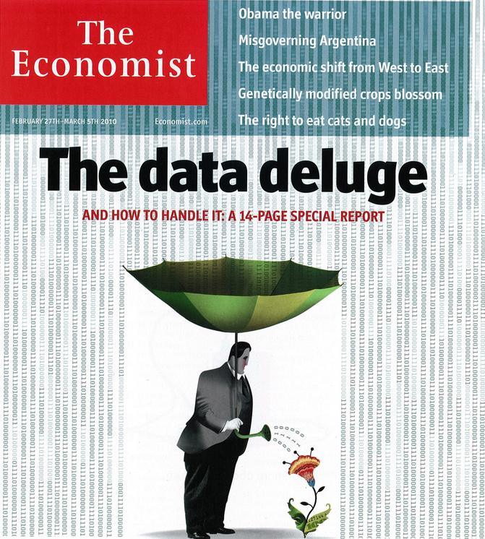
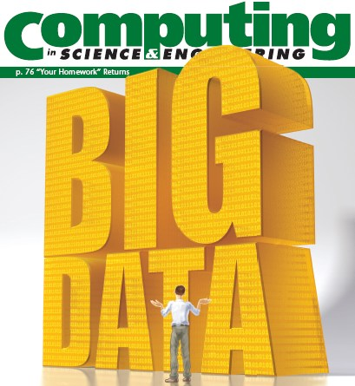
“It’s a great time to be a data geek.”
-- Roger Barga, Microsoft Research
“The greatest minds of my generation are trying
to figure out how to make people click on ads”
-- Jeff Hammerbacher, co-founder, Cloudera

Slide 9
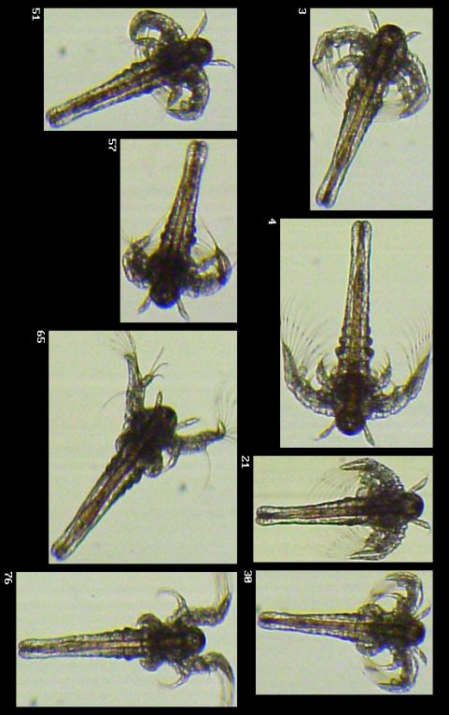
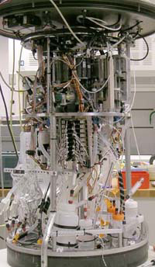
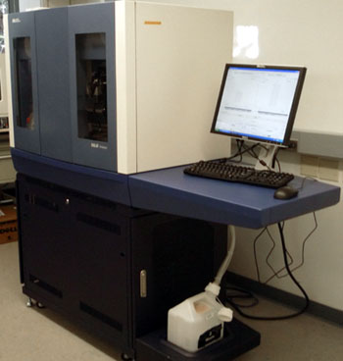
All of science is reducing to computational data manipulation
Old model: “Query the world” (Data acquisition coupled to a specific hypothesis)
New model: “Download the world” (Data acquisition supports many hypotheses)
Astronomy: High-resolution, high-frequency sky surveys (SDSS, LSST, PanSTARRS)
Biology: lab automation, high-throughput sequencing,
Oceanography: high-resolution models, cheap sensors, satellites
40TB / 2 nights
~1TB / day
100s of devices
Slide from Bill Howe, eScience Institute
Notes:
Slide from Bill Howe, eScience Institute, his notes:
Drowning in data; starving for information
We’re at war with these engineering companies. FlowCAM is bragging about the amount of data they can spray out of their device. How to use this enormous data stream to answer scientific questions is someone else’s problem.
“Typical large pharmas today are generating 20 terabytes of data daily. That’s probably going up to 100 terabytes per day in the next year or so.”
“tens of terabytes of data per day” -- genome center at Washignton University
Increase data collection exponentially with flowcam

Slide 10
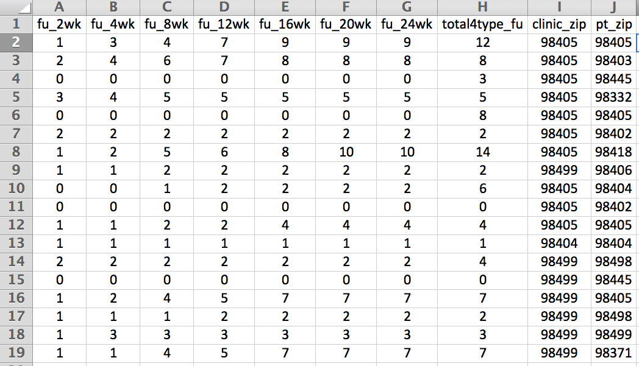
Example: Assessing treatment efficacy
number of follow ups within 16 weeks after treatment enrollment.
Zip code of clinic
Zip code of patient
Question: Does the distance between the patient’s home and clinic influence the number of follow ups, and therefore treatment efficacy?

Slide 11
Python program to assess treatment efficacy
# This program reads an Excel spreadsheet whose penultimate
# and antepenultimate columns are zip codes.
# It adds a new last column for the distance between those zip
# codes, and outputs in CSV (comma-separated values) format.
# Call the program with two numeric values: the first and last
# row to include.
# The output contains the column headers and those rows.
# Libraries to use
import random
import sys
import xlrd # library for working with Excel spreadsheets
import time
from gdapi import GoogleDirections
# No key needed if few queries
gd = GoogleDirections('dummy-Google-key')
wb = xlrd.open_workbook('mhip_zip_eScience_121611a.xls')
sheet = wb.sheet_by_index(0)
# User input: first row to process, first row not to process
first_row = max(int(sys.argv[1]), 2)
row_limit = min(int(sys.argv[2]+1), sheet.nrows)
def comma_separated(lst):
return ",".join([str(s) for s in lst])
headers = sheet.row_values(0) + ["distance"]
print comma_separated(headers)
for rownum in range(first_row,row_limit):
row = sheet.row_values(rownum)
(zip1, zip2) = row[-3:-1]
if zip1 and zip2:
# Clean the data
zip1 = str(int(zip1))
zip2 = str(int(zip2))
row[-3:-1] = [zip1, zip2]
# Compute the distance via Google Maps
try:
distance = gd.query(zip1,zip2).distance
except:
print >> sys.stderr, "Error computing distance:", zip1, zip2
distance = ""
# Print the row with the distance
print comma_separated(row + [distance])
# Avoid too many Google queries in rapid succession
time.sleep(random.random()+0.5)
23 lines of executable code!

Slide 12
Course logistics
Website: http://www.cs.washington.edu/cse160
See the website for all administrative details
Homework 0 - due Monday
Preliminary Survey and Ed Board intro due Friday
Questions? rea@cs.washington.edu
Notes:
If you want to join the class, sign sheet at front of class, email rea@cs.washington.edu, from your @u address

Slide 13
How to succeed
No prerequisites
Non-predictors for success:
Past programming experience
Enthusiasm for games or computers
Programming and data analysis are challenging
Every one of you can succeed
There is no such thing as a “born programmer”
Work hard
Follow directions
Be methodical
Think before you act
Try on your own, then ask for help
Start early

Slide 14
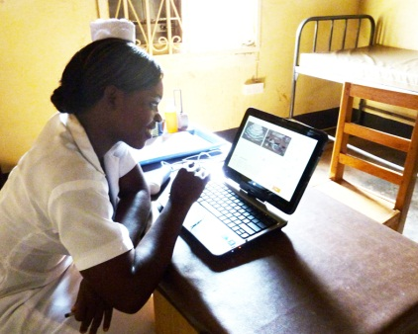
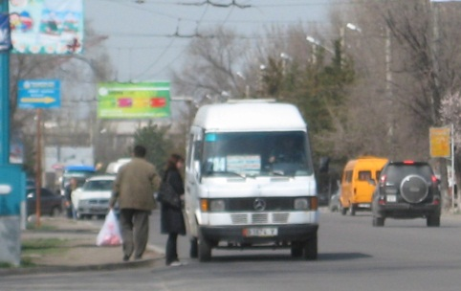
Me (Ruth Anderson)
Grad Student at UW: in Programming Languages, Compilers, Parallel Computing
Taught Computer Science at the University of Virginia for 5 years
PhD at UW: in Educational Technology, Pen Computing
Other Research: Computing and the Developing World, Computer Science Education

Slide 15
Introductions on Ed Board
Name
Major
Hometown
Interesting Fact or what I did over break.

