Slide 1
Graphs
Ruth Anderson
UW CSE 160
Winter 2016

Slide 2
A graph contains nodes and edges
Chicago
Seattle
Salt Lake City
San Francisco
Dallas

Slide 4
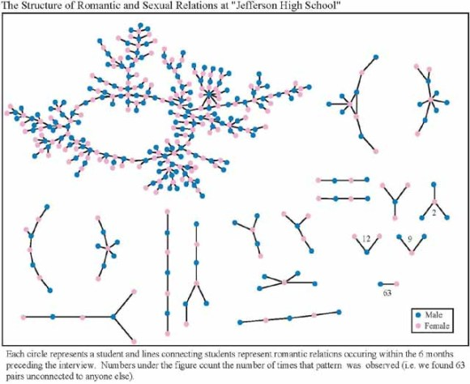
+ 350 students in no romantic and/or sexual relationship
From: “Chains of Affection: The Structure of Adolescent Romantic and Sexual Networks”, American Journal of Sociology, by Peter Bearman of (Columbia), James Moody (Ohio State), and Katherine Stovel (U. of Washngton);

Slide 5
Graphs
A graph can be thought of as either of:
a collection of edges
Each edge represents some relationship
for each node, a collection of neighbors
The neighbors are those connected by an edge

Slide 6
Operations on a graph
Creation:
Create an empty graph
Querying:
Look up a node: Does it exist? What are its neighbors?
Look up an edge (= a pair of nodes): does it exist? (You know the nodes it connects.)
Iterate through the nodes or edges
Modification:
Add/remove a node
Add/remove an edge

Slide 7
networkx Graph Library
Used in Homework 4
http://networkx.github.io/documentation/latest/tutorial/tutorial.html
import networkx as nx
g = nx.Graph()
g.add_node(1)
g.add_node(2)
g.add_edge(1, 2)
print g.nodes()
print g.edges()

Slide 8
Installing networkx Graph Library
Used in Homework 4
http://networkx.github.io/documentation/latest/tutorial/tutorial.html
To install networkx:
In Canopy select Tools-> Package Manager
Click on “Available Packages" and type "networkx“ in the search box in the upper left
Once found, the button next to networkx will say something like "free“, click on that button.
It will ask if you want to install, say yes.
To check if you have it installed, type “import networkx” in the python interpreter in Canopy (nothing should happen, but if it is NOT installed you will get an error message).

Slide 9
import networkx as nx
import matplotlib.pyplot as plt
g = nx.Graph() # Creates a graph
g.add_node(1) # Adds node 1
g.add_node(3)
g.add_node(2)
print g.nodes()
g.add_edge(1, 2) # Adds edge from node 1 to node 2
g.add_edge(1, 3)
print g.edges()
assert len(g.nodes()) == 3
assert len(g.edges()) == 2
nx.draw_networkx(g) # Draw the graph
plt.show() # Show the graph in a separate window

