Slide 1
CSE 160 Wrap-Up
CSE 160
Spring 2015
University of Washington

Slide 2
Presentations on Monday
2:30-4:20pm, Monday 6/08
No more than 5 slides (including title slide)
Keep your time to TWO minutes
Both partners should speak
Slides are due BY noon on 3/08 to catalyst

Slide 3
Progress in 10 weeks
10 weeks ago: you knew no programming
Goals:
Computational problem-solving
Python programming language
Experience with real datasets
Fun of extracting understanding and insight from data, and of mastery over the computer
Ability to go on to more advanced computing classes
Today: you can write a useful program to solve a real problem
You can even pose the problem yourself

Slide 4
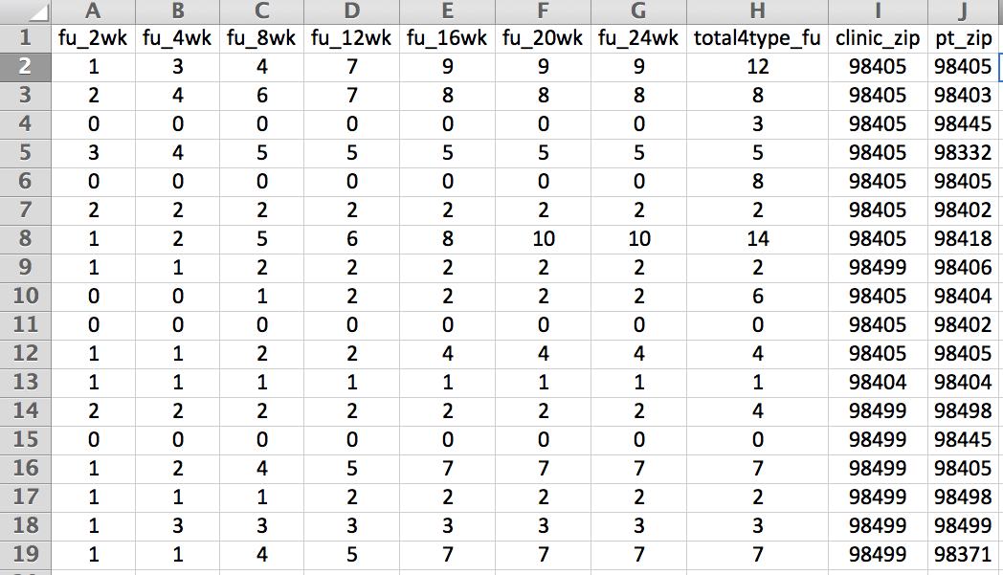
Example from lecture 0: Assessing treatment efficacy
number of follow ups within 16 weeks after treatment enrollment.
Zip code of clinic
Zip code of patient
Question: Does the distance between the patient’s home and clinic influence the number of follow ups, and therefore treatment efficacy?

Slide 5
Python program to assess treatment efficacy
# This program reads an Excel spreadsheet whose penultimate
# and antepenultimate columns are zip codes.
# It adds a new last column for the distance between those zip
# codes, and outputs in CSV (comma-separated values) format.
# Call the program with two numeric values: the first and last
# row to include.
# The output contains the column headers and those rows.
# Libraries to use
import random
import sys
import xlrd # library for working with Excel spreadsheets
import time
from gdapi import GoogleDirections
# No key needed if few queries
gd = GoogleDirections('dummy-Google-key')
wb = xlrd.open_workbook('mhip_zip_eScience_121611a.xls')
sheet = wb.sheet_by_index(0)
# User input: first row to process, first row not to process
first_row = max(int(sys.argv[1]), 2)
row_limit = min(int(sys.argv[2]+1), sheet.nrows)
def comma_separated(lst):
return ",".join([str(s) for s in lst])
headers = sheet.row_values(0) + ["distance"]
print comma_separated(headers)
for rownum in range(first_row,row_limit):
row = sheet.row_values(rownum)
(zip1, zip2) = row[-3:-1]
if zip1 and zip2:
# Clean the data
zip1 = str(int(zip1))
zip2 = str(int(zip2))
row[-3:-1] = [zip1, zip2]
# Compute the distance via Google Maps
try:
distance = gd.query(zip1,zip2).distance
except:
print >> sys.stderr, "Error computing distance:", zip1, zip2
distance = ""
# Print the row with the distance
print comma_separated(row + [distance])
# Avoid too many Google queries in rapid succession
time.sleep(random.random()+0.5)
23 lines of executable code!

Slide 6
Thanks!

Slide 7
Why do you care about processing data?
The world is awash in data
Processing and analyzing it is the difference between success and failure
for a team or for an individual
Manipulating and understanding data is essential to:
Astronomers
Biologists
Chemists
Economists
Engineers
Entrepreneurs
Linguists
Political scientists
Zoologists
… and many more!

Slide 8
Programming Concepts
Variables
Assignments
Types
Programs & algorithms
Control flow: loops (for), conditionals (if)
Functions
File I/O
Python execution model
How Python evaluates expressions, statements, and programs

Slide 9
Data structures: managing data
List
Set
Dictionary
Tuple
Graph
List slicing (sublist)
List comprehension: shorthand for a loop

Slide 10
Functions
f(x) = x²
Procedural abstraction
avoid duplicated code
the implementation does not matter to the client
Using functions
Defining functions
A function is an ordinary value
assign to variables
in a call, use an expression as the function: myfns[i](arg)
Method syntax: put first argument before a period (.)
arg1.methodname(arg2, arg3)
used for “objects”
(period also means “look up variable in a namespace”)

Slide 11
Data abstraction
Dual to procedural abstraction (functions)
A module is: operations
An object is: data + operations
Operations: create, query, modify
Clients use the operations, never directly access data
The representation of the data does not matter
Programmer defines a class. Each instance of a class is an object.

Slide 12
Testing and debugging
Write enough tests:
Cover every branch of each boolean expression
especially when used in a conditional expression (if statement)
Cover special cases:
numbers: zero, positive, negative, int vs. float
data structures: empty, size 1, larger
Assertions are useful beyond tests
Debugging: after you observe a failure
Divide and conquer
In time, in data, in program text, in development history
this is also a key program design concept
The scientific method
state a hypothesis; design an experiment; understand results
Think first
Be systematic: record everything; have a reason for each action

Slide 13
Data analysis
Statistics
Run many simulations
How uncommon is what you actually saw?
Graphing/plotting results

Slide 14
Program design
How to write a function:
Name, arguments, and documentation string
Tests
Body/implementation
How to write a program:
Decompose into parts (functions, modules)
Each part should be a logical unit, not too large or small
Write each part
Define the problem
Choose an algorithm
In English first; test it via manual simulation
Translate into code
When necessary, use wishful thinking
Assume a function exists, then write it later
Can test even before you write it, via a stub

Slide 15
Recursion
Base case: does all the work for a small problem
Inductive case:
passes the buck for most of a large problem
does a small amount of work (or none) to the subanswer
returns whole result

Slide 16
Speed of algorithms
Affected primarily by the number of times you iterate over data
“Constant factors” don’t matter (looping 2 times or 3 times)
Nested looping matters a lot

Slide 17
Data!
DNA
Images
Social Networks
Election Results/Polls
Detecting Fraudulent Data
Your Choice!

Slide 18
Coming on Monday…
Unemployment
Enzyme Kinetics
What planets can we live on?
Housing & Gentrification
Will a meteorite hit us?
Sports & Game Statistics
Immigration
Monkeys eating virtual bananas
Municipal Bonds
Consumer Complaints
Bitcoin Transactions
Crime rates
Causes of death
Hurricanes & Storms
Physics Education
What restaurants should we eat at?
Gender Inequality
Brain activity in mice
Supreme Court Trends
Rainfall & Stream Flow
Foreign languages
Gene expression in the liver
Wikipedia in China
Patents
Flight delays

Slide 19
There is more to learn
Data analysis, data science, and data visualization
Scaling up:
Larger and more complex programs
“Big data”: out-of-memory data, parallel programming, …
Ensuring correctness
Principled, systematic design, testing, and programming
Coding style
Managing complexity
Programming tools: testing, version control, debugging, deployment
GUIs, user interaction
Data structures and algorithms
Working in a team

Slide 20
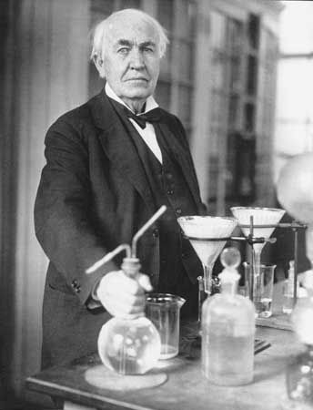
What you have learned in CSE 160
Compare your skills today to 10 weeks ago
Theory: abstraction, specification, design
Practice: implementation, testing
Bottom line: The assignments would be easy for you today
This is a measure of how much you have learned
There is no such thing as a “born” programmer!
Your next project can be more ambitious
Genius is 1% inspiration and 99% perspiration.
Thomas A. Edison
Notes:
Practice: also “teamwork” in some terms.

Slide 21
What you will learn later
Your next project can be much more ambitious
Know your limits
Be humble (reality helps you with this)
You will continue to learn
Building interesting systems is never easy
Like any worthwhile endeavor
Practice is a good teacher
Requires thoughtful introspection
Don’t learn only by trial and error!
Get lots of practice and feedback

Slide 22
Why the Python language?
 | Python | Excel | MATLAB | R | C/C++ | Java
Readable syntax | ☺ | ☹ | ☹ | ☹ | ☹ | ☺
Easy to get started | ☺ | ☺ | 😐 | ☹ | ☹ | ☹
Powerful libraries | ☺ | 😐 | ☺ | ☺ | 😐 | ☺

Slide 23
Comparison of Python with Java
Python is better for learning programming
Python is better for small programs
Java is better for large programs
Main difference: dynamic vs. static typing
Dynamic typing: put anything in any variable
Static typing:
Source code states the type of the variable
Cannot run code if any assignment might violate the type

Slide 24
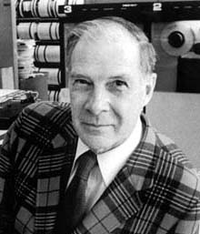
What comes next?
Classes
Java: CSE 142 (you might skip), CSE 143, CSE 143X
HDCE 310: Python for interactive systems
MATLAB, other programming languages
Self-study: books & websites
Data analysis: classes, research, jobs
In programming and software engineering
In any topic that involves software
Having an impact on the world
Jobs (and job interviews)
Larger programming projects
The purpose of computing is insight, not numbers.
Richard W. Hamming
Numerical Methods for Scientists and Engineers

Slide 25
More Computer Science Courses!!
You could take any of these now!
CSE 142, 143, 143x Programming in Java
CSE 154 Web Programming
Require CSE 143:
CSE 373 Data Structures & Algorithms
CSE 374 Intermediate Programming Concepts & Tools
CSE 410 Computer Systems (Operating Systems & Architecture)
CSE 413 Programming Languages and their Implementation
CSE 415 Artificial Intelligence
CSE 417 Algorithms and Complexity
Note: These classes are all open to NON-majors. You may also be interested in applying for the CSE major!

Slide 26
Go forth and conquer
System building and scientific discovery are fun!
It’s even more fun when your system works
Pay attention to what matters
Use the techniques and tools of CSE 160 effectively

