Slide 1
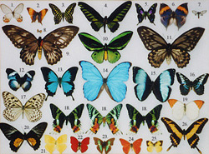
Collections
Ruth Anderson
UW CSE 160
Spring 2015

Slide 2
Count the words in a document
Assume you start with a list of words:
"to be or not to be that is the question whether tis nobler in the mind to suffer the slings and arrows of outrageous fortune or to take arms against a sea of troubles and by opposing end them to die to sleep no more".split()
Notes:
This problem is ambiguous: the number of words with or without repetition?
Before you start to design, clarify what the problem is.
Do the design on paper and pencil (think of a list on a piece of paper), describing the algorithm in English, before proceeding to Python data structures.
A good programmer never dives straight into code.
Split() Converts the string into a list of words.

Slide 3
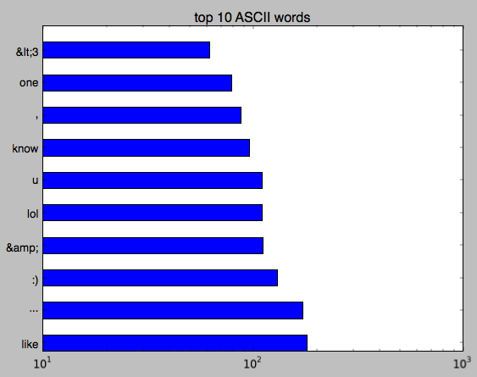
Count the occurrences of each word (make a histogram)
Most common words on Twitter

Slide 4
Count the number of unique words

Slide 5
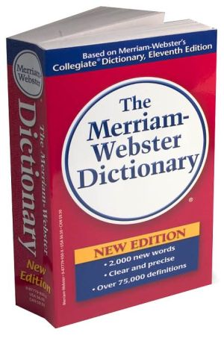
A collection groups similar things
List: ordered
Set: unordered, no duplicates
Tuple: unmodifiable list
Dictionary: maps from values to values
Example: word → definition
Notes:
95% or more of all data structures you ever use will be one of these, or a combination of these

Slide 6
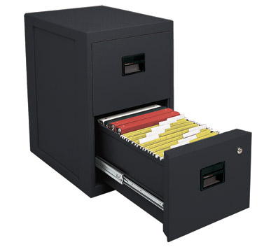
Data Structures
A data structure is way of organizing data
Each data structure makes certain operations convenient or efficient
Each data structure makes certain operations inconvenient or inefficient
Example: What operations are efficient with:
a file cabinet sorted by date?
a shoe box?

