Slide 1
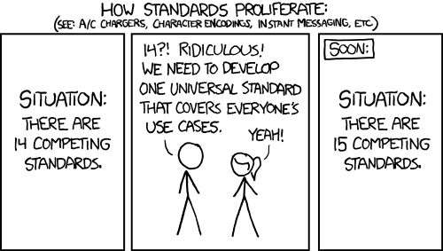
CSE 154
Lecture 12: XML

Slide 2
Storing structured data in arbitrary text formats (bad)
My note:
BEGIN
FROM: Alice Smith (alice@example.com)
TO: Robert Jones (roberto@example.com)
SUBJECT: Tomorrow's "Birthday Bash" event!
MESSAGE (english):
Hey Bob,
Don't forget to call me this weekend!
PRIVATE: true
END XML
Many apps make up their own custom text format for storing structured data.
We could also send a file like this from the server to browser with Ajax.
What's wrong with this approach?

Slide 3
XML: A better way of storing data
<?xml version="1.0" encoding="UTF-8"?>
<note private="true">
<from>Alice Smith (alice@example.com)</from>
<to>Robert Jones (roberto@example.com)</to>
<subject>Tomorrow's "Birthday Bash" event!</subject>
<message language="english">
Hey Bob, Don't forget to call me this weekend!
</message>
</note> XML
eXtensible Markup Language (XML) is a format for storing nested data with tags and attributes
essentially, it's HTML, but you can make up any tags and attributes you want
lots of existing data on the web is stored in XML format

Slide 4
What is XML?
XML is a "skeleton" for creating markup languages
you decide on an XML "language" of tags and attributes that you want to allow in your app
XML syntax is mostly identical to HTML's: <element attribute="value">content</element>
the HTML/XML tag syntax is a nice general syntax for describing hierarchical (nested) data
when you choose to store data in XML format (or access external XML data), you must decide:
names of tags in HTML: h1, div, img, etc.
names of attributes in HTML: id/class, src, href, etc.
rules about how they go together in HTML: inline vs. block-level elements
XML presents complex data in a human-readable, "self-describing" form

Slide 5
Anatomy of an XML file
<?xml version="1.0" encoding="UTF-8"?> <!-- XML prolog -->
<note private="true"> <!-- root element -->
<from>Alice Smith (alice@example.com)</from>
<to>Robert Jones (roberto@example.com)</to>
<subject>Tomorrow's "Birthday Bash" event!</subject>
<message language="english">
Hey Bob, Don't forget to call me this weekend!
</message>
</note> XML
begins with an <?xml ... ?> header tag (prolog)
has a single root element (in this case, note)
tag, attribute, and comment syntax is just like HTML

Slide 6
Uses of XML
XML data comes from many sources on the web:
web servers store data as XML files
databases sometimes return query results as XML
web services use XML to communicate
XML is the de facto universal format for exchange of data
XML languages are used for music, math, vector graphics
popular use: RSS for news feeds & podcasts

Slide 7
What tags are legal in XML?
any tags you want! examples:
a library might use tags book, title, author
a song might use tags key, pitch, note
when designing XML data, you choose how to best represent the data
large or complex pieces of data become tags
smaller details and metadata with simple types (integer, string, boolean) become attributes
<measure number="1">
<attributes>
<divisions>1</divisions>
<key><fifths>0</fifths></key>
<time><beats>4</beats></time>
<clef>
<sign>G</sign><line>2</line>
</clef>
</attributes>
<note>
<pitch>
<step>C</step>
<octave>4</octave>
</pitch>
<duration>4</duration>
<type>whole</type>
</note>
</measure> XML

Slide 8
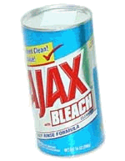
XML and Ajax
web browsers can display XML files, but often you instead want to fetch one and analyze its data
the XML data is fetched, processed, and displayed using Ajax
(XML is the "X" in "Ajax")
It would be very clunky to examine a complex XML structure as just a giant string!
luckily, the browser can break apart (parse) XML data into a set of objects
there is an XML DOM, similar to the HTML DOM

Slide 9
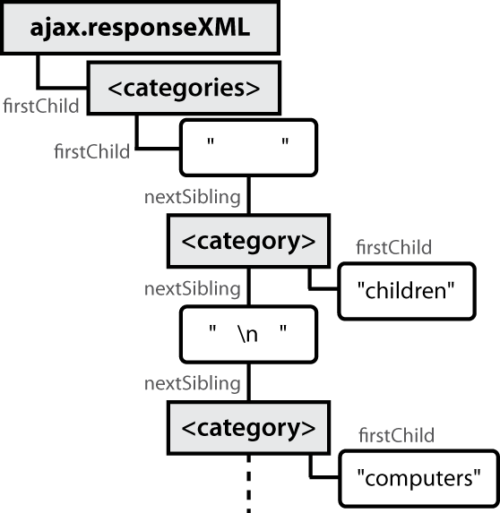
Fetching XML using Ajax (template)
var ajax = new XMLHttpRequest();
ajax.onload = functionName;
ajax.open("GET", url, true);
ajax.send();
...
function functionName() {
do something with this.responseXML;
} XML
this.responseText contains the data in plain text (a string)
this.responseXML is a parsed XML DOM tree object
it has methods very similar to HTML DOM objects

Slide 10
XML DOM tree structure
<?xml version="1.0" encoding="UTF-8"?>
<categories>
<category>children</category>
<category>computers</category>
...
</categories> XML
the XML tags have a tree structure
DOM nodes have parents, children, and siblings
each DOM node object has properties/methods for accessing nearby nodes

Slide 11
Interacting with XML DOM nodes
To get an array of nodes:
var elms = node.getElementsByTagName("tag");
var elms = node.querySelectorAll("selector"); // all elements
var elm = node.querySelector("selector"); // first element XML
To get the text inside of a node:
var text = node.textContent; // or,
var text = node.firstChild.nodeValue; XML
To get the value of a given attribute on a node:
var attrValue = node.getAttribute("name"); XML

Slide 12
Differences from HTML DOM
Don't usually use getElementById because XML nodes don't have IDs or classes.
var div = document.getElementById("main"); JS
Can't get/set the text inside of a node using innerHTML:
var text = div.innerHTML; JS
Can't get an attribute's value using .attributeName:
var imageUrl = document.getElementById("myimage").src; JS

Slide 13
Ajax XML DOM example
<?xml version="1.0" encoding="UTF-8"?>
<employees>
<lawyer money="99999.00" />
<janitor name="Ed"> <vacuum model="Hoover" /> </janitor>
<janitor name="Bill">no vacuum, too poor</janitor>
</employees> XML
// how much money does the lawyer make?
var lawyer = this.responseXML.querySelector("lawyer");
var salary = parseFloat(lawyer.getAttribute("money")); // 99999.0
// array of 2 janitors
var janitors = this.responseXML.querySelectorAll("janitor");
var vacModel = janitors[0].querySelector("vacuum").getAttribute("model"); var excuse = janitors[1].textContent; // "no vacuum, too poor"
How would we find out the first janitor's name? (use the Console)
How would we find out how many janitors there are?
How would we find out how many janitors have vs. don't have vacuums?

Slide 14
Larger XML file example
<?xml version="1.0" encoding="UTF-8"?>
<bookstore>
<book category="cooking">
<title lang="en">Everyday Italian</title>
<author>Giada De Laurentiis</author>
<year>2005</year><price>30.00</price>
</book>
<book category="computers">
<title lang="en">XQuery Kick Start</title>
<author>James McGovern</author>
<year>2003</year><price>49.99</price>
</book>
<book category="children">
<title lang="en">Harry Potter</title>
<author>J K. Rowling</author>
<year>2005</year><price>29.99</price>
</book>
<book category="computers">
<title lang="en">Learning XML</title>
<author>Erik T. Ray</author>
<year>2003</year><price>39.95</price>
</book>
<!-- you can play with this XML in the console as 'this.responseXML2' -->
</bookstore>

Slide 15
Navigating node tree example
// make a paragraph for each book about computers
var books = this.responseXML.getElementsByTagName("book");
for (var i = 0; i < books.length; i++) {
var category = books[i].getAttribute("category");
if (category == "computers") {
// extract data from XML
var title = books[i].querySelector("title").textContent;
var author = books[i].querySelector("author").textContent;
// make an HTML <p> tag containing data from XML
var p = document.createElement("p");
p.innerHTML = title + ", by " + author;
document.body.appendChild(p);
}
} JS

Slide 16
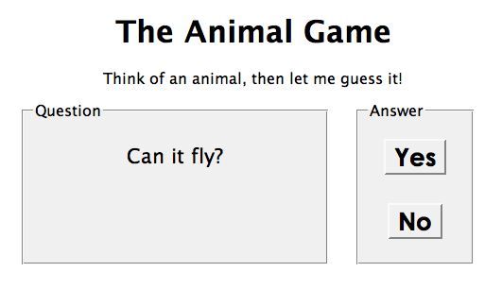
Exercise: Animal game
Write a program that guesses which animal the user is thinking of. The program will arrive at a guess based on the user's responses to yes or no questions. The questions come from a web app named animalgame.php.

Slide 17
Practice problem: Animal game (cont'd)
The data comes in the following format:
<node nodeid="id">
<question>question text</question>
<yes nodeid="id" />
<no nodeid="id" />
</node> XML
<node nodeid="id">
<answer>answer text</answer>
</node> XML
to get a node with a given id: animalgame.php?nodeid=id
start by requesting the node with nodeid of 1 to get the first question

Slide 18
Attacking the problem
Questions we should ask ourselves:
How do I retrieve data from the web app? (what URL, etc.)
Once I retrieve a piece of data, what should I do with it?
When the user clicks "Yes", what should I do?
When the user clicks "No", what should I do?
How do I know when the game is over? What should I do in this case?

Slide 19
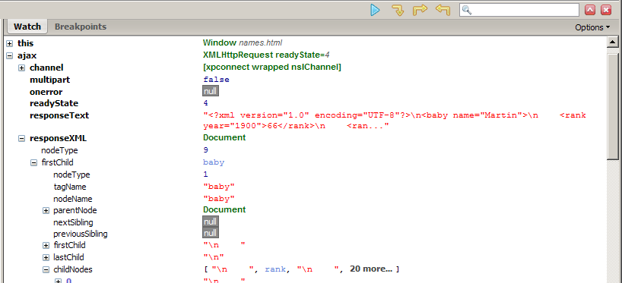
Debugging responseXML in Firebug
can examine the entire XML document, its node/tree structure

Slide 20
Full list of XML DOM properties
properties:
nodeName, nodeType, nodeValue, attributes
firstChild, lastChild, childNodes, nextSibling, previousSibling, parentNode
methods:
getElementById, getElementsByTagName, querySelector, querySelectorAll, getAttribute, hasAttribute,hasChildNodes
appendChild, insertBefore, removeChild, replaceChild
full reference

Slide 21
Schemas and Doctypes
"rule books" describing which tags/attributes you want to allow in your data
used to validate XML files to make sure they follow the rules of that "flavor"
the W3C HTML validator uses an HTML schema to validate your HTML (related to <!DOCTYPE html> tag)
these are optional; if you don't have one, there are no rules beyond having well-formed XML syntax
for more info:
W3C XML Schema
Document Type Definition (DTD) ("doctype")

Slide 22
Exercise: Late day distribution
Write a program that shows how many students turn homework in late for each assignment.
Data service here: http://webster.cs.washington.edu/cse154/hw/hw.php
parameter: assignment=hwN

